Slide 1
Social Finance Computing Research and Practice
社群金融計算研究與實務
Yung-Ming Li, Ph.D.
Institute of Information Management
National Yang Ming Chiao Tung University

Slide 2

Digital Financial Model
Accommodation of funds and financing through Internet platform

Slide 3
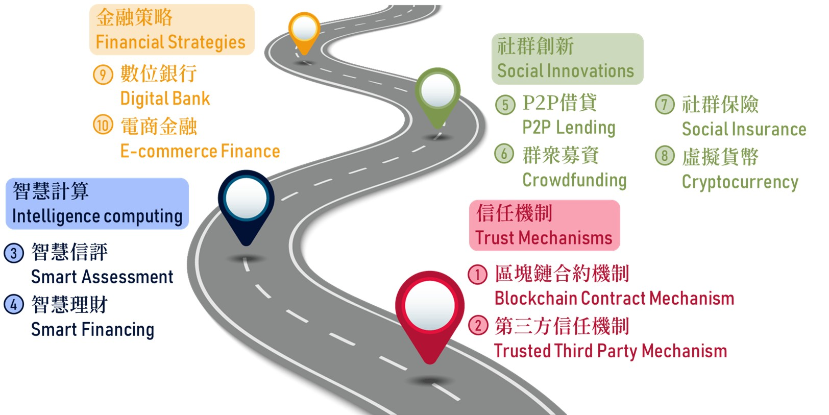
Road Map of Digital Finance

Slide 4



Five characteristics of digital finance
Online operating platform
AI & data driven analysis
Financial sector
Social business model
Customers
De-bundled financial service
Micro-financial market

Slide 5






Characteristics of digital finance (1): Online operating platform
Real time & personalized services
Cloud computing platform (low cost for mass market)
Digital Finance
Face-face service, limited market scalability
Limited temporal & space (huge cost)
Traditional Finance

Slide 6

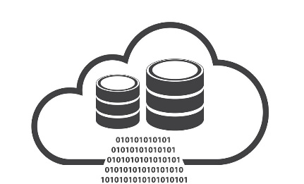








Characteristics of digital finance (2):AI-Data driven analysis
Precise prediction & matching
Risk management
Personal recommendation
Digital Finance
Data + AI
Product A B C
Traditional Finance
理財專員

Slide 7







Characteristics of digital finance (3): Social business model
Returns
Unconnected
Loan
Ｘ
Loans
credit barrier
Fund Provider
Fund Requstor
Information and power
Intransparency
Financial product
Fund demand
Saving
P2P & crowd platform
Information sharing and market matching

Slide 8
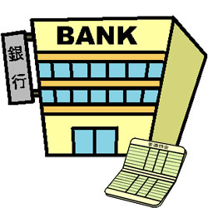

Characteristics of digital finance (4):Service Un-bundling
Traditional finance
Digital Finance
Third party payment
P2P
landing
Crowd
fundung
Virtual Currency
Insurance
Tech
Smart
Investment
Online Credit
Mobile payment
Digital Finance
Saving
Loan
Payment
Exchange
All financial service
in one bank
  Financial Service un-bunding

Slide 9
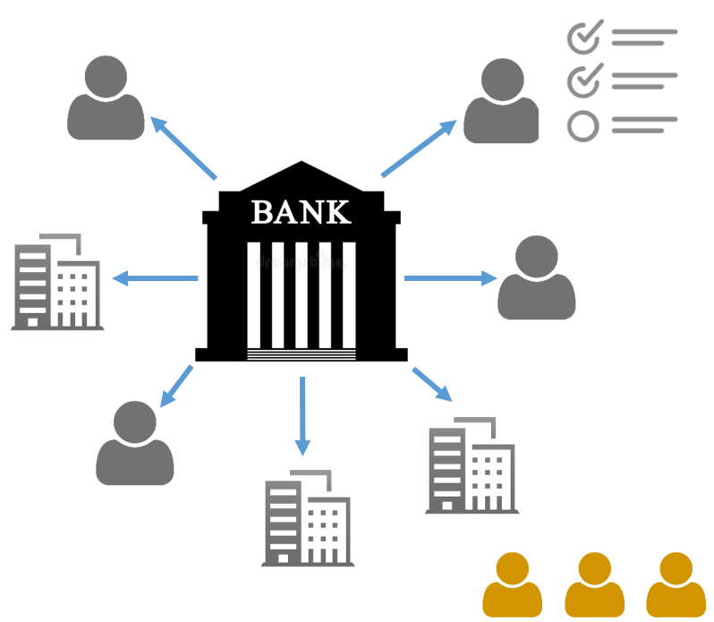
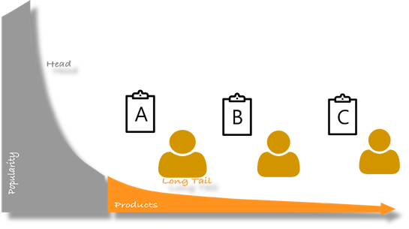
Characteristics of digital finance (5):Micro-financial market
Traditional finance services focus on secured customers, big, reputational customers or companies
New Finance services focus on small business or customers without credit
Long tail market: “Micro” & “Mass” market
Micro-customers

Slide 10
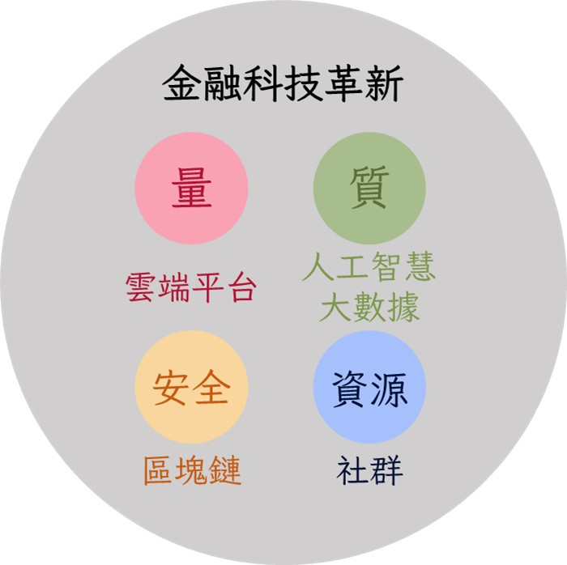

Slide 11


Social business model: P2P, Crowd, Social Networking
P2P
Crowd
Social network
Person to Person,
disintermediary
Long tail market ,
micro customer aggregation
Mutual interest, trust, reciprocal resource sharing

Slide 12












P2P
Crowd
Social network
Openness, low entry barrier
Mass market
Trend prediction (Crowd wisdom)
Transparency
User generation
(Crowdsourcing)
Recognition
Efficiency
Trustiness
Low cost
Endorsing
High variety
Collaborative sharing

Slide 13
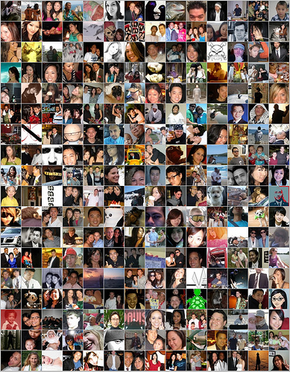

Social Finance
Crowdfunding
Crowdinvesting
Virtual Currency
Social Insurance
P2P Lending
Notes:
社群金融

Slide 14
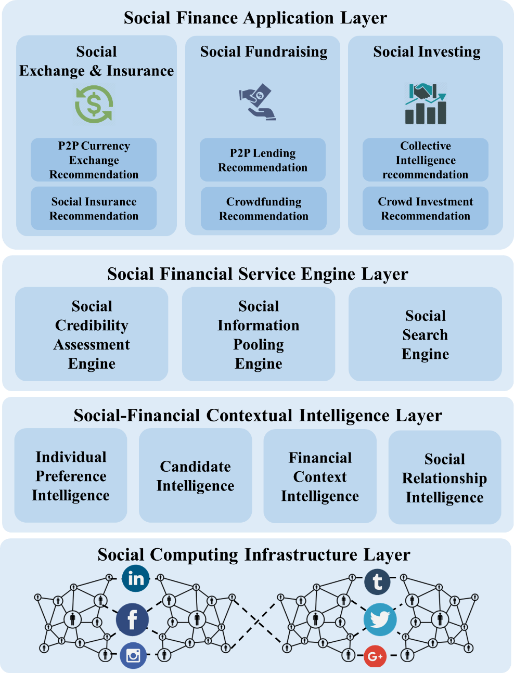
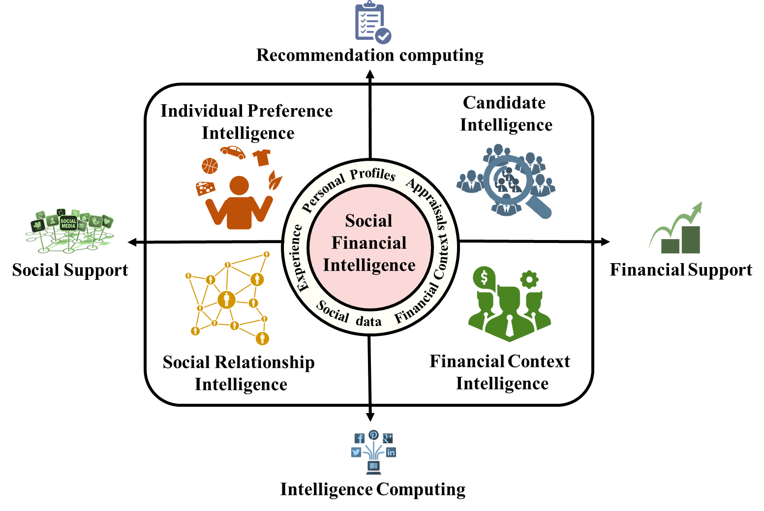
Social Finance Computing

Slide 15
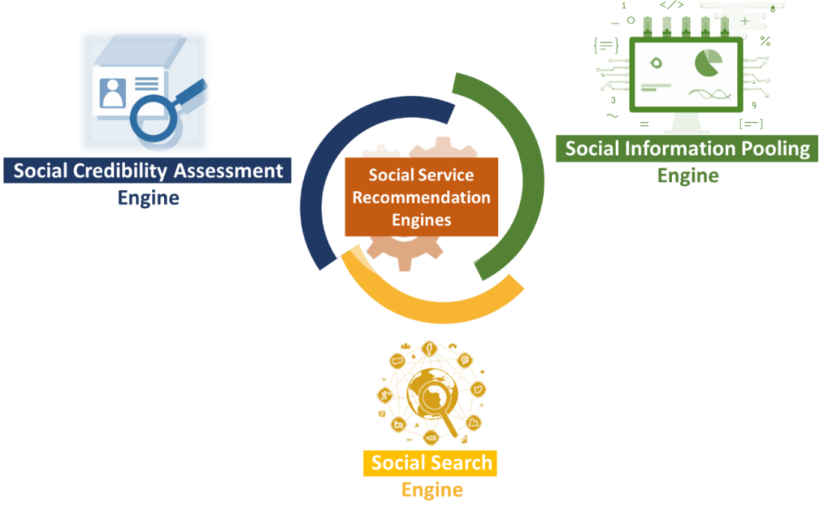
Social Finance Computing

Slide 16
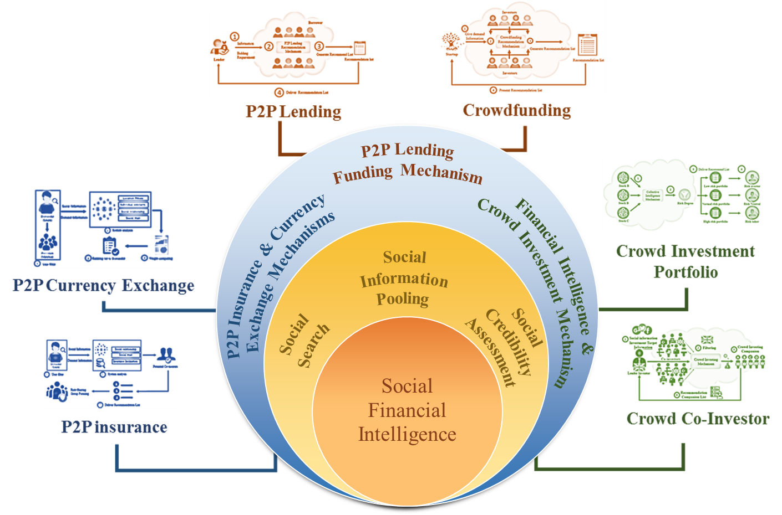
Social Finance Computing

Slide 17
Collective Intelligence for Social Finance

Slide 18
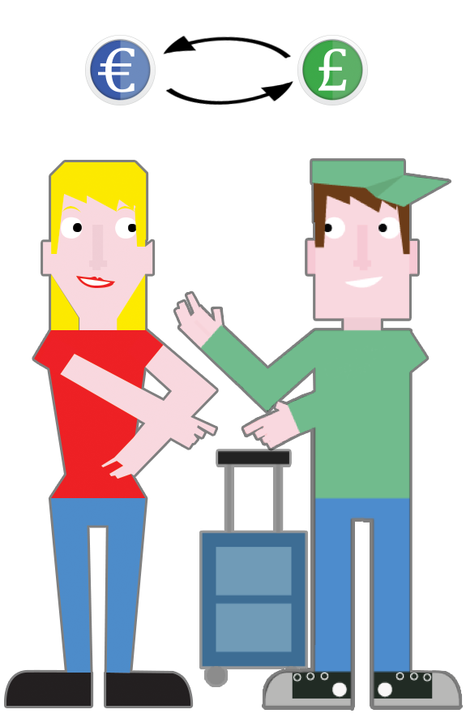
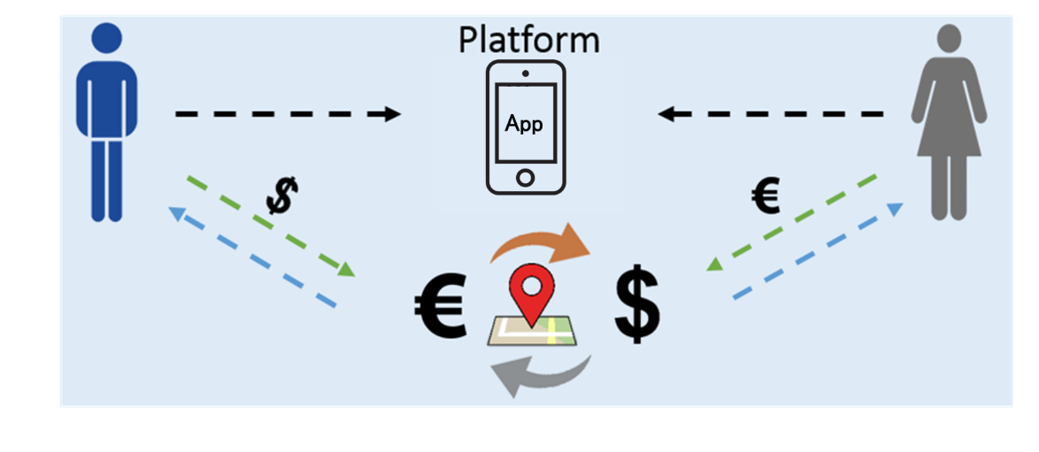
P2P Currency Exchange
Concepts:
  Location based P2P support & economy
  Currency exchange cutting out the middleman, banks, and brokers
  Two parties or individual to exchange directly
Techniques:
  Online to offline exchange model
  Matching based location and social intelligence

Slide 19
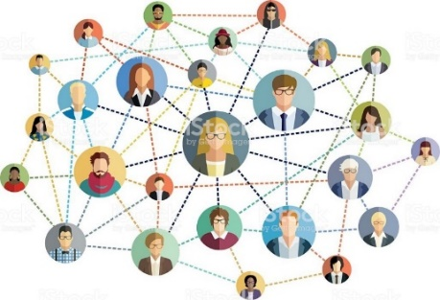
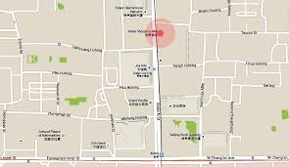
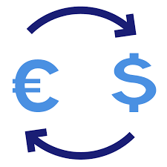
P2P Currency Exchange
Notes:
首先是系統的流程
1. 蒐集兩部分的資料集分別為
社群股票討論區的資訊 以及歷史股價
2. 然後透過我們提出的混合式推薦系統
3. 依據風險大小將股票分別匹配到不同的風險組合 產生三種類型的投資組合
4. 最後再依照投資俱樂部偏好推薦他們最適合的投資組合

Slide 20
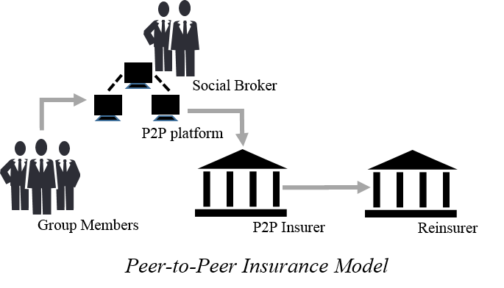
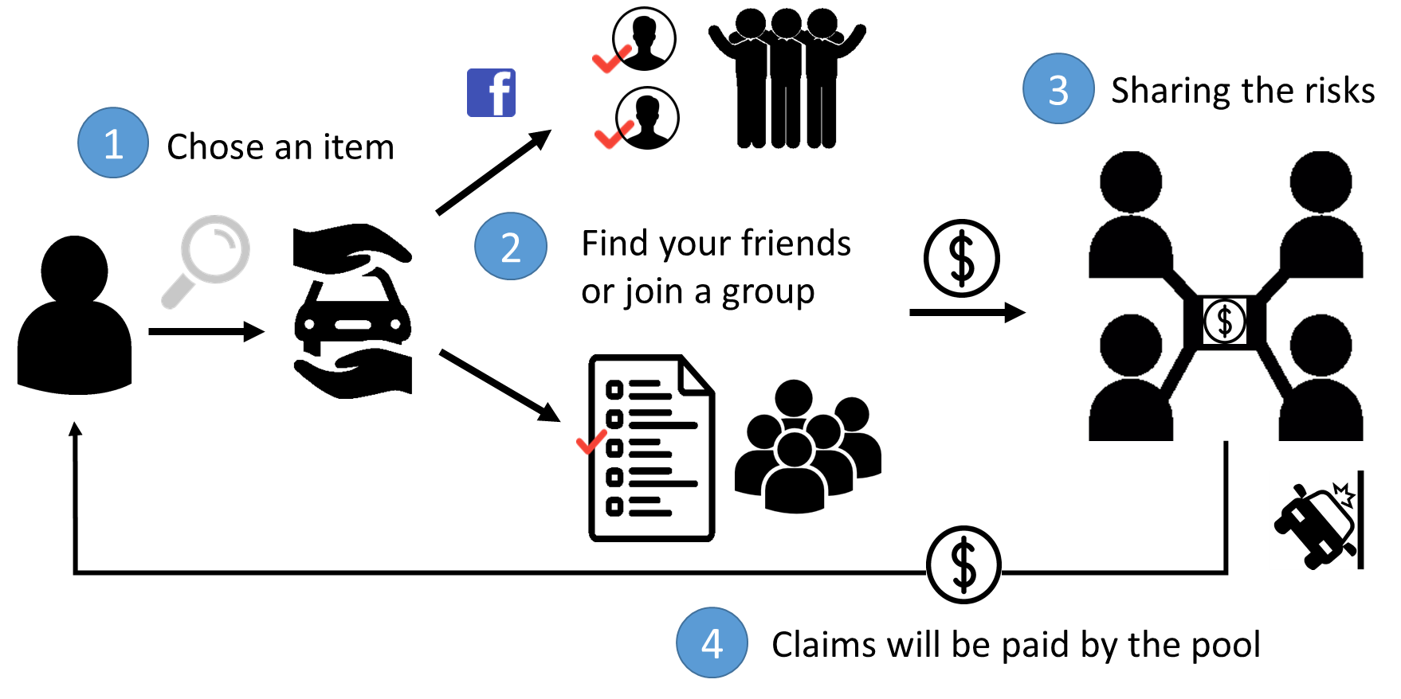
Social Insurance Formation
Concept:
  A group of people who share similar risk profiles forms an risk protection agreement of mutual assistance
  Group reinsurance
Success factor: inclination, similarity, trustiness

Slide 21
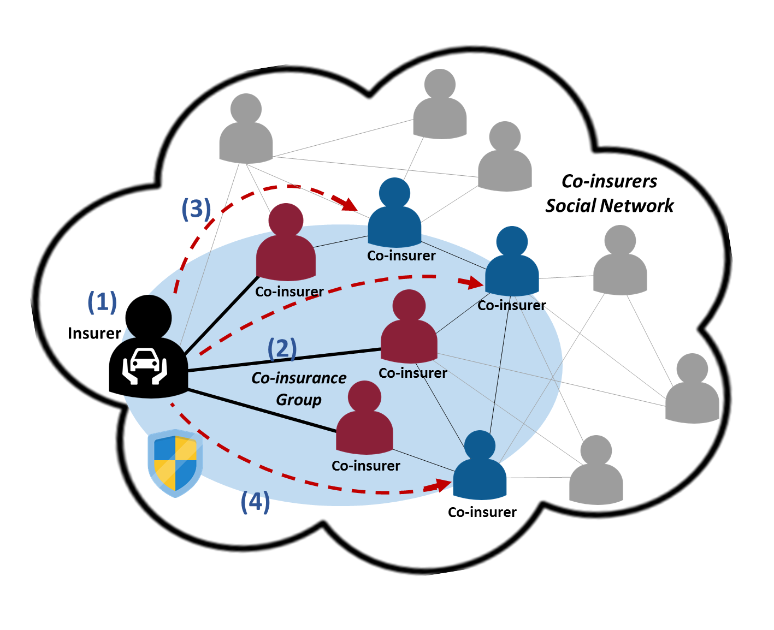
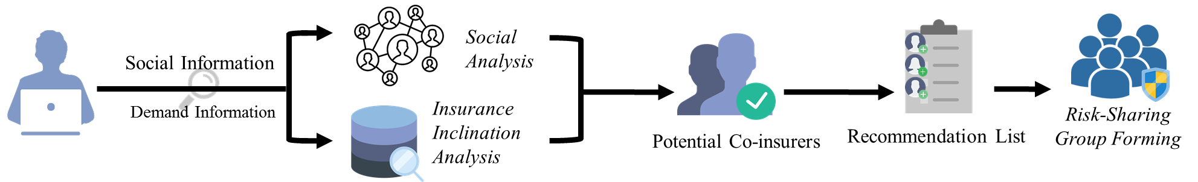
P2P Insurance Formation Process
(1)
(2)
(3)
(4)

Slide 22
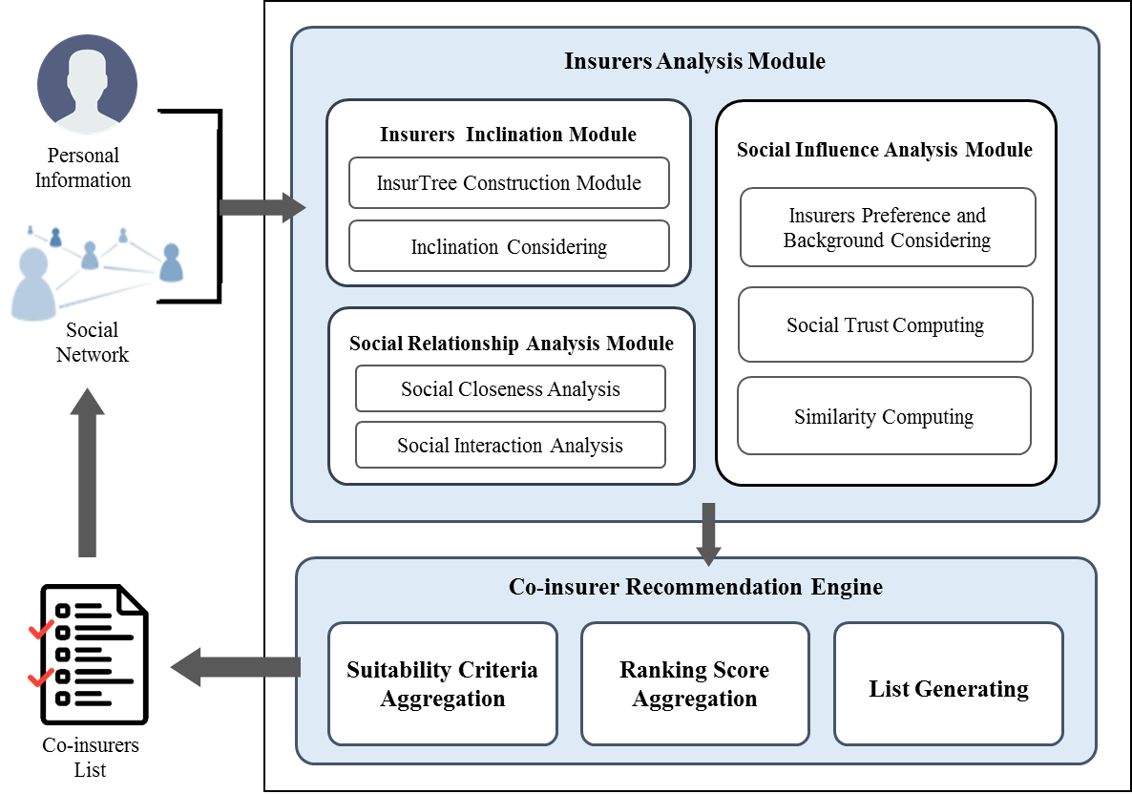

Slide 23
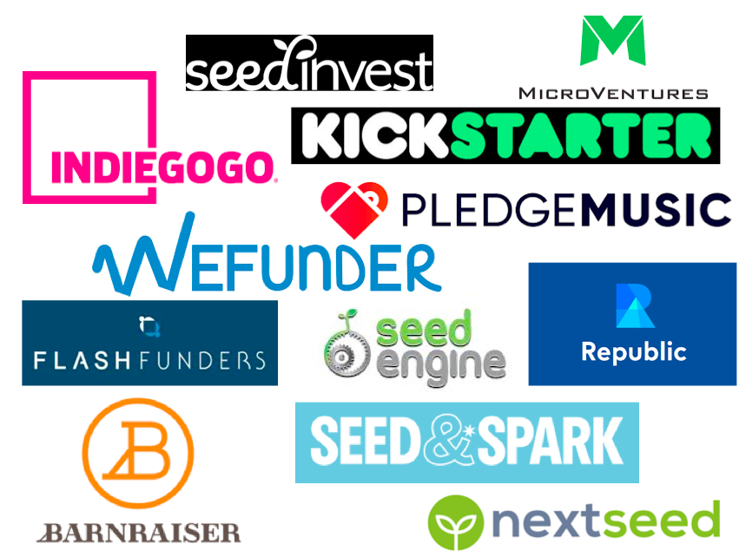

Crowdfunding Campaigns
Business problem: Success rate of projects has never exceeded 50%
Success factor: relationship, network, preference
Life cycle: Early, middle, late phases
Investors: family, friend, the crowd

Slide 24
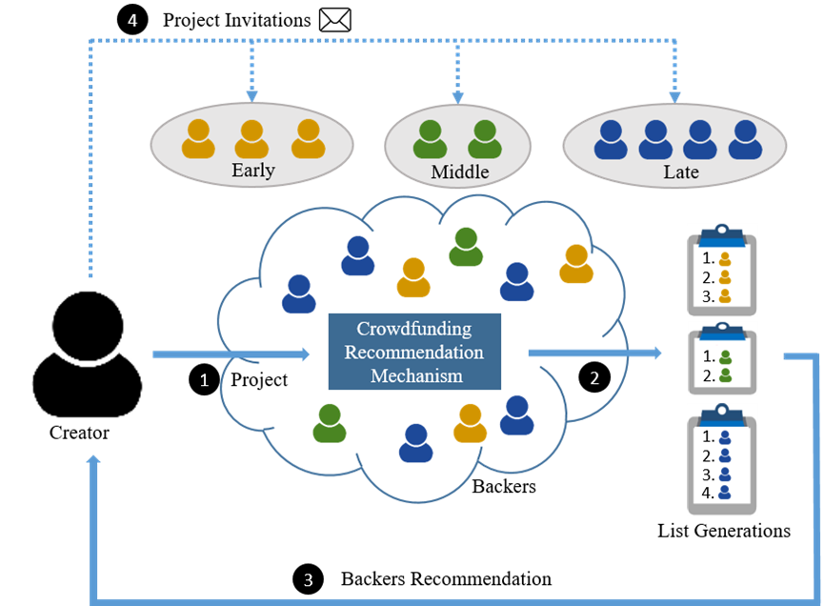
Phase-based Crowdfunding recommendation
(I&M 2020)
Process

Slide 25
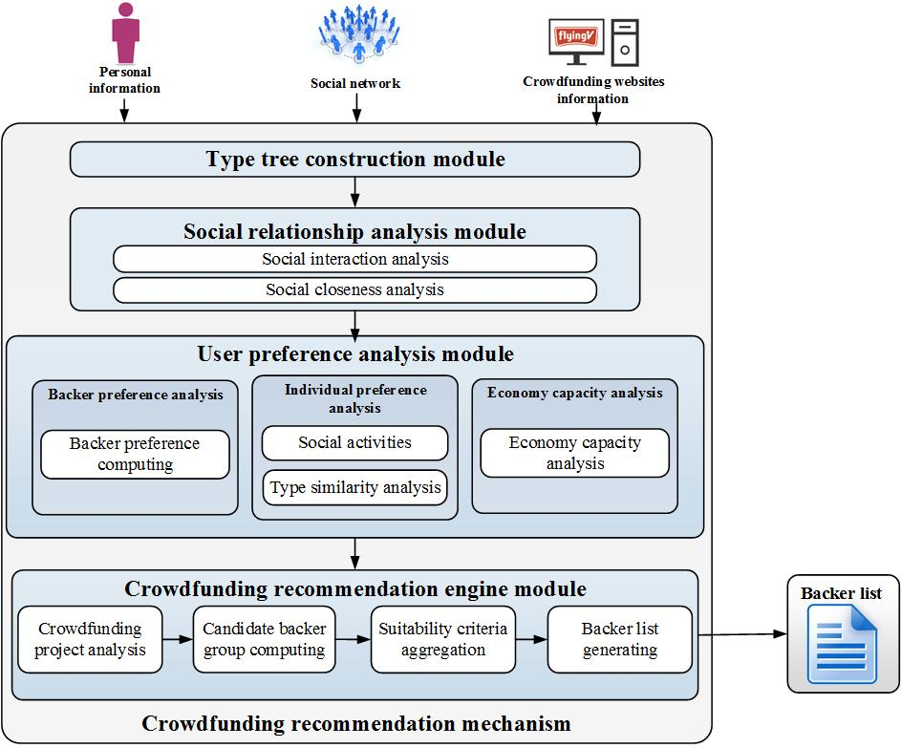
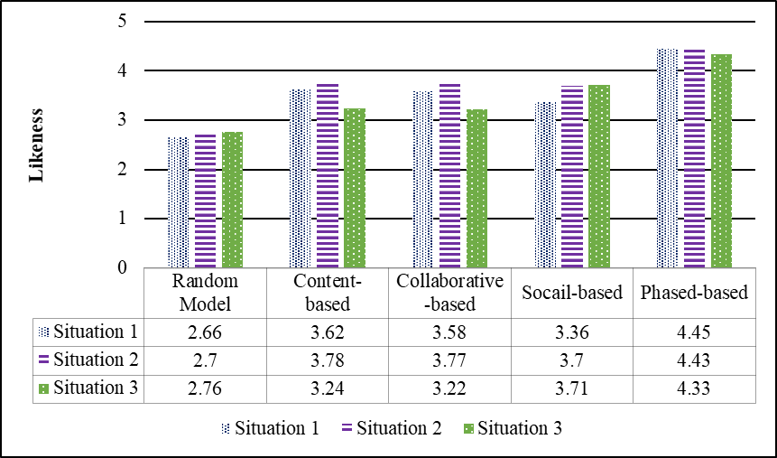

Slide 26

Social Investment
“Copy and paste” investment strategy
Following the influential investors
Influential investors have digest public as well as private information
Influential investors can be recognized by investment performance and social influence on social media
Collective investment intelligence from the influential investors

Slide 27
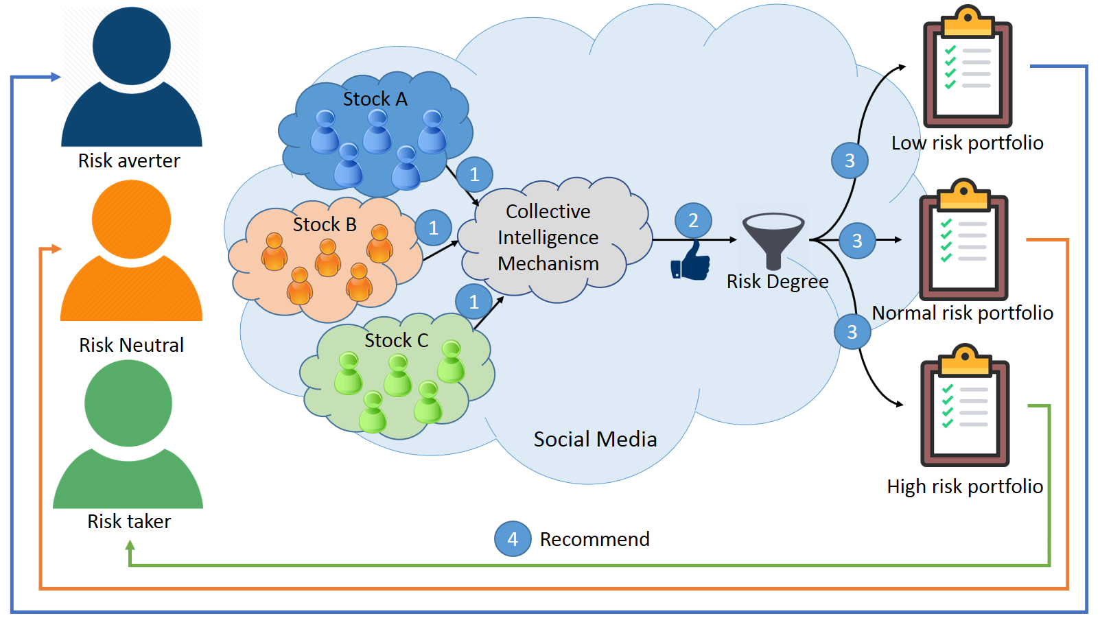
Social Investing approach for portfolio recommendation
(I&M 2021)

Slide 28
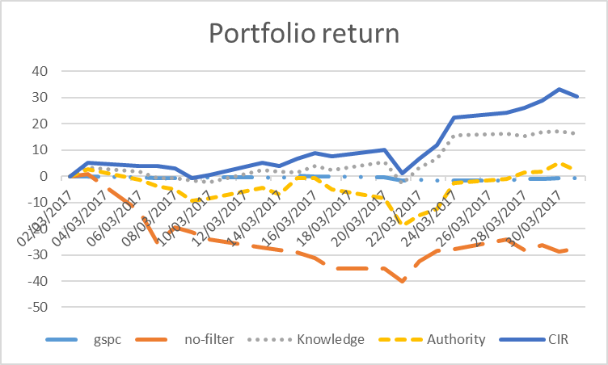
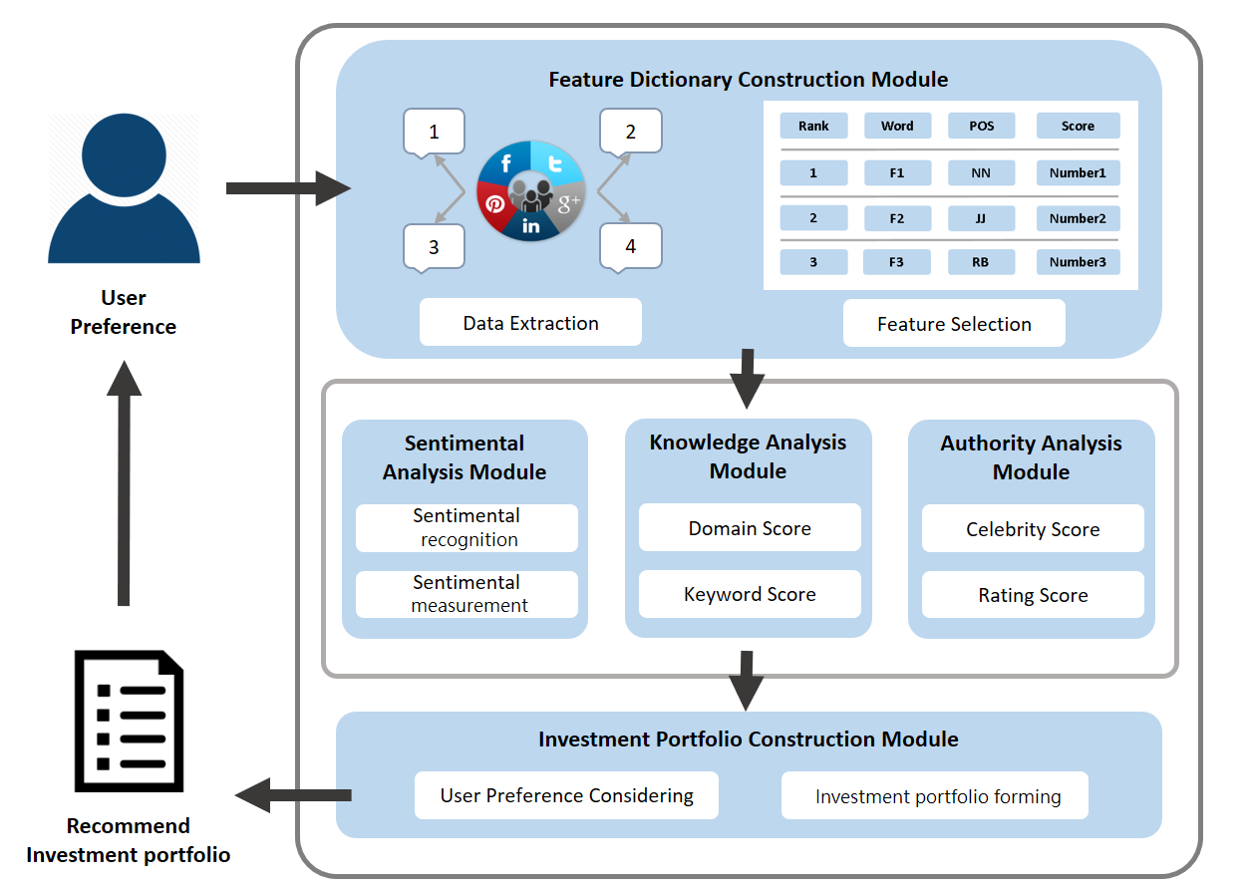
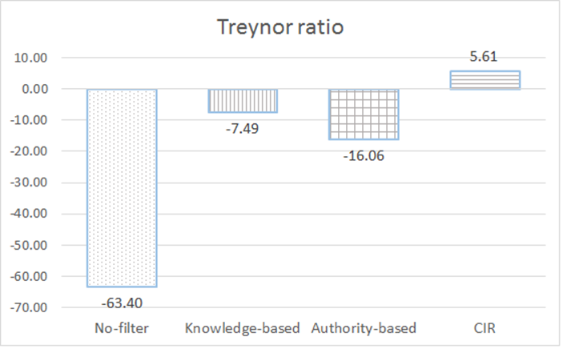

Slide 29


Smart Portfolios for Investment Clubs
Concepts: Power of crowd- Aggregation of information and funds
Techniques: Collective intelligence (Social computing) PLUS Deep learning (LSTM algorithm)

Slide 30
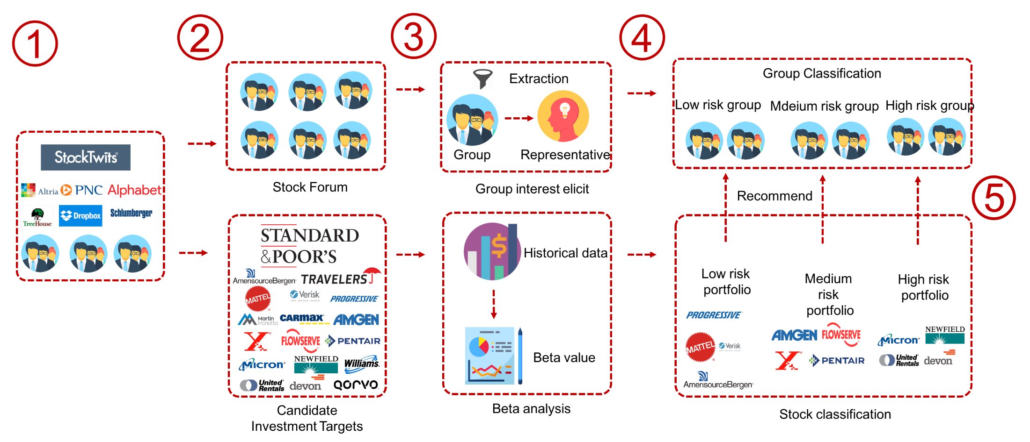
Smart Portfolios for Investment Clubs
Club Preference Analysis (risk type)
Stock Performance Analysis (risk type)
Notes:
首先是系統的流程
1. 蒐集兩部分的資料集分別為
社群股票討論區的資訊 以及歷史股價
2. 然後透過我們提出的混合式推薦系統
3. 依據風險大小將股票分別匹配到不同的風險組合 產生三種類型的投資組合
4. 最後再依照投資俱樂部偏好推薦他們最適合的投資組合

Slide 31
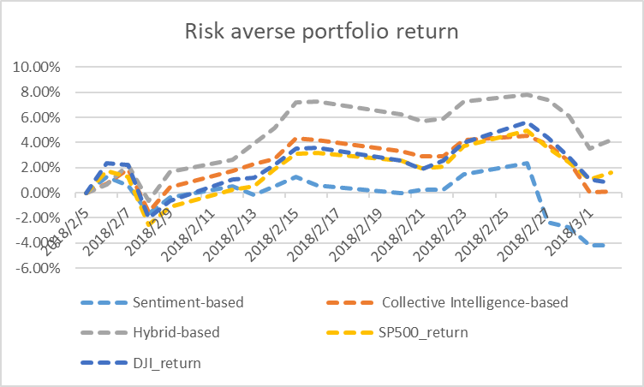
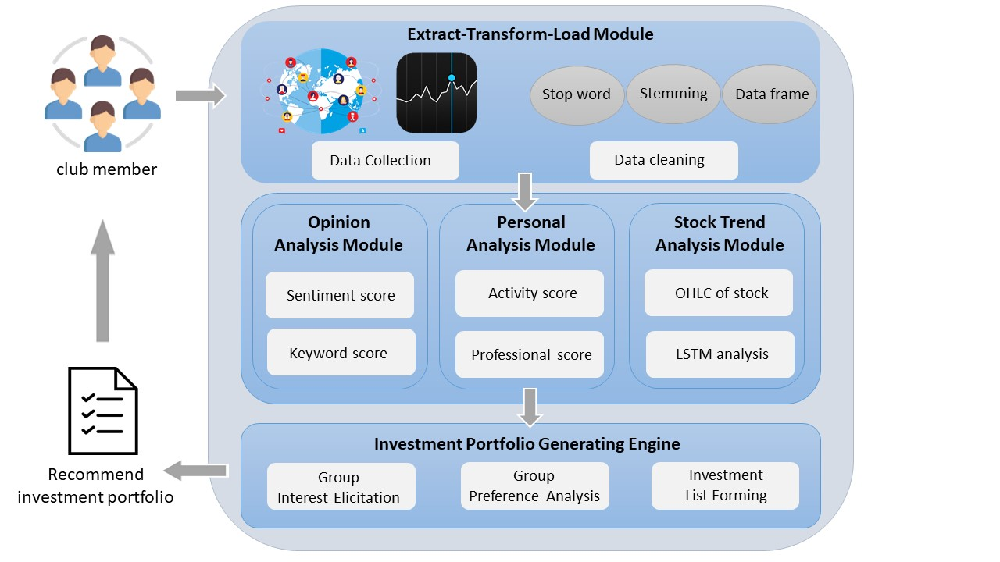
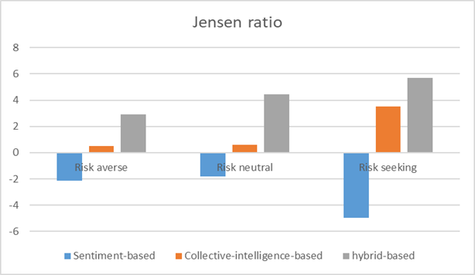
Notes:
接著是股票趨勢分析

Slide 32
Smart Contract for Social Finance

Slide 33
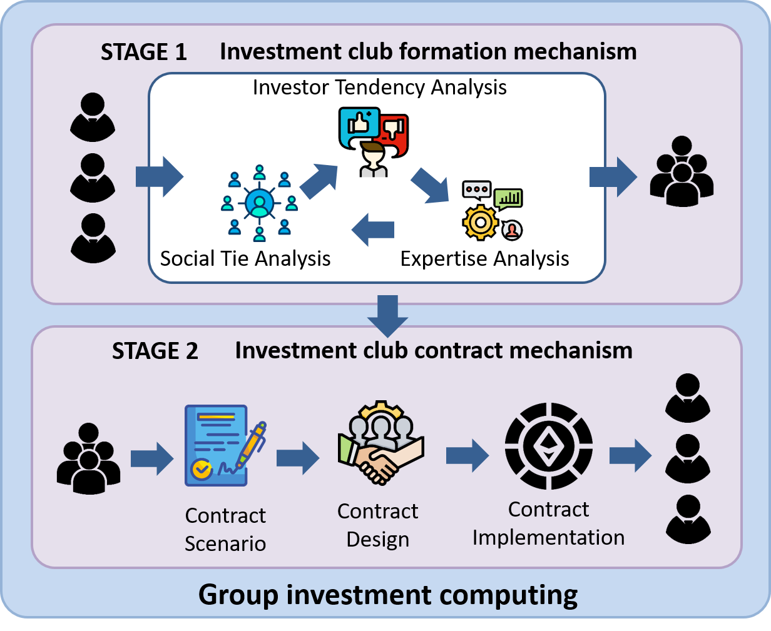
Group Investment: Formation and Contract

Slide 34
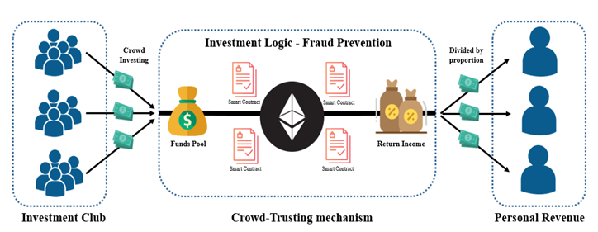




Smart Contract for Crowd Investment
Notes:
基於區塊鏈的群體合約投資信任機制 - 陳奕良 (2019)
A Blockchain-enabled Contract Mechanism for Crowd Investment

Slide 35
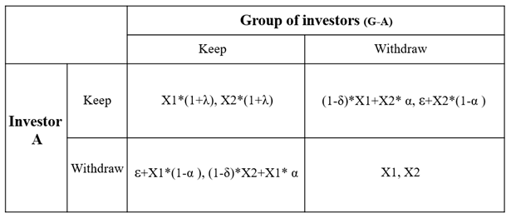
Smart Contracts Designed
The concept of protection mechanism of contracting is from personal investor to group of investors.
We assume investor A invests X1 ETH and group of investors invest X2 ETH
The return ratio is λ.
The penalty percentage is α
where 0 < α < 1.
The external factor
(opportunity) is ε.
The holding cost is δ
where δ < 1.
Notes:
我們設計的角度是從一個人對一群人，如果我們可以確保一個人的情況，其他人也可以以此類推
接著我們進行細部說明，如何透過賽局理論 設計處罰機制
我從個人對群體的概念下去設計，因為對於每個個別的投資者而言，都是面對一群投資者。
當懲罰機制被激活時，意味著它已經通過投票。 涉及投資者群體的大多數投資者都願意參與投資活動。 因此，將不討論（W，W）和（K，W）的情況。

Slide 36
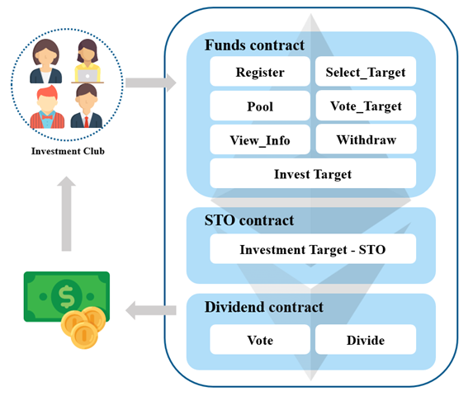
The smart contract structure

Slide 37
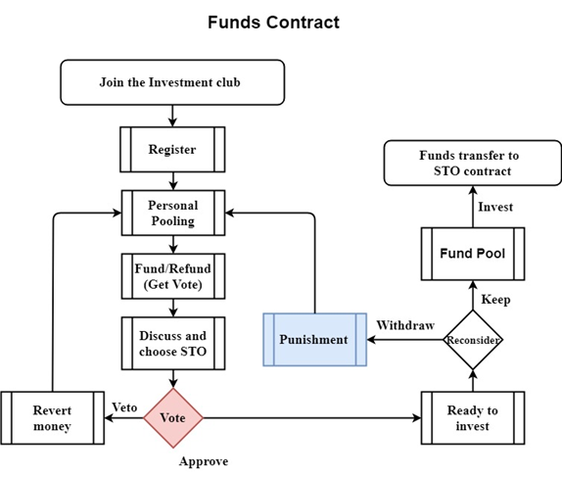
Funds Contract
Register
Invest
Select_Target
Vote_Target
Withdraw
View_Info
Purchase_Target

Slide 38
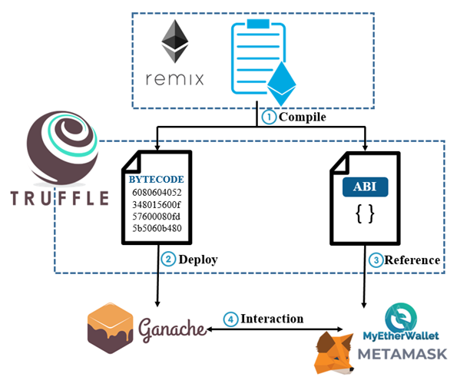
Experiment environment
Notes:
Truffle作為我們開發的框架，快速編譯和遷移智能合約並將它們部署到區塊鏈
Ganache是​​一個私有的以太坊Blockchain界面開發環境。顯示合約和交易，允許用戶快速查看交易紀錄如何與區塊鏈互動(模擬帳戶)
MEW可幫助用戶與以太坊區塊鏈進行交互

Slide 39
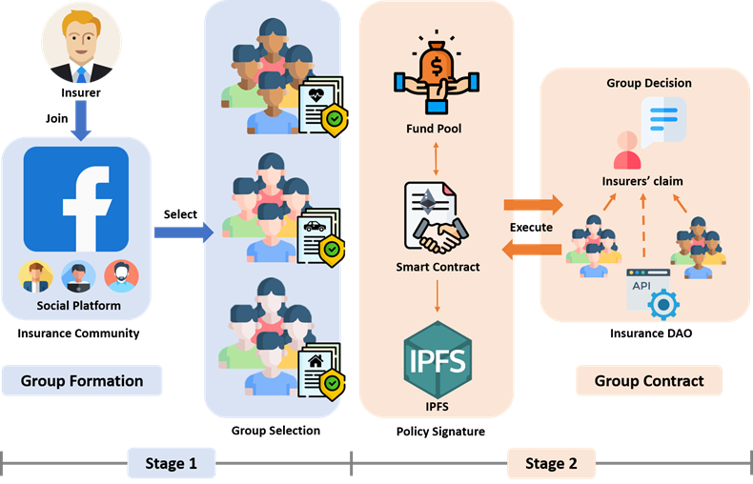
Smart Contract-driven P2P Insurance Mechanism
Notes:
基於智慧合約之P2P保險機制 - 陳紹雲 (2021)
A Smart Contract-driven P2P Insurance Mechanism
以系統觀來看，可以分為兩個階段
首階段，我們會先將保險人所處的社群平台利用合約進行分群，並且在保險自治模組中發揮群組決策的效用。
第二階段，我們會建立智慧合約來約束保險人行為。

Slide 40
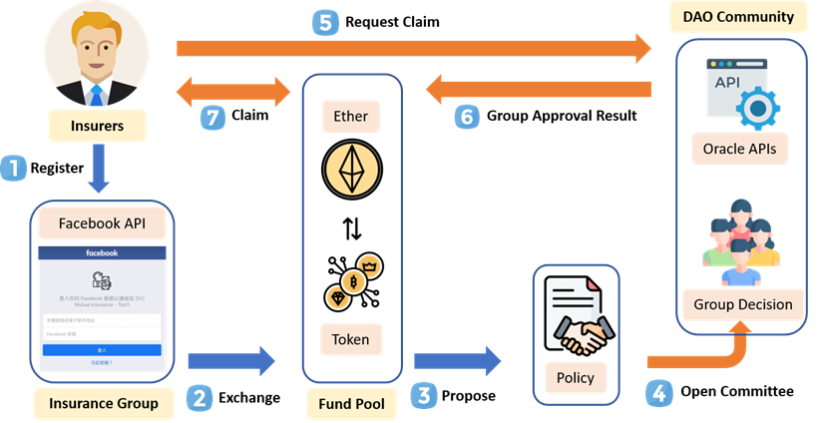
Notes:
以保險人的角度來看，
在系統流程，我們主要可以分為六個步驟
第一個步驟，保險人透過FACEBOOK來註冊平台，藉此完成身分驗證
在第二個步驟的部分，可以使用 以太幣 跟資金池交換平台代幣。 在他們獲得代幣後，他們可以與合約進行互動。
第三個步驟，提出保單，並將保單內容存儲在IPFS當中。
第四個步驟，在保險期間，保單項目的承保人可以使用其代幣提交證明請求理賠。
第五個步驟，委託人和保險人分別對於理賠進行審核投票。
最後，根據返回的結果，承保人可以獲得賠償。

Slide 41
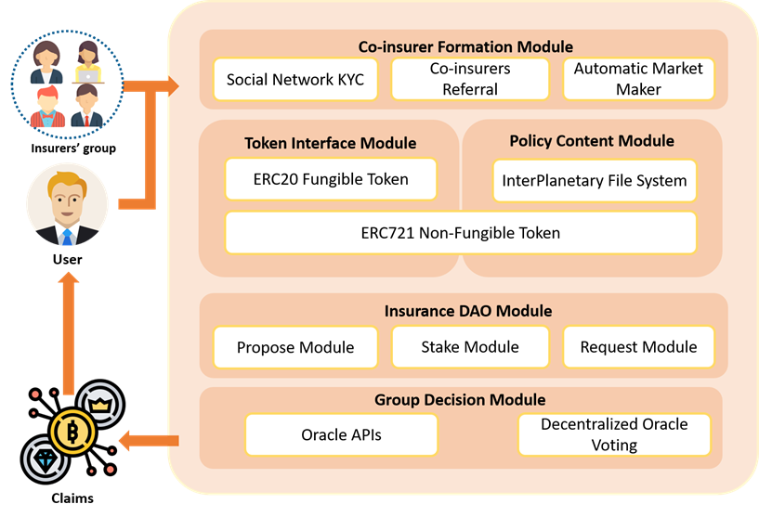
The System framework
Notes:
接著是我們的系統架構
我們的系統可以主要分為五個區塊
第一個是共保人組成模組，主要進行保險人的註冊, 共保人背書推薦以及資金池的溢資
第二個是代幣介面模組，提供代幣操作介面
第三個是保單內容模組，代幣保單以及確保保單的可靠性
第四個則是保險自治模組，負責了保險流程操作和其他模組的相互溝通
最後一個則是群體決策模組，接收來自保險自治模組的請求理賠

Slide 42
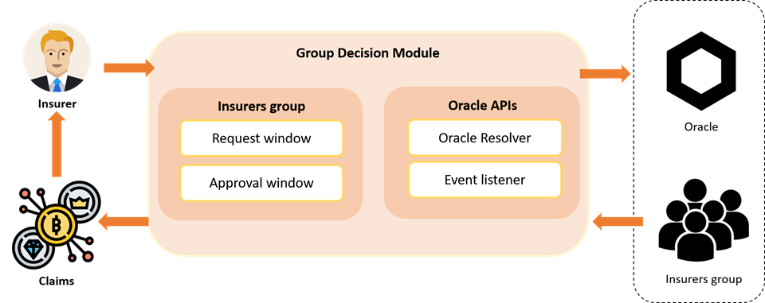
Group Decision Module
Notes:
群體決策模組可以分為保險人群組以及預言機API，
這個模組主要負責匯集預言機以及共保人之間的驗證結果。

Slide 43
Thank you ! Q&A

