Slide 1
數位經濟與人性軟體
李永銘
陽明交通大學資訊管理研究所 特聘教授

Slide 2
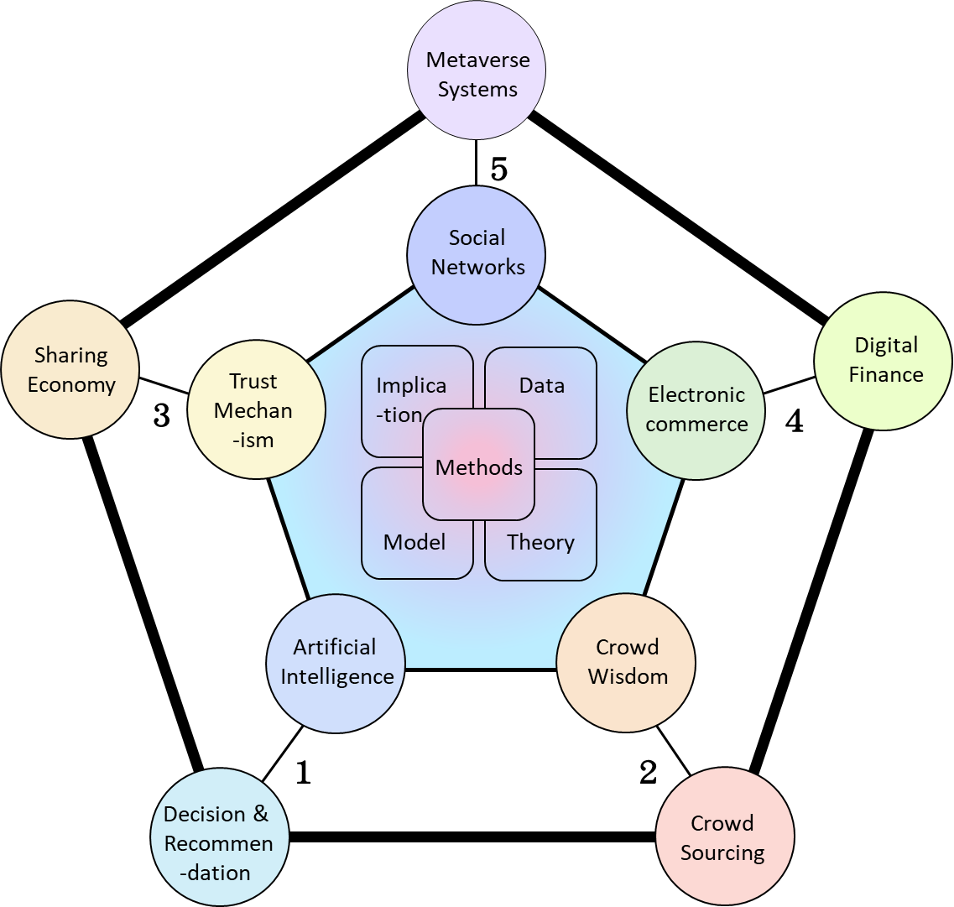
Research Topics in Digital Economy
Artificial Intelligence
Decision & Recommendation
Crowd Wisdom
Crowd Sourcing
Trust Mechanism
Sharing Economy
Electronic commerce
Digital Finance
Social Networks
Metaverse Systems
Notes:
Methods
implication

Slide 3
Research Framework
Platform
Data
Hypothesis
Discovery
Theory
Recommendation Prediction
Design Science
Social Science
Optimization
(Observations from data)
(Artifacts for platform )

Slide 4
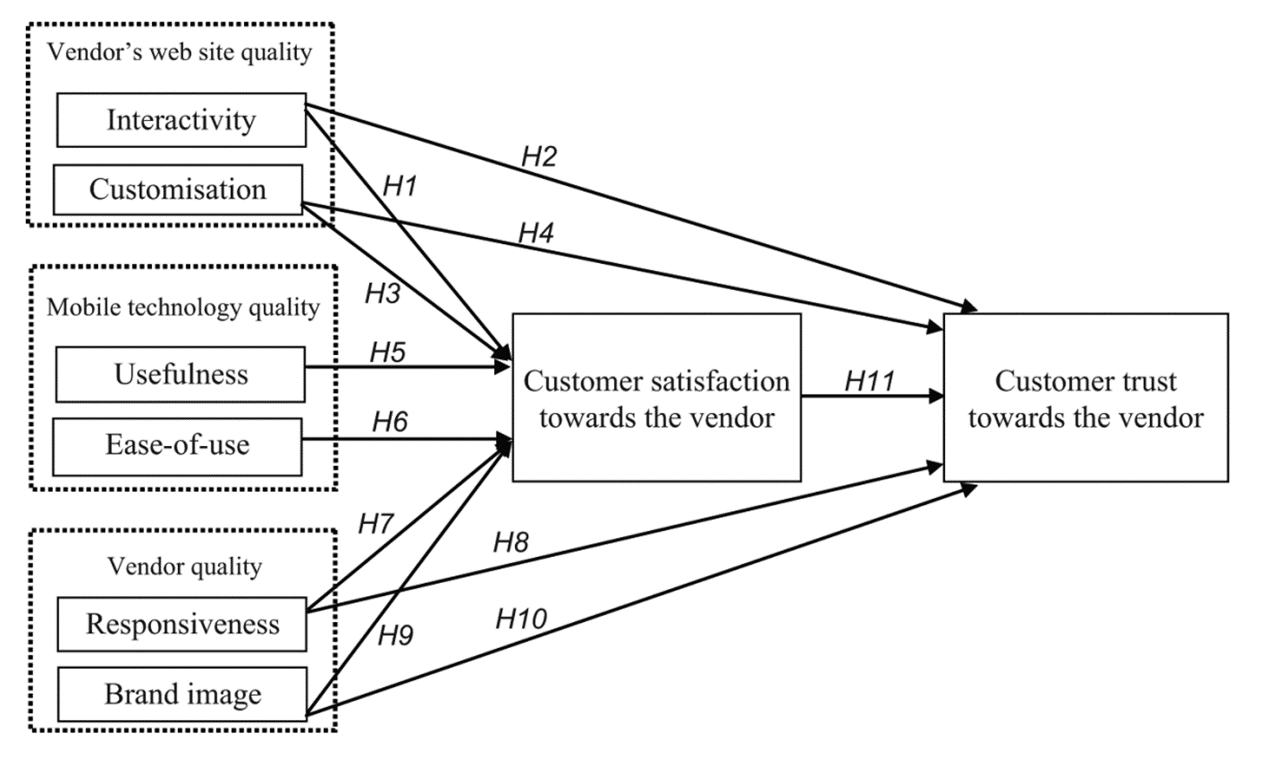
Research Frameworks – Hypothesis
Hypothesis, Discovery, Prediction, Recommendation (Optimization)
H1. Interactivity as m‐quality directly and positively
affects satisfaction.
H2. Interactivity as m‐quality directly and positively
affects trust.
H3. Customisation as m‐quality directly and
positively affects satisfaction.
H4. Customisation as m‐quality directly and
positively affects trust.
.
.
.
H11. Satisfaction directly and positively affects trust.
Yeh, Yung Shao, and Yung‐Ming Li. "Building trust in m‐commerce: contributions from quality and satisfaction."

Slide 5
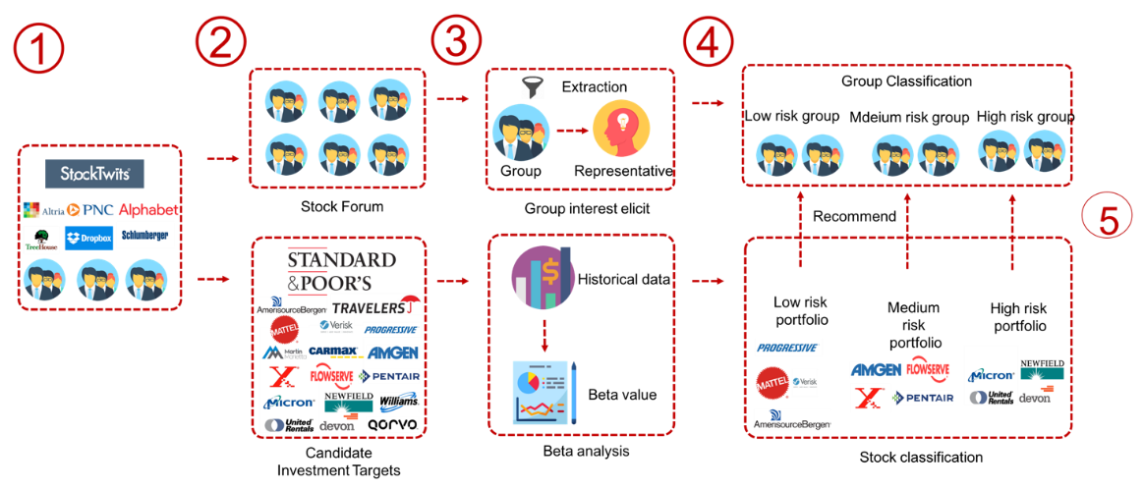
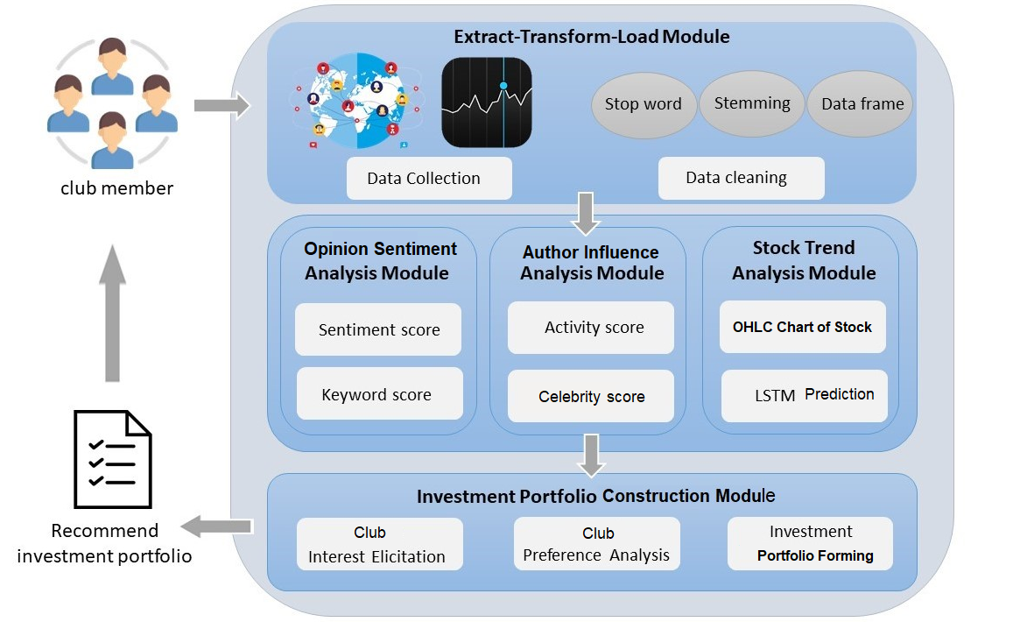
Research Frameworks- Discovery
Hypothesis, Discovery, Prediction, Recommendation, Optimization
A Collective Portfolio Recommendation Approach for Investment Clubs

Slide 6
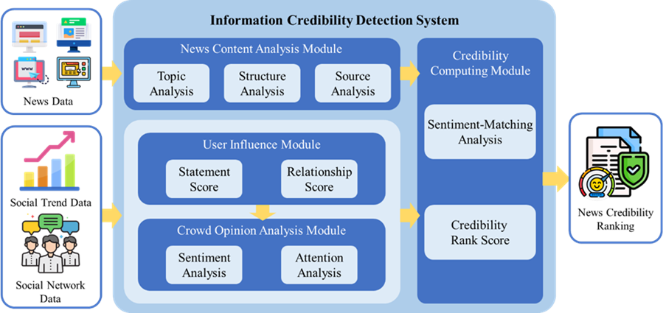
Research Frameworks- Prediction
Hypothesis, Discovery, Prediction, Recommendation, Optimization
Item 1
Factor 1
Item 5
Item 6
Item 2
Factor 2
Y
Item 4
Item 3
Factor 3
Item 7
Appraising the Information Credibility of Online News with Collective Intelligence
Prediction

Slide 7
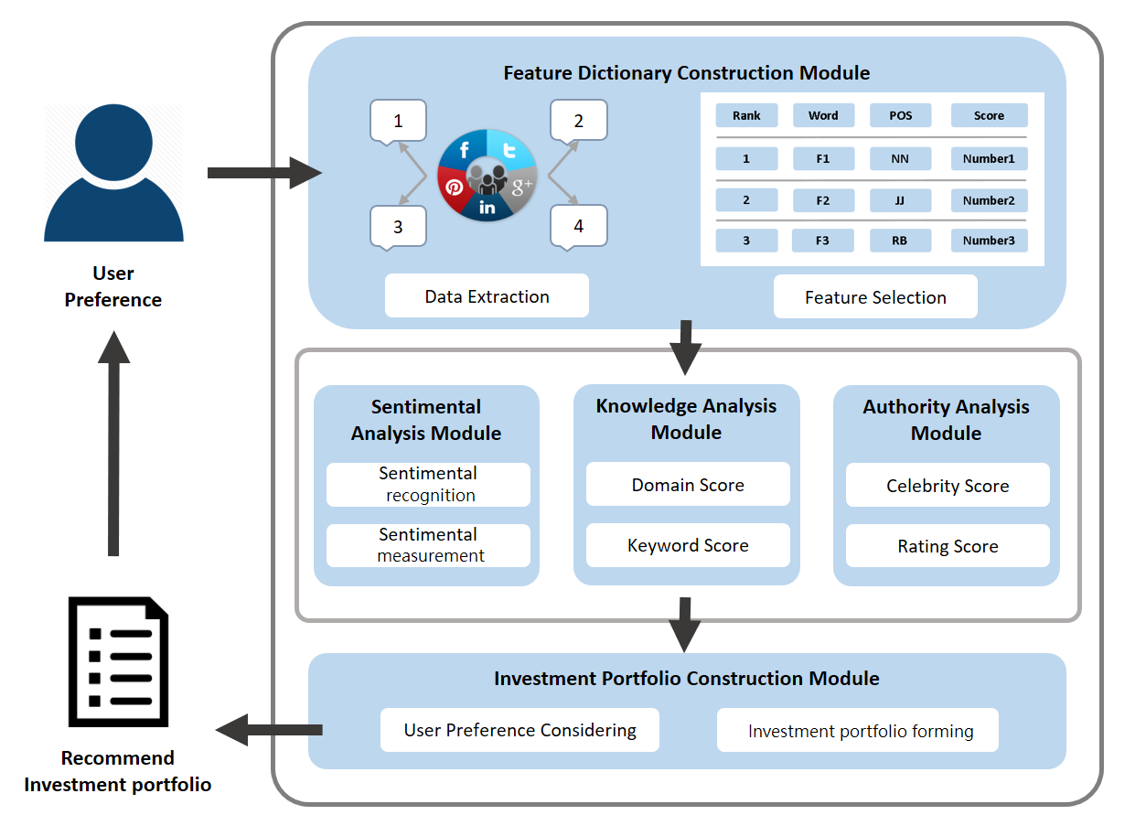
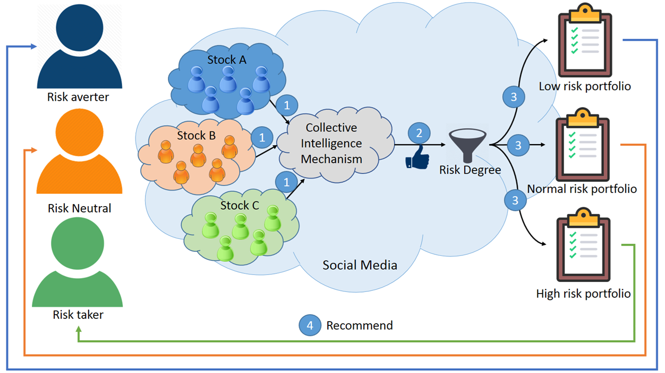
Research Frameworks – Recommendation
Hypothesis, Discovery, Prediction, Recommendation, Optimization
Li, Yung-Ming, et al. "A social investing approach for portfolio recommendation." Information & Management 58.8 (2021): 103536.

Slide 8
Hypothesis, Discovery, Prediction, Recommendation, Optimization
Optimal P2P Reward
Hossein Ghasemkhani, Yung-Ming Li, Kamram Moinzadeh and Yong Tang. “Contract Model for P2P Content Distribution" Production and Operations Management (2018)

Slide 9
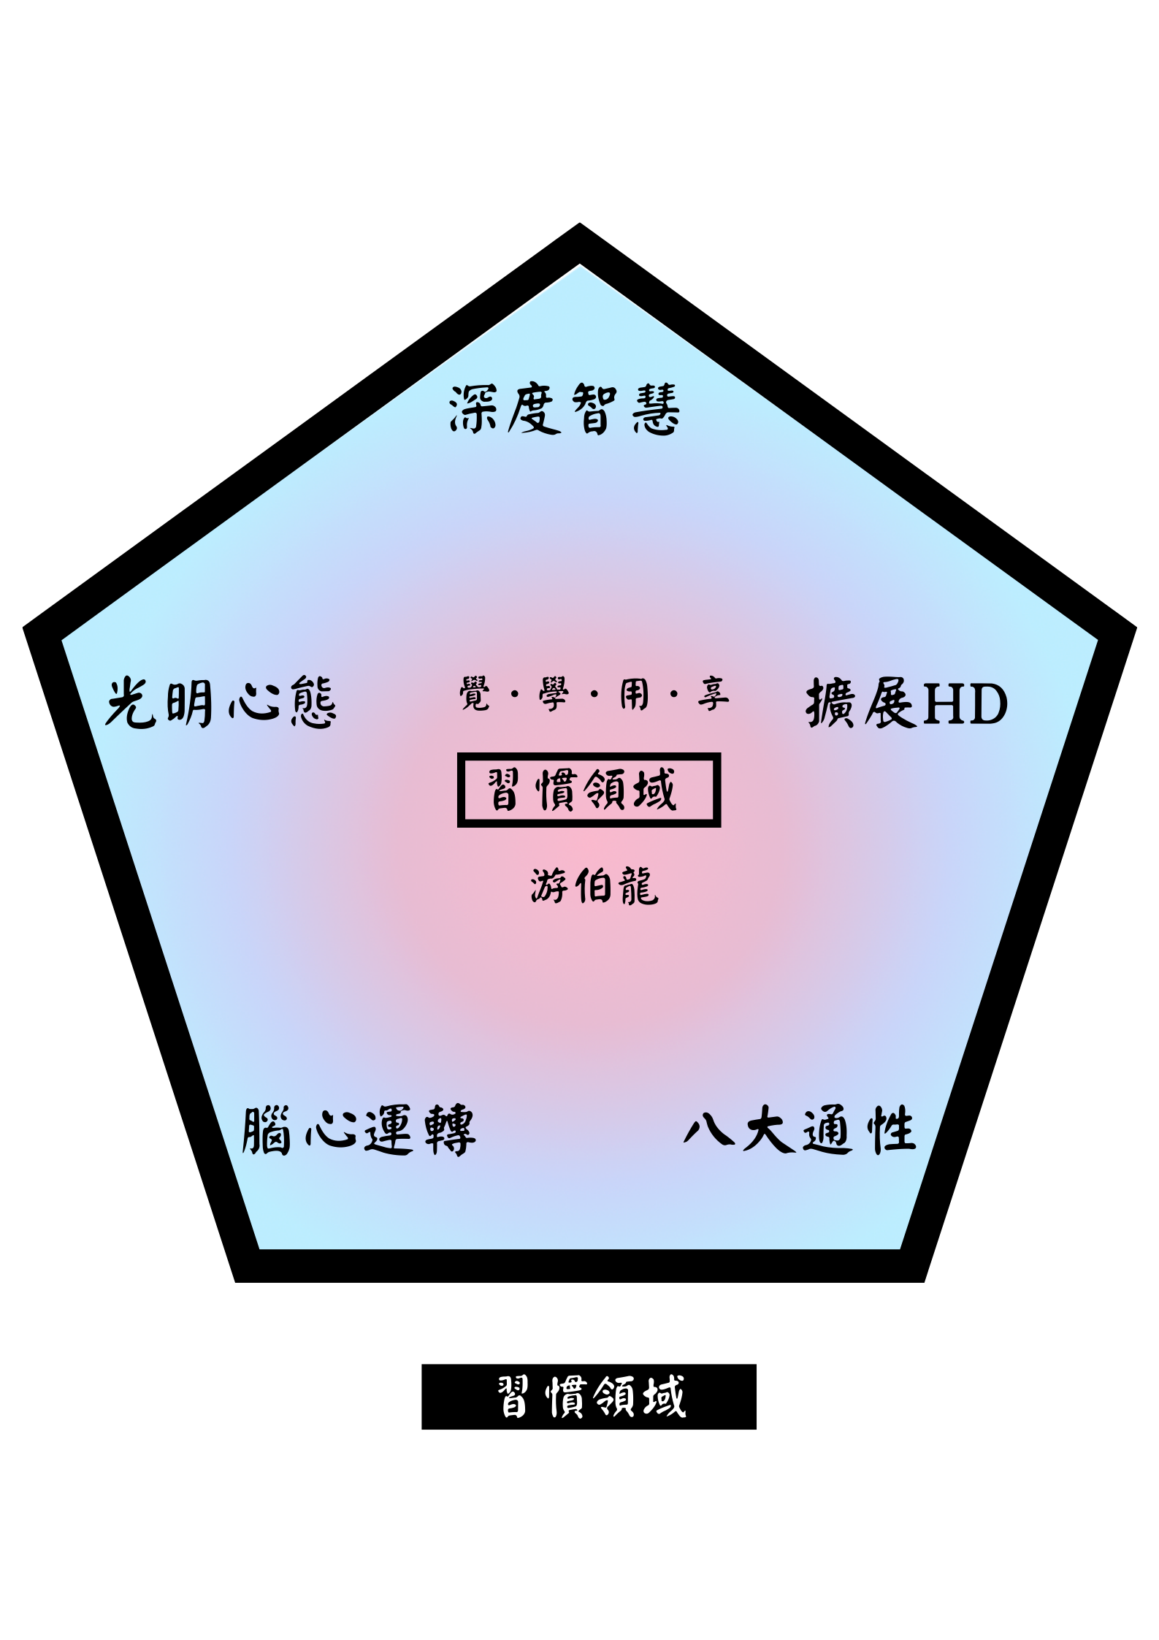
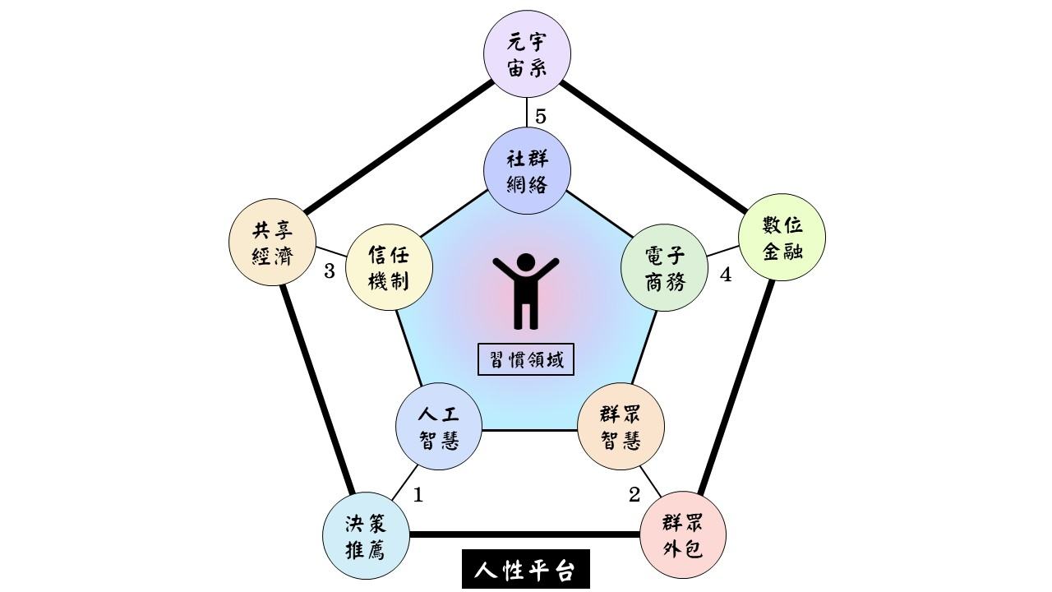
數位經濟 X 人性軟體

Slide 11
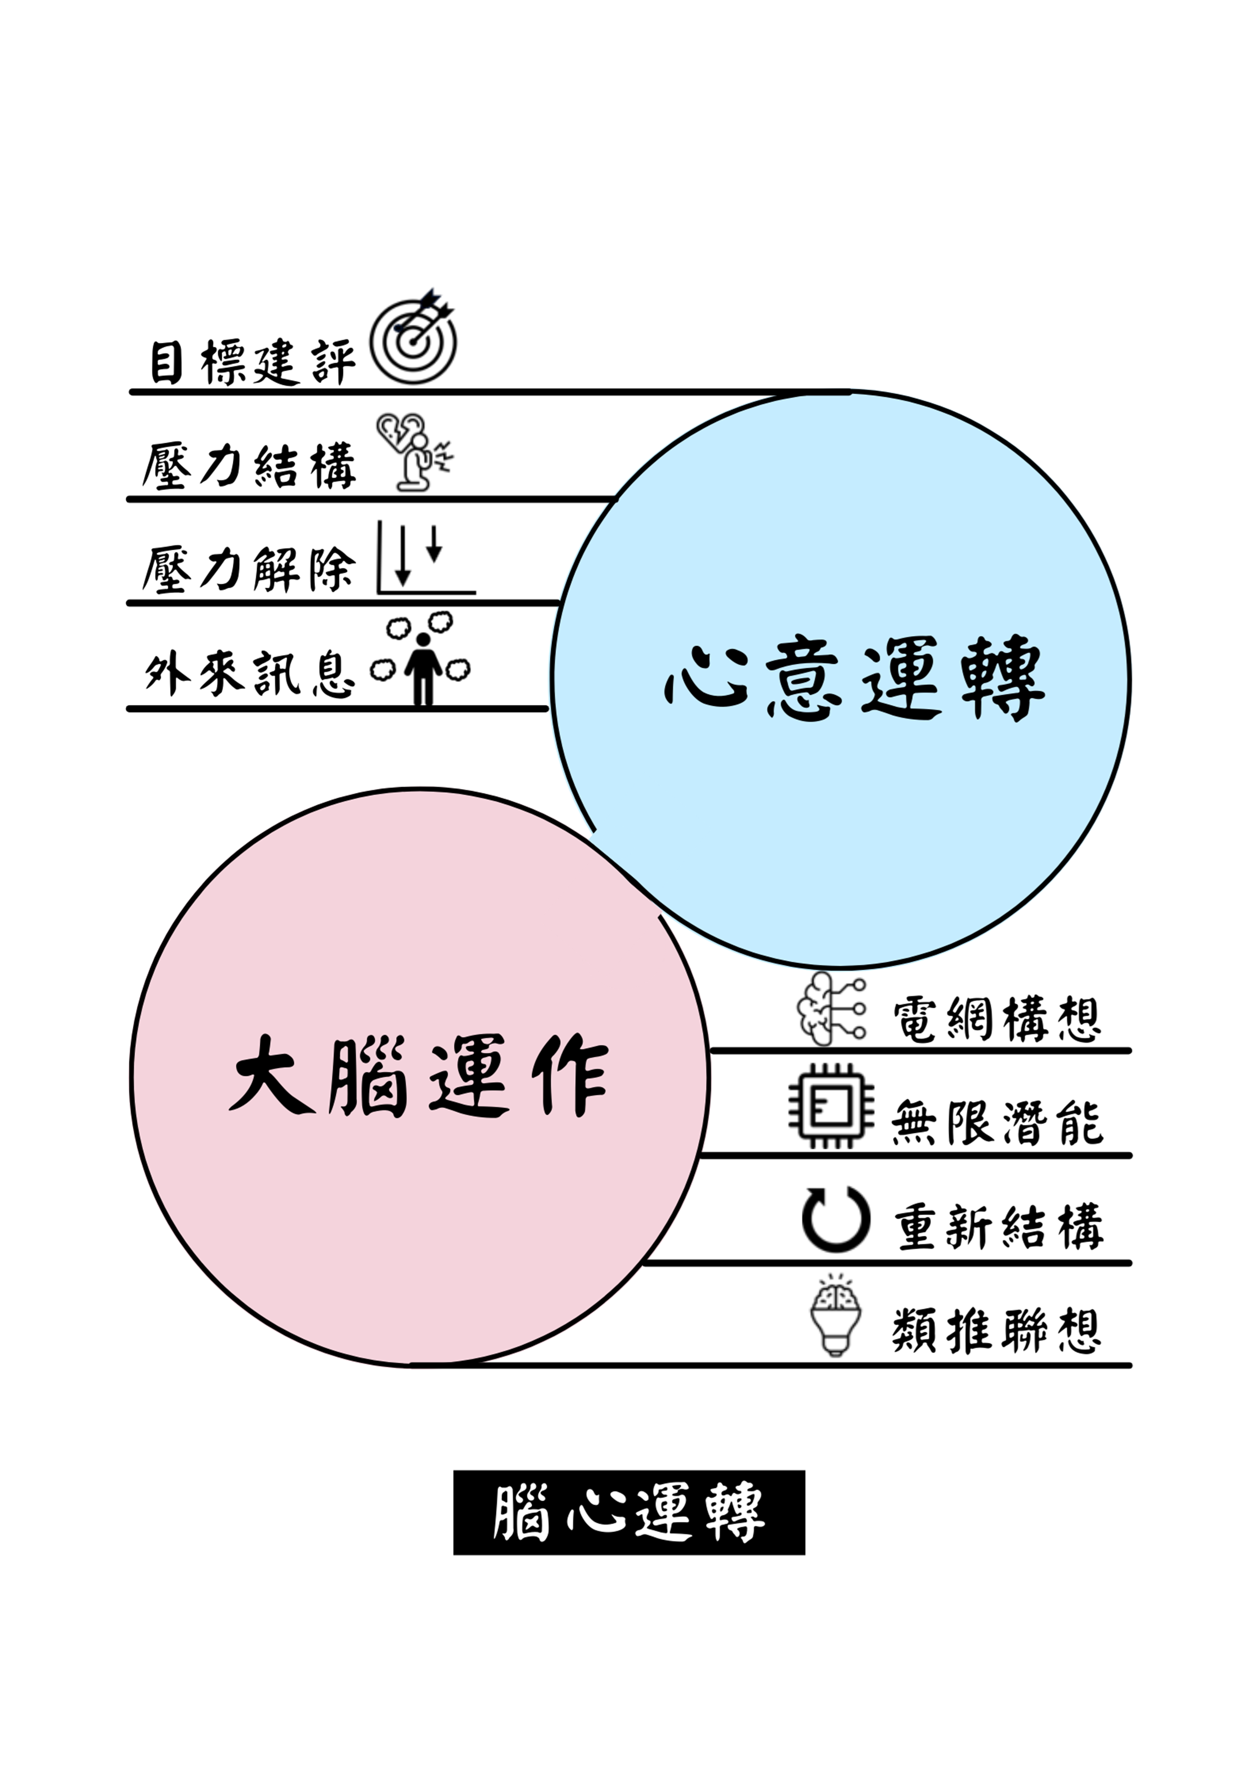

Slide 12
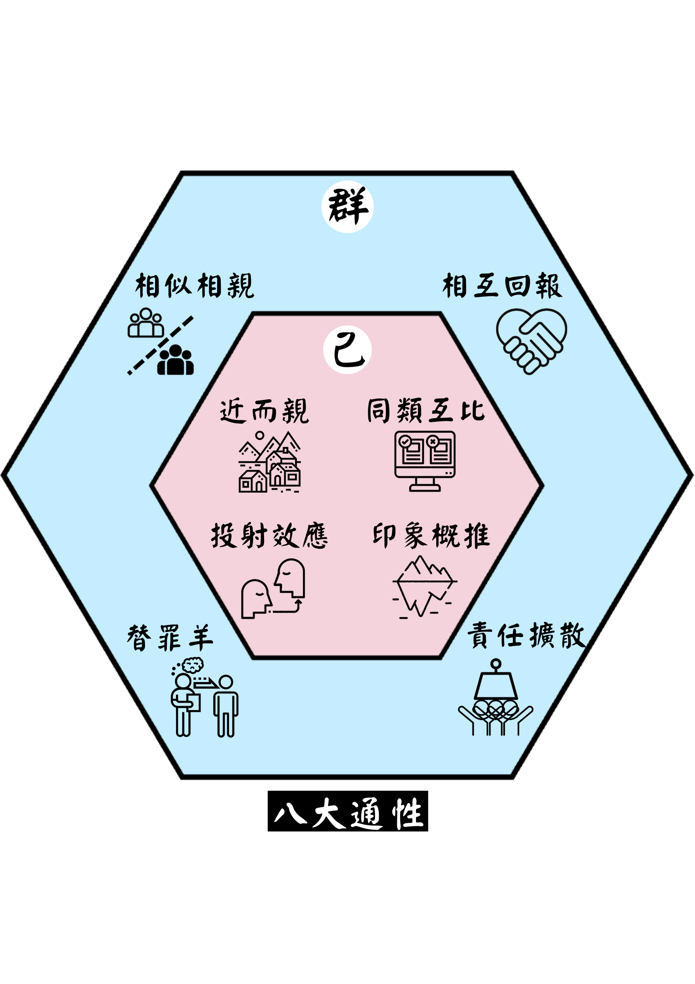
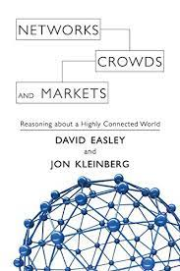

Slide 13
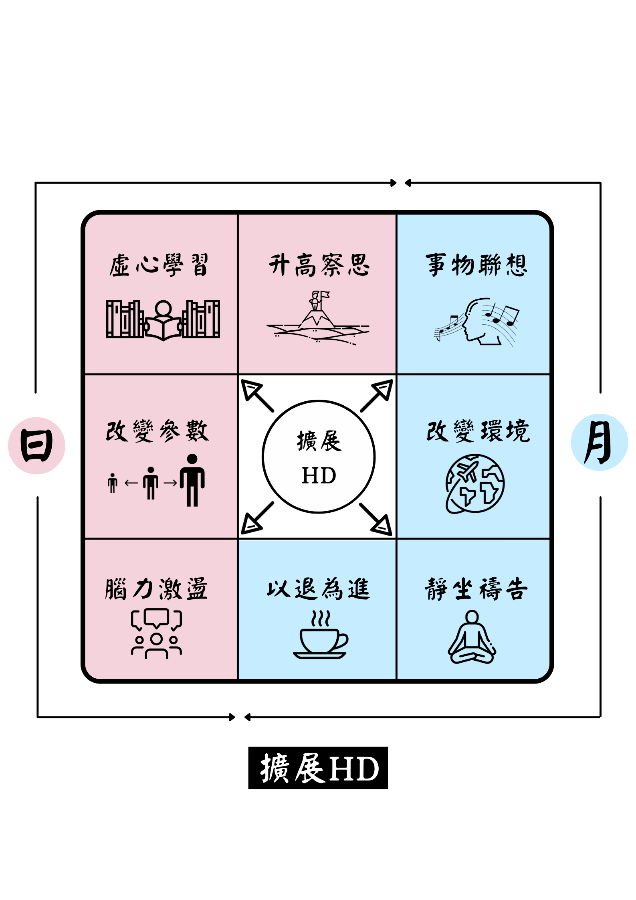

Slide 14
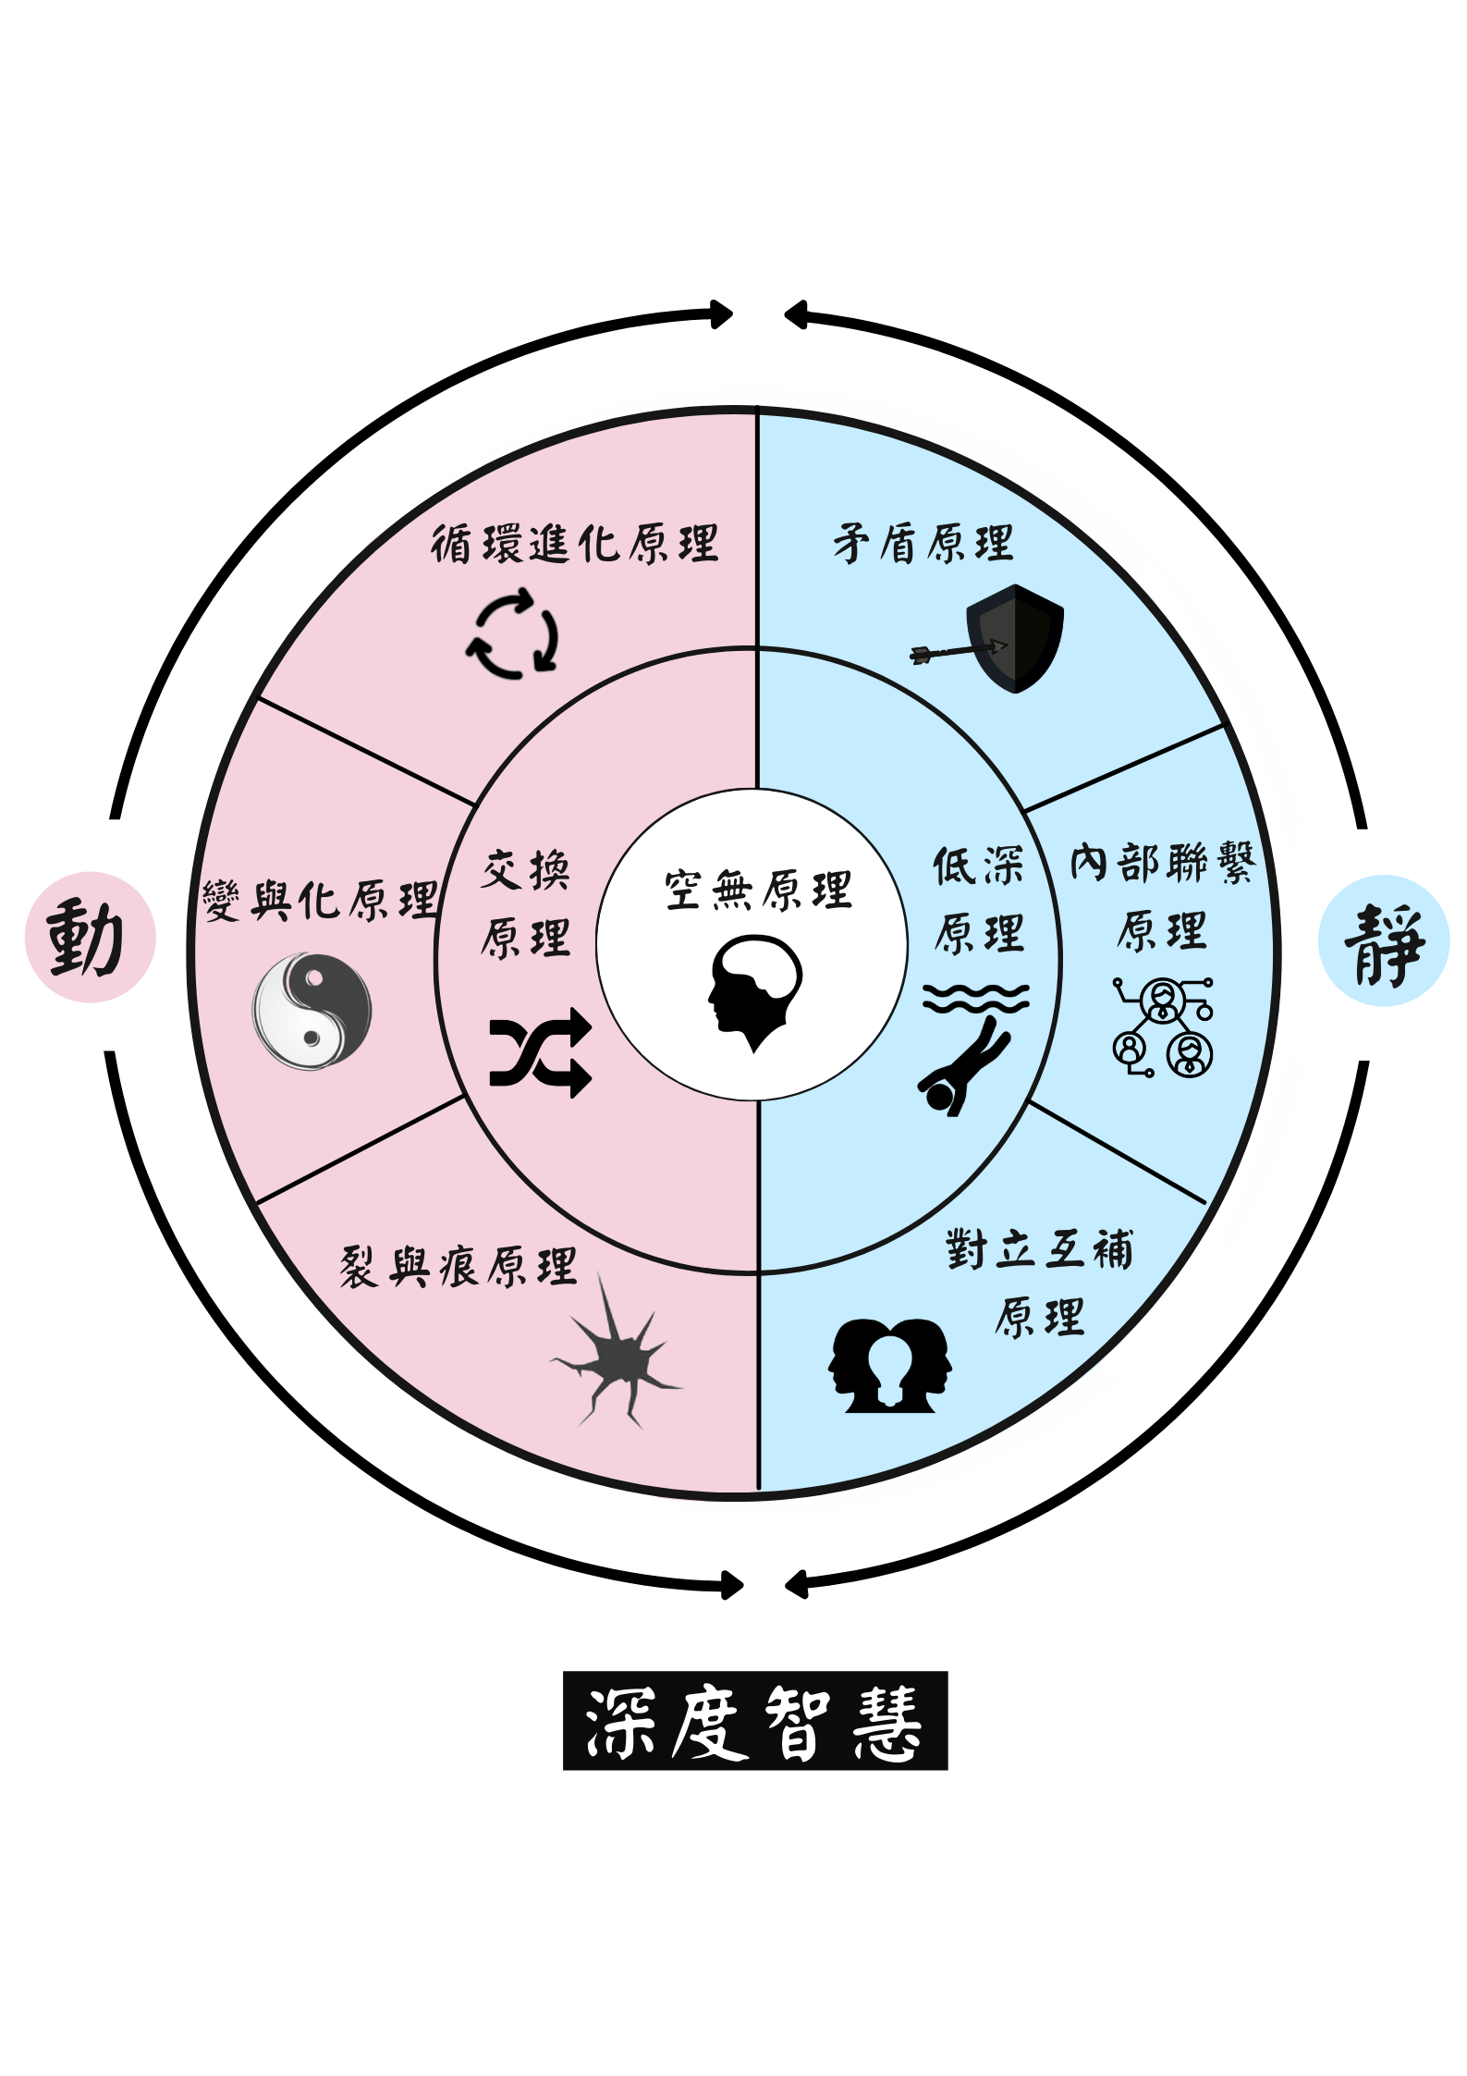

Slide 15
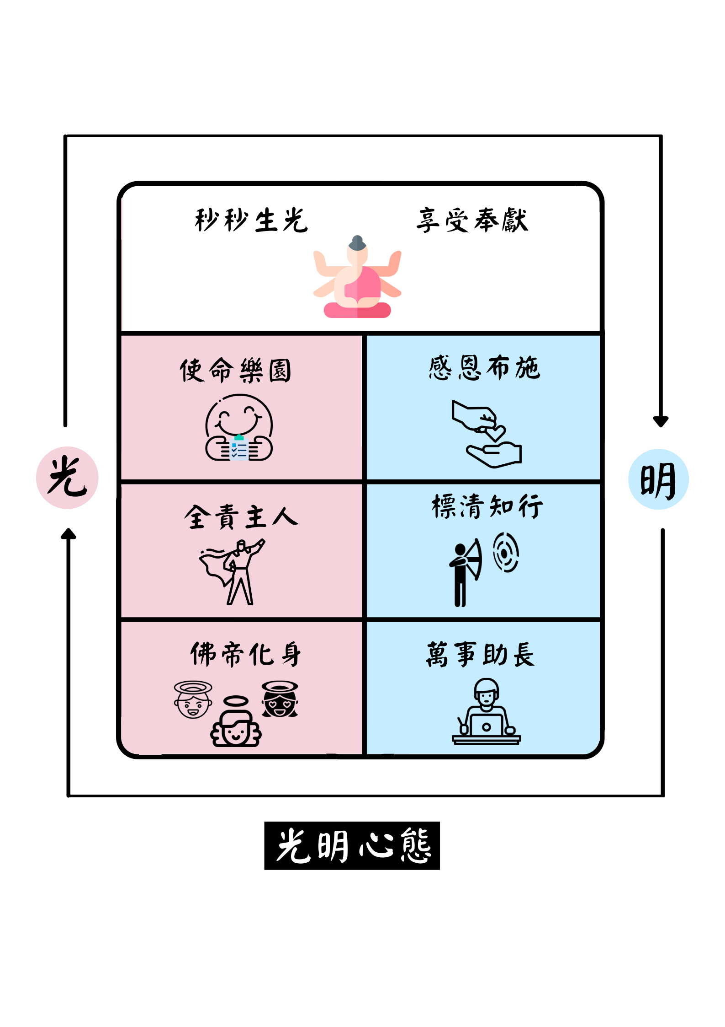

Slide 16
人性平台(Human Platform)- 習慣領域 X 數位經濟

Slide 17
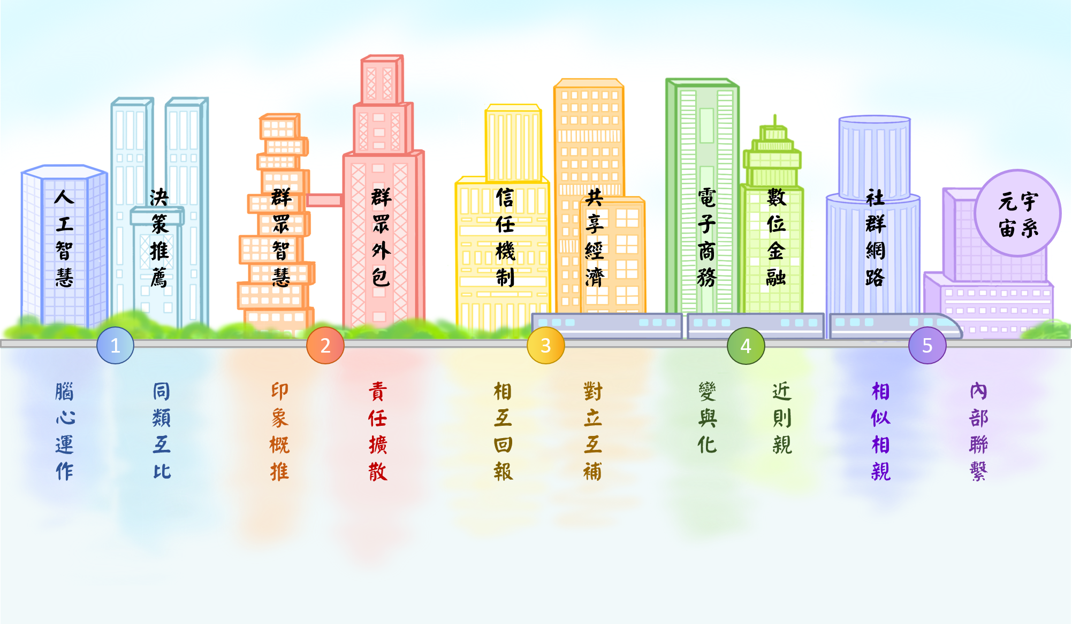

Slide 18
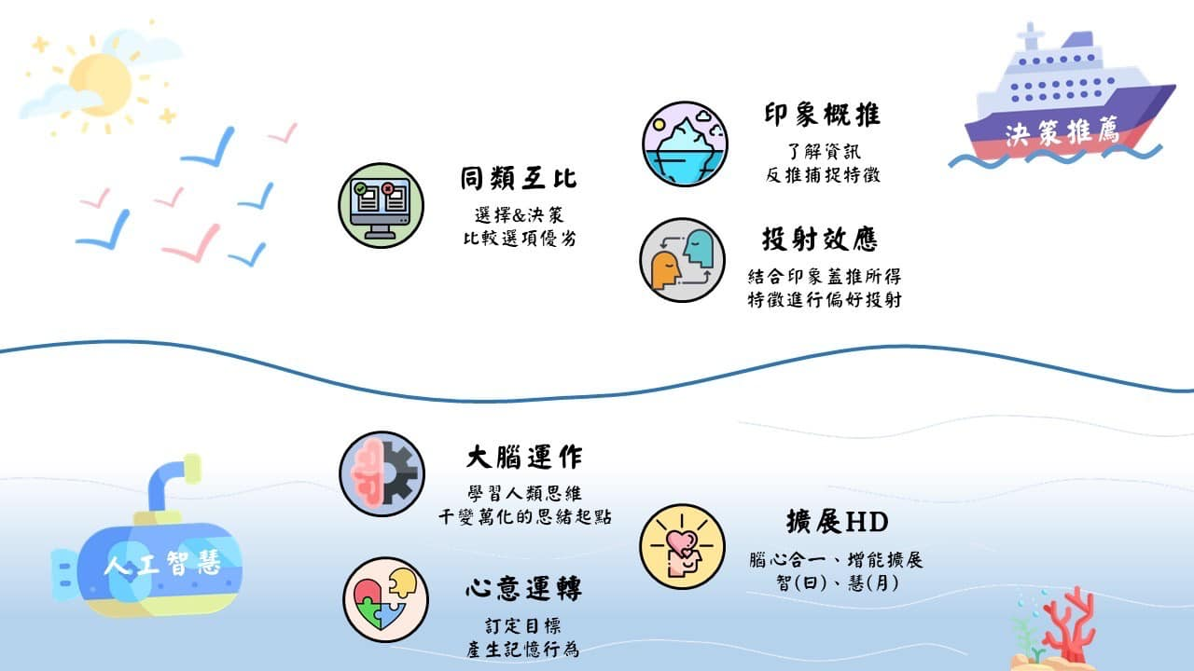

Slide 19
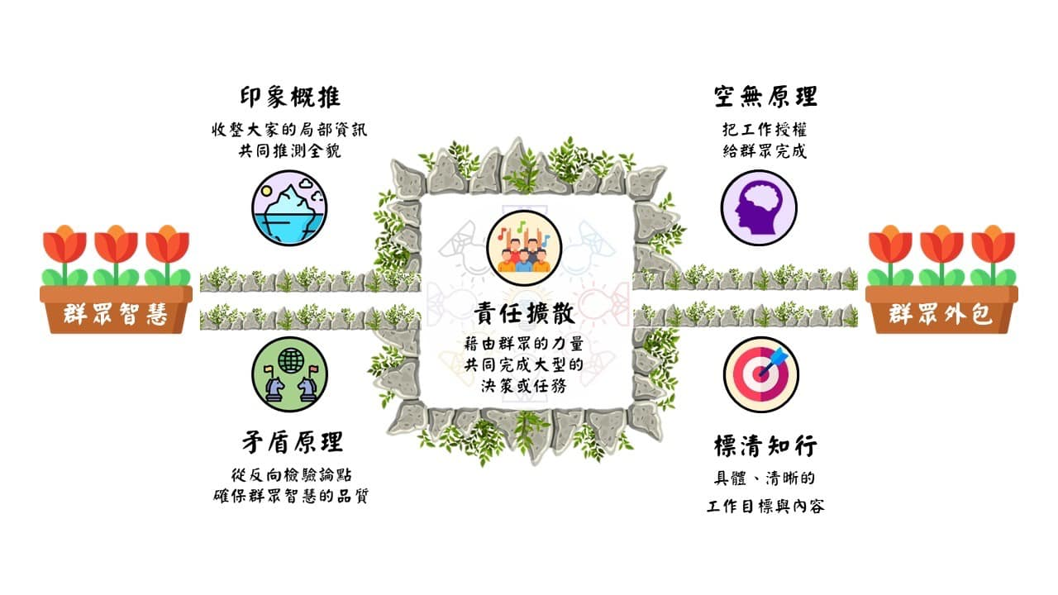

Slide 20
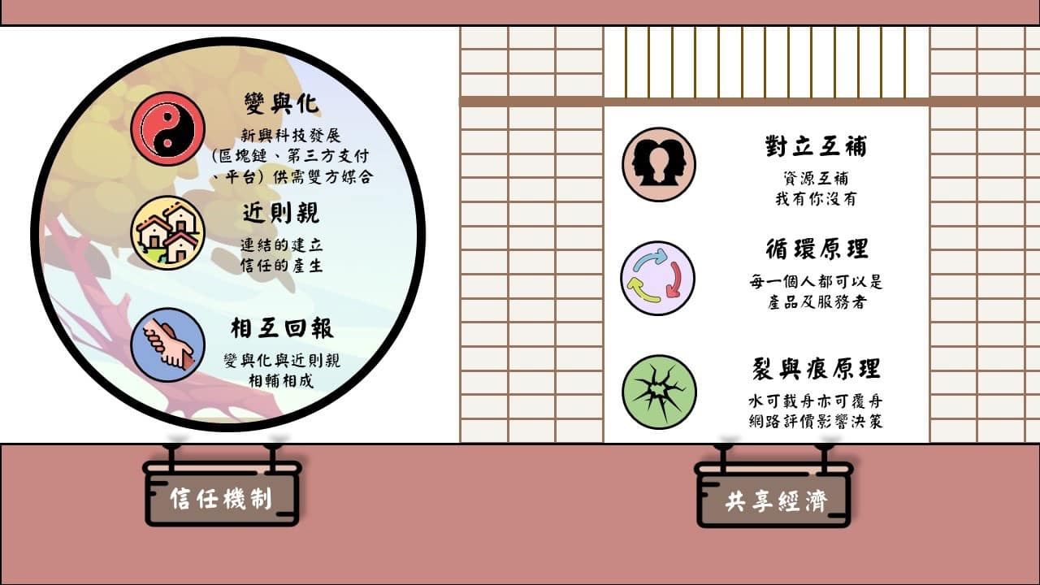

Slide 21
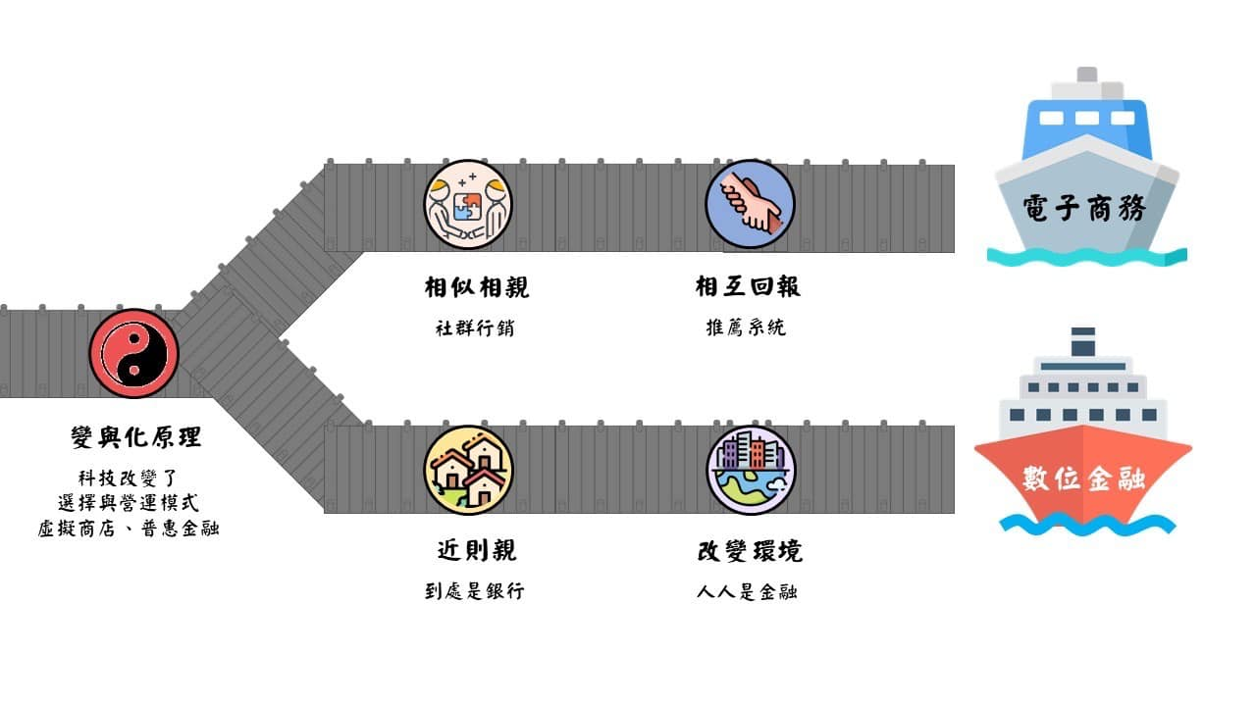

Slide 22
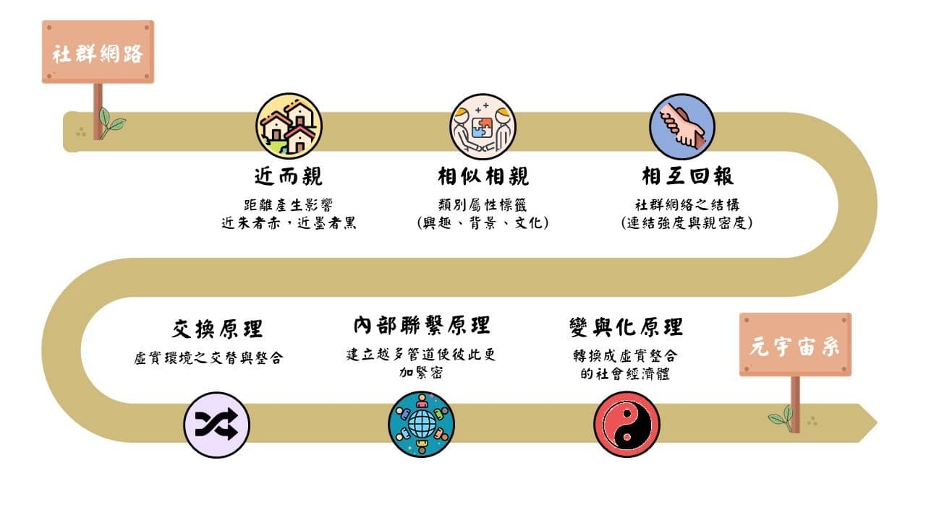

Slide 23
人性軟體之數位經濟
人工智慧: 從腦力到心力
群眾智慧: 從千眼到萬慧
信任機制: 從勤拭到無物
電子商務: 從虛實到贏贏
社群網路: 從小繫到大道
決策推薦: 從決策到妙策
群眾外包: 從群力到眾美
共享經濟: 從互補到循環
數位金融: 從處處到人人
元宇宙系: 從擴增到無間

Slide 24
Q&A

