Slide 1
Web 2.0 and Social Networks

Slide 2
Outline
1. The Web 2.0 Revolution, Social Media and Industry Disruptors
2. Online social networking : basics and examples
3. Commercial Aspect of Web 2.0 Applications and Social Networks
4 Social Computing

Slide 3
1. The Web 2.0 Revolution, Social Media and Industry Disruptors

Slide 4

The Web 2.0 Revolution
The emergence of Web’s digital democracy
  Time Magazine 2006 Person of the year: “You”
  Ordinary and regular people like you & I now control , use and are immersed in the information age
  Web 2.0 has become the framework for bring together the contributions of millions of people for information sharing, and aggregation of the wisdom of individuals
From Web 1.0 to Web 2.0
  Web 1.0 was organized around page, software, technology, and corporation
  Web 2.0 is organized around ordinary people and services
  The creator of the Web, Tim Berners Lee regards Web 2.0 as “a movement that encompasses a range of technologies such as blogs , wikis , and podcasts─representing the Web adolescence.”

Slide 5
What is in Web 2.0?
The popular term for advanced Internet technology and applications including : blogs, wikis ,RSS , and social network
Greater collaboration among Internet users , content providers and enterprises
Key Web 2.0 blogging statistics as of April 2007
  Over 75 million blogs exist online and about 120,000 new blogs are being added per day
  From 3000 to 7000 new splogs(fake or spam blogs) are created per day
  At least 1.5 million comments are posted in blogs every day (17 posts per second)
  Japanese is the #1 blogging language(37%), English second at 33% and Chinese third at 8%

Slide 6
Representative characteristics of Web 2.0
The following are representative characteristics
  The ability to tap into the collective intelligence of users (the more users contribute, the more popular and valuable)
  Making data available in new or never-intended ways (remixed or mashed up)
  Uses user-generated and user-controlled content and data
  The presence of lightweight programming techniques and tools that lets nearly anyone act as a developer
  Networks as platforms, delivering and allowing users to use applications entirely through a browser
  The virtual elimination of software-upgrade cycles makes every things a perpetual beta

Slide 7
Representative characteristics of Web 2.0
The following are representative characteristics
  An architecture of participation and digital democracy encourages users to add value to the application when they use it
  New business models are rapidly and continuously being created
  Major emphasis is on social network
  Rich interactive, user-friendly interface based on AJAX or similar framework is often use

Slide 8















Top 25 Web 2.0 Companies (Sloan 2007)
In social media:
  Wikia Slide Bebo
  Meebo StumbleUpon
In video:
  Joost Metacafe Blip TV
  Dabble Revision3
In the mobile area:
  Fon Mobio Soonr
  Loopt Tinypicture

Slide 9










Top 25 Web 2.0 Companies (Sloan 2007)
In advertising:
  Adify admob Turn
  Vitrue Spotrunner
In enterprise:
  SuccessFactors Janrain
  Logowork Simulscribe
  ReardenCommerce

Slide 10
Social media
Definition: online platforms and tools that people use to share opinions and experiences including photos , videos , music , insights and perceptions with each other
The is that people, rather than the organization, control and use then media
People can use these media with ease at little or no cost
Powerful democratization force : the network structure enables communication and collaboration on a massive scale.

Slide 11
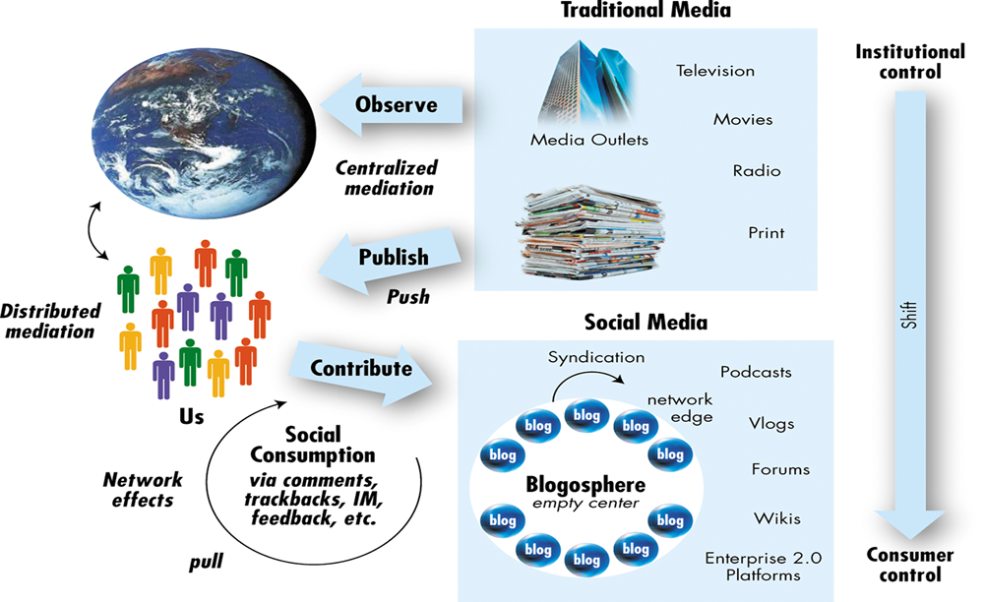
Social media
(Hinchcliffe, 2006)

Slide 12
Social media vs. Traditional media
From traditional media
  News papers, TV programs, Static web content
To social media
  New paradigm of message/news propagation
  Disseminate information through social interactions (definition quoted from wikipedia)
  Blog, Twitter, facebook, digg, plurk, tumblr, flickr…

Slide 13
The Shift to Social Media
Innovation is moving from a top-down to bottom-up model
Value is shifting from ownership to experiences
Power is moving from institutions to communities
                -Dion Hinchcliffe

Slide 14
Social interactions
Social networking
  Make friends, follow
Blog: Comment, Trackback (URL citation)
Video, photos: Embed
Social Bookmarking
Groups/communities
  Fans group of stars, politicians, athletes
  Communities for specific topics
Information sharing
  Retweet, Replurk,
All of above leads to more and stronger “Relations”
  Social network analysis comes to help
Notes:
retweet, replurk 就是把其他人講的話再講一次，也就是往下傳一層
14

Slide 15
Basic Forms of Social Media
At this time, there are basically six kinds of social media.
  Social Networks: Facebook, MySpace
  BLOGs/MicoBlog: Wretch, Twitter, Plurks
  WIKIs: Wikipedia
  Podcasts: Apple iTune
  Forums
  Content Communities: YouTube

Slide 16
Things that Boost Social Media
Better hardware/network infrastructure
  Broad band, 3g, notebooks, smart phones
New Tools for publishing content
  Mediawiki, building your own wiki site
  Blogspot, providing user-friendly blog system
  YouTube, distributing your video
  RSS
  Makes user-generated content more accessible.

Slide 17
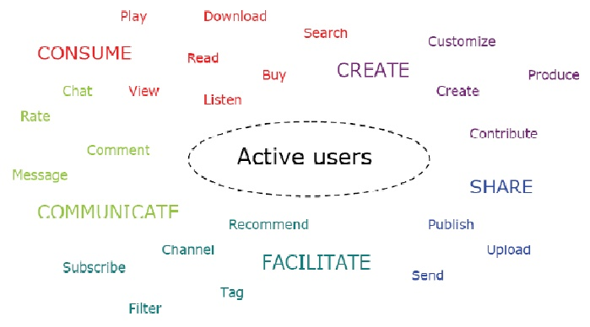
Users Role in Social Media

Slide 18
Industry & Market disruptors
Web 2.0-based innovations that could disrupt and reorder markets or even entire industries
A checklist of questions to help identify disruptors
  Is the service or product simpler, cheaper , or more accessible?
  Does the disruptors change the basis of the competition with the current suppliers?
  Does the disruptors have a different model?
  Does the product or service fit with what customers value and pay for?

Slide 19
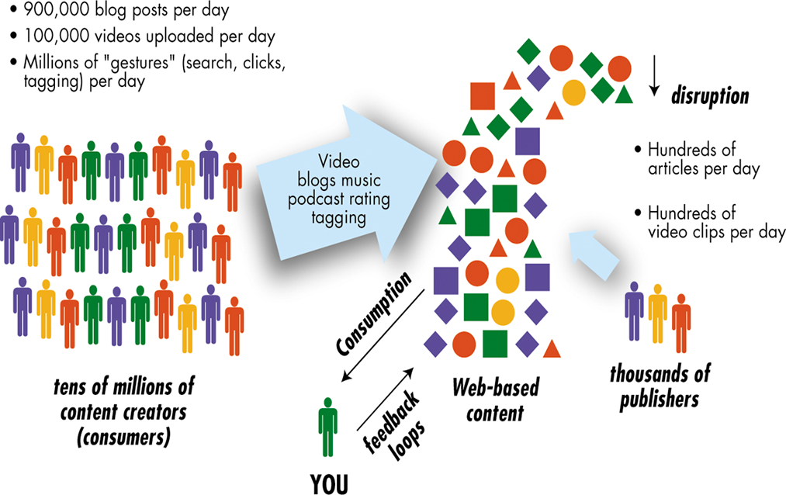
Industry & Market disruptors
(Hinchcliffe, 2006)

Slide 20
Industry & Marker disruptors
Examples #1: Will online wedding services disruptor the traditional industry?
  Disintermediate traditional vendors
  Live band , invitation printer , wedding playlist….
Example #2: Disruptors of the real estate industry
  e.g. Zillow.com
    Estimate an approximation of your home’s market value
    User can list their homes for free after calculating the actual selling price in the neighborhood
  Good for both seller and buyer
    Brokerage was disrupted
    Buyer can buy a house that is not even in the market- without open house, bidding

Slide 21
2. Online social networking : basics and examples

Slide 22
Social networks
Concepts & Definitions
  A place where people create their own space.
    on which they write blogs ; post pictures , videos , or music ; share ideas ; and link to other web locations they find interesting
  Social networkers tag the content with keywords they choose themselves , which makes their content searchable.
    The “tag” forms online communities of people with similar interests
  A social structure made of nodes that are usually individuals or small groups.
    Indicates the way in which individuals are connected through various social familiarities ranging from casual acquaintance to close familial bonds.

Slide 23
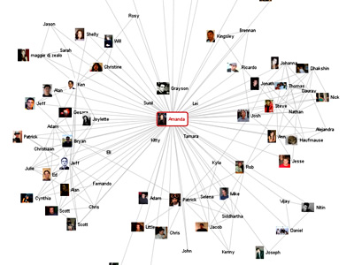
Social networks (cont’)
  A social structure made of individuals (or organizations) called "nodes," which are tied (connected) by one or more specific types of relation (quoted from wikipedia)
Applications
  Information Diffusion
  Viral Marketing
  Expert Finding
Source: www.visualcomplexity.com

Slide 24
Social networks (cont’)
Social network theory
  View social relationships in terms of nodes and ties
  Nodes : individual actors within he networks
  Ties : relationships between the actors
  In social network diagram, nodes are the points and ties are the lines
  The network can determine the social asset of individual
Social network services (SNS)
  To participate in social networking , people must join a company that provides the social services
  E.g. Facebook , MySpace , Bebo

Slide 25
Social networks (cont’)
Social network analysis (SNA)
  The mapping and measuring of relationships and flows between people , groups , organizations , computers or other information or knowledge processing entities
  Provides both visual and mathematical analysis of relationships
Social networking tools
  The most advertised are blogs (microblog) and wikis

Slide 26
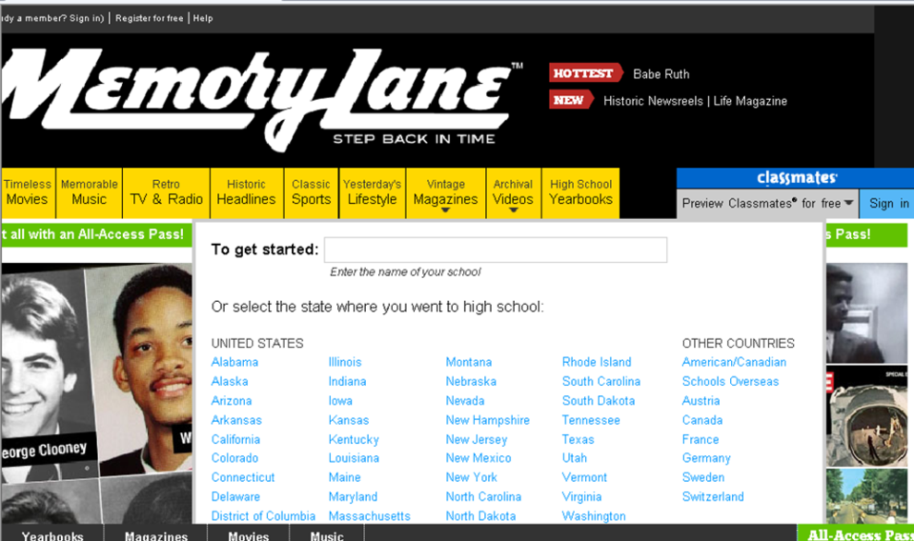
Representative social network services
Classmates Online
  Helps members find , connect and keep in touch with friends and acquaintances from through their lives
  More than 40 million active members in the US and Canada

Slide 27
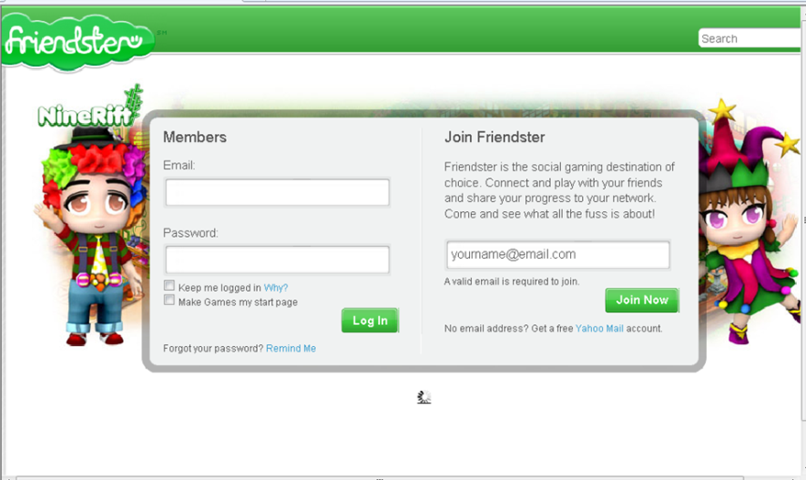
Representative social network services
Friendster
  Based on the Circle of Friends technique for networking individuals in virtual communities and demonstrates the small world phenomenon
  The top SNS until around April 2004 , when it was overtaken by MySpace

Slide 28
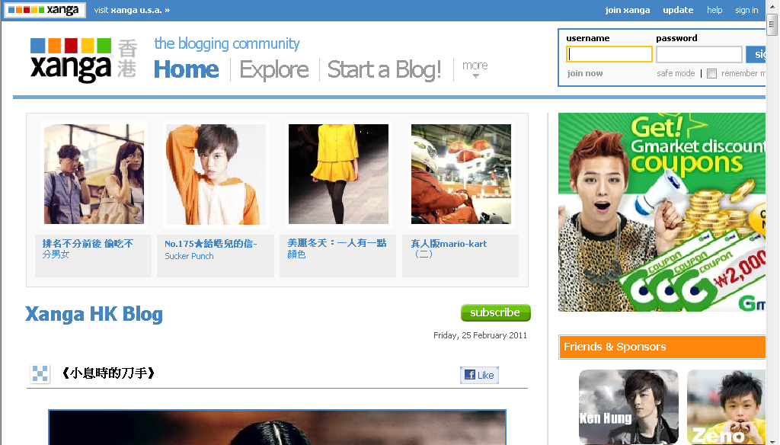
Representative social network services
Xanga
  A web site hosts Weblogs , photoblogs and social networking profiles
  Origins can e traced back to 1998 , when it began as a site for sharing book and music reviews

Slide 29
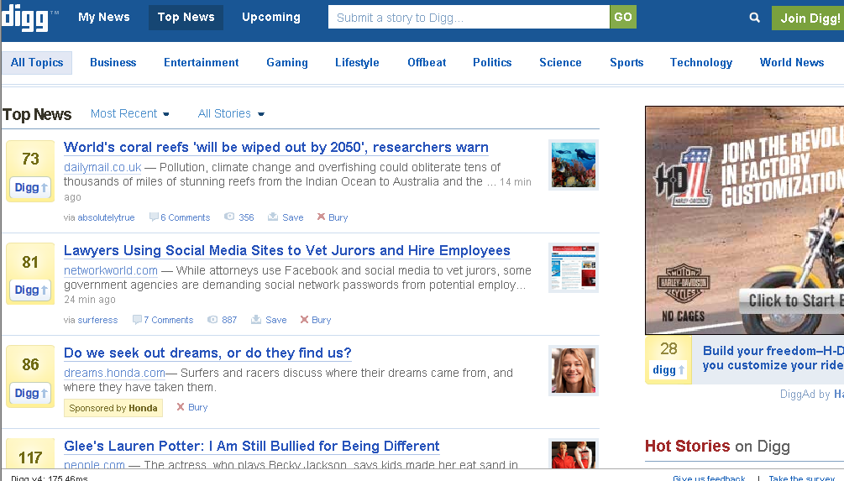
Representative social network services
Digg
  A community-based popularity Web site with an emphasis on technology and science articles
  It combines social bookmarking , blogging and syndication with a form of nonhierarchical , democratic editorial control

Slide 30
Major Social Network Services

Slide 31

Facebook: The Network Effect
Facebook
  Launched in 2004 by Mark Zuckerberg
  Photos, group, events, marketplace, posted items, and notes are the basic application
  “News feed” and “mini-feed” allow users to track the movement of friends in their social circles
  Network effect: more users mean more value
  Encouraging organizations to open pages where they can conduct advertisements and promotions

Slide 32

Facebook: The Network Effect
Bedo
  Provides a canvas for user to display personal profiles using such media as photos, diaries, music, embedded video, commercial applications, and quizzes
  Allows users to add other users as friends who can view their profiles and post messages
  Boasts a usership of over 40 million, making billions of page views per month

Slide 33

Craigslist: A trading Floor of the Cyber Revolution
Craigslist
  The most authoritative e-classifieds service
  The site is free to use, as is posting ads
  Revolutionized traditional commerce by facilitating direct buyer-seller interaction for free in an online context
  Allows for goods and services to be found, bought, and exchanged more quickly than any physical market

Slide 34

Orkut: Exploring the very Nature of Social networking sites
Orkut
  Similar to other major social network site
  Member can create their own group and forums called “communities”
  The autonomy over who can join and how posts are edited and controlled lies solely in the hands of the creator of that communities

Slide 35

Flickr Ticks off some of Its User
Flickr
  Allows for the storage and organization of photos
  Users require an individual account in order to add friends to their network and share their photos
  The upload restrictions of 2GB have been removed for users with paid ProAccoints
  Users can add video clips up to 90 seconds long as well as photos

Slide 36
Business-Oriented Social Network
Business network
  A group of people that have some kind of commercial or business relationship
  E.g. LinkdIn
    The main purpose is to allow registered users to maintain a list of contact details of people they know and trust in business

Slide 37

How LinkIn works
Linkin
  A contact network is built up consisting of users’ direct connections
  Can be used to find jobs, people, and business opportunities
  Employers can list jobs and search for potential candidates
  Job seekers can review the profiles of hiring managers

Slide 38
3. Commercial Aspect of Web 2.0 Applications and Social Networks

Slide 39
Why is there an interest?
Benefit from online communities
  Consumer can be a source of feedback which can lead to innovation for a retailer
  Brand awareness (Reach of social aspects but not commerce transaction)
  Word-of-mouth increases the visibility of niche retailers and products
  Effect of viral marketing
    free advertising that increases the visibility of niche retailers and products
  Harnessing techniques based on personal preferences such as collaborative filtering
    Higher degree of relevance in matching the knowledge of one person to someone of like interests who has a need to know

Slide 40
Advertising
Viral (Word-of-Mouth) Marketing
  Young adults are especially good at viral marketing
  Spread very quickly, sometimes to millions of people, at a minimal cost to companies
  E.g. (free sample)
    YouTube (free download of songs with ads)
    McNichol (free bottle of wine to bloggers , then receive reviews)
    MyPickList (integrate a user profile and favorite product recommendations; share picklist with )
    PayPerPost (a marketplace where advertisers can find blogers, online photographers, and podcasters willing to endorse the advertisers’ products.)

Slide 41
Classified Ads and Job Listing
MySpace has provided classifieds and job listings competing with Craigslist and CareerBuilder
MySpace is already a force in e-commerce: it send more traffic to shopping to shopping and a classifieds sites than MSNs, and is fast closing on Yahoo!
Google and eBay roll out “click-to-call” advertising and expanding to MySpace giant network

Slide 42
Mobile Advertising
Advertisement on cell phone and other mobile devices
  With increasing use of the cell phone with access to the Internet, the competition for ad revenue is intensifying
  Watching video clips has become popular on cell phone and dvertisers are starting to attach ads to video clips for cell phones

Slide 43
Feedback from Customers
Conversational Marketing
  Instead of traditional questionnaires and focus group, feedback via blogs, wikis, online forums, chat rooms, and social networking sites
  Generate faster and cheaper results than traditional focus groups
  Foster closer relationships with customers
  E.g. Dell and Cookshack (feedback and question answer)
Customer review
  Have long been part of cutting-edge sites such as Amazion.com and Netflix
  43% of EC sites offered customer review and ratings
  50% of customers 18-34 years old have posted a comment or review on the products they bought

Slide 44
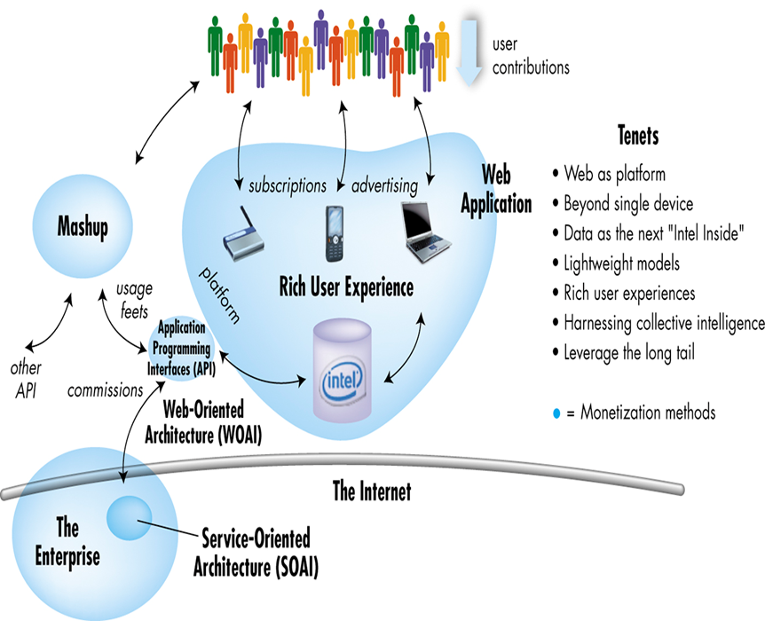
Generating Revenue from Web 2.0 Applications
(Hinchcliffe, 2006)

Slide 45
Strategies to make maximum use of Web 2.0 Applications
Three direct ways to monetize Web 2.0
  Advertising, subscription, and commission
Indirect ways that lead to revenue growth, user growth, and increased resistance to competition, which in turn increases advertising, subscription, and commission etc.
  Strategic acquisition
  Maintaining control of hard to recreate data sources
  Building attention trust
  Turning application into platforms
  Fully automated online customer self-service

Slide 46
Other Revenue-Generation Strategies in Social Networks
Offer premium service for a monthly service fee
Partner organizations with the social networks, Paying them a monthly service fee
Provide local physical venues (e.g. coffee shops for meeting) where members pay a fee to be affiliated with the social network

Slide 47
Enterprise Social Networking
Enterprise social networking
  Companies interact with Web 2.0 tools and social networks, resulted in an IT strategy that moved companies to be not only digital enterprises, but enterprises 2.0
Enterprises 2.0
  Web 2.0-style collaboration via blogs and wikis

Slide 48
Web 2.0 Commercial Activities Inside the Enterprise
Web 2.0 technology inside the enterprise
  Allow employees to collaborate and communicate
  Promote the use of enterprise wikis
  Set up enterprise social Bookmarking system
  CIOs should make sure the right infrastructure and tools are in place

Slide 49
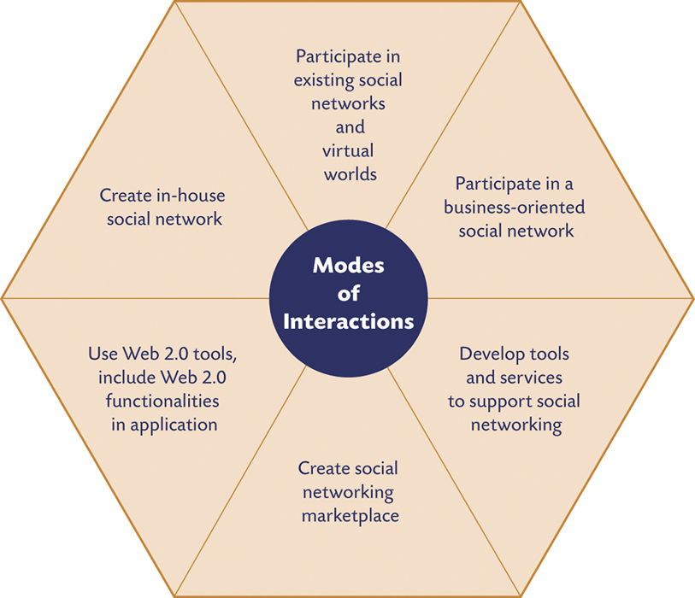
Interfacing with Social Networking

Slide 50
Interfacing with Social Networking
Create enterprise social network
  Utilize existing public social networks
  Create an in-house private social network and use it for communication and collaboration
  Conduct several business activities in a social network
  Create services for social networks
  Use Web 2.0 tools
  Create and participate in a social marketplace

Slide 51
Risks to Enterprises when Interfacing with Social Network
Risks in less controlled social networks
  Content is user-generated and often not edited or filtered has its downsides to company or product
  Minority of individuals contributes most of the content material in some blogs, wikis, and similar tools (20-80 rule)
    1000 of the millions of contributors write most of the Wikipedia
    One third of the stories in the Digg’s home page were by 30 users (out of 9000,000)
    User-submitted stock photography site iStockphoto has more than 35000 contributing photographers, but only about 100 have sold more than 1000,000 images
  Web 2.0 applications increase security risk

Slide 52
Social Marketplaces
Social marketplace
  Derived from the combination of social networking and marketplaces
  Harnessing the power of one’s social networks for introducing, buying, and selling of products, services, and resources
  E.g.
    Windows Live Expo (online classifieds, search sorted by friends, contacts, or geographic proximity)
    Fotolia (royalty fee stock images and illustrations trading)
    Flipsy (free commission for books, music, movies trading)

Slide 53
4. Social Computing

Slide 54
What is Social Computing ?
Social computing refers to the intersection of social behavior and computational systems
a set of open, web-based and user-friendly applications that enable users to network, share data, collaborate and co-produce content

Slide 55
What is Social Computing ?
Traditional computing systems concentrate on supporting organizational activities and business process, and zero in on cost reduction and increase of speed
  Top-down management and communication
Social computing concentrates on improving collaboration and interaction among people
  Bottom-up strategy where individuals in communities with their activities become a major organizational power
  People can collaborate online, get device from one another and from trusted experts, and finds goods and services they really like

Slide 56
Social Media VS. Social Computing
Social media is best understood as a group of new kinds of online media for disseminating information through social interactions
Social computing is often defined as modeling complex human interactions that are expressed on a variety of social media

Slide 57
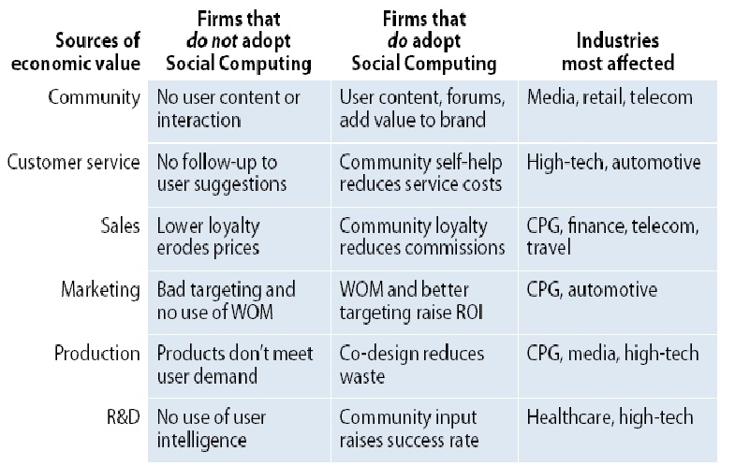
Economic Value of Social Computing
according to Forrester (2007)

Slide 58
Disciplines of Social Computing
Social computing is a multi-disciplinary research program that focuses on human, cultural, and behavioral aspects.
It brings together experts from various disciplines like: anthropology, cognitive science, computer science, economics, linguistics, mathematics, neuroscience, political science, psychology, sociology, statistics, and theology.

Slide 59
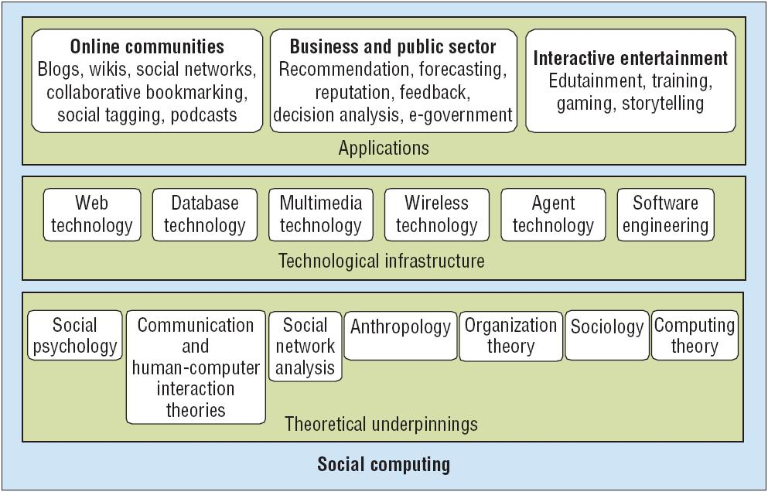
Research View of Social Computing
Wang et al (2007), IEEE intelligent systems

Slide 60
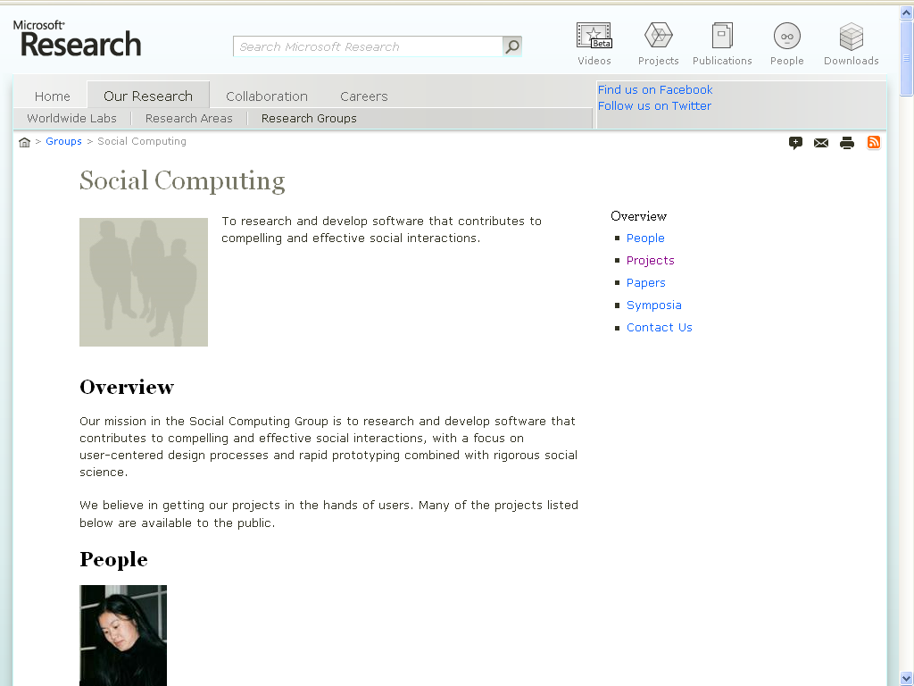

Slide 61
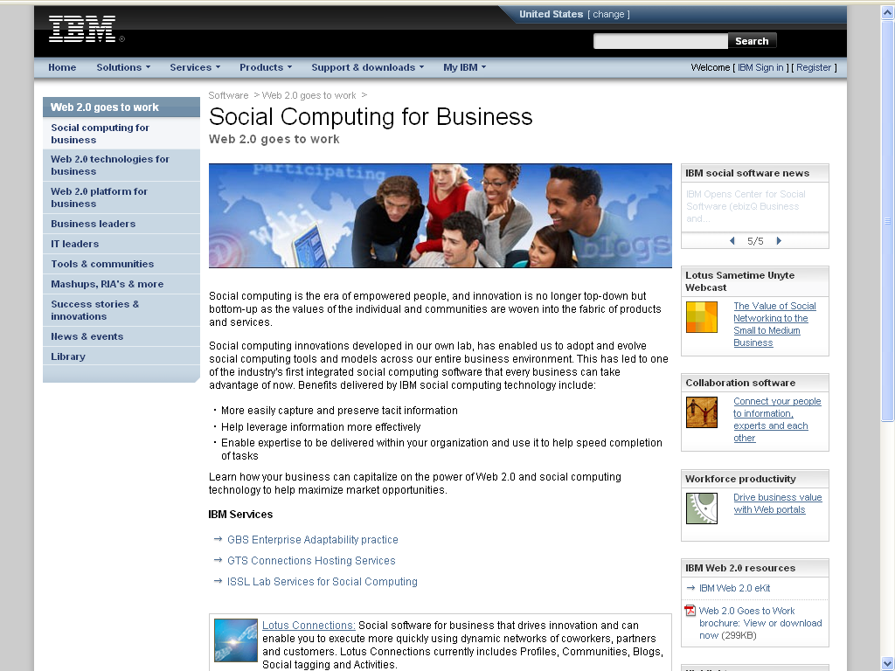

Slide 62
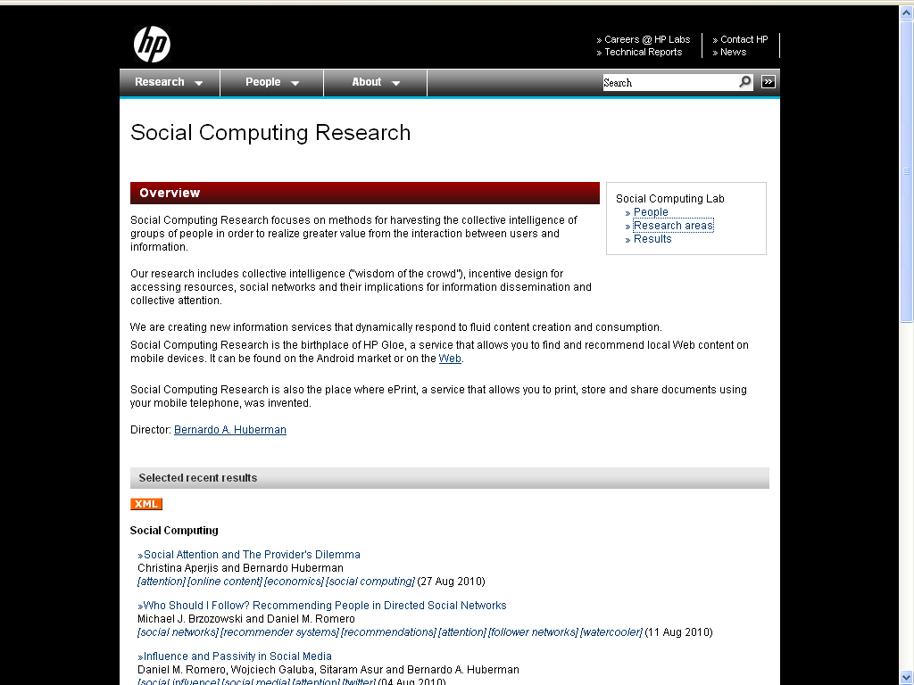

Slide 63
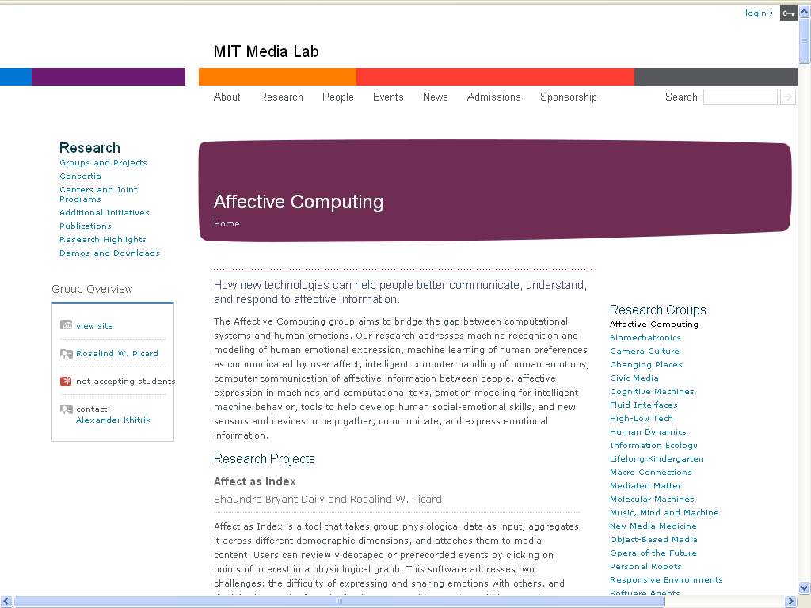

Slide 64
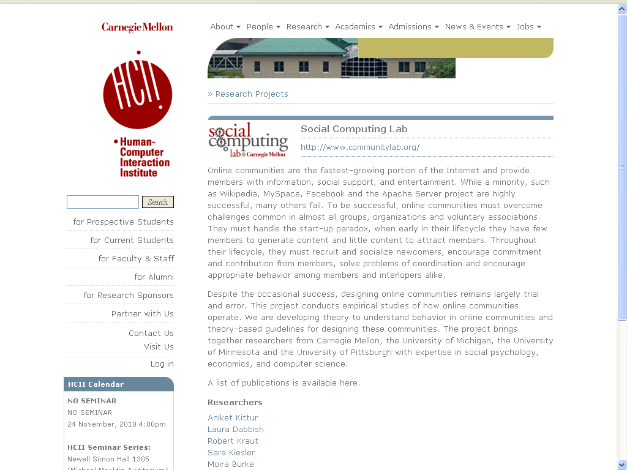

Slide 65
