Slide 1
Social Media, Social Networks and Social Economy

Slide 2
Outline
1. The Web 2.0 Revolution, Social Media and Industry Disruptors
2. Social economy
3, Social Computing

Slide 3
1. The Web 2.0 Revolution, Social Media and Industry Disruptors

Slide 4
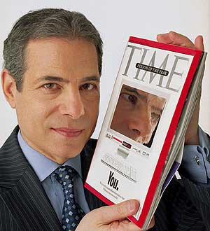
The Web 2.0 Revolution
The emergence of Web’s digital democracy
  Time Magazine 2006 Person of the year: “You”
  Ordinary and regular people like you & I now control , use and are immersed in the information age
  Web 2.0 has become the framework for bring together the contributions of millions of people for information sharing, and aggregation of the wisdom of individuals
From Web 1.0 to Web 2.0
  Web 1.0 was organized around page, software, technology, and corporation
  Web 2.0 is organized around ordinary people and services
  The creator of the Web, Tim Berners Lee regards Web 2.0 as “a movement that encompasses a range of technologies such as blogs , wikis , and podcasts─representing the Web adolescence.”

Slide 5
What is in Web 2.0?
The popular term for advanced Internet technology and applications including : blogs, wikis ,RSS , and social network
Greater collaboration among Internet users , content providers and enterprises
Key Web 2.0 blogging statistics as of April 2007
  Over 75 million blogs exist online and about 120,000 new blogs are being added per day
  From 3000 to 7000 new splogs (fake or spam blogs) are created per day
  At least 1.5 million comments are posted in blogs every day (17 posts per second)
  Japanese is the #1 blogging language(37%), English second at 33% and Chinese third at 8%

Slide 6
Representative characteristics of Web 2.0
The following are representative characteristics
  The ability to tap into the collective intelligence of users (the more users contribute, the more popular and valuable)
  Making data available in new or never-intended ways (remixed or mashed up)
  Uses user-generated and user-controlled content and data
  The presence of lightweight programming techniques and tools that lets nearly anyone act as a developer
  Networks as platforms, delivering and allowing users to use applications entirely through a browser/app
  The virtual elimination of software-upgrade cycles makes every things a perpetual beta

Slide 7
Representative characteristics of Web 2.0
The following are representative characteristics
  An architecture of participation and digital democracy encourages users to add value to the application when they use it
  New business models are rapidly and continuously being created
  Major emphasis is on social network
  Rich interactive, user-friendly interface based on AJAX or similar framework is often use

Slide 8
Representative characteristics of Generative AI / LLM
– The ability to generate new and original content from user prompts
– The ability to understand and respond to natural language in a human-like manner
– The ability to generate, transform, summarize, and translate content across different formats
– The ability to maintain context and engage in multi-turn conversations
– The ability to generate different types of content, including text, images, audio, video, and code

Slide 9
Representative characteristics of Generative AI / LLM
The following are representative characteristics
– The ability to perform a wide range of tasks through a single general-purpose model
– The ability to adapt its output to different users, contexts, instructions, and styles
–The ability to create and transform content across a wide range of domains, such as writing, analysis, reporting, programming, and creative work
– The ability to interact with external tools, applications, and data sources to perform tasks
– The ability to support human creativity, knowledge work, and decision-making through human-AI collaboration

Slide 10
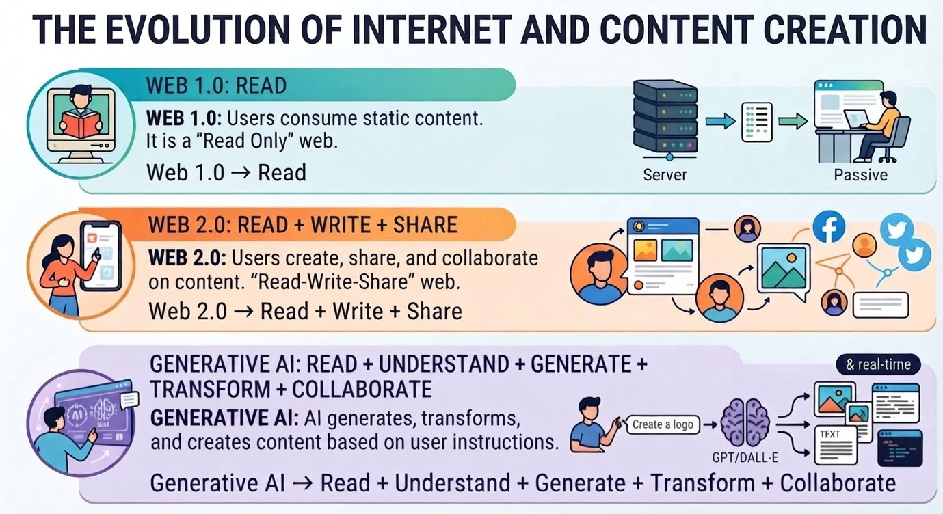

Slide 11
Social media
Definition: online platforms and tools that people use to share opinions and experiences including photos , videos , music , insights and perceptions with each other
The is that people, rather than the organization, control and use then media
People can use these media with ease at little or no cost
Powerful democratization force : the network structure enables communication and collaboration on a massive scale.

Slide 12
The Shift to Social Media
Innovation is moving from a top-down to bottom-up model
Value is shifting from ownership to experiences
Power is moving from institutions to communities
                -Dion Hinchcliffe

Slide 13
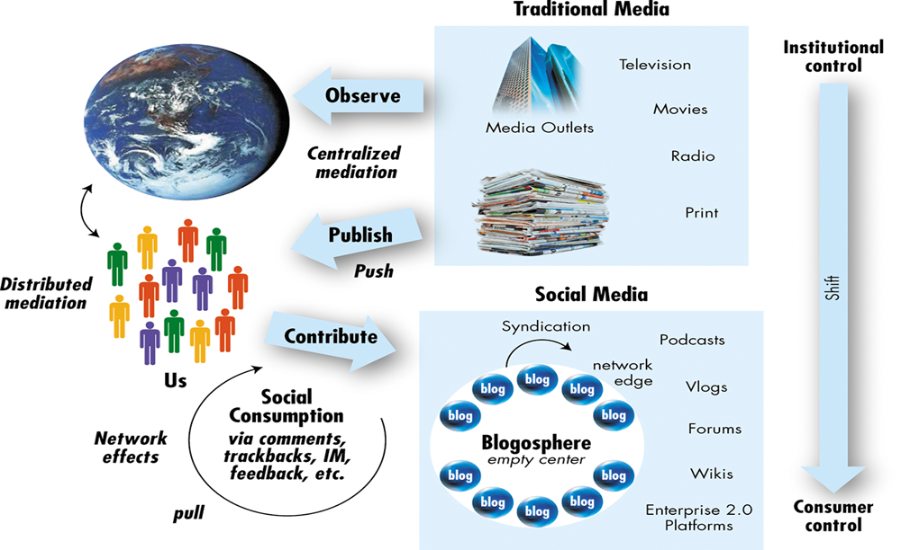
Social media
(Hinchcliffe, 2006)

Slide 14
Social media vs. Traditional media
From traditional media
  News papers, TV programs, Static web content
To social media
  New paradigm of message/news propagation
  Disseminate information through social interactions (definition quoted from wikipedia)
  Blog, Twitter, facebook, digg, plurk, tumblr, flickr…

Slide 15
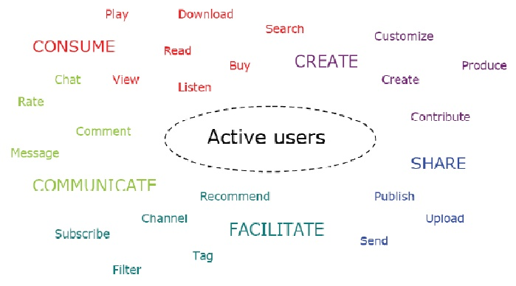
Users Role in Social Media

Slide 16
Social interactions
Social networking
  Make friends, follow
Blog: Comment, Trackback (URL citation)
Video, photos: Embed
Social Bookmarking
Groups/communities
  Fans group of stars, politicians, athletes
  Communities for specific topics
Information sharing
  Retweet, Replurk,
All of above leads to more and stronger “Relations”
  Social network analysis comes to help
Notes:
retweet, replurk 就是把其他人講的話再講一次，也就是往下傳一層
16

Slide 17
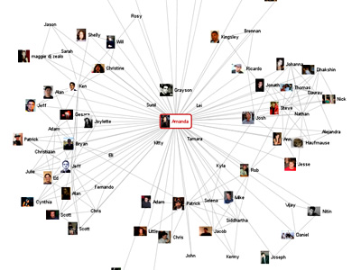
Social networks
A social structure made of individuals (or organizations) called "nodes," which are tied (connected) by one or more specific types of relation (quoted from wikipedia)
Applications
  Information Diffusion
  Viral Marketing
  Expert Finding
Source: www.visualcomplexity.com

Slide 18
2. Social Economy

Slide 19
Social Marketplaces
Social marketplace
  Derived from the combination of social networking and marketplaces
  Harnessing the power of one’s social networks for introducing, buying, and selling of products, services, and resources
  E.g.
    Online classifieds, search sorted by friends, contacts, or geographic proximity (Windows Live Expo)
    Books, music, movies trading (Flipsy)
    Social investing (E-toro)
    P2P lending (Lending club)

Slide 20
Social economy, Sharing economy and P2P economy
`
`
Social economy
Digital economy
Sharing economy
Platform economy
P2P economy

Slide 21
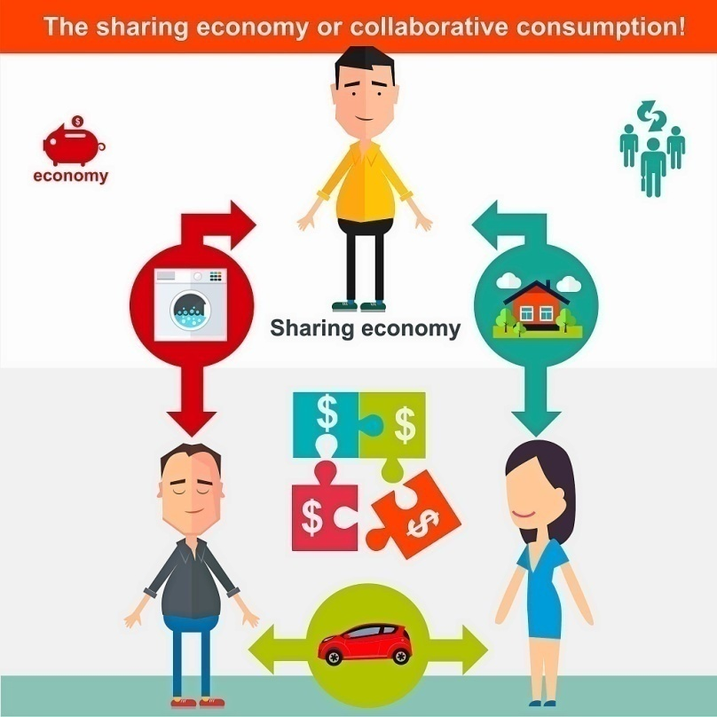
Sharing Economy
Owner: Idle resource sharing
User: Rent, not buy

Slide 22
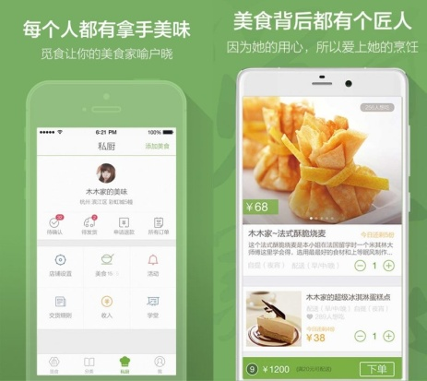


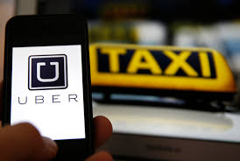
Sharing Economy
覓食、領廚
Air Closet
Air bnb
Uber

Slide 23
3. Social Computing

Slide 24
What is Social Computing ?
Social computing refers to the intersection of social behavior and computational systems
A set of open, web-based and user-friendly applications that enable users to network, share data, collaborate and co-produce content`

Slide 25
What is Social Computing ?
Traditional computing systems concentrate on supporting organizational activities and business process, and zero in on cost reduction and increase of speed
  Top-down management and communication
Social computing concentrates on improving collaboration and interaction among people
  Bottom-up strategy where individuals in communities with their activities become a major organizational power
  People can collaborate online, get device from one another and from trusted experts, and finds goods and services they really like

Slide 26
Social Media VS. Social Computing
Social media is best understood as a group of new kinds of online media for disseminating information through social interactions
Social computing is often defined as modeling complex human interactions that are expressed on a variety of social media

Slide 27
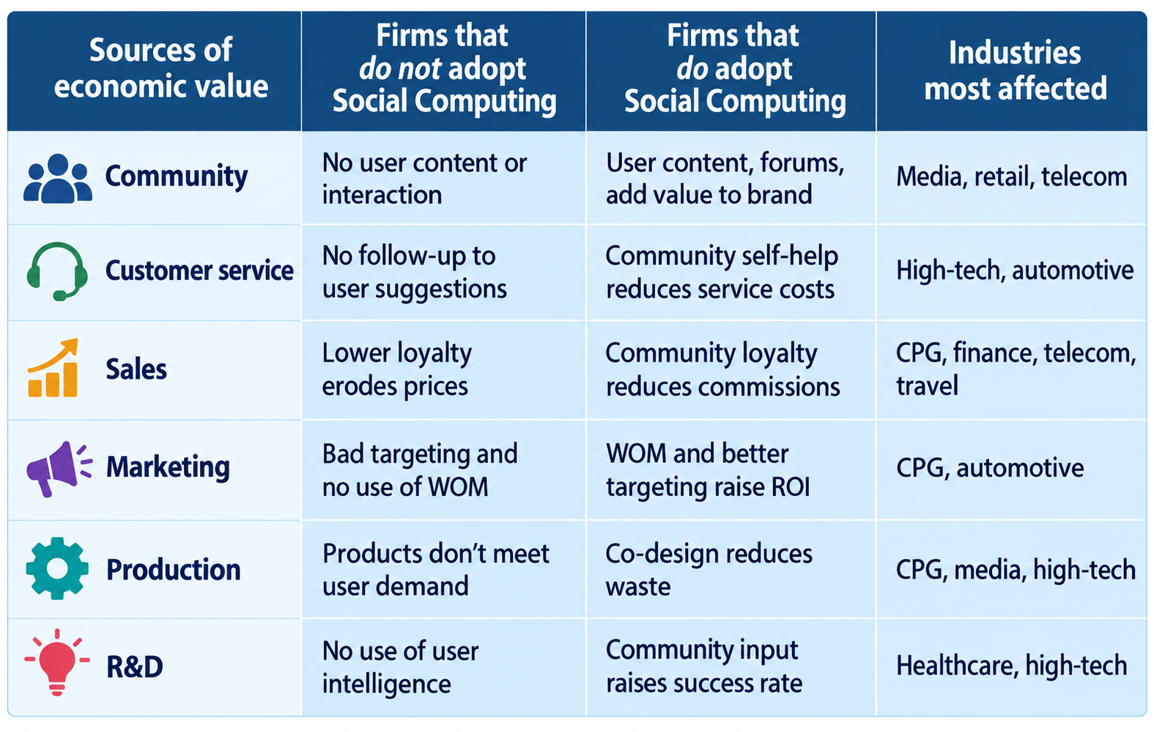
Economic Value of Social Computing
according to Forrester (2007)

Slide 28
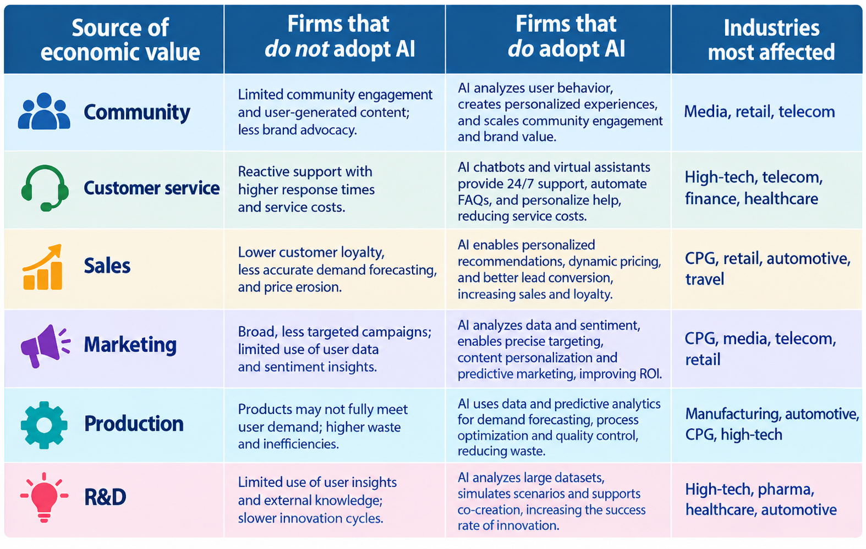

Slide 29
Disciplines of Social Computing
Social computing is a multi-disciplinary research program that focuses on human, cultural, and behavioral aspects.
It brings together experts from various disciplines like: anthropology, cognitive science, computer science, economics, linguistics, mathematics, neuroscience, political science, psychology, sociology, statistics, and theology.

Slide 30
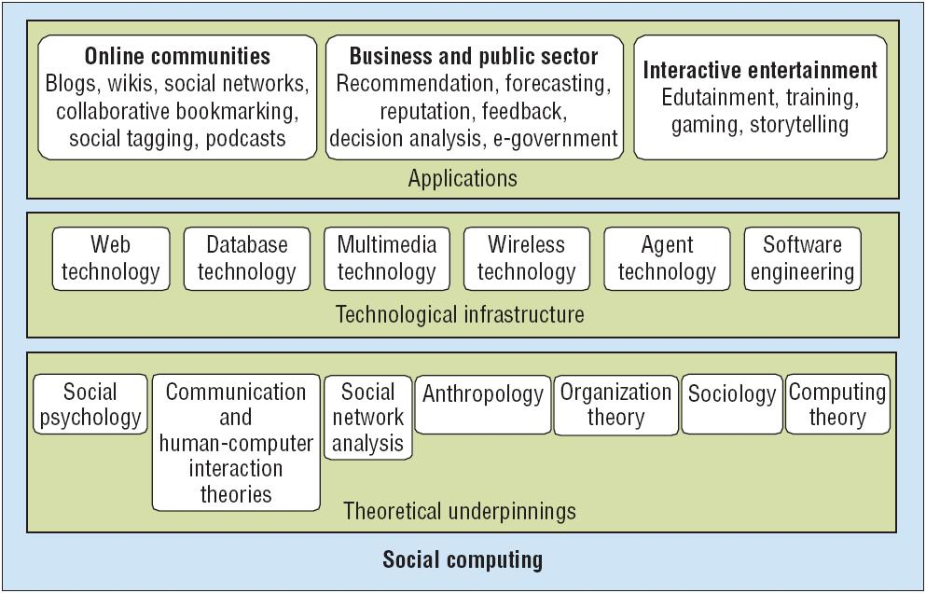
Research View of Social Computing
Wang et al (2007), IEEE intelligent systems

