Slide 1
Voting

Slide 2
23.1 Voting for Group Decision
Like markets, voting systems also serve to aggregate information across a group.
But there are definite distinctions:
  Voting is used in situations where a group is trying to reach a single decision. (ex: legislation, a jury vote,…)
  The overt goal of the market is to enable transactions, rather than any broader synthesis or group decision.
  Voting is no natural way to average the preferences of individuals.
  The choices in a market are often numerical.

Slide 3
23.1 Voting for Group Decision
The notion of voting encompasses a broad class of methods which methods have effects both on the process and the result for reaching a group decision.
Voting can be used in choosing a single winner or producing a ranked list.

Slide 4
23.1 Voting for Group Decision
Voting is often used in situations where the voters disagree because of genuine divergence in their subjective evaluations. (ex: ranking the greatest movies)
  Because of differing aesthetic evaluations.
  The difficulty is a lack of information.
Recently voting have been adopted in a number of on-line applications. (ex: product ranking, recommendation systems…)

Slide 5
23.2 Individual Preference
The goal of a voting system can be describe as follows.
  A group of people is evaluating a finite set of possible alternatives.
  The people wish to produce a single group ranking that reflect the collective opinion from best to worst.
To begin with, if individual prefers alternative to alternative , then we write .

Slide 6
23.2 Completeness and Transitivity
We require that individual preferences satisfy two properties.
Each person’s preference are complete:
  For each pair of distinct alternatives and , either she prefers to , or she prefers to , but not both.
Each individual’s preferences be transitive:
  If an individual prefers to and to , then should also prefer to .

Slide 7
23.2 Individual Rankings
This fact lets us construct the ranked list we want.
  defeats all other alternatives, we can safely put it at the front of the ranked list.
  Removing from the set of alternatives.
  Repeating the same process on the remaining alternatives.
  The preferences defined by are still complete and transitive on the remaining alternatives.
  Continuing in this way until we exhaust the finite set of alternatives.

Slide 8
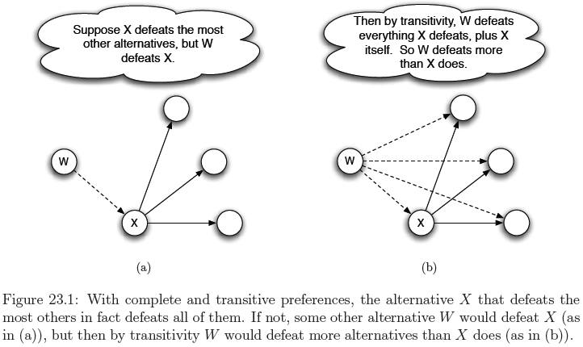
23.2 Individual Rankings
Justify our construction of the ranked list.

Slide 9
23.3 Voting Systems: Majority Rule
We can now describe a voting system (also called an aggregation procedure) as follow.
  It’s any method that takes a collection of complete and transitive individual preference relations and produces a group ranking.

Slide 10
23.3 Majority Rule and the Condorcet Paradox
Under majority rule, we take the alternative that is preferred by a majority of the voters and rank it first.
For this discussion we will assume that the number of voters is odd.
Firstly we create group preferences and then turn it into a group ranking.
  Counting the number of individuals for whom and the number of individuals for whom .
  If the first number is larger than the second, then we say that the group preference satisfies .

Slide 11
23.3 Majority Rule and the Condorcet Paradox
The surprising difficulty is that the group preferences may not be transitive, even when each individual’s preferences are transitive.
  Individual 1’s ranking is
  Individual 2’s ranking is
  Individual 3’s ranking is
  Majority-rule: we’d have (both 1 and 3), (both 1 and 2), and (both 2 and 3).
  This violates transitivity.

Slide 12
23.3 Majority Rule and the Condorcet Paradox
The possibility of non-transitive group preferences arising from transitive individual preferences is called the Condorcet Paradox.
The Condorcet Paradox has also been used to show how a single person can naturally be led to form non-transitive individual preferences.

Slide 13

23.3 Majority Rule and the Condorcet Paradox
The student was planning to decide between pairs of colleges by three criteria.
  On ranking and scholarship
  On ranking and class size
  On scholarship and class size
Each criterion is like a voter, and the student’s individual preference relation is the group preference relation.

Slide 14
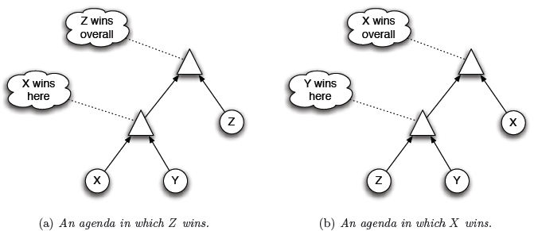
23.3 Pathologies in Voting Systems based on Majority Rule.
The Condorcet Paradox, however, can be used to uncover an important pathology that such voting systems exhibit:
  Their outcomes are susceptible to a kind of strategic agenda-setting.

Slide 15
23.3 Pathologies in Voting Systems based on Majority Rule.
The problem of agenda-setting has an analogue in the context of such individual decisions as well.
Ex: college-choice
  if the acceptances arrive in the order X, Y, Z.

Slide 16
23.4 Voting Systems: Positional Voting
A different class of voting systems tries to produce a group ranking directly from the individual rankings, rather than pairwise comparisons of alternatives.
  Each alternative receives a certain weight based on its positions in all the individual rankings.
  The alternatives are then ordered according to their total weight.
  A simple example of such a system is the Borda Count.

Slide 17
23.4 Voting Systems: Positional Voting
Suppose there are four alternatives, named A, B, C, and D, and there are two voters with the individual rankings.
  and
  The weight assigned by the Borda Count to alternative A is 3 + 1 = 4, B is 5, C is 3, D is 0.
  Sorting the weights in descending order, the group ranking is
Any system of this type as a positional voting system.

Slide 18
23.4 Pathologies in Positional Voting Systems
Borda Count always produces a complete, transitive ranking for a set of alternatives.
Most of the problems with the Borda Count, and with positional voting systems:
  Competition for top spots can depend critically on the rankings of alternatives that are further down in the list.

Slide 19
23.4 Pathologies in Positional Voting Systems
Suppose that asking five film critics to discuss their choice for the greatest movie. The two movies are Citizen Kane, and The Godfather.
  Critics 1, 2, 3 favor Citizen Kane, critics 4, 5 favor The Godfather
At the last minute, Pulp Fiction is added as a third option.
  Critics 1 to 3
  Critics 4, 5
Applying the Borda Count

Slide 20
23.4 Pathologies in Positional Voting Systems
Citizen Kane is favored by a vote of three to two before.
But a third alternative was introduced, the identity of the group favorite has changed.
So what we find is that the outcome in the Borda Count can depend on the presence of alternatives that intuitively seem “irrelevant” that act as “spoilers" in shifting the outcome.

Slide 21
23.4 Pathologies in Positional Voting Systems
The problem of Borda Coun is strategic misreporting of preferences.
  Suppose that critics 4 and 5 actually had the true ranking
Applying the Borda Count
Voters in the Borda Count can sometimes benefit by lying about their true preferences, so as to downgrade the overall group ranking of an alternative.

Slide 22
23.4 Examples from U.S. Presidential Elections
With only two candidates, plurality voting is the same as majority rule.
But with more than two candidates, one sees recurring “third-party” effects.
Where an alternative that is the favorite of very few people can potentially shift the outcome from one of the two leading contenders to the other.
This causes some voters to make their choices strategically, misreporting their top-ranked choice.

Slide 23
23.5 Arrow's Impossibility Theorem
Is there any voting system that produces a group ranking for more alternatives, and avoids all of the pathologies we've seen thus far?
A reasonable voting system satisfy:
  in the rankings of every individual , then the group ranking should also have . (Pareto Principle, or Unanimity)
  While leaving the relative ordering of X and Y unchanged and changing others, the voting system should still produce . (Independence of Irrelevant Alternatives, IIA)

Slide 24
23.5 Voting Systems that Satisfy Unanimity and IIA
When there are three or more alternatives, it's trickier to find a voting system that satisfies these two properties.
However, a voting system that satisfies the two properties is dictatorship.
  Declaring the group ranking to be equal to the ranking provided by individual .
Arrow's Theorem: If there are at least three alternatives, then any voting system that satisfies both Unanimity and IIA must correspond to dictatorship by one individual.

Slide 25
23.6 Single-Peaked Preferences and the Median Voter Theorem
Recall that alternatives X, Y, and Z, and three voters 1, 2, and 3:
  Suppose that X, Y, and Z correspond to amounts of money to spend on education or national defense.
  X corresponding to a small amount, Y to a medium amount, and Z to a large amount.
  , , and
  Voters’ preference can be explained by a fixed number.
  There’s no “ideal” quantity in the third voter’s preferences, so it can’t be explained reasonably.

Slide 26
23.6 Single-peaked preferences
If voter 3’s ranking don’t contain this structure, the Condorcet Paradox cannot arise.
Assume that the k alternatives are named , and that voters all perceive them as being arranged in this order.
A voter has single-peaked preferences if there is no alternative for which both neighboring alternatives and are ranked above .

Slide 27
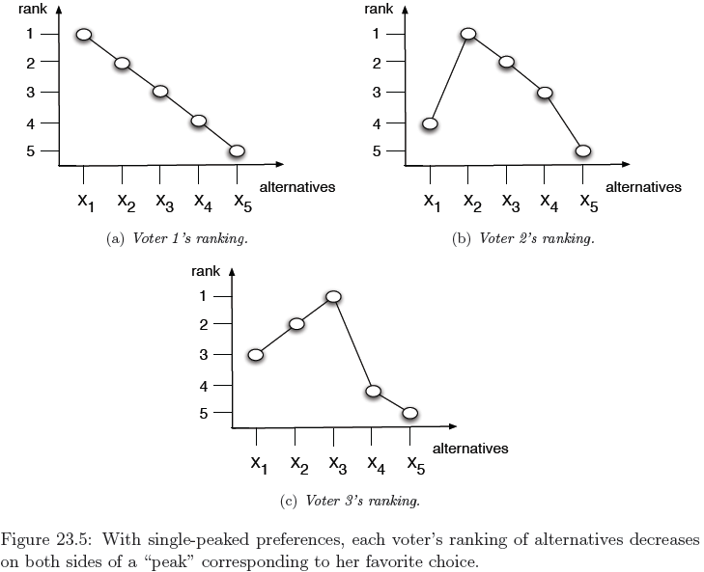
23.6 Single-peaked preferences

Slide 28
23.6 Majority Rule with Single-Peaked Preferences
The Condorcet Paradox showed that using majority rule to produce a group was in vain.
But with single-peaked preferences, original plan works perfectly.
Claim: If all individual rankings are single-peaked, then majority rule applied to all pairs of alternatives produces a group preference relation that is complete and transitive.

Slide 29
23.6 The Median Individual Favorite
The median individual favorite is a natural idea to consider as a potential group favorite, since it naturally “compromises” between more extreme individual favorites on either side.
The Median Voter Theorem: With single-peaked rankings, the median individual favorite defeats every other alternative in a pairwise majority vote.

Slide 30
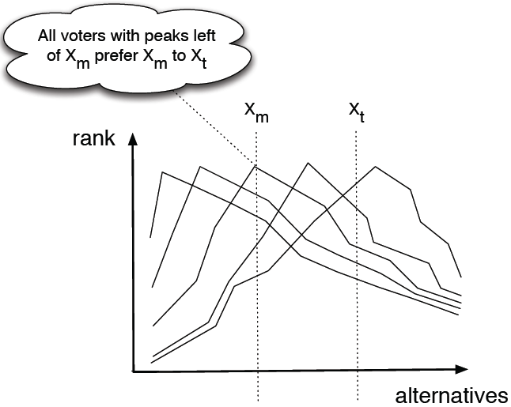
23.6 The Median Individual Favorite

Slide 31
23.6 The Median Individual Favorite
In Figure 23.5, we get three preference:
We would identify X2 as the median individual favorite.
Once we remove this alternative, we have three single-peaked rankings.
Proceeding in this way, we end up with the group ranking

Slide 32
23.7 Voting as a Form of Information Aggregation
Thus far, voting is used to aggregate fundamentally and genuinely different opinions.
But voting is also used by a group of people who have a shared goal.
This isn’t appropriate for the ranking of political candidates or work of art.
However, it’s appropriate for decisions made by a board of advisers to a company.

Slide 33
23.7 Voting as a Form of Information Aggregation
It’s reasonable to suppose that the individual rankings differ only because of different information they have and different evaluations of the information.
We then discuss what happens in situations where one or both of these assumptions do not hold.

Slide 34
23.7 Simultaneous, Sincere Voting: The Condorcet Jury Theorem
There ate two alternatives X and Y; one of these two is genuinely the best choice.
Each voter will vote for what she believes to be this best choice, and they possess different but uncertain information.
Suppose first that there is a prior probability of X (1/2) being the best choice, and voters receive an independent, private signal about which of X or Y is the best.

Slide 35
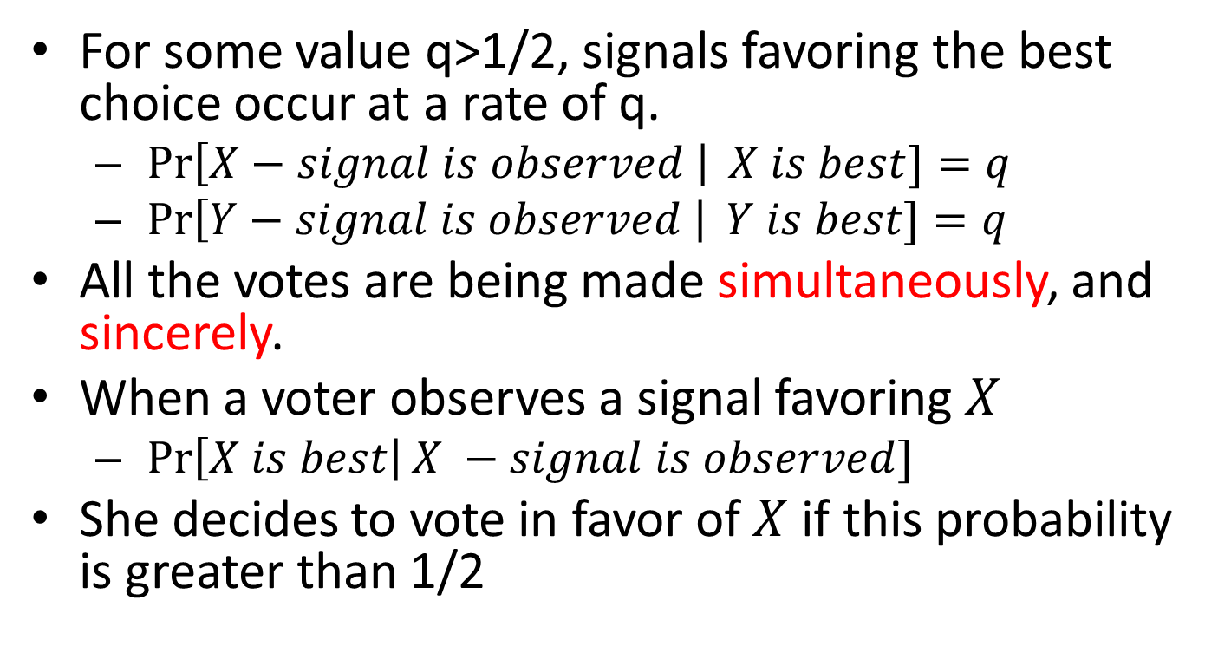
23.7 Simultaneous, Sincere Voting: The Condorcet Jury Theorem
For some value q>1/2, signals favoring the best choice occur at a rate of q.
  $\operatorname{Pr}\left[X−signal is observed \right| X is best]=q$
  $\operatorname{Pr}\left[Y−signal is observed \right| Y is best]=q$
All the votes are being made simultaneously, and sincerely.
When a voter observes a signal favoring $X$
  $\operatorname{Pr}\left[X is best\right|X −signal is observed]$
She decides to vote in favor of $X$ if this probability is greater than 1/2

Slide 36
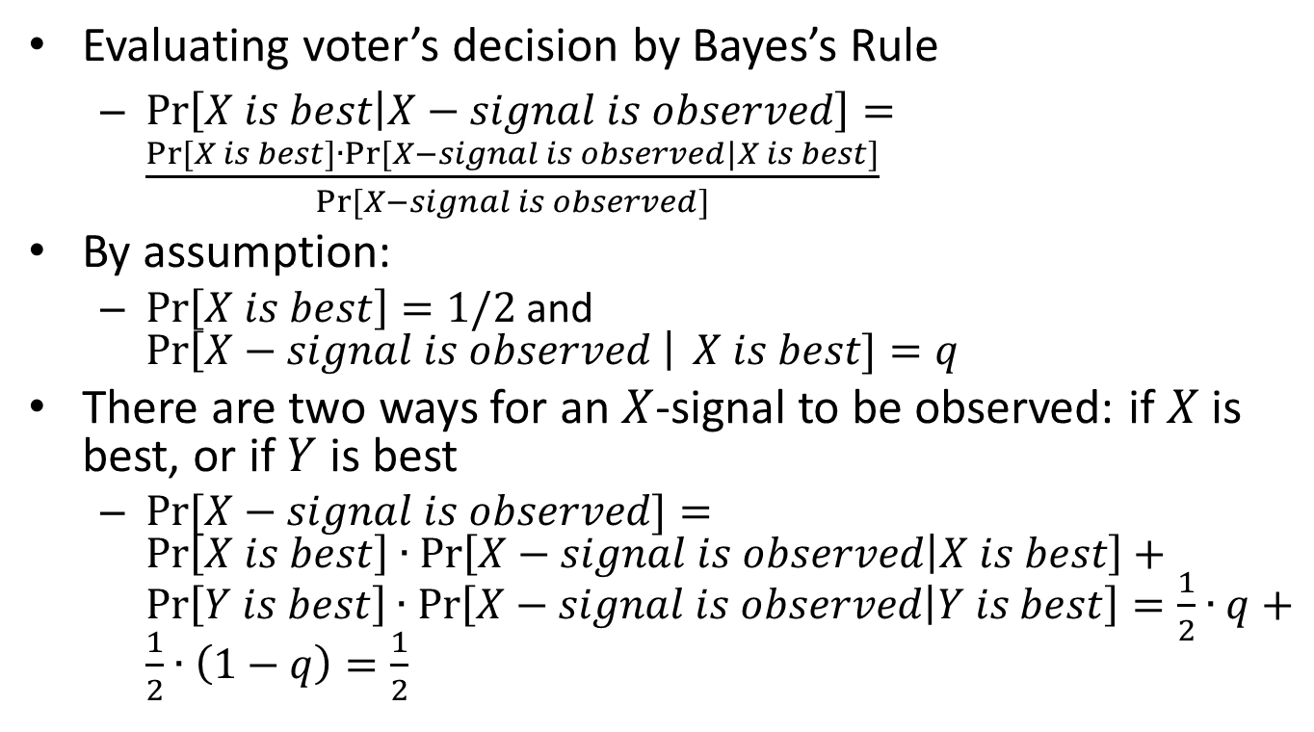
23.7 Simultaneous, Sincere Voting: The Condorcet Jury Theorem
Evaluating voter’s decision by Bayes’s Rule
  $\operatorname{Pr}\left[X is best | X−signal is observed\right]=\frac{Pr⁡[X is best]∙Pr⁡[X−signal is observed|X is best]}{Pr⁡[X−signal is observed]}$
By assumption:
  $\operatorname{Pr}\left[X is best\right]=1/2$ and $\operatorname{Pr}\left[X−signal is observed \right| X is best]=q$
There are two ways for an $X$-signal to be observed: if $X$ is best, or if $Y$ is best
  $\operatorname{Pr}{[X−signal is observed]}=$ $\operatorname{Pr}\left[X is best\right]∙\operatorname{Pr}\left[X−signal is observed | X is best\right]+\operatorname{Pr}\left[Y is best\right]∙\operatorname{Pr}\left[X−signal is observed | Y is best\right]=\frac{1}{2}∙q+\frac{1}{2}∙\left(1−q\right)=\frac{1}{2}$

Slide 37
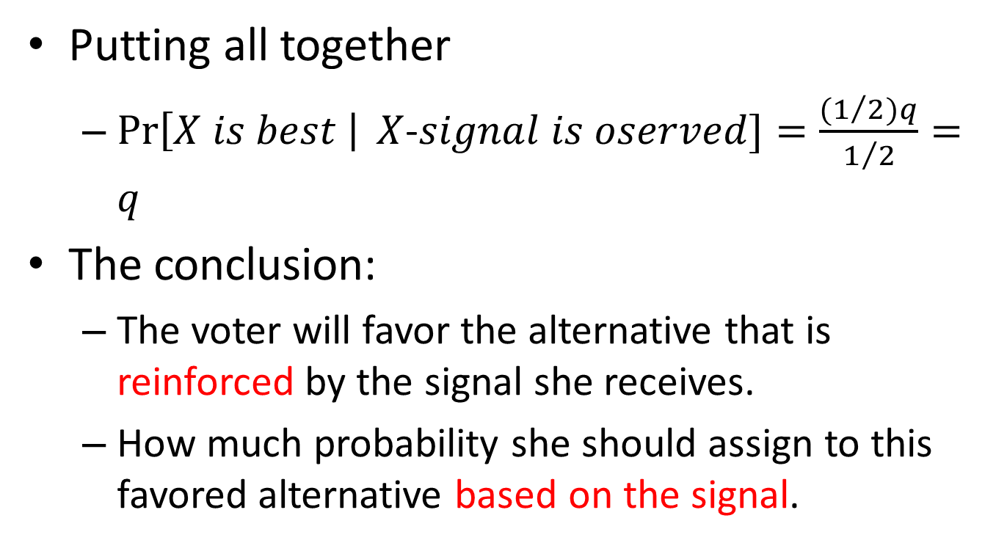
23.7 Simultaneous, Sincere Voting: The Condorcet Jury Theorem
Putting all together
  $\operatorname{Pr}\left[X is best \right| X$-$signal is oserved]=\frac{{(1}/2)q}{1/2}=q$
The conclusion:
  The voter will favor the alternative that is reinforced by the signal she receives.
  How much probability she should assign to this favored alternative based on the signal.

Slide 38
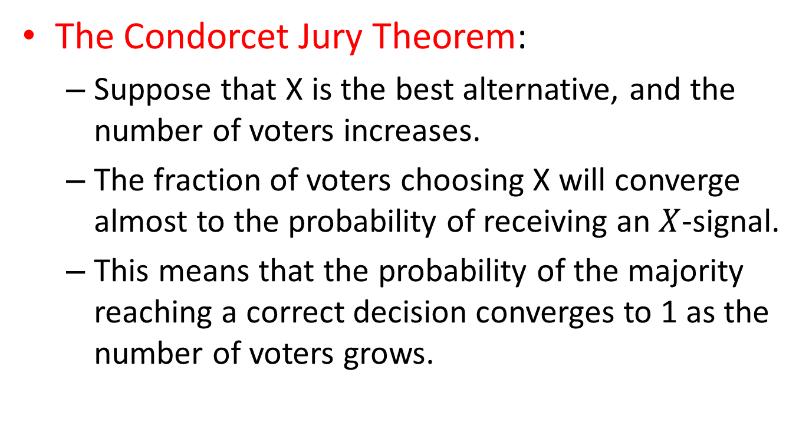
23.7 Simultaneous, Sincere Voting: The Condorcet Jury Theorem
The Condorcet Jury Theorem:
  Suppose that X is the best alternative, and the number of voters increases.
  The fraction of voters choosing X will converge almost to the probability of receiving an $X$-signal.
  This means that the probability of the majority reaching a correct decision converges to 1 as the number of voters grows.

Slide 39
23.8 Insincere Voting for Information Aggregation
One of the assumption behind the Condorcet Jury Theorem is that all individuals are voting sincerely.
In fact, however, an individual should actually choose to vote insincerely, even though her goal is to maximize the probability that the group as a whole selects the best alternative.

Slide 40
23.8 An Experiment that Encourages Insincere Voting
There are 10 marbles in the urn.
  There is 50% chance the urn contain ten white marbles (“pure”), and a 50% chance it contain nine green marbles and one white marble (“mixed”).
Asking three people to guess according to the following protocol:
  Each one is allowed to draw one marble (without showing to the other), and then replace it.
  The three are asked to vote without communication.
  If a majority of votes are for the correct type, they win.

Slide 41
23.8 Conditional Probabilities and Decisions about Voting
You vote sincerely:
  When you draw a white marble, you will guess pure by Bayes’ Rule.
  If you draw a green marble, then you will guess the urn is mixed.
“In what situations does my vote actually a
affect the outcome?“
  Whenever your vote actually matters to the outcome, the urn is mixed. (manipulating the group choice)

Slide 42
23.8 Interpretations of the Voting Experiment
It becomes natural to think of voting with a shared objective in terms of game theory.
Points worth reflecting on from this discussion:
  This phenomenon of insincere voting has the advantage of clearly exposing what's going on.
  You evaluate the consequences of your actions only in the cases where they actually affect the outcome.

Slide 43
23.9 Jury Decisions and the Unanimity Rule
Jury decisions in criminal trials were important initial example to motivate this discussion:
  A group of the jurors agree in principle that there is a “best ” decision for the group.
  The defendant should be convicted if guilty and acquitted if innocent.
Can insincere voting arise in this case, and if so, what are its consequence?

Slide 44
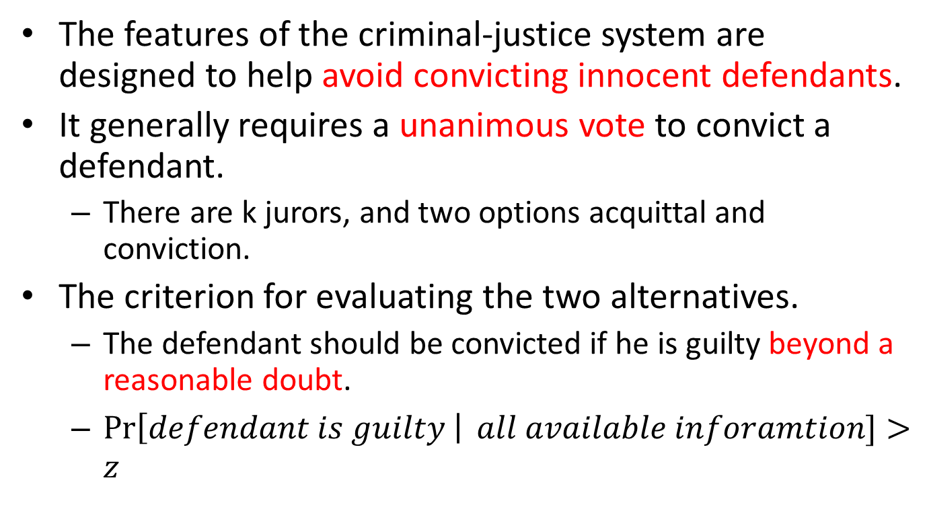
23.9 Verdicts, Unanimity, and Private Signals
The features of the criminal-justice system are designed to help avoid convicting innocent defendants.
It generally requires a unanimous vote to convict a defendant.
  There are k jurors, and two options acquittal and conviction.
The criterion for evaluating the two alternatives.
  The defendant should be convicted if he is guilty beyond a reasonable doubt.
  $\operatorname{Pr}\left[defendant is guilty \right| all available inforamtion]>z$

Slide 45
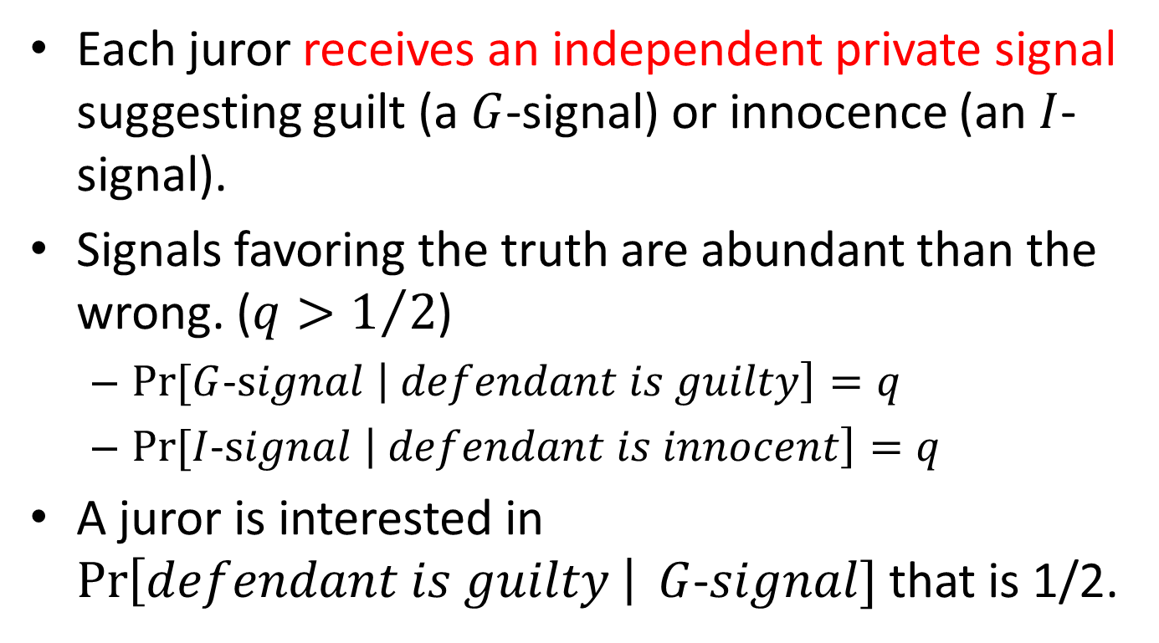
23.9 Verdicts, Unanimity, and Private Signals
Each juror receives an independent private signal suggesting guilt (a $G$-signal) or innocence (an $I$-signal).
Signals favoring the truth are abundant than the wrong. ($q>1/2$)
  $Pr⁡[G$-$signal \left| defendant is guilty\right]=q$
  $Pr⁡[I$-$signal \left| defendant is innocent\right]=q$
A juror is interested in $\operatorname{Pr}\left[defendant is guilty \right| G$-$signal]$ that is 1/2.

Slide 46
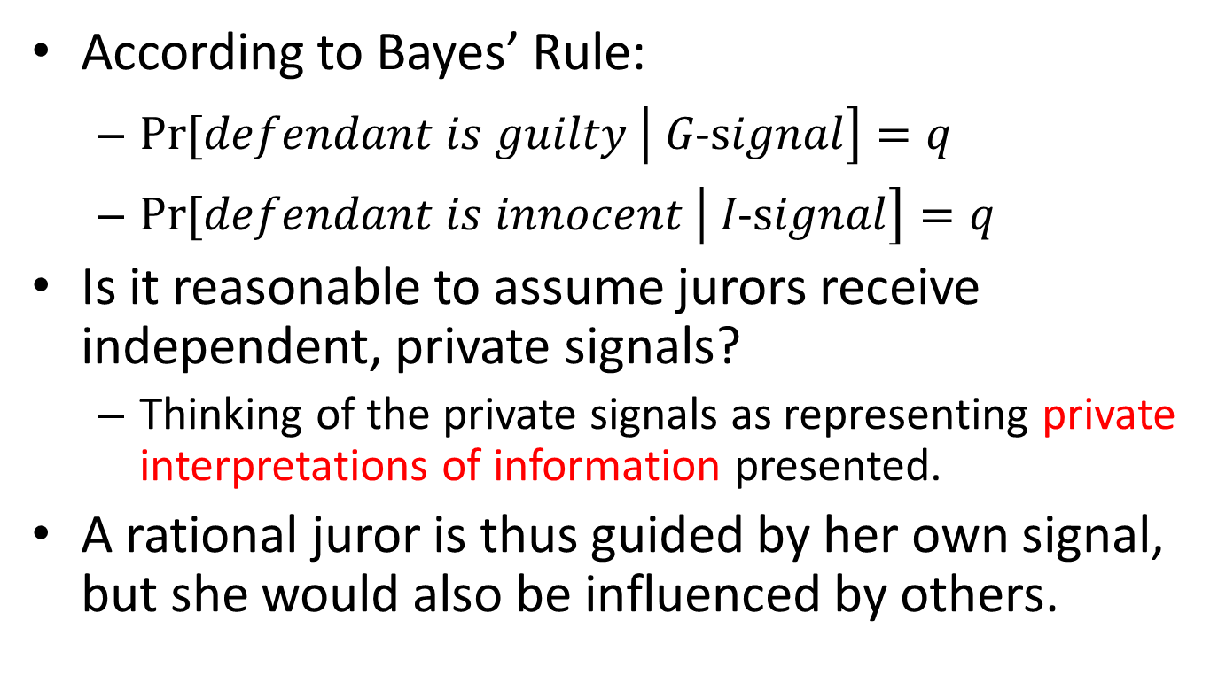
23.9 Verdicts, Unanimity, and Private Signals
According to Bayes’ Rule:
  $Pr⁡[defendant is guilty \left| G\text{−}signal\right]=q$
  $Pr⁡[defendant is innocent \left| I\text{−}signal\right]=q$
Is it reasonable to assume jurors receive independent, private signals?
  Thinking of the private signals as representing private interpretations of information presented.
A rational juror is thus guided by her own signal, but she would also be influenced by others.

Slide 47
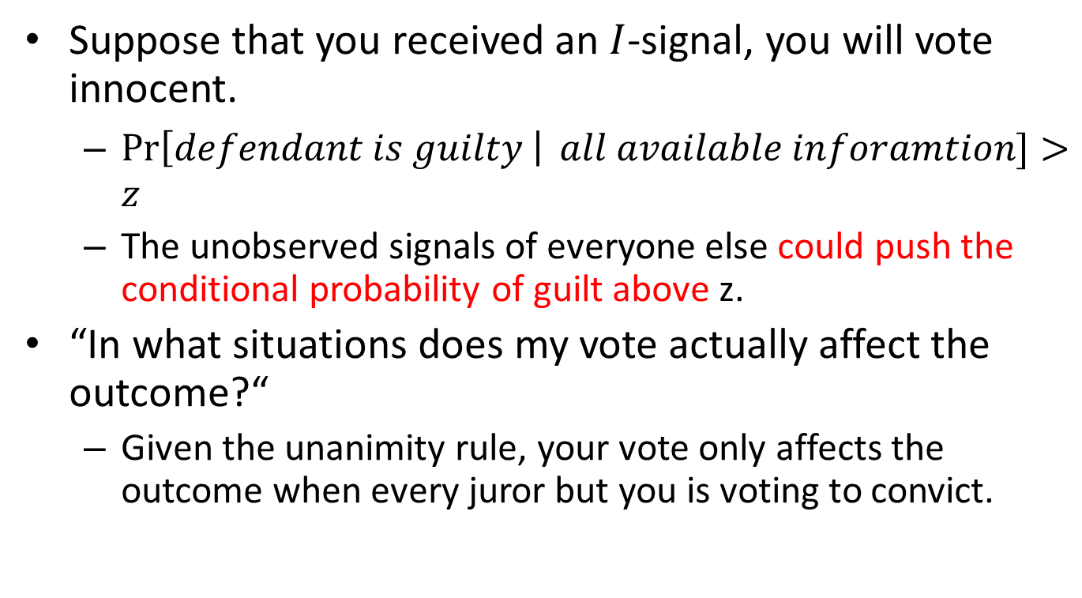
23.9 Modeling a Juror's Decision
Suppose that you received an $I$-signal, you will vote innocent.
  $\operatorname{Pr}\left[defendant is guilty \right| all available inforamtion]>z$
  The unobserved signals of everyone else could push the conditional probability of guilt above z.
“In what situations does my vote actually affect the outcome?“
  Given the unanimity rule, your vote only affects the outcome when every juror but you is voting to convict.

Slide 48
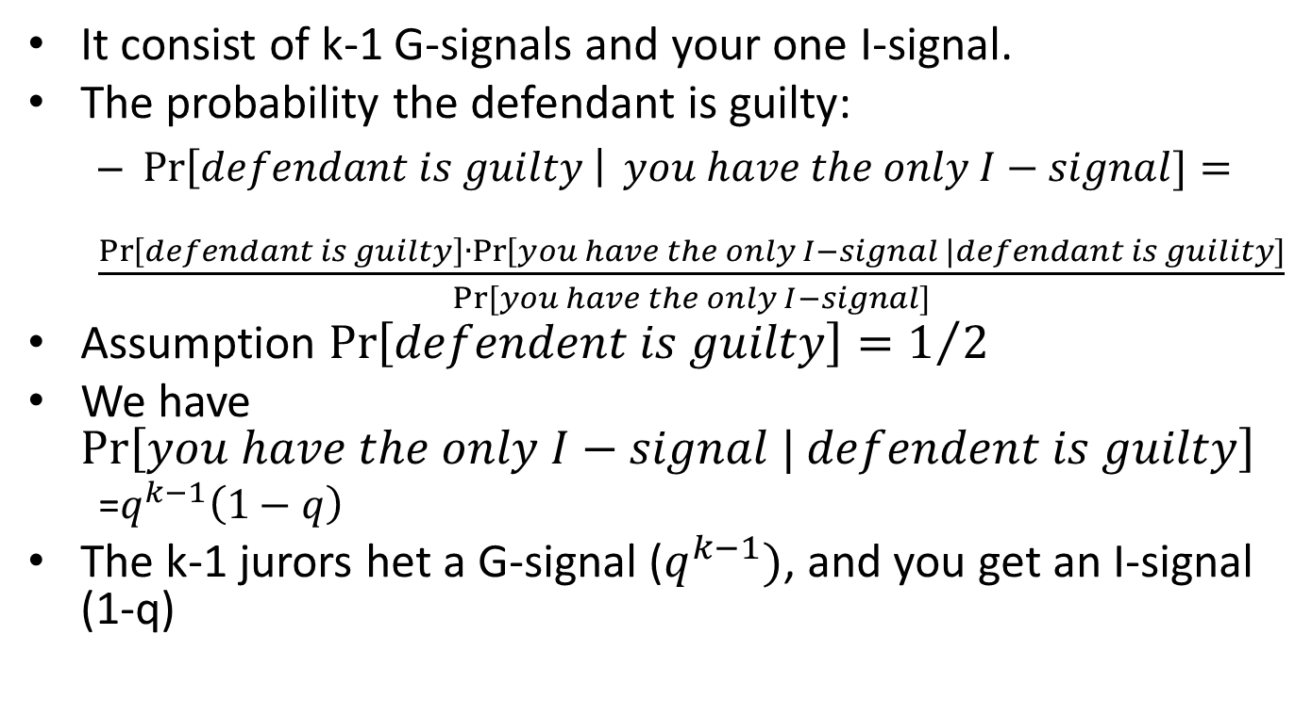
23.9 Modeling a Juror's Decision
It consist of k-1 G-signals and your one I-signal.
The probability the defendant is guilty:
  $\operatorname{Pr}\left[defendant is guilty \right| you have the only I−signal]=$
  $\frac{\operatorname{Pr}\left[defendant is guilty\right]∙\operatorname{Pr}\left[you have the only I−signal \right|defendant is guility]}{Pr⁡[you have the only I−signal]}$
Assumption $\operatorname{Pr}\left[defendent is guilty\right]=1/2$
We have $Pr\left[you have the only I−signal | defendent is guilty\right]$
  =$q^{k−1}\left(1−q\right)$
The k-1 jurors het a G-signal ($q^{k−1})$, and you get an I-signal (1-q)

Slide 49
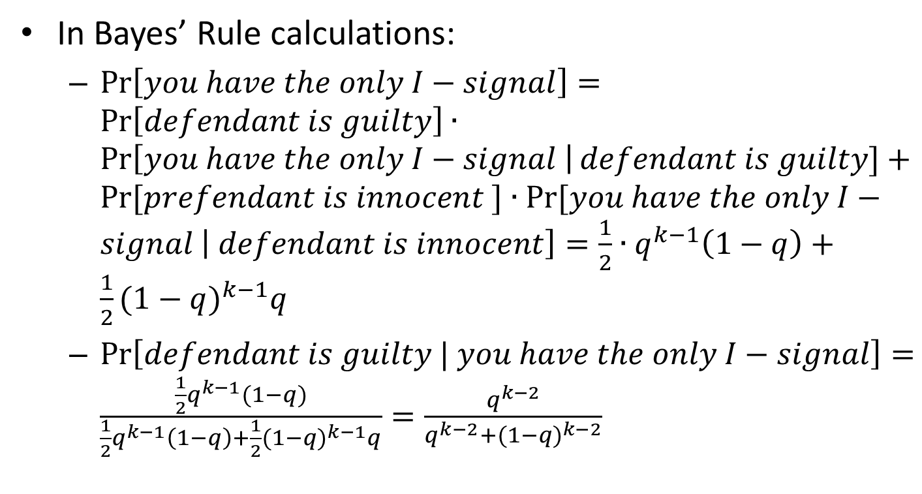
23.9 Modeling a Juror's Decision
In Bayes’ Rule calculations:
  $\operatorname{Pr}\left[you have the only I−signal\right]=\operatorname{Pr}\left[defendant is guilty\right]∙\operatorname{Pr}\left[you have the only I−signal \right|defendant is guilty]+Pr⁡[prefendant is innocent ]∙Pr⁡[you have the only I−signal \left| defendant is innocent\right]=\frac{1}{2}∙q^{k−1}\left(1−q\right)+\frac{1}{2}{(1−q)}^{k−1}q$
  $\operatorname{Pr}\left[defendant is guilty | you have the only I−signal\right]=\frac{\frac{1}{2}q^{k−1}(1−q)}{\frac{1}{2}q^{k−1}\left(1−q\right)+\frac{1}{2}{(1−q)}^{k−1}q}=\frac{q^{k−2}}{q^{k−2}+{(1−q)}^{k−2}}$

Slide 50
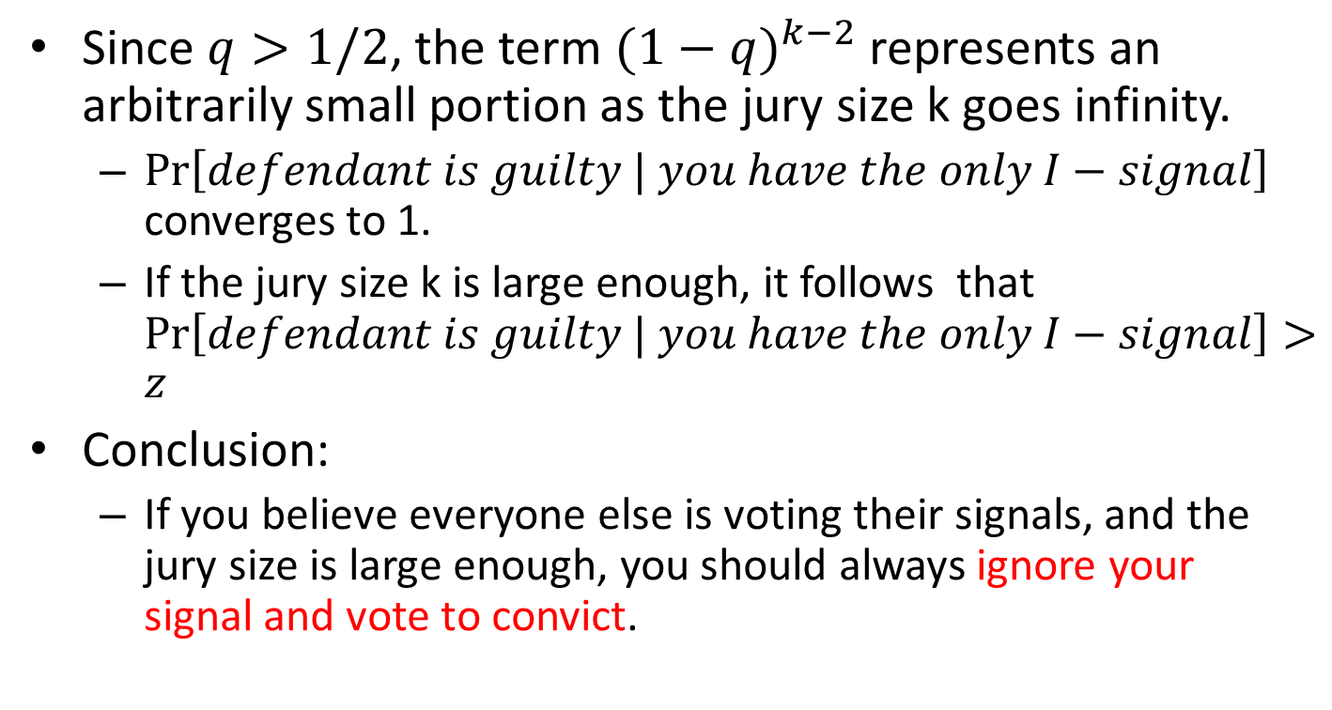
23.9 Modeling a Juror's Decision
Since $q>1/2$, the term ${(1−q)}^{k−2}$ represents an arbitrarily small portion as the jury size k goes infinity.
  $\operatorname{Pr}\left[defendant is guilty | you have the only I−signal\right]$ converges to 1.
  If the jury size k is large enough, it follows that $\operatorname{Pr}\left[defendant is guilty | you have the only I−signal\right]>z$
Conclusion:
  If you believe everyone else is voting their signals, and the jury size is large enough, you should always ignore your signal and vote to convict.

Slide 51
23.9 Equilibria for Voting under Unanimity and Other Systems
There’s an equilibrium but a bit pathological:
  If everyone decides to ignore their signals to vote to acquit, this is an equilibrium.
  No juror can affect the outcome.
A unique equilibrium with the properties:
  All jurors use the same strategy.
  Each juror's behavior actually depends on the signal she receives.

Slide 52
23.10 Sequential Voting and the Relation to Information Cascades
In the last two sections, we’ve examined what happens when we remove the assumption of sincerity.
Now, we remove the assumption of simultaneity and see what happens.
  The model is similar to information cascades.
  They are able to observe the choices of earlier voters. (Like Section 16.5)
The fact that cascades begin when one alternative leads the other by exactly two votes.
  The Condorcet Jury Theorem doesn’t apply.

Slide 53
23.11 Advanced Material: A Proof of Arrow's Impossibility Theorem
Assume that we have a set of k individuals, and each one has a ranking of alternatives.
  The collection of all k rankings is a profile.
  A voting system produces a group ranking by a profile.
  The system satisfies Unanimity and Independence of Irrelevant Alternatives (IIA)

Slide 54
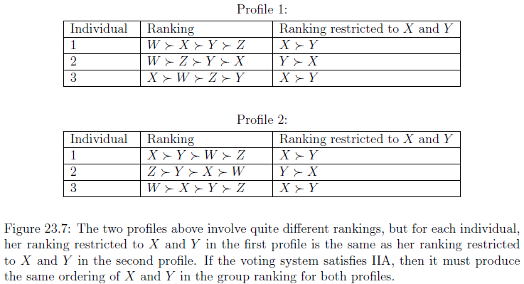
23.11 Advanced Material: A Proof of Arrow's Impossibility Theorem

Slide 55
23.11 Advanced Material: A Proof of Arrow's Impossibility Theorem
A Proof of Arrow's Theorem
  We decide to show that it in fact coincide with dictatorship by a single individual.
First step:
  If a voting system satisfies Unanimity and IIA, then it must place any polarizing alternative in either first or last place in the group ranking.
Second step:
  Identity a natural candidate for the role of dictator.
Third step:
  Proving that this individual is in fact a dictator.

Slide 56
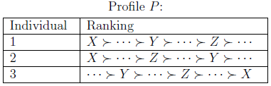
23.11 First Step: Polarizing Alternatives
Let P be a profile in which X is a polarizing alternative.
Contradiction:
  Function F doesn’t place X in either first or last in the group ranking F(P).
  F(P) produce

Slide 57
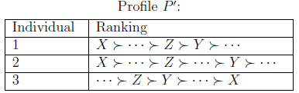
23.11 First Step: Polarizing Alternatives
Let’s change Z to the position ahead of Y.
According to IIA, F(P’) still have .
In P’, Z is head of alternative Y in every individual ranking, so we should have in F(P’)
Putting together
  ( )

Slide 58
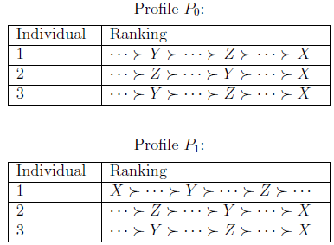
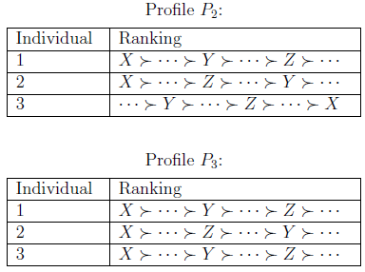

23.11 Second Step: Identifying a Potential Dictator
Starting with any profile $P_{0}$ that has X at the end of individual ranking.
Moving X from last place to first place while leaving all other parts the same.

Slide 59
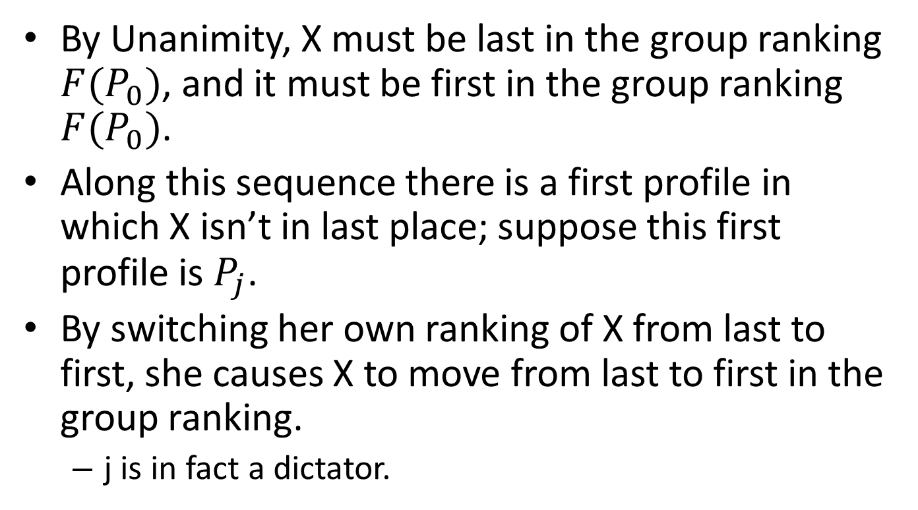
23.11 Second Step: Identifying a Potential Dictator
By Unanimity, X must be last in the group ranking ${F(P}_{0})$, and it must be first in the group ranking ${F(P}_{0})$.
Along this sequence there is a first profile in which X isn’t in last place; suppose this first profile is $P_{j}$.
By switching her own ranking of X from last to first, she causes X to move from last to first in the group ranking.
  j is in fact a dictator.

Slide 60
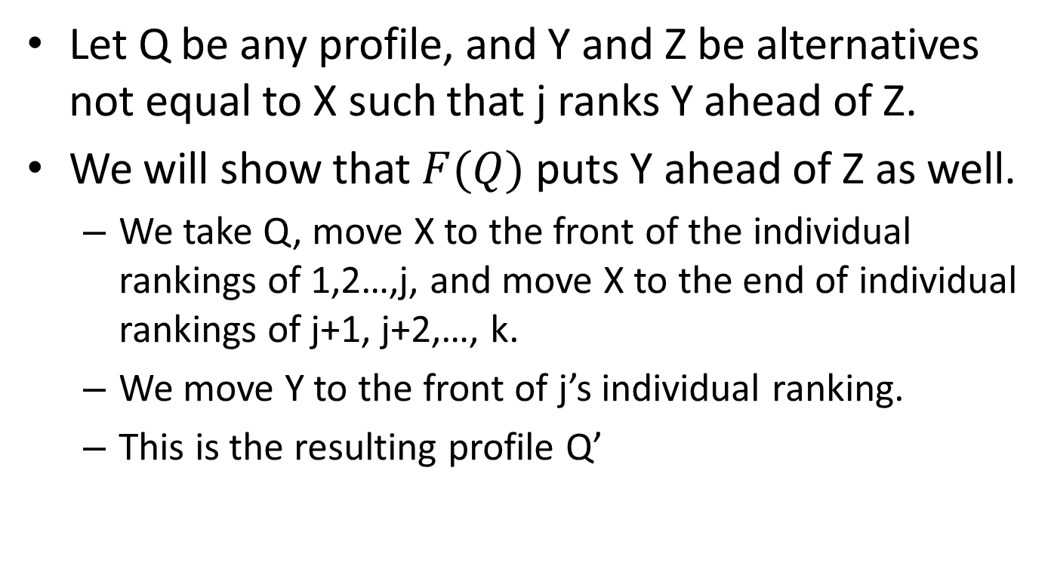
23.11 Third Step: Establishing that j is a Dictator
Let Q be any profile, and Y and Z be alternatives not equal to X such that j ranks Y ahead of Z.
We will show that $F(Q)$ puts Y ahead of Z as well.
  We take Q, move X to the front of the individual rankings of 1,2…,j, and move X to the end of individual rankings of j+1, j+2,…, k.
  We move Y to the front of j’s individual ranking.
  This is the resulting profile Q’

Slide 61
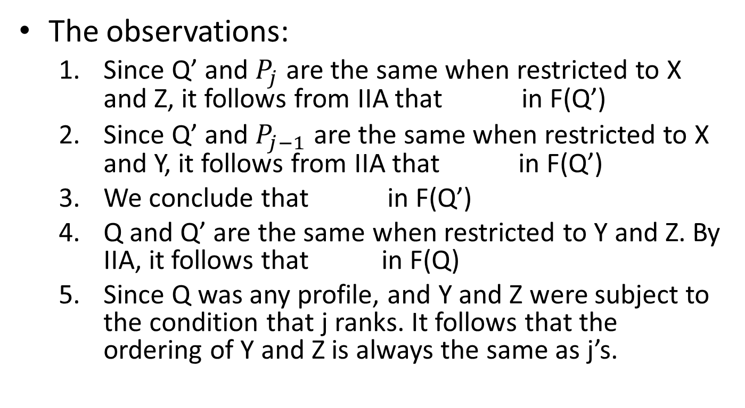
23.11 Third Step: Establishing that j is a Dictator
The observations:
  Since Q’ and $P_{j}$ are the same when restricted to X and Z, it follows from IIA that in F(Q’)
  Since Q’ and $P_{j−1}$ are the same when restricted to X and Y, it follows from IIA that in F(Q’)
  We conclude that in F(Q’)
  Q and Q’ are the same when restricted to Y and Z. By IIA, it follows that in F(Q)
  Since Q was any profile, and Y and Z were subject to the condition that j ranks. It follows that the ordering of Y and Z is always the same as j’s.

Slide 62
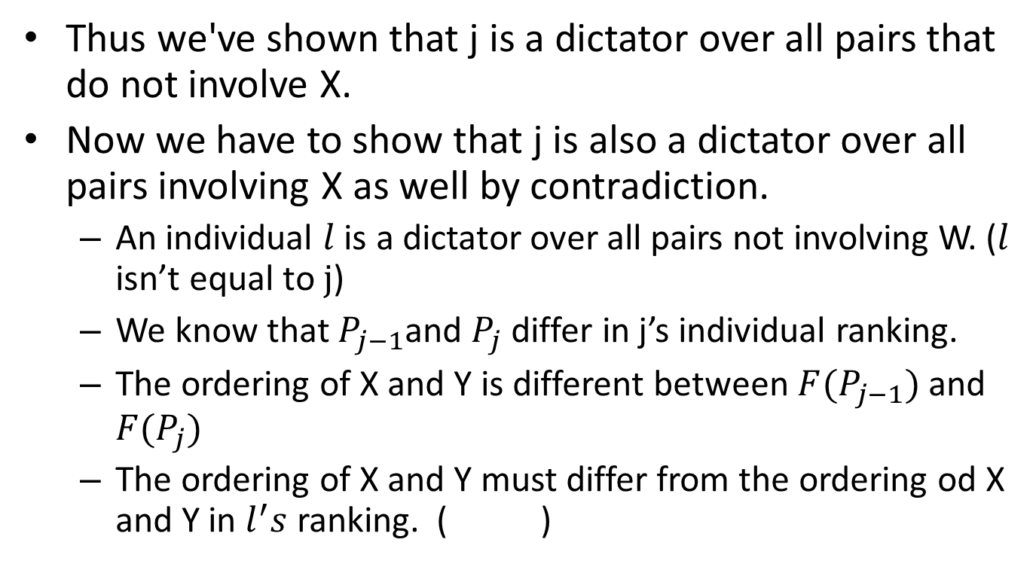
23.11 Third Step: Establishing that j is a Dictator
Thus we've shown that j is a dictator over all pairs that do not involve X.
Now we have to show that j is also a dictator over all pairs involving X as well by contradiction.
  An individual $l$ is a dictator over all pairs not involving W. ($l$ isn’t equal to $j$)
  We know that $P_{j−1}$and $P_{j}$ differ in j’s individual ranking.
  The ordering of X and Y is different between ${F(P}_{j−1})$ and ${F(P}_{j})$
  The ordering of X and Y must differ from the ordering od X and Y in $l^{′}s$ ranking. ( )

