Slide 1
CH22 Markets and Information

Slide 2
Agenda
22.1 Markets with Exogenous Events
22.2 Horse Races, Betting, and Beliefs
22.3 Aggregate Beliefs and the \Wisdom of Crowds“
22.4 Prediction Markets and Stock Markets
22.5 Markets with Endogenous Events
22.6 The Market for Lemons
22.7 Asymmetric Information in Other Markets
22.8 Signaling Quality
22.9 Quality Uncertainty On-Line: Reputation Systems and Other Mechanisms
22.10 Advanced Material: Wealth Dynamics in Markets

Slide 3
22.1 Markets with Exogenous Events

Slide 4
Basic concept
Instituion
  any set of rules, conventions ,or mechanisms that synthesizes individual behavior across a population into an overall outcome.
  Markets , voting , and property rights
Individuals expectations affect their behavior.
  Ex: Braess’s Paradox ,information cascades and network effects
Notes:
Individual’s expectations about payoffs matter for how they will choose

Slide 5
Basic concept
Exogenous desirability
  means that a given alternative is inherently a good idea or a bad idea, regardless of how the individuals make their decisions.
  Ex : information cascade
Endogenous desirability
  the desirability of an alternative depends on the actual decisions people make about it.
  Ex : Braess’s Paradox and network effect(FAX)

Slide 6
Markets with Exogenous Events
Prediction Markets
  aggregate opinions about events in settings where underlying events are exogenous-the probabilities of the events are not affected by the outcomes in the market.
  EX : Forecasting of a election(a contract that pays out if a Democrat wins in Iowa Electronic Markets)
The price separate the buyer’s and the seller’s beliefs
  their beliefs are on opposite sides of the price, and we can view the price as an average of their beliefs.

Slide 7
Markets with Exogenous Events
Betting Markets for sporting events
  such as horse races: what happens in the betting market does not affect the outcome of the sporting event
Markets for stocks
  The financial capital that the company receives for its shares of stock affects its real investment decisions and thus the future value of the stock.
Conclusion
  we can interpret the price of the asset being traded, whether it's a stock,a contract that pays out if a Democrat wins, or a betting ticket at a race-track, as a market prediction about some event.

Slide 8
22.2 Horse Races , Betting, and Beliefs
Betting on a two-horse race, suppose that
  1.Two horses : A and B, will run a race which one of them will win.
  2.A bettor has w dollars and must bet all of this money ,and r represents the fraction of his wealth on horse A ,and 1-r represents the fraction will bet on horse B.
  3. The bettor believes that horse A will win with probability a, and that horse B will win with probability b = 1-a.
Notes:
In the this section, we will examine how these markets work and we will build an understanding of the circumstances under which they do a good or bad
job of producing a useful aggregate prediction.

Slide 9
Modeling Risk and Evaluating the Utility of Wealth
The bet depends on more than the probability of A and B winning the race,it may also depend on two other factors.
  Odds, higher odds may be more attractive to bettor. And suppose that is the odds on horse A ,and is the odds on B.
  A bettor’s reaction to risk
    Risk-averse people will bet so as to have some money left no matter which horse wins, by betting some money on each horse.
    The model of the bettor’s attitude toward risk: the bettor evaluates a bet according to the expected value of the payoff on the bet.

Slide 10
Utility Function
,means bettor’s utility for wealth is exactly it’s value.
,the bettor's utility increase from gaining a dollar is precisely equal to his utility decrease from losing a dollar.
,natural logarithm of the wealth

Slide 11
Example : A Fair gamble
Suppose that a
  total wealth is w,
  a gamble in which he gains w dollars with probability ½ , and loses w dollars with probability ½.
  So
  If utility function is ,so the gambleing would be indifferent between accepting and rejecting.
  If ,so he will reject the gamble

Slide 12

Logarithmic Utility
Suppose that utility function is the natural logarithm of the wealth , ,where w>0.
Intuitive property
  the value of each additional dollar declines as wealth increases, but the value of doubling one's wealth is always the same.
  A similar argument would hold for any multiplicative increase or decrease in the bettor's wealth: the change in utility doesn't depend on the current wealth.

Slide 13
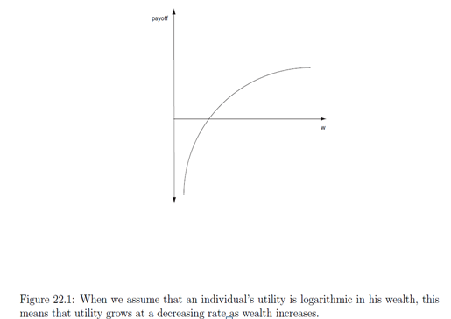
Natural logarithm of wealth

Slide 14


The Optimal Strategy : Betting Your Beliefs
The expected utility after the bet is
  =
As the third and fourth terms don’t contain r , so the bettor's maximization problem is really just to maximize the first two terms.
The derivative of the expression is , so r=a.
Conclusion
  The bettor bets his beliefs

Slide 15
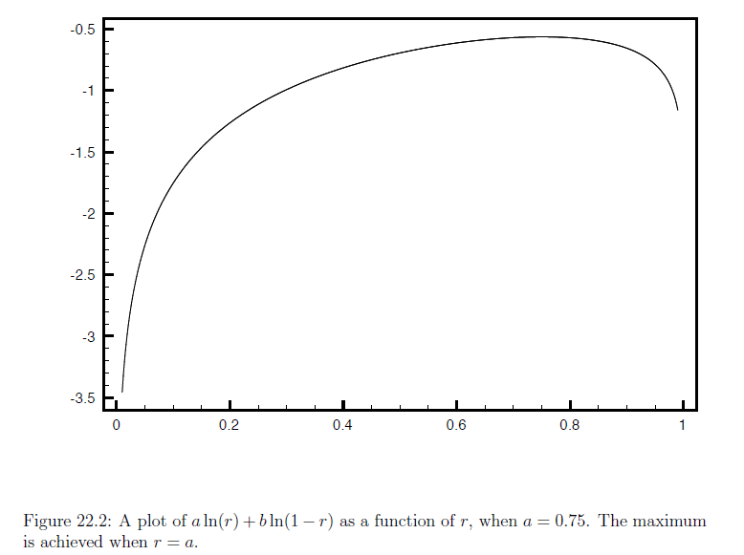

Slide 16
22.3 Aggregate Beliefs and the “Wisdom of Crowds”
System with multiple bettors
  N bettors named 1,2,3…N
  Each bettors n believes A will win in a probability of ,and thus a probability of that B will win.
  Each bettors n has wealth ,total wealth is
  So the amount that bet on A is sum
  So the amount that bet on B is sum

Slide 17
The Odds Determined by the
Race-Track
Assume that no matter which horse wins ，the race-track pays out everything .
  If A win ,the total amount owed to the bettors is sum of their winning , which is equal to
  If B win, the total amount owed to the bettors is sum of their winning , which is equal to

Slide 18
Inverse odds on horse
inverse odds on horse A
Inverse odds on horse B
for the share of total wealth held by bettor n,

Slide 19
State Price
State Price
  Price of a dollar in the event that a certain future state of the world is reached
  is state price for that horse A wins
  is state price for that horse B wins
  State price are weighted averages of the individual’s beliefs
how much influence a bettor's beliefs have on the state price depends on how much of the aggregate wealth is controlled by that bettor

Slide 20
The Relationship to the
“Wisdom of Crowds”
The crowd at the racetrack determines the odds, or the state prices, and these odds are an average of the opinions in the crowd.
The limitations of the wisdom of crowds
  First , it is important that opinion are independent.
    Non-independent opinion may lead to poor aggregate predictions
  Second , all beliefs are equally weighed.
    The more accuracy of state price depends on beliefs of these wealthy bettors are more accurate.

Slide 21
22.4 Prediction Markets and Stock Market
State prices play a key role in both markets
  Prediction Markets
    Individuals trade claims to one-dollar return conditional on the occurrence of some event
    The price reflect an wealth-share weighted averaging of the beliefs of the participants in the market
    The market price
  Stock Markets
    a share of stock in a company offers a monetary amount that will vary depending on which of possibly many states occurs.

Slide 22
State Price in the Stock Market
Suppose that
  Two companies , named 1 and 2
  Two possible state s1 (company 1 does well)and s2(company 2 does well ),and and denote the state prices for states s1 and s2.
  In state s1 , company 1 worth 2 dollars and company 2 worth 1 dollars ; In state s2, company 1 worth 1 dollars and company 2 worth 2 dollars
  v1 and v2 are the price for the stock 1 and stock 2
  State price : ,the solution is

Slide 23
22.5 Markets with Endogenous Events
Endogenous Events
  whether the events come true depends on the aggregate behavior of the individuals themselves.
  Ex: network effects and the market for lemons
  A important common theme is the notion of self-fulfilling expectations(Chapter 17)
  Asymmetric Infromation
  In many settings where buyers and sellers interact, one side of the market has better information about goods or services being traded than the other side does.
  Ex: eBay , health insurance ,stock market ,market for used car and so on.

Slide 24
22.6 The Market for Lemons
Market for Lemons
  A used car that is particularly bad is called a lemon
  By economist George Akerlof who shared the 2001 Nobel Prize in Economics.
  Clearly articulate the underlying principle and its implications for how markets work - or, in some cases, how they fail to work.

Slide 25
Suppose that
  Two types of used cars：good car and bad cars
  Each seller knows the quality of his or her own car , but buyers do not know.
  Sellers value good cars at 10 and bad car at 4 ,and buyers value good cars at 12 and a bad car at 6
  A fraction g of used cars are good cars and hence a fraction 1-g are bad cars
  There are more buyers than used car

Slide 26
The Market with Symmetric Information
  The type of each car is known to everyone
  In this case ,every car could be sold.
The Market with Asymmetric Information
  The type of each car is not known to buyers
  All car can only be traded at one price
  If the fraction of good cars in the population of used cars for sale is some number h , so the value that any buyer places on a used car is
    12h+6(1-h)=6+6h

Slide 27
Characterizing the Self-Fulfilling Expectations Equilibria
One candidate for an Equilibria equilibrium of this form is h=g – the fraction of good car in the overall used-car population
  If p*=6+6g≥10 ,or g≥2/3, then seller will seller with good car and bad car would be happy to make a sale
    So if g≥2/3 ,there is a self-fulfilling expectations equilibrium in which all cars are offered for sale
  If g<2/3,then p*<10,then owners of good cars would not be willing to sell, so they will keep them off the market – meaning that h ≠ g
    So if g<2/3,h=g is not a self-fulfilling expectations equilibrium
  If h=0 (only bad cars are sold) ,then buyers willing to pay 6.
    So h=0 is a self-fulfilling expectations equilibrium

Slide 28
Complete Market Failure
Suppose that
  Three types of used car: good , bad and lemons.
  Lemons are completely worthless to both buyers and sellers
  1/3 of the cars are good, 1/3 are bad and 1/3 are lemons
  Sellers value good cars at 10, bad cars at 4, and lemons at 0
  Buyers value good cars at 12, bad cars at 6, and lemons at 0.
  There are more buyers than there are used cars.
Three candidates for an equilibrium
  (a). All cars are offered for sale
  (b). Only bad cars and lemons are offered for sale
  (c). only lemons are offered for sale , which represents the complete failure of the market

Slide 29
(a) If all cars to be on the market, then the expected value of a car to a buyer would be
  As 6<10, so good cars would not be put on market , that means (a) is not a equilibrium.
(b) If buyers expect bad car and lemons to be on market, then the expected value would be
  As 3<4, so bad car would not be put on market, that means (b) is not a equilibrium
(c)Finally, if only lemons for sold ,the expect value is 0,and this is the buyers are willing to pay , then the market will consist completely of lemons , it is a equilibrium.

Slide 30
Summary : Ingredients of the Market for Lemons
Key features that led to market failure
  (i) The items that can be offered for sale have varying qualities.
  (ii) he buyers value the items of that quality at least as much as the sellers do - so with complete information, the market would succeed
  (iii) There is asymmetric information about the quality of the items
  (iv) Because of (iii), the items all must be sold for the same uniform price, and sellers will only put their items up for sale if they value them at or below this uniform price

Slide 31
22.7 Asymmetric Information in Other Markets
The Labor Market, the people seeking jobs is the sellers ,and the companies is the buyers , basic assumptions:
  (i)There are different qualities of workers -productive and less productive workers
  (ii)There are different kinds of jobs at dierent levels of wages
  (iii)There is asymmetric information: a person has a better sense for how productive they are
  (iv)Because of (iii), a uniform wage will be offered, and only applicants who believe this wage acceptably values their skills will take the job.

Slide 32
Equilibria in the labor Market
Suppose that
  Productive worker hired by the firm will generate $80,000 ,while each unproductive worker will generate $40,000
  Each productive and unproductive worker could also produce an income of $55,000 and $25,000 respectively by being self-employed

Slide 33
If Half the workers in the population are of each type
  The expected revenue per employee will be
  As 60,000>55,000 ,so both types of workers will be willing to accept the firm’s offers and this is an equilibrium in which all workers are hired
If the firm expects only unproductive workers on job market
  Only 40,000 per years for employee
  At this wage , only unproductive workers will accept jobs.
  If only ¼ of workers are productive and ¾ are unproductive
  The expected revenue per employee will be
  As 50,000<55,000,the productive worker wouldn’t accept the firm’s offers. So there is no equilibrium- they have been driven out of the market by high frequency of unproductive workers

Slide 34
The Market for Insurance
Ingredients of the market
  individuals in a given risk category can be more or less costly to insure, but the insurance company cannot reliably make these fine-grained distinctions.
  it is the buyers of health insurance, rather than the sellers, who have the additional information.
  For any risk category, the insurance company has to essentially charge a uniform price for the insurance
  the healthiest individuals in the group are being charged a price that is greater than the expected cost of providing care for them, and so they may be unwilling to buy insurance. So the average quality in the pool goes down ,the insurance must set higher price , which at last no one will buy insurance

Slide 35
22.8 Signaling Quality
A kind of certification mechanism
  a way for a seller to provide a signal about the quality of the good that he or she is offering for sale.
  The overall warranties might be crucial for breaking down information asymmetries
Signaling in the Used-car Market
  Offer a guarantee that a given car is a “certified used car”
  Offer a warranty promising that if the car needs to be repaired after the sale.
Signaling in the labor Market
  Education

Slide 36
22.9 Quality Uncertainty On-Line:
Reputation Systems and Other Mechanisms
Reputation System
  Serve as a signal of seller quality
  Can reduce some of information asymmetries inherent in the site
Challenges in creating a reputation system
  The reputational consequences of bad behavior can be mitigated on-line if there is an easy way to “start over” by simply registering a new identity on the site
  The seller can obtain identities with high reputation scores despite no genuine history of good behavior.
Notes:
Many of the standard mechanisms used in web sites for on-line commerce are in fact motivated by considerations of asymmetric information and signaling

Slide 37
Ad Quality in Keyword-Based Advertising
Ad quality
  Not just a proxy for the estimated rate of clicks the ad will get
  But based on a broader estimate of overall user satisfaction with the ad
  An unappealing ad based on a high bid could end up clogging the top slot on the page, generating very little revenue for the search engine because almost no one clicks on it.
  the ranking of an ad should not be based purely on the bid offered by the advertiser, but also on an estimate of the true click through rates

Slide 38
Advanced Material : Wealth Dynamics in Markets
Markets impose a kind of “natural selection” favoring traders whose decisions are closest to optimal
  People with more accurate beliefs will do better in the market
  The wealth shifts toward them which increase their wealth share
  Their overall effect on the aggregate market price would increase which produce more accurate market price.

Slide 39
Bayesian Learning in a Market
Beginning with a set of N possible hypotheses for the probabilities of horse A wins and horse B wins , which we will denote by
Let be the prior probability on hypothesis ,and assume that is greater than zero
Initial predicted probability of A winning is
Suppose that T races are run ,and we observe a sequence S of outcome of these races, in which horse A wins a total of k times and horse B wins a total times

Slide 40
The posterior posterior probability of the hypothesis ,conditional on the sequence S ,as follow
After this sequence S of observed outcome , the learner’s predicted probability on horse A is
The learner is Bayesian: as he observes outcome , he updates his predicted probability to Bayes ’ Rule.

Slide 41
Convergence to the Correct Hypothesis
Suppose that ,the ratios that compare the correct hypothesis to alternate hypothesis ：
  Log odds ratio
  Divide both by total number of observations T,

Slide 42
When T goes infinity
  As is maximized when x=a ，
    So
    So Each
    So the probability on hypothesis is converging to one while the probability one each of the others is converging to zero.

Slide 43
Convergence without a Correct Hypothesis
If ,but the hypothesis is closer than other
  Realtive entropy
  So
  So we can draw same conclusion as before: that the posterior probability the learner places on converges to one

Slide 44
Wealth Dynamic
Suppose that
  start wealth share bettors m and n is and
  If horse A wins the ratio of the wealth share of m and n changes from to
  If horse B wins the ratio of the wealth share of m and n changes from to
So after a sequence of races S in which A win k times and B wins L times ,then we end up with a ratio of wealth share that’s equal to

Slide 45
Conclusion
The wealth shares of the bettors evolve exactly like the posterior probabilities on hypotheses under Bayes' Rule
if there is a unique bettor whose beliefs are closest in relative entropy to the correct probabilities (a,b), then in the limit the wealth share of this bettor will converge to 1.

