Slide 1
Chapter 15
Sponsored Search Markets

Slide 2
15.1 Advertising Tied to Search Behavior
Web search
  It seeks to take the content people produce on the Web and ﬁnd the pages that are most relevant, useful, or authoritative for any given query.
  Become lucrative: combining search with advertising
Early Web advertising
  Be sold on the basis of Impressions
  Missing one of the main beneﬁts of the Internet
  Inefficient for specialized product (e.g. calligraphy pens)

Slide 3
Search engine queries
  A potent way to get users to express their intent
  Catch a user at precisely this receptive moment
Keyword-based advertising
  Originally pioneered by the company Overture
  Successful way for search engines to make money
  Nice blend of ideas came up in earlier chapters
    It creates markets out of the Information-seeking behavior of hundreds of millions of people traversing the Web
    CH9: Auctions
    CH10: Matching markets

Slide 4
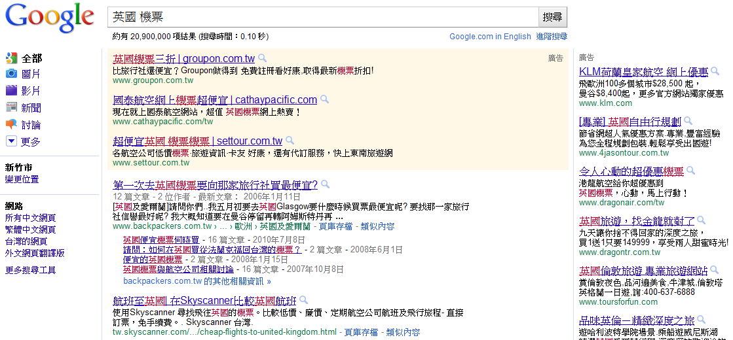
Keyword-based ads show up on search engine results pages alongside the unpaid (“organic” or “algorithmic”) results.
  The slots higher up on the page are more expensive,
  since users click on these at a higher rate.
Query
Paid results (2)
More expensive!
Paid results (1)
Algorithmic
results

Slide 5
Paying per click
Clicking on an ad represents an even stronger indication of intent than simply issuing a query
  A user who issued the query, read the ad, and visit the site
  As a result, the amount that advertisers are willing to pay per click is often surprisingly high
  advertisers are still interested in potential customers even if their query contains a small but frequent typo
  The cost per click can be very high:
  due to advertiser’s estimate expected value for every user who clicks through such an ad to its site
    “loan consolidation” or “mortgage reﬁnancing”

Slide 6
Setting prices through an auction
Post prices is inappropriate
  many possible keywords and combinations of keywords
  each appealing to a small number of potential advertisers
  It’s difficult to maintain reasonable prices for each query
Auction procedure
  single slot: single-item auction (CH9 sealed-bid second-price auction)
  multiple slots: some are more valuable than others

Slide 7
Setting prices through an auction
Stages of auction design
  if the search engine knew all the advertisers’ valuations for clicks: matching market (CH10)
  If the advertisers’ valuations are not known
    - encourage truthful bidding
    - deal with the consequences of untruthful bidding
    design a price-setting procedure for matching markets in which truthful bidding is a dominant strategy for the buyers
    Vickrey-Clarke-Groves (VCG) mechanism
  The auction procedure in practice:
    Generalized Second-Price Auction (GSP)
    - simple description but leads to complex bidding behaviors

Slide 8
Outlines
15.1 Advertising Tied to Search Behavior
15.2 Advertising as a Matching Market
15.3 Encouraging Truthful Bidding in Matching Markets:
The VCG Principle
15.4 Analyzing the VCG Procedure:
Truth-Telling as a Dominant Strategy
15.5 The Generalized Second Price Auction
15.6 Equilibria of the Generalized Second Price Auction
15.7 Ad Quality
15.8 Complex Queries and Interactions Among Keywords
15.9 Advanced Material:
VCG Prices and the Market Clearing Property

Slide 9
15.2 Advertising as a Matching Market
Search engine’s side:
  The slots are the inventory that it is trying to sell
  Click-through rate: the number of clicks per hour that an ad placed in that slot will receive
Assumptions
  advertisers know the click-through rates
    advertisers have a number of means for estimating it
  the click-through rate depends only on the slot itself
    Problematic: a relevant, high-quality ad in a high slot will receive more clicks than an oﬀ-topic ad (15.7+15.8)
  doesn’t depend on the ads that are in other slots
    more complex issue and still not well understood

Slide 10
Advertisers’ side
  Revenue per click: the expected amount of revenue it receives per user who clicks on the ad
Assumptions
  this value is intrinsic to the advertiser
  does not depend on what was being shown on the page when the user clicked on the ad

Slide 11
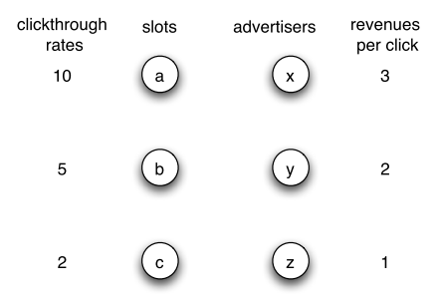
Basic set-up of a search engine’s market for advertising

Slide 12
Constructing a Matching Market
Review of Matching Market (CH10)
  The participants in a matching market consist of a set of buyers and a set of sellers.
  Each buyer j has a valuation for the item oﬀered by each seller i. This valuation can depend on the identities of both the buyer and the seller, and we denote it v_{ij} .
  The goal is to match up buyers with sellers, in such a way that no buyer purchases two diﬀerent items, and the same item isn’t sold to two diﬀerent buyers.
Notations
  r_{i} to denote the click-through rate of slot i
  v_{j} to denote the revenue per click of advertiser j
  v_{ij=} r_{i} v_{j}

Slide 13
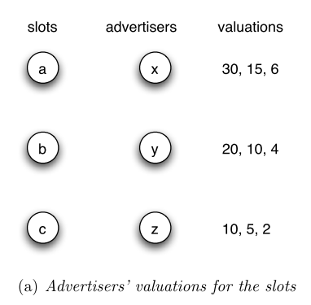
  v_{ij=} r_{i} v_{j}
a , b , c
Notice:
Matching markets in CH10: the same number of sellers and buyers
Different sellers and buyers: ﬁctitious slots (with 0 click-through rate)

Slide 14
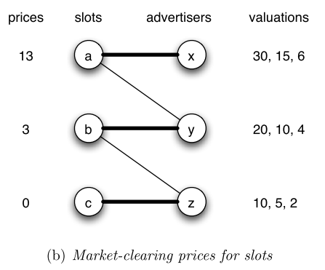
Obtaining Market-Clearing Prices
market-clearing prices (CH10)
  a set of prices charged by the sellers is market-clearing if, with these prices, each buyer prefers a diﬀerent slot
Payoff
= valuation - price
17, 12, 6
7, 7, 4
-3, 2, 2
The prices are market-clearing if
this graph has a perfect matching

Slide 15
15.3 Encouraging Truthful Bidding in
Matching Markets: The VCG Principle
Early search industry: ﬁrst-price auction
  advertisers were simply asked to report their revenues per click in the form of bids, and then they were assigned slots in decreasing order of these bids
  Bids were shaded downward, below their true values
  → huge resource expenditure (Price experimentations)
Single-item auction
  Second-price auction: truthful bidding is a dominant
Multiple slots
  The VCG Principle
  A massive generalization of the second-price auction

Slide 16
The VCG Principle
Vickrey-Clarke-Groves (VCG) principle
  Generalization: view the second-price auction in a somewhat less obvious way
  The second-price auction produces an allocation that maximizes social welfare
  The winner of the auction is charged an amount equal to the “harm” he causes the other bidders by receiving the item

Slide 17
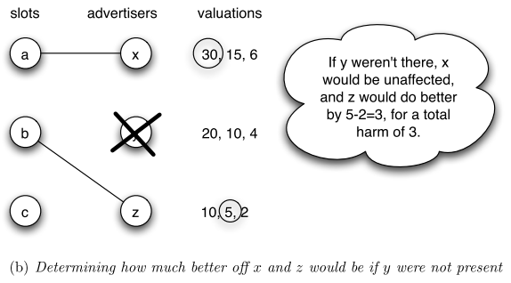
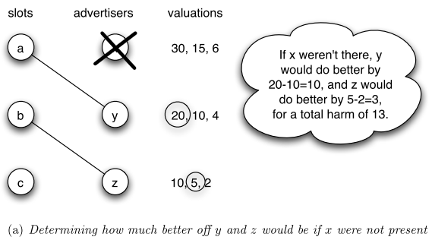
Applying the VCG Principle to Matching Markets
X

Slide 18
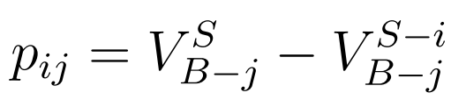
Notations
  S: the set of sellers
  B: the set of buyers.
  V_{B}^{S} : the maximum total valuation over all possibleperfect matchings of sellers and buyers
  S-i: the set of sellers with seller i removed
  B-j: the set of buyers with buyer j removed
  The VCG price:

Slide 19
The VCG Price-Setting Procedure
there is a single price-setting authority (auctioneer)
procedure
  Ask buyers to announce valuations for the items. (These announcements need not be truthful.)
  Choose a socially optimal assignment of items to buyers — that is, a perfect matching that maximizes the total valuation of each buyer for what they get. This assignment is based on the announced valuations (since that’s all we have access to.)
  Charge each buyer the appropriate VCG price:
  if buyer j receives item i under the optimal matching, then charge buyer j a price p_{ij}.

Slide 20
Observations
Diﬀerence between VCG &market-clearing prices
  Personalized prices VS Posted prices
  sealed-bid second-price auction VS ascending auction

Slide 21
15.4 Analyzing the VCG Procedure:
Truth-Telling as a Dominant Strategy
Claim of the VCG procedure
  If items are assigned and prices computed according to the VCG procedure, then truthfully announcing valuations is a dominant strategy for each buyer.
  And the resulting assignment maximizes the total valuation of any perfect matching of slots and advertisers.
  2. can be proved by 1.

Slide 22


Suppose that buyer j announces her valuations truthfully: payoﬀ is v_{ij} − p_{ij}
If buyer j decides to lie about her valuations
gets item h instead of item j: payoff is v_{hj} − p_{hj}
To show that there is no incentive to lie and receive item h instead of i, we need to show that
➔

Slide 23
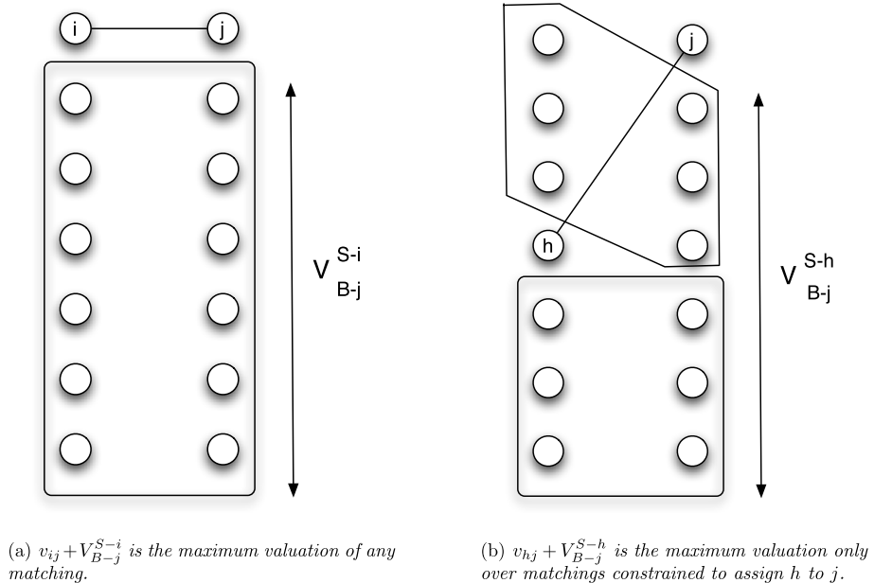

Slide 24
15.5 The Generalized Second Price Auction
Finding and achieving an assignment of advertisers to slots that maximizes the total valuation obtained by advertisers isn’t the aim of search engine company but revenue.
Generalized Second Price auction (GSP)
  doesn’t retain the nice properties of the second-price auction and VCG
  Single slot: equivalent to the second-price auction
  Multiple slots: cumulative price of slot i is r_{i} b_{i+1}
  while bids per click are b₁, b₂, b₃, . . . (in descending order)

Slide 25
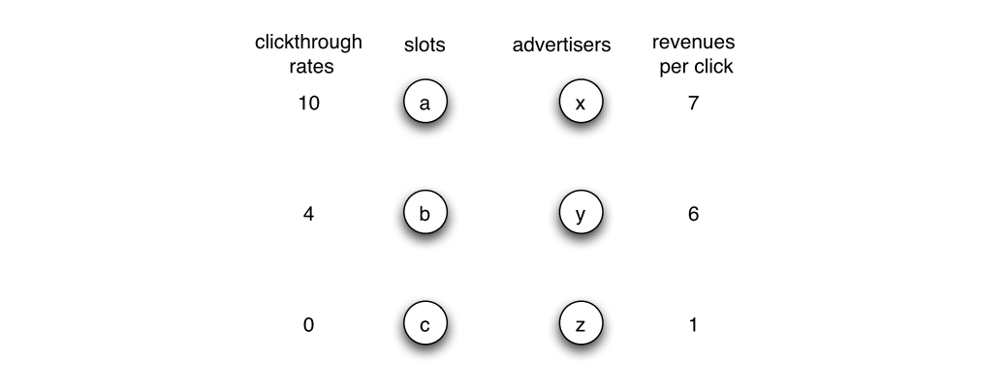
Flaws of GSP
  truth-telling might not constitute a Nash equilibrium *
  some of these may produce assignments of advertisers to slots that do not maximize total advertiser valuation
However
  there is always at least one Nash equilibrium set of bids for GSP, and that among the (possibly multiple) equilibria
  there is always one that does maximize total advertiser valuation.
If X tell truth
price: 10*6 = 60
payoff: 70-60 = 10
If x lower the bid to 5
price: 4*1=4
payoff: 4*7-4 = 24
→ Eqalibrium but not truthful

Slide 26
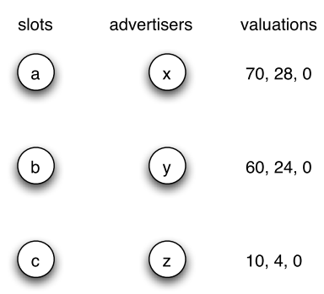
The Revenue of GSP and VCG
Does GSP or VCG provide more revenue to the search engine?
GSP procedure
  With bids of 5, 4, and 2
  revenue = 10*4+4*2=48
  With bids of 3, 5, and 1
  revenue = 10*3+4*1 = 34
VCG procedure: maximizes the total valuation of all advertisers for the slot they get
  60-24=36, 4-0=4 → x: 40
  4-0=4 → y: 4
  Total revenue: 44
Answer: it depends on which equilibrium of GSP the advertisers use.
10
4
0
5
4
2
3
5
1

Slide 27
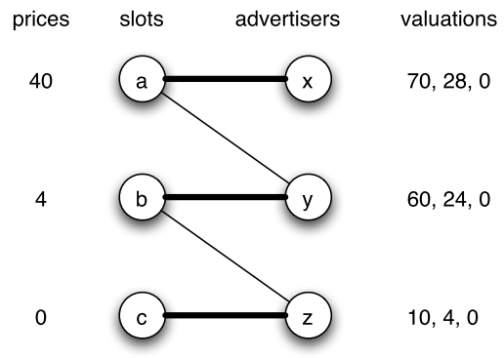
15.6 Equilibria of the
Generalized Second Price Auction
GSP always has a Nash equilibrium

Slide 28
Constructing the bids
  p_{j}∗ = p_{j} / r_{j}
  p₁∗ ≥ p₂∗ ≥ · · · ≥ p_{n}∗
  Buyer k + slot k : (v_{K} -p_{K}∗ ) r_{K}
  Buyer k + slot j : (v_{K} -p_{j}∗ ) r_{j}
  (v_{K} -p_{K}∗ ) r_{K} ≥ (v_{K} -p_{j}∗ ) r_{j}
  p_{j}∗ ≥ p_{K}∗
The bids form a Nash equilibrium
  since the prices are market-clearing

Slide 29
15.7 Ad Quality
users will look at the thumbnail description of an ad placed in a given slot (evaluating, for example, whether they recognize the name of the company placing the ad)
  they don’t trust the company, or the ad is only minimally relevant to the query term
Add an estimated quality factor q_{j}
  the valuation of advertiser j for slot i:
  v _{ij} = r _{i} v _{j} → v _{ij} = q _{j} r _{i} v _{j} .
The mysterious nature of ad quality
  since the ad quality factor is under the search engine’s control, it gives the search engine nearly unlimited power to aﬀect the actual ordering of the advertisers for a given set of bids

Slide 30
15.8 Complex Queries and Interactions
Among Keywords
Which keywords to use
How specific is the query
Which ad to show
Agreement: extrapolate from their bids on certain queries to implied bids on more complex queries

Slide 31
Conclusion
Search engine advertising market
  Buyer: advertisers
  Product: slot
Single slot: single item auction
Multiple slots:
  Known valuation: matching marketing
  Unknown valuation: encourage truth bidding
    VCG principle
    GSP procedure

