Slide 1
Chapter 7
Evolutionary Game Theory

Slide 2
Outline
7.1 Fitness as a Result of Interaction
7.2 Evolutionarily Stable Strategies
7.3 A General Description of Evolutionarily Stable Strategies
7.4 Relationship Between Evolutionary and Nash Equilibria
7.5 Evolutionarily Stable Mixed Strategies

Slide 3
Abstract
In this chapter, we explore the notion of
evolutionary game theory
  the idea was ﬁrst articulated by John Maynard Smith and G. R. Price
  Evolutionary biology is based on the idea that an organism’s genes largely determine its observable characteristics, and hence its ﬁtness in a given environment

Slide 4
7.1 Fitness as a Result of Interaction
Interaction Among Organisms
  When two beetles compete for some food, we have the following possible outcomes
    When beetles of the same size compete, they get equal shares of the food
    When a large beetle competes with a small beetle, the large beetle gets the majority of the food
    In all cases, large beetles experience less of a fitness benefit from a given quantity of food, since some of it is diverted into maintaining their expensive metabolism

Slide 5
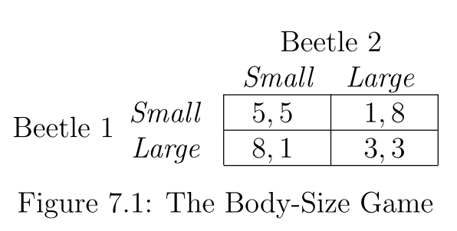
The payoffs to the beetles

Slide 6
7.2 Evolutionarily Stable Strategies
The basic definitions
  the ﬁtness of an organism in a population is the expected payoﬀ it receives from an interaction with a random member of the population
  a strategy T invades a strategy S at level x, for some small positive number x, if an x uses T and a 1 − x uses S
  S is evolutionarily stable if there is a (small) positive number y such that when any other strategy T invades S at any level x < y, the ﬁtness of an organism playing S is strictly greater than the ﬁtness of an organism playing T

Slide 7
First Example
a 1 − x fraction of the population uses Small and an x fraction of the population uses Large
  What is the expected payoff to a small beetle
    5(1 − x) + 1 · x = 5− 4x
  What is the expected payoff to a large beetle
    8(1 − x) + 3 · x = 8− 5x
    =>Small is not evolutionarily stable

Slide 8
First Example
a 1−x fraction of the population uses Large and an x fraction of the population uses Small
  What is the expected payoff to a large beetle
    3(1 − x) + 8 · x = 3 + 5x
  What is the expected payoff to a small beetle
    (1 − x) + 5 · x = 1 + 4x
    =>Large is evolutionarily stable

Slide 9
Interpreting the Evolutionarily Stable Strategy in our Example
small beetles cannot drive out the large ones
  Small is not evolutionarily stable
large beetles resists the invasion of small beetles
  Large is evolutionarily stable

Slide 10
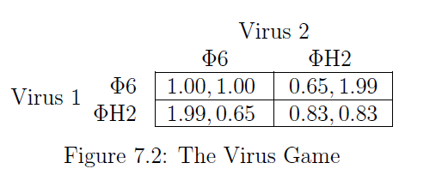
Empirical Evidence for Evolutionary Arms Races
the heights of trees can obey Prisoner’s-Dilemma
the root systems of plants
virus populations can also play an evolutionary version of the Prisoner’s Dilemma

Slide 11
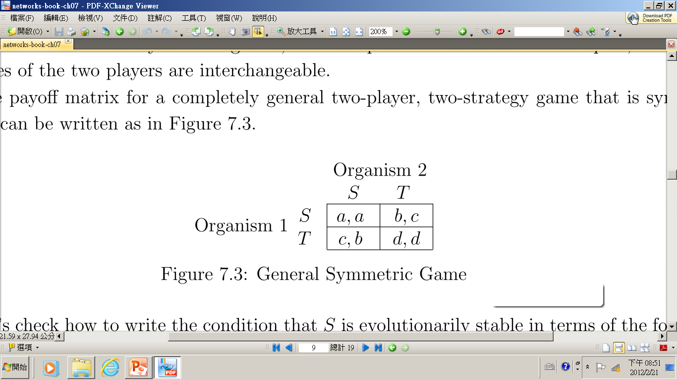
7.3 A General Description of Evolutionarily Stable Strategies
General Symmetric Game
  The expect payoff to S : a(1-x)+bx
  The expect payoff to T: c(1-x)+dx
  a(1-x)+bx > c(1-x)+dx
  In a two-player, two-strategy, symmetric game, S is evolutionarily stable precisely when either
  (i) a > c, or (ii) a = c and b > d

Slide 12
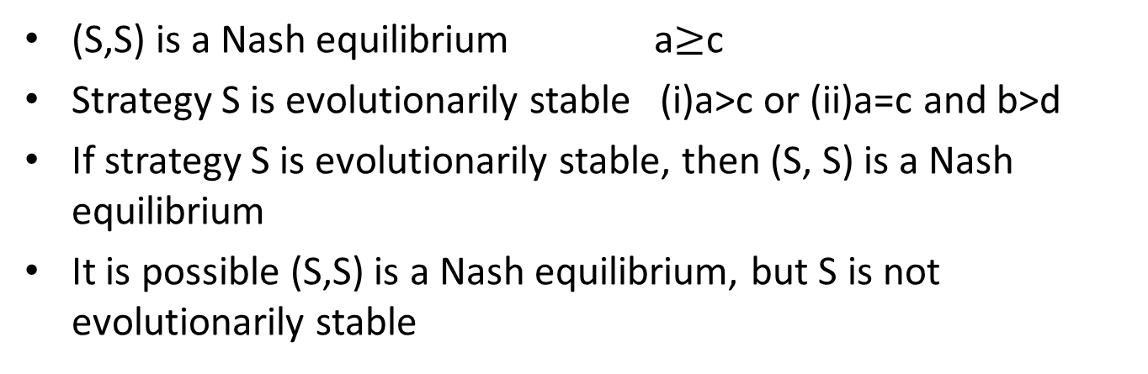
7.4 Relationship Between Evolutionary and Nash Equilibria
(S,S) is a Nash equilibrium a$≥$c
Strategy S is evolutionarily stable (i)a>c or (ii)a=c and b>d
If strategy S is evolutionarily stable, then (S, S) is a Nash equilibrium
It is possible (S,S) is a Nash equilibrium, but S is not evolutionarily stable

Slide 13
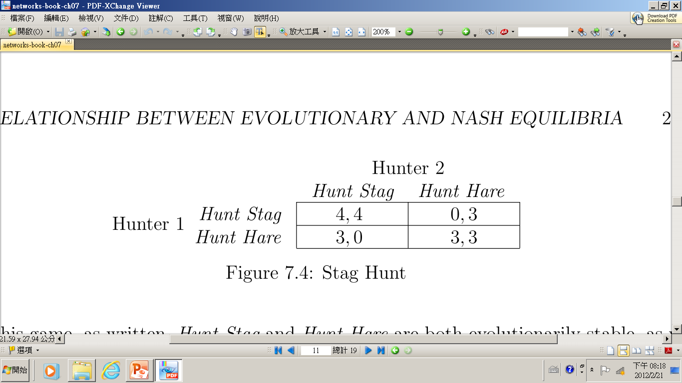
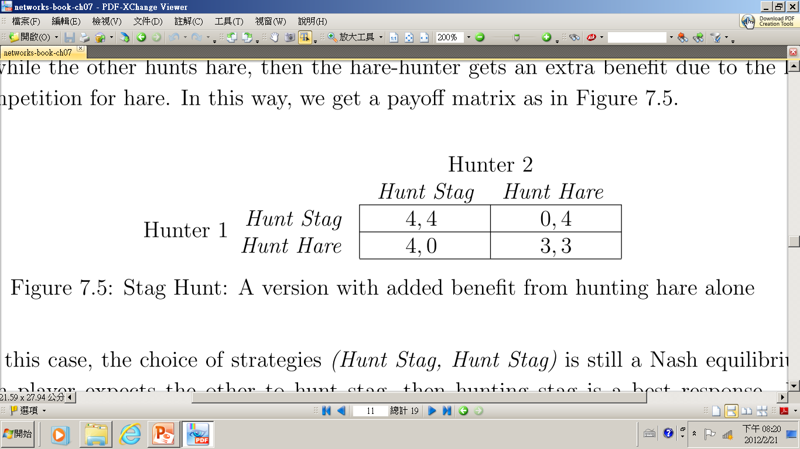

Slide 14
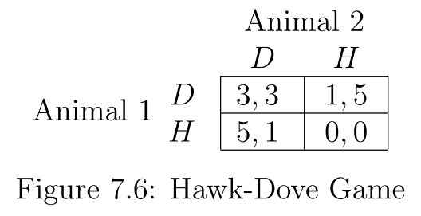
7.5 Evolutionarily Stable
Mixed Strategies
Hawk-Dove Game
  Two animals compete for a piece of food
  Hawk (H) behaves aggressively
  Dove (D) behaves passively

Slide 15
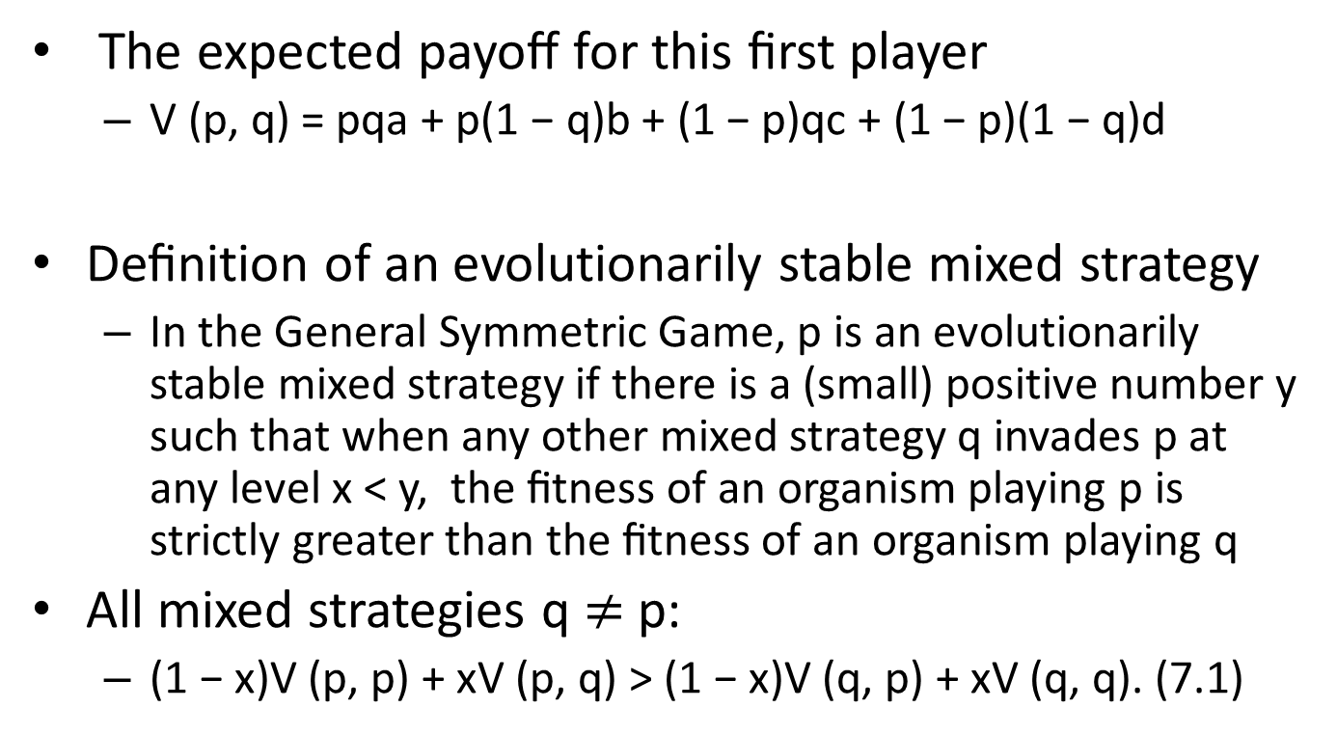
Defining Mixed Strategies in
Evolutionary Game Theory
The expected payoﬀ for this ﬁrst player
  V (p, q) = pqa + p(1 − q)b + (1 − p)qc + (1 − p)(1 − q)d
Deﬁnition of an evolutionarily stable mixed strategy
  In the General Symmetric Game, p is an evolutionarily stable mixed strategy if there is a (small) positive number y such that when any other mixed strategy q invades p at any level x < y, the ﬁtness of an organism playing p is strictly greater than the ﬁtness of an organism playing q
All mixed strategies q $≠$ p:
  (1 − x)V (p, p) + xV (p, q) > (1 − x)V (q, p) + xV (q, q). (7.1)

Slide 16
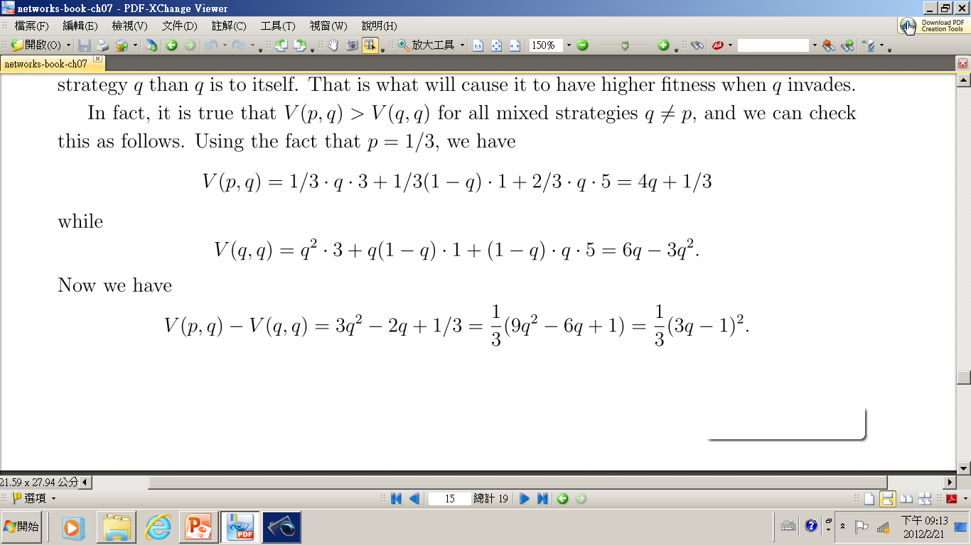
Evolutionarily Stable Mixed Strategies in the Hawk-Dove Game
p is indeed an evolutionarily stable mixed strategy

Slide 17
Interpretations of Evolutionarily Stable Mixed Strategies
all participants in the population may actually be mixing over the two possible pure strategies with the given probability
it could be that 1/3 of the animals are hard-wired to always play D, and 2/3 are hard-wired to always play H

Slide 18
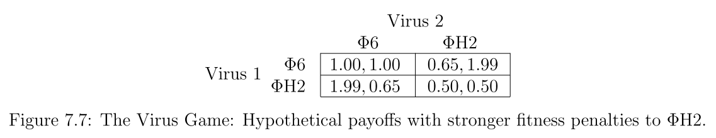
The Virus Game
  In this event, rather than having a Prisoner’s Dilemma type of payoﬀ structure, we’d have a Hawk-Dove payoﬀ structure: having both viruses play ΦH2 is suﬃciently bad that one of them needs to play the role of Φ6.
  Two pure equilibria : (Φ6,ΦH2) and (ΦH2,Φ6)

