Slide 1
Chapter 6
Game Theory

Slide 2
Outline
What is a Game?
Reasoning about Behavior in a Game
Best Responses and Dominant Strategies
Nash Equilibrium
Multiple Equilibria: Coordination Games
Multiple Equilibria: The Hawk-Dove Game
Mixed Strategies
Mixed Strategies: Examples and Empirical Analysis
Pareto-Optimality and Social Optimality
Advanced Material: Dominated Strategies and Dynamic Games

Slide 3
The main idea of game theory
Game theory is designed to address situations in which the outcome of a person’s decision depends not just on how they choose among several options, but also on the choices made by the people they are interacting with.

Slide 4
Basic Ingredients of a Game
There is a set of participants, whom we call the players.
Each player has a set of options for how to behave; we will refer to these as the player’s possible strategies.
For each choice of strategies, each player receives a payoff that can depend on the strategies selected by everyone

Slide 5
Underlying Assumptions
Everything that a player cares about is summarized in the player’s payoff.
Each player knows everything about the structure of the game, this means that each player knows his or her own list of possible strategies.
Finally, we suppose that each individual chooses a strategy to maximize her own payoff, given her beliefs about the strategy used by the other player.

Slide 6
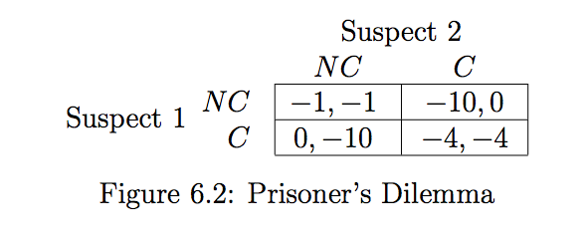
Example: The Prisoner’s Dilemma

Slide 7
Example: The Prisoner’s Dilemma
If Suspect 2 were going to confess, then Suspect 1 would receive a payoff of 4 by confessing and a payoff of 10 by not confessing. So in this case, Suspect 1 should confess.
If Suspect 2 were not going to confess, then Suspect 1 would receive a payoff of 0 by confessing and a payoff of 1 by not confessing. So in this case too, Suspect 1 should confess.

Slide 8
Strictly dominant strategy
Strictly dominant strategy : is the best choice regardless of what the other player’s chooses.
As a result, being confess is a strictly dominant strategy.
And we should expect both suspects to confess, each getting a payoff of -4.

Slide 9
Best responses and Domain strategy
Best response: it is the best choice of one player, given a belief about what the other player will do
We say that a dominant strategy for Player 1 is a strategy that is a best response to every strategy of Player 2.
We say that a strictly dominant strategy for Player 1 is a strategy that is a strict best response to every strategy of Player 2.

Slide 10
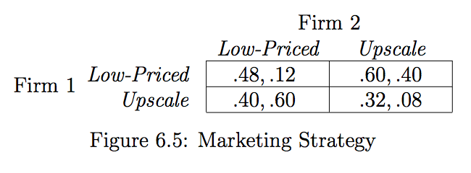
Example: A Game in Which Only One Player Has a Strictly Dominant Strategy

Slide 11
Example: A Game in Which Only One Player Has a Strictly Dominant Strategy
Since Firm 1 has a strictly dominant strategy in Low-Priced, we can expect it will play it.
Now, If Firm 2 knows Firm 1’s payoffs, and knows that Firm 1 wants to maximize profits, then Firm 2 can confidently predict that Firm 1 will play Low-Priced.
Firm 1 is so strong that it can proceed without regard to Firm 2’s decision

Slide 12
Nash Equilibrium
What if neither player in a two-player game has a strictly dominant strategy?
Ans : Using Nash Equilibrium

Slide 13
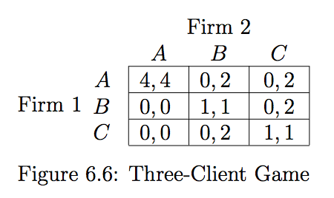
Example : Nash Equilibrium
Notes:
Suppose there are two firms that each hope to do business with one of three large clients, A, B, and C. Each firm has three possible strategies: whether to approach A, B, or C. The results of their two decisions will work out as follows.
If the two firms approach the same client, then the client will give half its business to each.
Firm 1 is too small to attract business on its own, so if it approaches one client while Firm 2 approaches a di↵erent one, then Firm 1 gets a payo↵ of 0.
If Firm 2 approaches client B or C on its own, it will get their full business. However, A is a larger client, and will only do business with the firms if both approach A.
Because A is a larger client, doing business with it is worth 8 (and hence 4 to each firm if it’s split), while doing business with B or C is worth 2 (and hence 1 to each firm if it’s split).

Slide 14
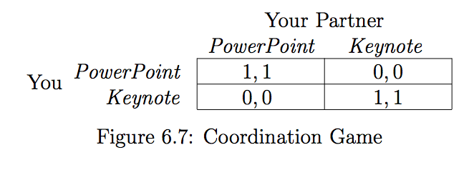
Multiple Equilibria :
Coordination Games
the underlying difficulty is that the game has two Nash Equilibrium
Notes:
A simple but central example is the following Coordination Game, which we can motivate through the following story. Suppose you and a partner are each preparing slides for a joint project presentation; you can’t reach your partner by phone, and need to start working on the slides now. You have to decide whether to prepare your half of the slides in PowerPoint or in Apple’s Keynote software. Either would be fine, but it will be much easier to merge your slides together with your partner’s if you use the same software.
If the players fail to coordinate on one of the Nash equilibria, perhaps because one player expects Power- Point to be played and the other expects Keynote, then they receive low payoff
Thomas Schelling [364] introduced the idea of a focal point as a way to resolve this diculty. He noted that in some games there are natural reasons (possibly outside the payo↵ structure of the game) that cause the players to focus on one of the Nash equilibria.

Slide 15
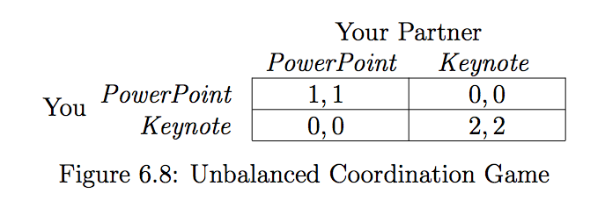
Multiple Equilibria :
Coordination Games
suppose that both you and your project partner each prefer Keynote to PowerPoint
Notes:
Here, Schelling’s theory of focal points suggests that we can use a feature intrinsic to the game — rather than an arbitrary social convention — to make a prediction about which equilibrium will be chosen by the players. That is, we can predict that when the players have to choose, they will select strategies so as to reach the equilib- rium that gives higher payo↵s to both of them.

Slide 16
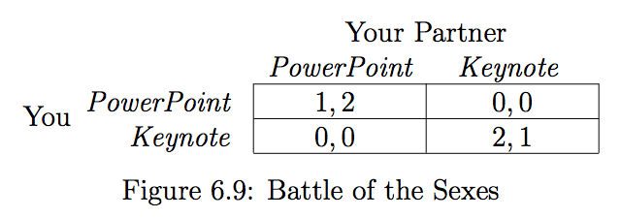
Multiple Equilibria :
Coordination Games
if you and your partner don’t agree on which software you prefer
Notes:
In this case, the two equilibria still correspond to the two di↵erent ways of coordinating, but your payo↵ is higher in the (Keynote,Keynote) equilibrium, while your partner’s payo↵ is higher in the (PowerPoint,PowerPoint) equilibrium. This game is traditionally called the Battle of the Sexes

Slide 17
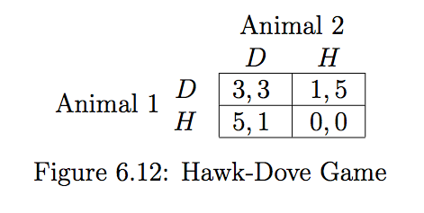
Multiple Equilibria:
The Hawk-Dove Game
Notes:
Essentially, one of you must behave passively and prepare for the presentation, while the other achieves the higher payo↵ by studying for the exam. If you both try to avoid the role of the passive player, you end up with very low payoffs, but we cannot predict from the structure of the game alone who will play this passive role.
the concept of Nash equilibrium helps to narrow down the set of reasonable predictions, but it does not provide a unique prediction.

Slide 18
6.7. Mixed Strategies
There are also games which have no Nash equilibria at all.
For such game we will make predictions by enlarging the set of strategies to include the possiblity of randomization;
Once players are allowed to behave randomly ,then the equilibria always exist.
“attack-defense” games can expose this phenomenon.

Slide 19
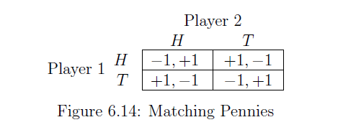
Matching Pennies
A simple “attack-defense” game
A game in which two people each hold a penny ,and simultaneously choose whether to show heads(H) or tail(T) on their penny. Player1 loses his penny if they match , and wins player2’s penny if they don’t match .
This produces a payoff matrix as shown in Figure 6.14.

Slide 20
Matching Pennies
Zero-sum games are games with the property that the payoffs of the players sum to zero in every outcome , where the players’ interests are in direct conflict.
Matching Pennies have in fact been used as metaphorical descriptions of decisions made in combat.
For example : the Allied landing in Europe involved a decision whether to cross the English Channel at Normandy or at Calais in World War II.;

Slide 21
Matching Pennies
Notice ：there is no pair of strategies that are best responses to each other.
This means that if we treat each player as simply having the two strategies H or T ,then there is no Nash equilibrium.
So in real life , players generally try to make it difficult for their opponents to predict what they will play.

Slide 22
Mixed Strategies
Randomized behavior is to say that each player is not actually choosing H or T directly , but rather is choosing a probaility.
So in this model, the possible strategies for Player 1 are numbers p between 0 and 1; a given number p means that Player 1 is committing to play H with probability p, and T with probability 1-p. Similarly, the possible strategies for Player 2are numbers q between 0 and 1, representing the probability that Player 2 will play H.
Mixed strategies : they involve “mixing” between the options H and T.

Slide 23
Payoffs from Mixed Strategies
In order to rank random payoffs numerically, we will use the expected value of the payoff.
For example:if player 1 choose the pure strategy H while player2 choose a probabiity of q, then the expected payoff ot player1 is
Similarly, if Player 1 chooses the pure strategy T while Player 2 chooses a probability of q,then the expected payoff to Player 1 is

Slide 24
Equilibrium with Mixed Strategies
Nash equilibrium for the mixed-strategy version : it is a pair of strategies (now probabilities) so that each is a best response to the other.
No pure strategy can be part of a Nash equilibrium .
So we've concluded that in any Nash equilibrium for the mixed-strategy version of Matching Pennies, we must have
The situation is symmetric for player2 ,so the p=1/2

Slide 25
Interpreting the Mixed-Strategy Equilibrium for Matching Pennies
Both probabilities turned out to be 1/2 is a result of the highly symmetric structure of Matching Pennies; when the payoffs are less symmetric, the Nash equilibrium can consist of unequal probabilities
Nash‘s main mathematical result was to prove that every such game has at least one mixed-strategy equilibrium.

Slide 26
Interpret mixed-strategy equilibria in real-world situations.
Sometimes, particularly when the participants are genuinely playing a sport or game , the players may be actively randomizing their actions.
Sometimes the mixed strategies are better viewed as proportions within a population.
Ex : two species of animal are foraging for food.
If each player believes that her partner will play according to a particular Nash equilibrium, then she too will want to play according to it.

Slide 27
6.8 Mixed Strategies : Examples and Empirical Analysis
As mixed-strategy equilibrium is a subtle concept, it's useful to think about it through further examples.
Two main examples : The Run-Pass Game and The Penalty-Kick Game.

Slide 28
The Run-Pass Game
Two American football teams plan their next play in a football game. The offense can choose either to run or to pass, and the defense can choose either to defend against the run or to defend against the pass.
Here is how the payoffs work.
  If the defense correctly matches the offense's play, then the offense gains 0 yards.
  If the offense runs while the defense defends against the pass, the offense gains 5 yards.
  If the offense passes while the defense defends against the run, the offense gains 10 yards.

Slide 29
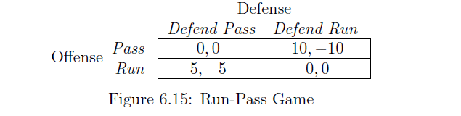
The Run-Pass Game
Payoff matrix shown in Figure 6.15

Slide 30
The expected payoff to the offense
Payoff from passing
Payoff from running
To make the offense indifferent between its two strategies，we need to set 10-10q=5q，and hence q=2/3

Slide 31
The expected payoff to the defense
Payoff from defending against the pass
Payoff from defending against the run
To make the defense indifferent between its two strategies，we need to set 5p-5=-10p，and hence p=1/3
So the only possible probability values are p=1/3 for the offense ,and q=2/3 for the defense.

Slide 32
Strategic Interpretation of the Run-Pass
Notice
Although passing is the offense’s more poweful weapon, it uses it less than half the time;
If p=1/2,the offense’s expected payoff will be 5/2 ,which is less than the 10/3;
The defense is defending against the pass 2/3 of the time ,even the offense is using it only 1/3 of the time;

Slide 33
The Penalty-Kick Game
In 2002,Ignacio Palacios-Huerta undertook a large study of penalty kicks from the perspective of game theory.
The structure of the game is very much like Matching Pennies: if the goalie dives in the direction where the ball is aimed, he has a good chance ofblocking it; if the goalie dives in the wrong direction, it is very likely to go in the goal.

Slide 34
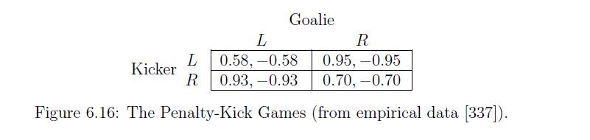
The Penalty-Kick Game
four basic outcomes: whether the kicker aims left(L) or right(R), and whether the goalie dives left or right. This led to a payoff matrix as shown in Figure 6.16.

Slide 35
The Penalty-Kick Game
if q is the probability that a goalie chooses L, we need to set q so as to make the kicker indifferent between his two options:
We get q = 0.42. We can do the analogous calculation to obtain the value of p that makes the goalie indifferent, obtaining p = 0.39.

Slide 36
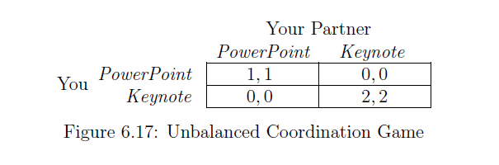
Finding all Nash Equilibria
it is important to note that a game may have both pure-strategy and mixed strategye quilibria.
An example exhibiting both pure and mixed equilibiria : Unbalanced Coordination Game from section 6.5:

Slide 37
Finding all Nash Equilibria
Suppose that you place a probability of p strictly between 0 and 1 on PowerPoint, and your partner places a probability of q strictly between 0 and 1 on PowerPoint.
You will be indifferent between PowerPoint and Keynote if
So q=2/3,and we also get p=2/3.
Thus, in addition to the two pure equilibria ,we also get an equilibrium in which each of you choose PowerPoint with probability 2/3.

Slide 38
6.9 Pareto-Optimality and Social Optimality
A choice of strategies – one by each player – is Pareto-optimal if there is no other choice of strategies in which all players receive payoffs at least as high, and at least one player receives a strictly higher payoff.
Example : in the Exam-or-Presentation Game, the outcome in which you and your partner both study for the exam is not Pareto-optimal, since the outcome in which you both prepare for the presentation is strictly better for both of you.
It shows that even though you and your partner realize there is a superior solution, there is no way to maintain it without a binding agreement between the two of you.

Slide 39
Social Optimality
A choice of strategies - one by each player - is a social welfare maximizer (or socially optimal) if it maximizes the sum of the players' payoffs.
In the Exam-or-Presentation Game,both you and your partner prepare for the presentation will produce a combined payoff of 90+90=180.
it's not always clear that we can meaningfully combine my satisfaction with an outcome and your satisfaction by simply adding them up.
Outcomes that are socially optimal must also be Pareto-optimal , but in turn is not.

Slide 40
6.10 Advanced Material: Dominated Strategies and Dynamic Games
Two issues arise in the analysis of games:
  Studying the role of dominated strategies in reasoning about behavior in a game.
  Reinterpreting the strategies and payoffs in a game to deal with situations.

Slide 41
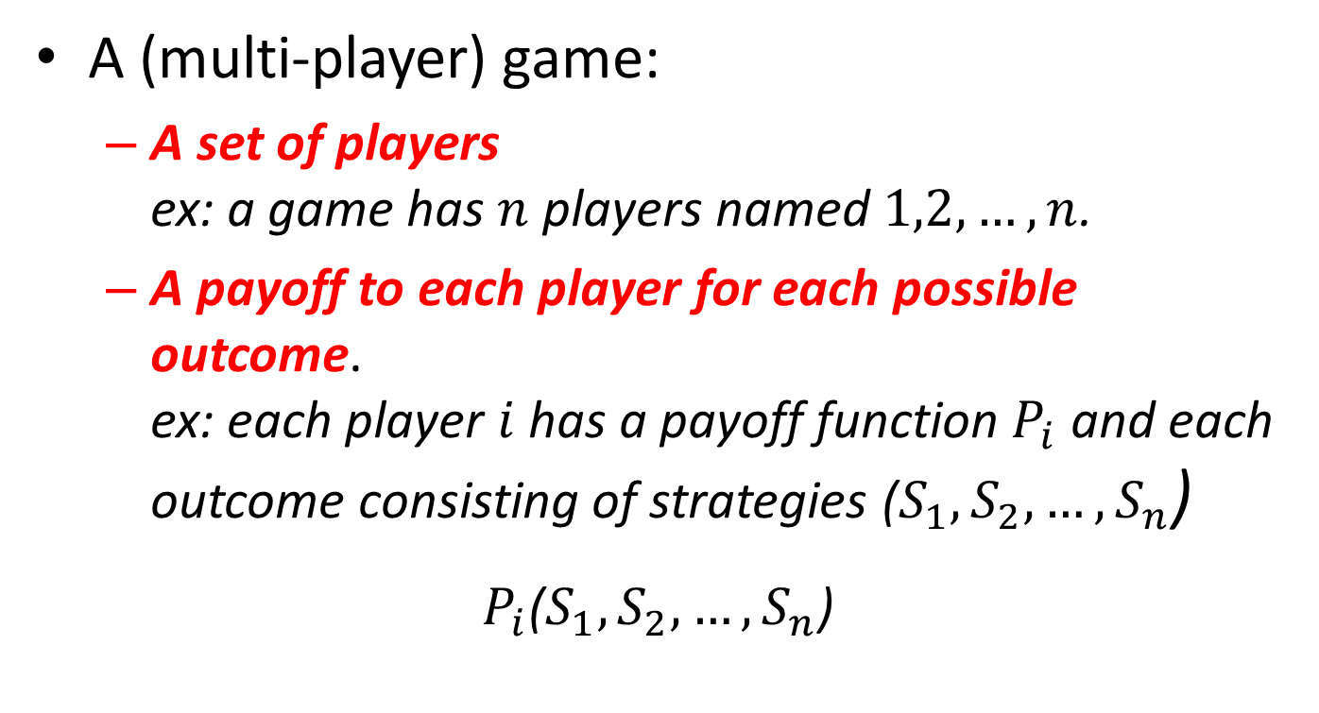
A. Multi-Player Games
A (multi-player) game:
  A set of players
  ex: a game has $n$ players named $1,2,…,n$.
  A payoff to each player for each possible outcome.
  ex: each player $i$ has a payoff function $P_{i}$ and each outcome consisting of strategies ($S_{1},S_{2},…,S_{n}$)
$P_{i}$($S_{1},S_{2},…,S_{n}$)

Slide 42
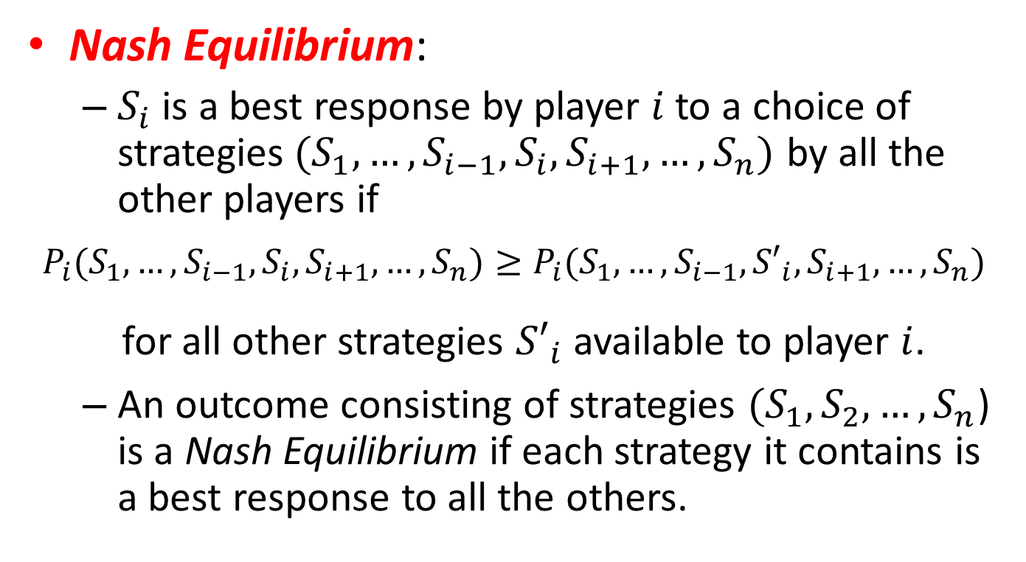
A. Multi-Player Games
Nash Equilibrium:
  $S_{i}$ is a best response by player $i$ to a choice of strategies${ (S}_{1},…,S_{i−1},S_{i},S_{i+1},…,S_{n})$ by all the other players if
$$P_{i}(S_{1},…,S_{i−1},S_{i},S_{i+1},…,S_{n})≥P_{i}(S_{1},…,S_{i−1},{S′}_{i},S_{i+1},…,S_{n})$$
  for all other strategies ${S′}_{i}$ available to player $i$.
  An outcome consisting of strategies ${(S}_{1},S_{2},…,S_{n}$) is a Nash Equilibrium if each strategy it contains is a best response to all the others.

Slide 43
B. Dominated Strategies and their Role in Strategic Reasoning
Although dominant and strictly a dominant strategies can exist in games with many players and many strategies, they are rare.
However, the outcome of the game can still be uniquely predicted using the structure of the dominated strategies.

Slide 44

Example 1: The Facility Location Game
Two firms plan to open a store in one of six towns located along six consecutive exits on a highway.
Firm 1 has the option of opening its store in any of towns A, C, or E, while Firm 2 has the option in any of towns B, D, or F.

Slide 45
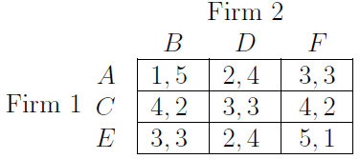
Example 1: The Facility Location Game
For instance, if Firm 1 open its store in town C and Firm 2 opens its store in town B, then the store in town B will attract customers from A and B, while the store in town C will attract customers from C, D, E, and F.

Slide 46
Example 1: The Facility Location Game
Neither player has a dominant strategy in this game.
  If Firm 1 locates at node A, then the strict best response of Firm 2 is B.
  If Firm 1 locates at node E, then the strict best response of Firm 2 is D

Slide 47
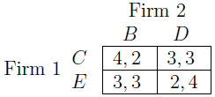
Dominated Strategies in the Facility Location Game
Strictly dominated strategy should always be replaced by a strategy that does better, so it can be effectively eliminated from the game.
  A is a strictly dominated strategy for Firm 1
  F is a strictly dominated strategy for Firm 2

Slide 48

Dominated Strategies in the Facility Location Game
The strategies B and E now are strictly dominated.
A prediction for the play of the game:
  Firm 1 will play C, and Firm 2 will play D
This reduced game is called the iterative deletion of strictly dominated strategies.

Slide 49
Dominated Strategies in the Facility Location Game
Observations:
  All the steps that led to it were based simply on removing strategies that were strictly inferior to others from the perspective of payoff-maximization.
  Iterated deletion can in principle be carried out for a very large number of steps

Slide 50
Iterated Deletion of Dominated Strategies: The General Principle
The process of iterated deletion of strictly dominated strategies proceeds as follows:
  Starting with any n-player game, and all the strictly dominated strategies, and deleting them.
  Considering the reduced game in which these strategies have been removed.
  Repeatedly finding and removing strictly dominated strategies until none can be found.

Slide 51
Iterated Deletion of Dominated Strategies: The General Principle
Proving the set of Nash equilibria remains the same through one round of deletion:
  Any Nash equilibrium of the original game is a Nash equilibrium of the reduced game.
  Any Nash equilibrium of the reduced game is also a Nash equilibrium of the original game.

Slide 52
Weakly Dominated Strategies
Weakly dominated:
  If there is another strategy that does at least as well no matter what the other players do, and does strictly better against some joint strategy of the other players.

Slide 53
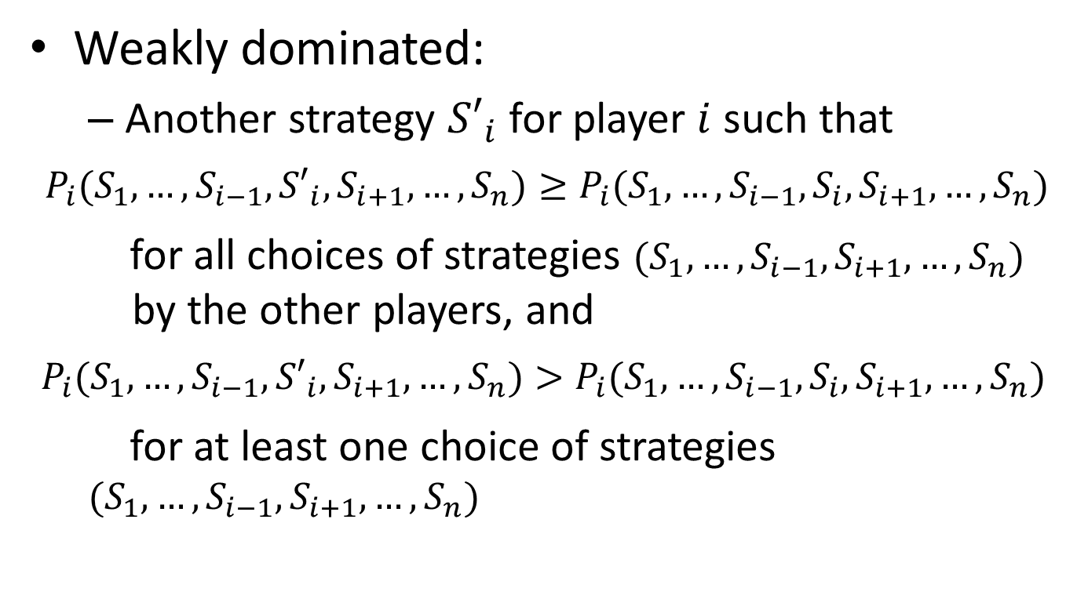
Weakly Dominated Strategies
Weakly dominated:
  Another strategy ${S′}_{i}$ for player $i$ such that
$$P_{i}(S_{1},…,S_{i−1},{S′}_{i},S_{i+1},…,S_{n})≥P_{i}(S_{1},…,S_{i−1},S_{i},S_{i+1},…,S_{n})$$
  for all choices of strategies $(S_{1},…,S_{i−1},S_{i+1},…,S_{n})$
  by the other players, and
$$P_{i}(S_{1},…,S_{i−1},{S′}_{i},S_{i+1},…,S_{n})>P_{i}(S_{1},…,S_{i−1},S_{i},S_{i+1},…,S_{n})$$
  for at least one choice of strategies $(S_{1},…,S_{i−1},S_{i+1},…,S_{n})$

Slide 54
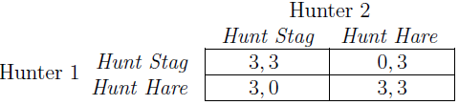
Weakly Dominated Strategies
For example:
  Hunt Stag is a weakly dominated strategy by playing Hunt Hare. (each player always does at least as well, and sometimes strictly better)
  Hunt Stag is a Nash equilibrium
  Thus, deleting weakly dominated strategies is not in general a safe thing to do.

Slide 55
C. Dynamic Games
Dynamic Games:
  Some player or set of players moves first, other players observe the choice(s) made, and then they respond, perhaps according to a predetermined order of governing who moves when.
  Board games, card games, bidding in an auction,…

Slide 56
Normal and Extensive Forms of a Game
Normal-form:
  The list of players, their possible strategies, and the payoffs arising from every possible (simultaneous) choice of strategies by the players.
Extensive-form:
  Specifying who moves when, what each player knows at any opportunity, what they can do when it is their turn to move, and what the payoffs are at the end of the game.

Slide 57
Reasoning about Behavior in a Dynamic Game
Making predictions for what players will do in dynamic games by a game tree.
Analysis method (extensive-form):
  Starting one step above the terminal nodes.
  (This lets us predict what the last player will do)
  Moving one more level up the game tree.
  (Reasoning about what the player move earlier will do)
  Continuing in this way up the tree.

Slide 58
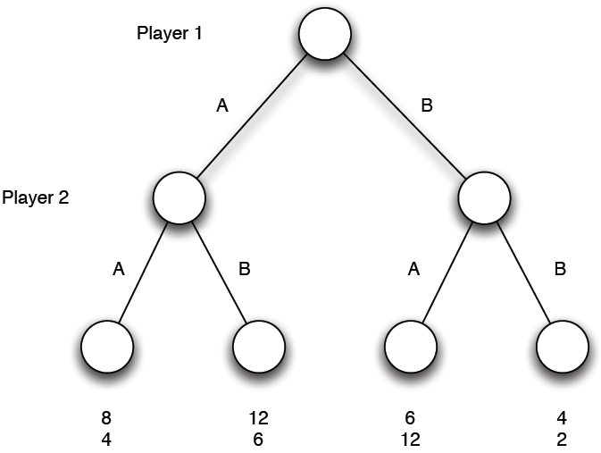
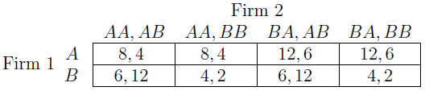
Reasoning about Behavior in a Dynamic Game
Extensive-form:
Normal-form:

Slide 59
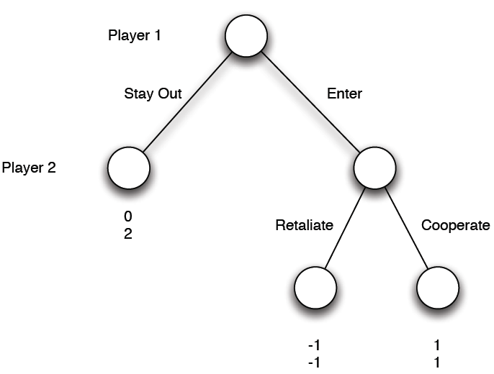
A More Complex Example: The Market Entry Game
Firm 2 is currently the only serious participant, and Firm 1 is considering whether to enter the market.

Slide 60
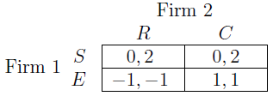
Subtle Distinctions Between Extensive and Normal Form Representations
Extensive-form:
  Starting at the terminal nodes to analyze.
  Finally, firm 1 will enter the market, and then Firm 2 will cooperate.
Normal-form:
  discovering two distinct (pure-strategy) Nash equilibria

Slide 61
Subtle Distinctions Between Extensive and Normal Form Representations
The Market Entry Game shows how the ability to commit to a particular course of action.
If Firm 2 could make Firm 1 believe that it really would retaliate in the event of entry, then Firm 1 would choose to stay out, resulting in a higher payoff for Firm 2.
In practice, this suggests particular courses of action that Firm 2 could take before the game even starts.

Slide 62
Relationship to Weakly Dominated Strategies.
The strategy R for Firm 2 is weakly dominated.
If the structure in fact arises from a dynamic game in extensive form information about the dynamic game that is lost in the translation to normal form could potentially be sufficient to eliminate such equilibria.

Slide 63
Final Comments
In this chapter we introduce two analysis method:
  normal-form
  extensive-form
There are more complex components to the theory as well, allowing for richer structure.

