Slide 1
Property Rights

Slide 2
Outline
24.1 Externalities and the Coase Theorem
24.2 The Tragedy of the Commons
24.3 Intellectual Property

Slide 3
Property rights
Property rights
  give the holder of the right
  and ability to exclude others from using it
  and usually the right to sell or transfer the resource to another person.
The central message of this chapter (property rights)
  the property rights a society chooses to establish will affect the allocations that occur, and some property rights are more likely than others to result in socially optimal allocations.

Slide 4
Property forms
Physical property
  A plot of land
  A can of Diet Coke
Intellectual property
  A song
  A manufacturing process

Slide 5
24.1 Externalities and the Coase Theorem

Slide 6
Externalities and Non-Optimal Allocations
Take the following as examples :
Scenario #1:
  The smoker purchased the cigar at a price which presumably covered the cost of producing the cigar, so at least between the smoker and the producer there is no externality created by the sale of the cigar.

Slide 7
Example of Socially optimal allocation
Scenario#2: But consuming the cigar in the restaurant the smoker imposes a harm on the other diner without compensating this person for the harm.
  One mechanism achieve this goal is a law that prohibits smoking in restaurants.
  An alternative is establish a property right to smoke-free air in restaurants and to make this property right tradeable.

Slide 8
Example of Socially optimal allocation
Smoking example ‘s socially optimal allocation:
Establishing a property right to smoke-free air,
Because after the negotiation between the smoker and the other diner, smoking occurs when it is socially optimal for it to occur.

Slide 9
2nd example of Socially optimal allocation
Property rights are not clearly defined and enforced:
  Power-generating plant pollutes the air and water.
  It pays for many of goods that it uses in the process of generating power, such as labor, capital equipment on the market at prices that compensate the sellers of these goods for the harm they suffer.

Slide 10
2nd example of Socially optimal allocation
If the power plant had to pay a price that reflected the harm it causes to, then the allocation of power, air, and water would be socially optimal.
Social optimality is unlikely to mean there would be no pollution. Instead, it simply requires that the amount of pollution, like the amount of all other goods, is determined so that there is no reallocation that improves welfare.

Slide 11
Mechanisms for determining socially optimal Allocation
  Using property right and mutually agreeable compensation to determine socially optimal allocation
  Vickrey-Clark-Groves(VCG) mechanism induce truth-telling for polluters and for those suffered by pollution
    Who is potentially harmed by the pollution
    Who should be included in the mechanism
  Cap and trade systems

Slide 12
Mechanisms for Determining Socially Optimal Allocations
The central idea behind the use of property rights or tradeable pollution permits as a device to solve problems created by externalities is Coase’s theorem will lead to a socially optimal outcome no matter who initially owns the property rights.

Slide 13
Mechanisms for Determining Socially Optimal Allocations
Who owns the right will affect how well off each of the parties is in the resulting equilibrium and they will certainly disagree about who should initially own the right.
The initial allocation of permits will make some better off and some worse off, and it is sure to be politically contentious
Coase’s argument is that it ignores transaction costs and simply assumes that negotiation beginning from any assignment of property rights will lead to an efficient outcome

Slide 14
24.2 The Tragedy of the Commons

Slide 15
The Tragedy of the Commons
Story proposed by Garrett Hardin (1968 in Science)
A story there is a village commons on which any herdsman can freely graze his cattle.
Hardin noted that inevitably the commons will be overused to the detriment of all the villagers. He then argued that establishing property rights would solve the problem.
These property rights could be privately held, the commons could be sold to some individual, or they could be publicly held.

Slide 16

A Model for the Commons
Suppose that there is a village with N people, and each villager owns one cow.
f(x) means the revenue generated per cow, if an x fraction of this population of N cows grazes on the commons.
The total revenue generated is equal to f (x)(xN), which in our example is (cx − x²)N.
x*= c/2 which is the socially optimal fraction of cattle on the commons that maximizes the function f (x)(xN).
$$f(x)=c−x$$

Slide 17
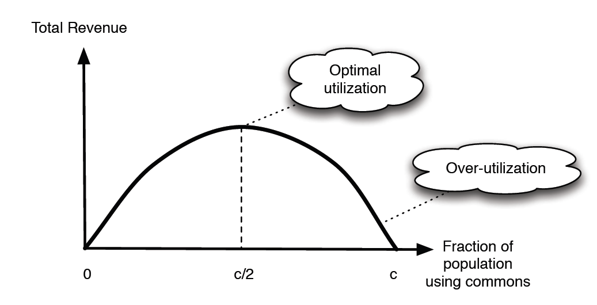

A Model for the Commons
The maximum revenue
Notes:
If a fraction x of this population of N cows grazes on the commons,
then the revenue generated per cow is equal to f(x) for some function f(·). Hardin noted
that the fewer cows there are on the commons, the more grass there is per cow, and so the
greater revenue per cow. That is, the function f(·) is decreasing. Let’s suppose for example
that f(x) = c − x for some number c < 1. This means that the revenue per cow remains
positive until x reaches c, at which point it becomes zero: increasing the fraction of cattle
using the commons beyond x = c will cause a negative revenue per cow due to the crowding
of the commons.

Slide 18
The tragedy of the commons
What happens if the commons is freely available to all the villagers?
If f(x) >0 There are villagers who cows are not currently using the commons
Equilibrium
There will be twice as many cows on the commons as is socially optimal
The total revenue become

Slide 19
Avoiding the Tragedy
There are two ways to avoid the tragedy (overgrazing)
Way #1: For the village to continue to own the commons jointly but somehow limit the quantity of cattle to the socially optimal number (charge c/2 per cow)
Way#2: The village could sell the commons to a large owner of livestock who has many cows.
Notes:
One approach is for the village to continue to own the commons jointly but somehow limit the quantity of cattle to the socially optimal number. This could be done either by charging a price for grazing on the commons, or by simply setting the fraction of cattle that
are allowed on the commons at the optimal value x!, which in our example is equal to c/2. If the village charges a price, the optimal price to charge is c/2 per cow. To see why this is optimal, note that a villager will add his cow to the commons if and only if the revenue
from grazing a cow on the commons is greater than the price. Thus, in an equilibrium, the revenue from grazing a cow on the commons must be equal to the price. So the equilibrium will be the value of x which solves f(x) = c/2 and this is x = c/2. Alternatively, the village
could sell grazing rights for x!N cows. Again, the maximum price per cow the village could charge for such grazing rights is c/2 per cow, as we just found above. Either variation on this method results in the socially optimal use of the commons and a revenue to the village
of c2N/4.
Instead of owning it jointly, the village could sell the commons to a large owner of livestock
who has many cows. This livestock owner who buys the commons would put x!N cows on
the commons too as this is the number of cows that maximizes his revenue. The maximum
price that the village could sell the commons for is the revenue that the buyer would receive
from optimal use of the commons, which is again c2N/4. So in either approach — joint
ownership by the village with an appropriate price charged per cow for grazing; or outright
sale to an individual — the village receives a revenue of c2N/4, and the commons is used by
the optimal fraction of cattle.

Slide 20
Way#1: Village continue to own the commons
A villager will add his cow to the commons if and only if the revenue from grazing a cow on the commons is greater than the price.
The equilibrium will be x that solves f (x) = c/2. Alternatively, the village could sell grazing rights for x*N cows.
Either variation on this method results in the socially optimal use of the commons and a revenue to the village of c²N/4.

Slide 21
Way#2: Sell the commons to a large owner of livestock
The livestock owner who buys the commons would
put x*N cows on the commons.
The maximum price that the village could sell the commons for is the revenue that the buyer would receive from optimal use of the commons, which is again c²N/4.
In Hardin’s village commons example, all that is needed to avoid the tragedy is to establish a property right.

Slide 22
24.3 Intellectual Property

Slide 23
Efficient use of resources
Solving the property rights problem by assigning the property rights to someone solves the problem of inefficient use of the resource and it also solves the problem of a lack of incentives for productivity-enhancing investment.

Slide 24
Rivalrous and Non-Rivalrous Goods
Rivalrous goods
  Goods such that use or consumption by one user precludes use or consumption by any other potential.
  Can of Diet Cole, grass
Non-rivalrous goods
  Goods that can be used or consumed over and over.
  Air, digitalized book

Slide 25
Copyrights
In the U.S. the case of books, songs, plays, television shows and movies, all of these creations are covered by the copyright law which gives the creator of the work the exclusive right to copy the work, to distribute it, to modify it or to perform the work.

Slide 26
Copyrights
The copyright holder’s exclusive right to copy the work does not actually prohibit all copying. The doctrine of fair use has evolved to permit limited copying for noncommercial use of parts of a copyrighted work
Copyright law does not prohibit the owner of a copy of a work from reselling that copy

Slide 27
Patents
Inventions such as a new drug, a new manufacturing process, or a new piece of computer hardware can apply to the United States Patent and Trademark Office for a patent.
They have the right to exclude others from using the invention for a fixed period of time, usually 20 years.

Slide 28
Copyrights vs Patents
 | Copyrights | Patents
Granting | Automatic | Filing an application
Enforcement | Holder of copyrights | Holder of patents
Compelling | Less compelling | More compelling
Complex | Less complex | More complex

