Slide 1
Modeling Network Traffic using Game Theory

Slide 2
Abstract
Modeling transportation network
  Models for network traffic using the game-theoretic ideas are developed
How it responds to traffic congestion
  Adding capacity to a network can sometimes actually slow down the traffic
Braess’s Paradox
  Is more roads mean less congestion?

Slide 3
8.1 Traffic at Equilibrium

Slide 4
Basic setting
A transportation network is represented by a directed graph
Edges – highways
Nodes - where you can get on or off a particular highway

Slide 5
Example
Assuming that everyone wants to drive from A to B
  Two particular nodes of transportation network
Each edge has a designated travel time
  depends on the amount of traffic
Imaging that A is an exit in the suburbs, B is an exit downtown, and we’re looking at a large collection of morning commuters

Slide 6
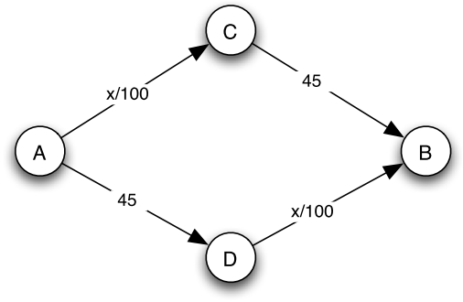
Highway network
A-D and C-B edges are insensitive to congestion
A-C and D-B edges are highly sensitive to congestion
Each edge labeled by its travel time (in minutes) when there are x cars using it

Slide 7
Traffic Game
Players: drivers
Strategies: possible routes from A to B
  Two strategies in example: A->C->B and A->D->B
    larger networks contain many strategies for players
Payoff: the negative of driver’s travel time
  Large travel times are bad

Slide 8
Equilibrium traffic
In this traffic game, there is generally not a dominant strategy
  Either route has the potential to be the best choice for a player if all the other players are using the other route
The Nash equilibrium of the traffic game
  drivers balance themselves evenly between the two routes; 2000 on each

Slide 9
Why does equal balance yield a Nash equilibrium?
We just observe that with an even balance between the two routes, no driver has an incentive to switch over to the other route.
  Incentive: the shorter travel time

Slide 10
Why do all Nash equilibria have equal balance?
x drivers use the upper route and 4000 − x drivers use the lower route
Driver has incentive to switch from a slower to a faster route, if routes have unequal travel times
  x is not equal to 2000
Any list of strategies in which x = 2000 is a Nash equilibrium
  x is not equal to 2000 cannot be a Nash equilibrium

Slide 11
Highway network
One route:
4000/100 + 45 = 85
Two routes:
2000/100 + 45 = 65
When 4000 cars get from A to B
  Using one route: travel time is 85 minutes
  Evenly between two routes: each carries 2000 cars , travel time is 65 minutes

Slide 12
8.2 Braess’s Paradox

Slide 13
Original highway network
In the previous traffic network, everything works out very cleanly
  Self-interested behavior by all drivers causes them to balance perfectly between the available routes
  Nash equilibrium
But with only a small change to the network, we can find counterintuitive territory

Slide 14
Change of network: add a new route
The city government builds a very fast highway from C to D
Simply model its travel time as 0
  regardless of the number of cars on it
People’s travel time from A to B ought to get better after this edge from C to D is added. Does it?

Slide 15
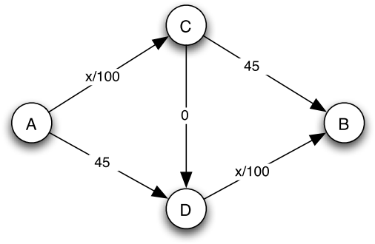
New highway network

Slide 16
New equilibrium
The unique Nash equilibrium in this new highway network leads to a worse travel time
Driver uses the route through both C and D
  4000/100 + 0 + 4000/100 = 80
Why is this the only equilibrium?
  No driver can benefit by changing their route
  Any other route would now take 85 minutes

Slide 17
  Braess’s Paradox Phenomenon
Adding resources to a transportation network can sometimes hurt performance at equilibrium
  Known as Braess’s Paradox
  First articulated by Dietrich Braess in 1968
Many counterintuitive anomalies needs the right combination of conditions to actually pop up in real life
  Seoul, Korea build a public park actually improved travel time into and out of the city
  Destruction of a six-lane highway

Slide 18
Some reflections on Braess’s Paradox
Adding a new strategy to a game makes things worse for players
Prisoner’s Dilemma
  If the only strategy for each player were NC
    Not-Confess
  Then add C into the options of player
    Confess
Informal sense
  “upgrading” a network has to be a good thing, and so it is surprising when it turns out to make things worse

Slide 19
Some reflections on Braess’s Paradox
Assuming that the travel time on each edge depends in a linear way on the number of cars traversing it
  Travel time have the form ax + b
    Each of a and b is either 0 or a positive number
Travel time is no more than 4/3 times
  An equilibrium in the new network
  4/3 got from the previous examples
    Replace travel times of 45 with 40, the equilibrium would jump from 60 to 80 (80/60=4/3)

Slide 20
Some reflections on Braess’s Paradox
There are many settings in which adding a new strategy to a game makes things worse for everyone
  Prisoner’s dilemma (add “Confess” choice)
We could think about ways of designing networks to prevent bad equilibria from arising, or to avoid bad equilibria through the judicious use of tolls on certain parts of the network.

Slide 21
8.3 Advanced Material: The Social Cost of Traffic at Equilibrium

Slide 22
General definitions
Network: any directed graph
Player: a set of drivers
  With different starting points and destinations
Edge e: highway between two route
  Each edge has a travel-time function T_{e}(x)
    The time takes all drivers to cross the edge when there are x drivers using it
Travel-time function: T_{e}(x) = a_{e}x+b_{e}
  All are linear in the amount of traffic
  a_{e} and b_{e} that are either positive or zero

Slide 23
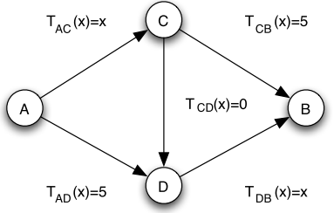
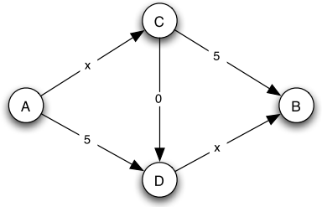
Travel time annotation
Travel times written as
explicit functions of x
Travel times written as
annotations on the edges

Slide 24
Social cost
Traffic pattern: choice of a path by each driver
Social cost: sum of the travel times incurred by all drivers when they use this traffic pattern
Example
  Two different traffic patterns
  Four drivers from node A to node B

Slide 25
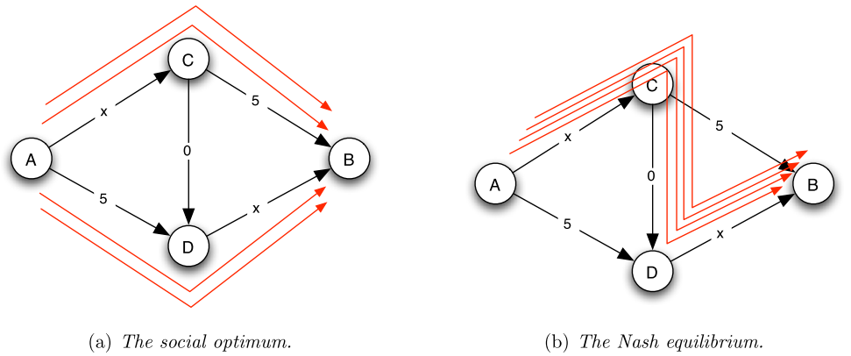
Traffic pattern
TP (a): minimum social cost (social optimum)
  A driver requires 7 travel time, the social cost is 28
TP (b): unique Nash equilibrium
  Driver requires 8 travel time, the social cost is 32
X =2
X =4
X =2
X =4

Slide 26
Traffic Pattern at Equilibrium
Best-response dynamics: A procedure dynamically reconfigures the players ‘s strategies by constantly having some player perform his or her best response to the current situation
  A driver changes paths when it causes his travel time to decrease
Potential energy: evolutionary progress measure
  If an edge currently has x driver, the potential energy of this edge
Potential energy change vs best-response dynamics
  The potential energy in the system strictly decreases through the best-response dynamics
  The change in the potential energy is exactly the improvement in the driver’s travel time

Slide 27
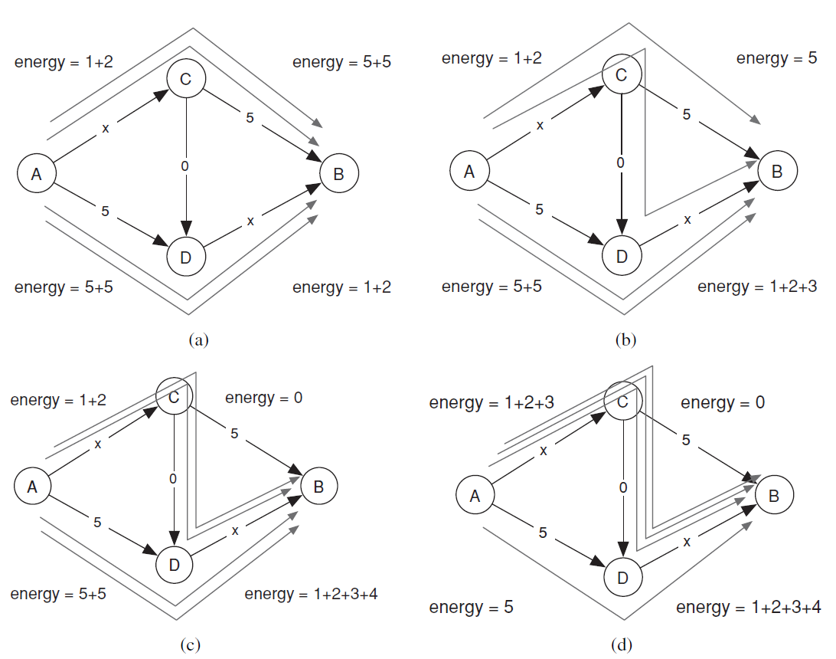
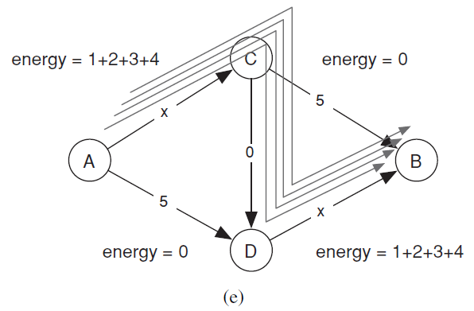
Progress of best-response dynamics and Change of potential energy

Slide 28

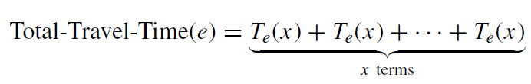


Slide 29
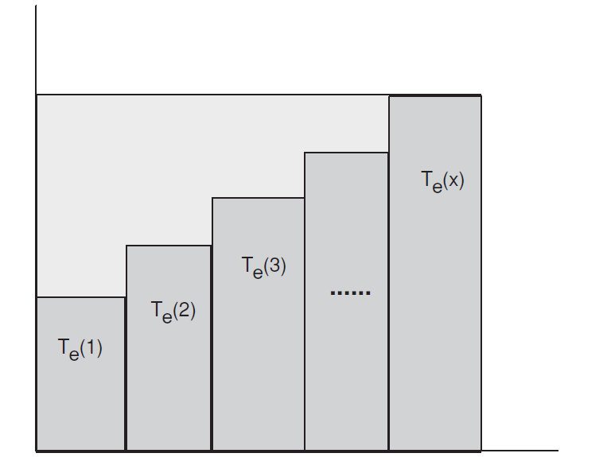


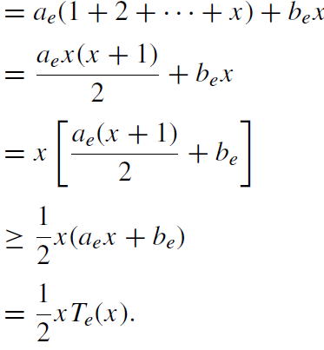

Potential Energy

Slide 30

Traveling Time Equilibrium and Social Optimality
Energy (Z) denotes the total potential energy of all edges when drivers follow the traffic pattern Z
Social-Cost (Z) denotes the social cost of the traffic pattern (the sum of the travel times experiences by all drivers

