Slide 1
Will Affective Computing Emerge From Foundation Models and General Artificial Intelligence? A First Evaluation of ChatGPT
Mostafa M. Amin, University of Augsburg, Augsburg, Germany
Erik Cambria, Nanyang Technological University, Singapore
Björn W. Schuller, University of Augsburg, Augsburg, Germany
IEEE INTELLIGENT SYSTEMS, March-April 2023, pp. 15-23, vol. 38
DOI Bookmark: 10.1109/MIS.2023.3254179

Slide 2
01
Introduction

Slide 3
Introduction
Homogenization
  most use the same model for fine-tuning and training for downstream tasks, as they are effective across many tasks and too cost-intensive to train individually
Emergence
  tasks can be solved that these models were not originally trained upon—potentially even without additional fine-tuning or downstream training
ChatGPT's capabilities on three affective computing problems
  Big-five personality prediction
  Sentiment analysis
  Suicide tendency detection
Notes:
隨著越來越大規模的通用機器學習模型的出現，一個新時代的「基礎模型」已經開始。這些基礎模型的特點是它們是在“廣泛”的數據上訓練的，通常是自監督訓練，規模大，導致了兩個方面的特點：1）同質化（即大多數使用相同的模型進行微調和下游任務的訓練，因為它們對許多任務都有效，且單獨訓練成本過高）和2）湧現（即這些模型可以解決原本未訓練過的任務，甚至可能無需額外的微調或下游訓練）
ChatGPT作為一種通用人工智能模型的潛力，因為它已經在許多自然語言處理任務中展示了良好的表現。在這項工作中，作者評估了ChatGPT在三個情感計算問題上的能力，分別是大五人格預測、情感分析和自殺傾向檢測。他們使用了三個基準線，一個強大的語言模型（RoBERTa-base）、一個具有預訓練嵌入的遺留詞模型（Word2Vec）和一個簡單的詞袋（BoW）基準線
總的來說，這篇文章的目的是為了系統化評估框架，評估ChatGPT在各種分類任務上的表現，以回答它是否展示了其他（與情感計算相關的）NLP任務的完全出現特徵。

Slide 4
02
METHODS

Slide 5
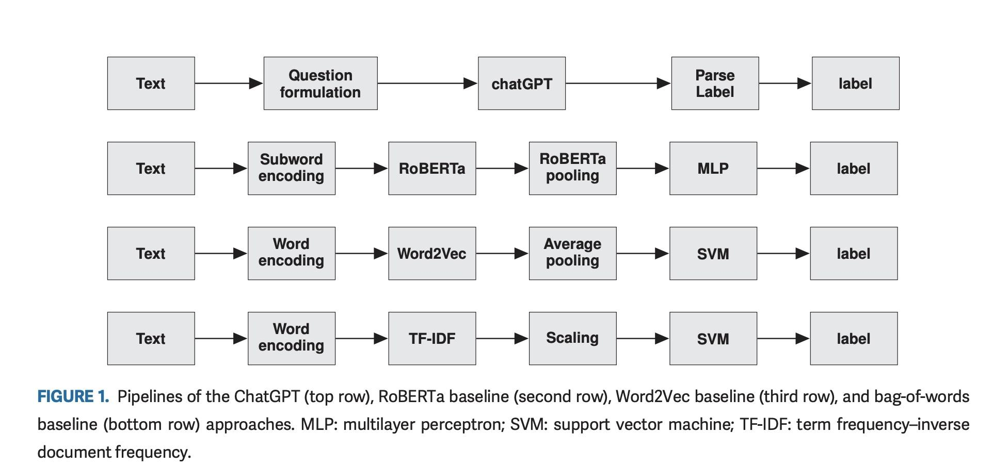
Pipelines of all methods (ChatGPT and the three baselines)
Notes:
本文的目的是評估ChatGPT在各種情感計算任務中的泛化能力。
為了評估這一點，我們使用了三個對應於三個不同問題的數據集，如前所述：大五人格預測、情感分析和自殺傾向評估。對於這些任務，我們使用了三個數據集。對於每個介紹的任務，我們試圖獲得ChatGPT對相應測試集中每個示例的評估。
此外，我們將ChatGPT與三個基準線進行比較，即一個大型語言模型、一個具有預訓練嵌入的詞模型，以及一個基本的詞袋（BoW）模型，而不使用任何外部數據。在本節中，我們描述了數據集、對ChatGPT的查詢過程以及基準線。圖1展示了所有方法（ChatGPT和三個基準線）的流程圖。

Slide 6
Personality Dataset
Personality Dataset
  encompassing the five major personality traits: openness, conscientiousness, extraversion, agreeableness, and neuroticism.
  The dataset consists of 15-second videos, each featuring a single speaker whose personality has been manually labeled.
Sentiment Dataset
  We employed the Sentiment140 dataset for sentiment analysis of Twitter tweets. The dataset includes labeled tweets (positive or negative sentiment),
  with a 9:1 split for training and development, and a test set reduced to 359 tweets due to the absence of neutral labels in the training data.
Suicide and Depression Dataset
  The dataset, drawn from Reddit, features posts from subreddits such as "SuicideWatch," "depression," and "teenagers," with "teenagers" posts labeled as negative and others as positive
  excluding examples exceeding 512 characters and partitioned into training, development, and testing subsets.
Notes:
人格數據集
我們利用第一印象數據集（First Impressions dataset）進行人格任務。人格由五大人格特質來表示，分別是開放性、負責任性、外向性、親和力和神經質。該數據集包含了一位發言者的15秒視頻，其人格是手動標記的。這種標記是通過相對比較兩個視頻之間的排名來進行的，評估哪個人在每個五大人格特質上得分較高。然後使用統計模型將標籤轉化為在[0, 1]範圍內的回歸值。人格標籤是基於視頻的多種模態進行的，包括圖像、音頻和文本（內容）。我們利用這些視頻的文字稿作為用於預測人格的輸入。我們使用數據集出版者提供的訓練/開發（dev）/測試分割。與Kaya等人一樣，我們將模型訓練為回歸問題（使用平均絕對誤差作為損失函數），因為連續的地面真值可以給出對標籤更細緻的估計；然後，我們使用閾值0.5將其二元化為正面或負面。
情感數據集
我們採用了Sentiment140數據集進行情感分析任務。該數據集從Twitter上收集了大量推文，文本非常嘈雜，這可能對許多模型（尤其是詞模型）構成挑戰。該數據集包含推文和相應的情感標籤（正面或負面）。我們將訓練部分按9:1的比例分割，形成訓練和開發部分，如表1所列。測試部分僅包含497條推文；然而，由於其餘的推文有中性標籤，在訓練集中並不存在，因此將其過濾為359條。
自殺和憂鬱數據集來自Reddit平台，分別來自不同的子論壇類別，包括“SuicideWatch”、“depression”和“teenagers”。來自“teenagers”類別的帖子文本被標記為負面，而來自其他兩個類別的文本被標記為正面。我們排除了長於512個字符的示例，然後將數據集分為三個部分：訓練、開發和測試。

Slide 7
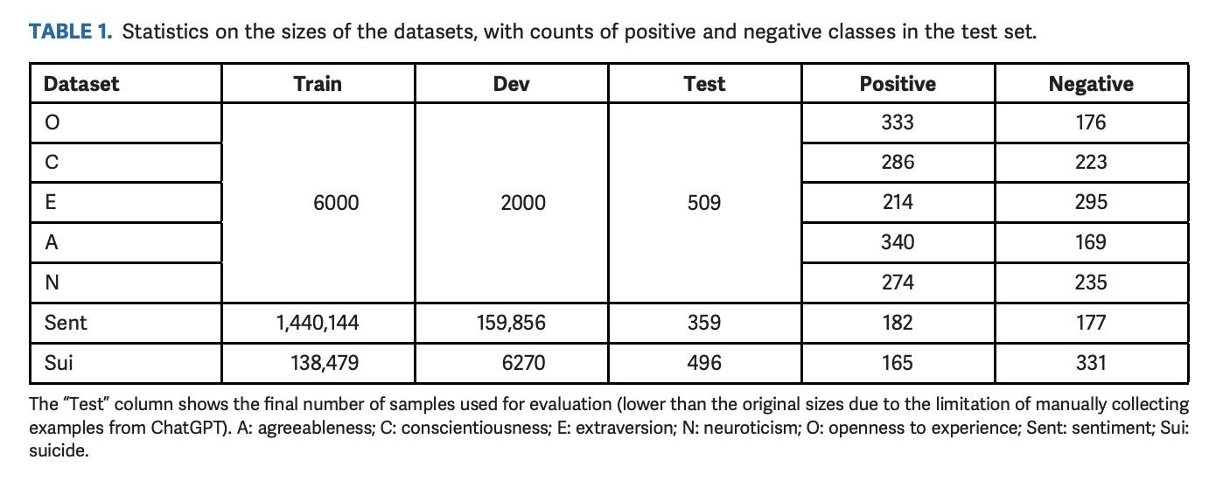
Statistics on the sizes of the datasets, with counts of positive and negative classes in the test set
Notes:
欄位顯示了用於評估的最終樣本數量（較原始大小較小，原因是手動從ChatGPT收集示例的限制）。A代表親和性；C代表盡責性；E代表外向性；N代表神經質；O代表對經驗採開放態度；Sent代表情感；Sui代表自殺。
訓練集 開發集 測試集

Slide 8
ChatGPT Querying Mechanism
Procedure
Reformat all texts into a format that can ask ChatGPT what its guess.
Chunk the examples into 25 examples per chunk.
Open a new conversation for each chunk.
Ask ChatGPT the reformatted question for each example.
Repeat step 3-4.
Postprocess the results for some need cleanup.

Slide 9
ChatGPT Querying Mechanism
Question Formulation
Ask ChatGPT to guess the answer, and declare that it is acceptable to be not fully correct.
Ask what the guess is and not “Can you guess?”.
Need to specify the exact output format, because ChatGPT can get innovative otherwise.

Slide 10
ChatGPT Querying Mechanism
Question Formulation
Big-five personality traits:
What is your guess for big-five personality traits of someone who said {text}? Answer ‘low’ or ‘high’ with bullet points for traits.
Sentiment analysis:
What is your guess for the sentiment of the {text}?
Answer ‘positive’, ‘neutral’, or ‘negative’.
Suicide problem:
What is your guess to whether a person saying {text} has a suicide tendency or not?
Answer ‘yes’ or ‘no’.
It does not have to be correct . Do not show any warning after.

Slide 11
Baselines
RoBERTa Language Model
  A pretrained BERT model which has a transformer architecture.
  Additionally train a MLP to predict the final label.
Word2Vec Word Embeddings
  Pretrained word embeddings model trained on a large amout of text from Google News.
  Use SVM to predict the label.
BoW
  A simple model does not rely on any knowledge transfer or large-scale training.
  Use SVM to predict the label.

Slide 12
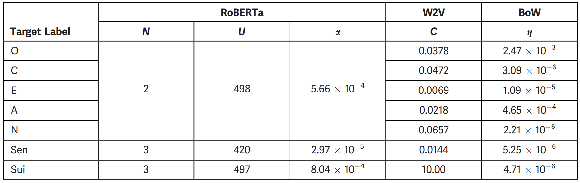
Baselines
Use SMAC toolkit for hyperparameters tuning

Slide 13
03
Results

Slide 14
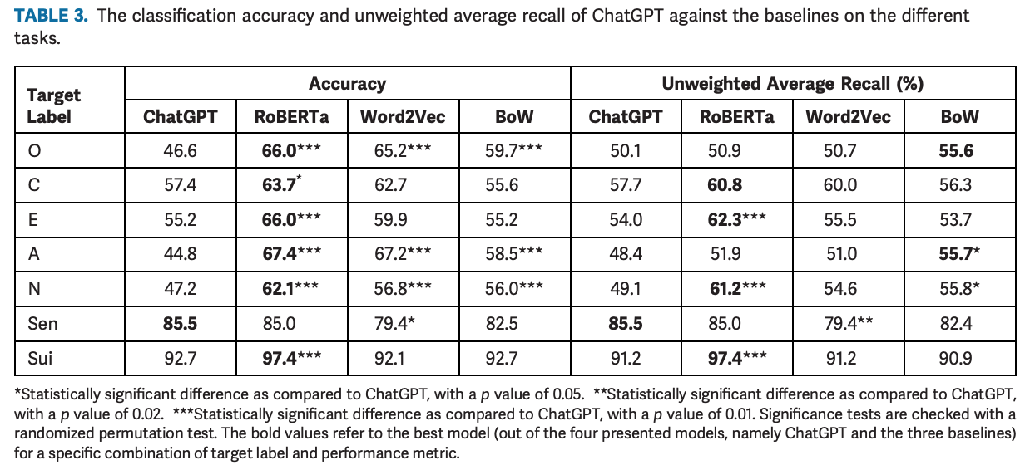
Results
Notes:
在本節中，本研究回顧作者的實驗結果。綜上所述，作者評估性能ChatGPT 與三個基線 RoBERTa 的對比，Word2Vec 和 BoW——三個下游分類任務，即人格特徵、情緒分析和自殺傾向評估。作者測量分類準確率與未加權平均召回率(UAR)20 作為績效衡量標準。 UAR 的優點是可以揭示模型的性能是否非常好
在一個類別上表現良好，但會犧牲另一個類別的效能，尤其是在不平衡的資料集中。此外，作者利用隨機排列檢定作為統計顯著性檢定。21 實驗的主要結果是
如表3所示。

Slide 15
04
Discussion

Slide 16
Discussion
RoBERTa Model:
Best for personality and suicide assessment tasks.
Statistically significant improvement over ChatGPT in accuracy.
ChatGPT:
Best in sentiment analysis, slightly better than RoBERTa.
Inferior performance compared to baselines and RoBERTa in personality assessment.
Suicide assessment task, less challenging than personality assessment, with more training data. ChatGPT better predicts negative sentiment.
Limitations:
Limited evaluation data (497, 362, and 509 examples for the three tasks) due to ChatGPT's availability only for manual entries, restricting automated large-scale testing.
ChatGPT responds to approximately 25-35 requests per hour to manage computational costs and prevent brute force attacks.
In experiments, ChatGPT's responses exhibit arbitrary formatting despite explicit format specification in question prompts, potentially limiting future experiments.
Notes:
RoBERTa 模型在個性和自殺評估任務上取得最佳表現，與 ChatGPT 相比準確性有顯著提高，且統計上具有意義。
ChatGPT 在情感分析中表現最佳，在此方面略優於 RoBERTa 和 BoW，並且比 Word2Vec 顯著優越。
ChatGPT 在個性評估上的表現不及三個基準模型，尤其是與 RoBERTa 相比。
自殺評估任務不如個性評估困難，並具有更多的訓練數據。ChatGPT 在預測負面情感方面表現較好。
限制：
評估數據量較少，且 ChatGPT僅供消費者手動輸入，無法進行自動大規模測試。
每小時僅回應約 25-35 次請求，以降低計算成本和避免強制攻擊。
在實驗中，ChatGPT 的回應格式不一致，儘管問題提示明確指定了所需格式，這可能限制了未來實驗的進行。

Slide 17
05
Conclusion

Slide 18
Conclusion
Findings:
ChatGPT is a generalist model with decent performance across various problems without specialized training.
Superior in sentiment analysis, poor in personality assessment, average in suicide assessment.
Shows emergence properties, potentially reducing reliance on task-specific databases.
Comparison:
ChatGPT's performance not significantly better than simple BoW model in most cases.
RoBERTa, when fine-tuned for specific tasks, outperforms ChatGPT, suggesting specialized models still optimal.
Future Directions:
  Plan to extend experiments to include metrics like explainability and computational efficiency.
  Expand evaluation to more sophisticated models and advanced affective computing tasks, including sarcasm detection, metaphor understanding, and conversational emotion recognition.
Notes:
介紹：
透過廣泛資料訓練的基礎模型首次洞察任務的潛在出現。
專注於情感運算中的自然語言任務，使用 ChatGPT 作為示範模型。
框架：
引入了框架來評估 ChatGPT 作為通才與專業模型的表現。
對三個情緒計算問題的七個分類任務進行評估：人格評估、情緒分析和自殺傾向評估。
基線：
將結果與三個基準進行比較：RoBERTa、Word2Vec 和詞袋 (BoW) 模型。
發現：
ChatGPT 是一種通才模型，無需專門培訓即可在各種問題上表現良好。
情感分析優秀，性格評估較差，自殺評估一般。
顯示湧現屬性，有可能減少對特定任務資料庫的依賴。
比較：
在大多數情況下，ChatGPT 的表現並不明顯優於簡單的 BoW 模型。
當針對特定任務進行微調時，RoBERTa 的表現優於 ChatGPT，這表明專用模型仍然是最佳的。
未來發展方向：
計劃擴展實驗以包括可解釋性和計算效率等指標。
將評估擴展到更複雜的模型和高級情感計算任務，包括諷刺檢測、隱喻理解和會話情感識別。

Slide 19

THANKS!

Slide 20
USE THIS CALENDAR
JANUARY | FEBRUARY | MARCH | APRIL
Main activity | Main activity | Main activity | Main activity
MAY | JUNE | JULY | AUGUST
Main activity | Main activity | Main activity | Main activity
SEPTEMBER | OCTOBER | NOVEMBER | DECEMBER
Main activity | Main activity | Main activity | Main activity

Slide 21
THREE IMPORTANT IDEAS
JUPITER
VENUS
SATURN
Jupiter is a gas giant and the biggest planet in the Solar System. It's the fourth-brightest object in the night sky and it was named after the Roman god of the skies
Venus has a beautiful name and is the second planet from the Sun. It’s terribly hot and its atmosphere is poisonous. It’s the second-brightest natural object in the night sky
Saturn is a gas giant and has several rings and it's composed mostly of hydrogen and helium. Saturn was also named after the Roman god of wealth and agriculture

Slide 22
YOU CAN USE THIS INFOGRAPHIC
PHASES
1 | OK | Mercury is the smallest planet of them all
2 | - | Venus is extremely hot, even hotter than Mercury
3 | - | Despite being red, Mars is actually a cold place
4 | X | Jupiter is the biggest planet in the Solar System
DATE
MON | TUE | WEN | THU | FRI | SAT | SUN
1 | 2 | 3 | 4 | 5 | 6 | 7
8 | 9 | 10 | 11 | 12 | 13 | 14
15 | 16 | 17 | 18 | 19 | 20 | 21
22 | 23 | 24 | 25 | 26 | 27 | 28
29 | 30 | 31 | - | - | - | -

Slide 23
THESE ARE FOUR IDEAS
MARS
VENUS
Despite being red, Mars is actually a cold place. It's full of iron oxide dust, which gives the planet its reddish cast
Venus has a beautiful name and is the second planet from the Sun. It’s terribly hot, even hotter than Mercury
JUPITER
SATURN
Jupiter is a gas giant and the biggest planet in the Solar System. It's the fourth-brightest object in the night sky
Saturn is a gas giant and has several rings. It's composed mostly of hydrogen and helium. It has beautiful rings

Slide 24
HERE’S ANOTHER INFOGRAPHIC
MOON
The Moon is Earth’s only natural satellite
EARTH
Earth is the third planet from the Sun
NEPTUNE
Neptune is the farthest planet from the Sun
PROJECT
SATURN
It’s composed of hydrogen and helium
JUPITER
It’s the biggest planet in the Solar System
MARS
Despite being red, Mars is a cold place

Slide 25
REVIEWING CONCEPTS
MARS
VENUS
NEPTUNE
Despite being red, Mars is actually a cold place. It's full of iron oxide dust, which gives the planet its reddish cast
Venus has a beautiful name and is the second planet from the Sun. It’s terribly hot, even hotter than Mercury
Neptune is the farthest planet from the Sun. It's also the fourth-largest planet by diameter in the Solar System
EARTH
SATURN
JUPITER
Earth is the third planet from the Sun and the only one that harbors life in the Solar System. This is where we all live
Saturn is a gas giant and has several rings. It's composed mostly of hydrogen and helium. It has beautiful rings
Jupiter is a gas giant and the biggest planet in the Solar System. It's the fourth-brightest object in the night sky

Slide 26
AWESOME WORDS

Slide 27
—SOMEONE FAMOUS
“This is a quote, words full of wisdom that someone important said and can make the reader get inspired”

Slide 28

A PICTURE IS WORTH A THOUSAND WORDS

Slide 29

A PICTURE ALWAYS REINFORCES
THE CONCEPT
Images reveal large amounts of data, so remember: use an image instead of a long text. Your audience will appreciate it

Slide 30
98,300,000
Big numbers catch your audience’s attention

Slide 31
9h 55m 23s
333,000
386,000 km
Jupiter's rotation period
The Sun’s mass compared to Earth’s
Distance between Earth and the Moon

Slide 32
ALSO USE THIS INFOGRAPHIC
DEFINE
PLAN
CLOSE
Despite being red, Mars is a cold place
Mercury is the closest planet to the Sun
The Moon is Earth’s only natural satellite
Saturn was named after a Roman god
Venus is the second planet from the Sun
Pluto is now considered a dwarf planet
Jupiter is the biggest planet of them all
Earth is the third planet from the Sun
Neptune is very far away from us

Slide 33
LET’S USE SOME PERCENTAGES
25%
50%
75%
MERCURY
VENUS
MARS
Mercury is the closest planet to the Sun and the smallest of them all
Venus has a beautiful name and is the second planet from the Sun
Despite being red, Mars is actually a cold place. It’s full of iron oxide dust

Slide 34
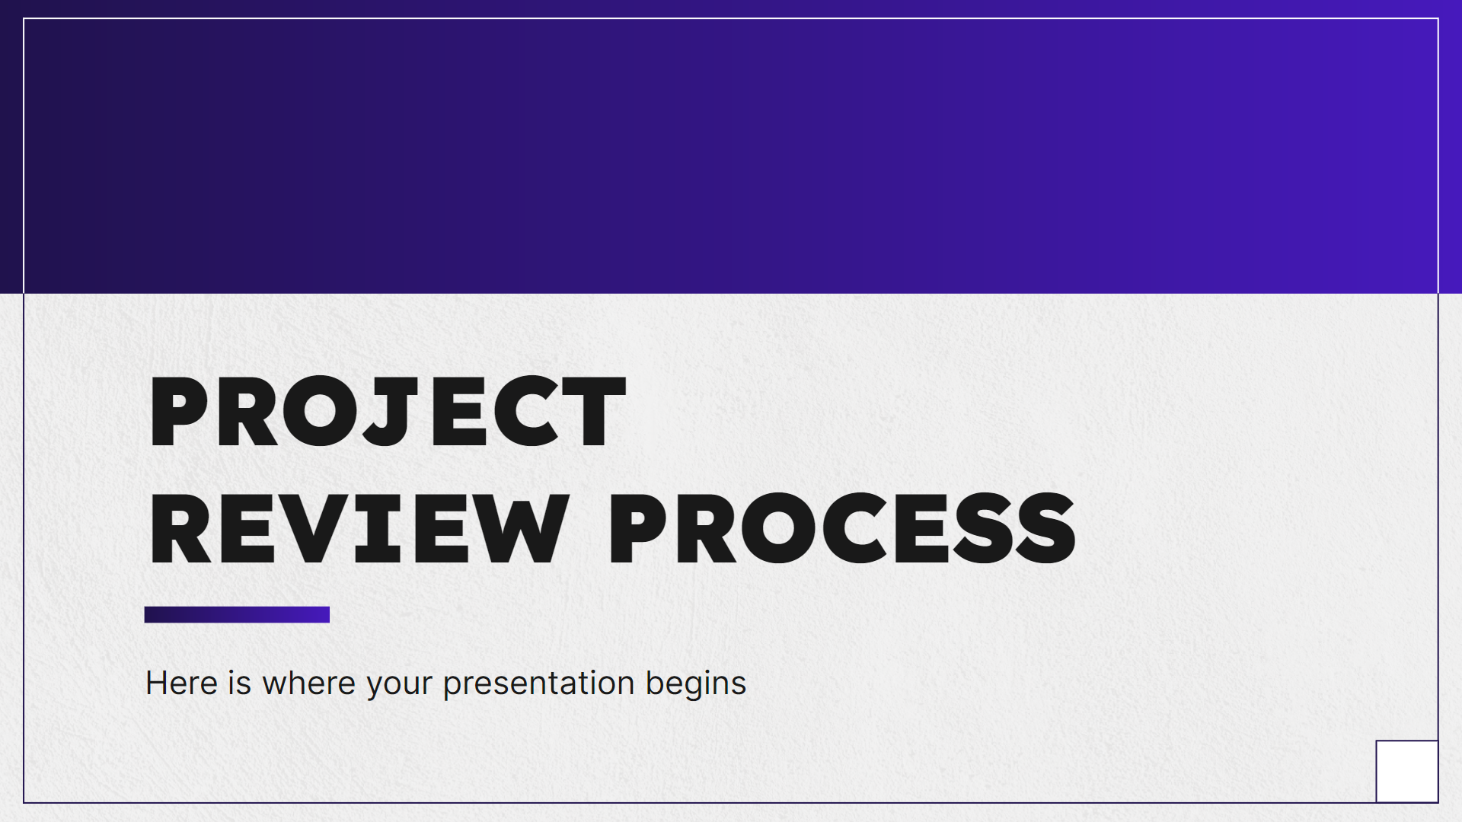
COMPUTER MOCKUP
You can replace the image on the screen with your own work. Just right-click on it and select “Replace image”

Slide 35

TABLET MOCKUP
You can replace the image on the screen with your own work. Just right-click on it and select “Replace image”

Slide 36

PHONE MOCKUP
You can replace the image on the screen with your own work. Just right-click on it and select “Replace image”

Slide 37
A TIMELINE ALWAYS WORKS WELL
STEP 1
STEP 2
STEP 3
STEP 4
Earth is the third planet from the Sun
The Moon is Earth’s only natural satellite
Mercury is the closest object to the Sun
Saturn was named after a Roman god
01
02
03
04
08
07
06
05
STEP 8
STEP 7
STEP 6
STEP 5
Neptune is very far away from us
Despite being red,
Mars is a cold place
Jupiter was named after a Roman god
Ceres is located in the main asteroid belt

Slide 38
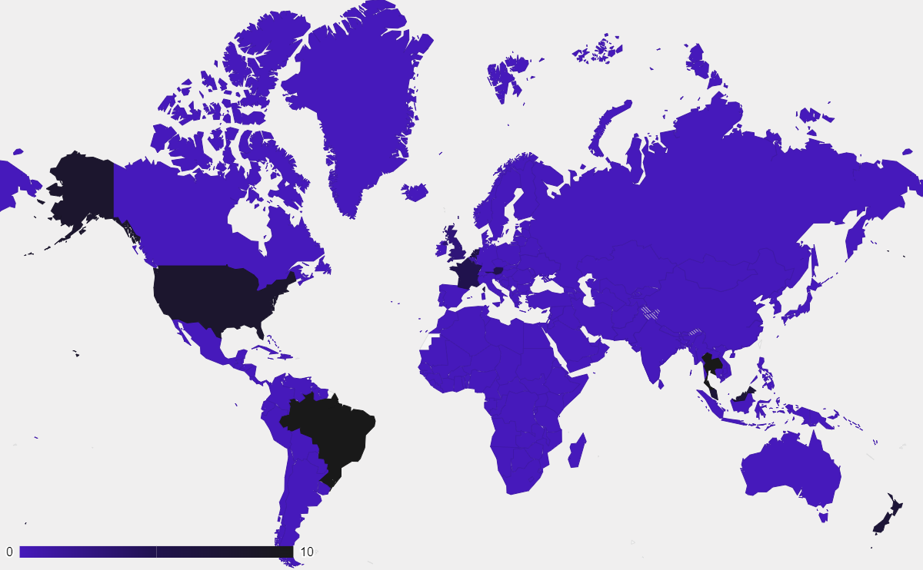
THIS IS A MAP
MARS
Mars is very cold
MERCURY
Mercury is small
VENUS
Venus is very hot
Follow the link in the graph to modify its data and then paste the new one here. For more info, click here

Slide 39
A TIMELINE ALWAYS WORKS WELL
STEP 01
STEP 03
Jupiter is the farthest planet from the Sun
Despite being red, Mars is a cold place
STEP 02
STEP 04
Saturn was named after a Roman god
Mercury is the closest object to the Sun

Slide 40
INFOGRAPHICS ARE USEFUL
MARS
A
B
VENUS
Despite being red, Mars is actually a cold place. It’s full of iron oxide dust
Venus has a beautiful name and is the second planet from the Sun
SOLAR SYSTEM
MERCURY
G
H
JUPITER
Mercury is the closest planet to the Sun and the smallest of them all
Jupiter is a gas giant and the biggest planet in the Solar System

Slide 41
USE TABLES TO REPRESENT DATA
 |  | TEAM A | TEAM B | TEAM C | TEAM D
TASK 1 | MERCURY | Jupiter is big | Mercury is small | Venus is very hot | Earth has life
 | MARS | XX | XX | XX | XX
TASK 2 | SATURN | Saturn has rings | Mars is a red planet | The Sun is a star | Mars is very cold
 | VENUS | XX | XX | XX | XX
RESULTS |  | 100K | 250K | 860K | 450K

Slide 42
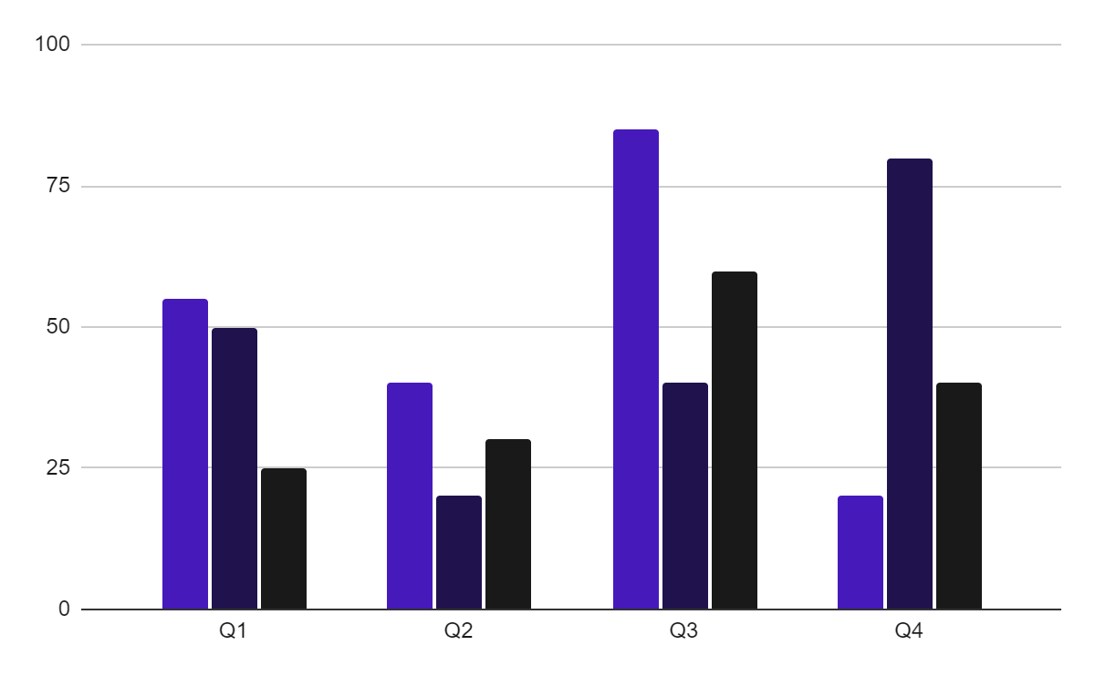
YOU CAN USE THIS GRAPH
TEAM 1
TEAM 2
TEAM 3
Follow the link in the graph to modify its data and then paste the new one here. For more info, click here

Slide 43
ROADMAP INFOGRAPHIC
 |  | MONTH
 |  | 1 | 2 | 3 | 4 | 5 | 6 | 7 | 8 | 9 | 10 | 11 | 12
PHASE 01 | Task 1
 | Task 2
PHASE 02 | Task 4
 | Task 5
PHASE 03 | Task 6
In progress
Done

Slide 44


OUR TEAM
SOFIA HILL
TOM HARRIS
You can speak a bit about this person here
You can speak a bit about this person here

Slide 45
THANKS!
Do you have any questions?
youremail@freepik.com
+34 654 321 432
yourwebsite.com
Please keep this slide for attribution

Slide 46
ALTERNATIVE RESOURCES
Here’s an assortment of alternative resources whose style fits the one of this template:

Slide 47
RESOURCES
Did you like the resources on this template? Get them for free at our other websites:
Photos
Beautiful women working together in a startup company
Corporate employee posing at the office
Businessman looking on a tablet
Two male colleagues talking to each other during a meeting
Office workers using finance graphs
Man showing something to his colleagues on laptop during a meeting

Slide 48
Instructions for use
If you have a free account, in order to use this template, you must credit Slidesgo by keeping the Thanks slide. Please refer to the next slide to read the instructions for premium users.
As a Free user, you are allowed to:
Modify this template.
Use it for both personal and commercial projects.
You are not allowed to:
Sublicense, sell or rent any of Slidesgo Content (or a modified version of Slidesgo Content).
Distribute Slidesgo Content unless it has been expressly authorized by Slidesgo.
Include Slidesgo Content in an online or offline database or file.
Offer Slidesgo templates (or modified versions of Slidesgo templates) for download.
Acquire the copyright of Slidesgo Content.
For more information about editing slides, please read our FAQs or visit our blog:
https://slidesgo.com/faqs and https://slidesgo.com/slidesgo-school

Slide 49
Instructions for use (premium users)
As a Premium user, you can use this template without attributing Slidesgo or keeping the Thanks slide.
You are allowed to:
Modify this template.
Use it for both personal and commercial purposes.
Hide or delete the “Thanks” slide and the mention to Slidesgo in the credits.
Share this template in an editable format with people who are not part of your team.
You are not allowed to:
Sublicense, sell or rent this Slidesgo Template (or a modified version of this Slidesgo Template).
Distribute this Slidesgo Template (or a modified version of this Slidesgo Template) or include it in a database or in any other product or service that offers downloadable images, icons or presentations that may be subject to distribution or resale.
Use any of the elements that are part of this Slidesgo Template in an isolated and separated way from this Template.
Register any of the elements that are part of this template as a trademark or logo, or register it as a work in an intellectual property registry or similar.
For more information about editing slides, please read our FAQs or visit our blog:
https://slidesgo.com/faqs and https://slidesgo.com/slidesgo-school

Slide 50
Fonts & colors used
This presentation has been made using the following fonts:
Lexend
(https://fonts.google.com/specimen/Lexend)
Inter
(https://fonts.google.com/specimen/Inter)
#191919
#f0efef
#ffffff
#4619bb
#20124d

Slide 51




Storyset
Create your Story with our illustrated concepts. Choose the style you like the most, edit its colors, pick the background and layers you want to show and bring them to life with the animator panel! It will boost your presentation. Check out how it works.
Pana
Amico
Bro
Rafiki
Cuate

Slide 52
Use our editable graphic resources...
You can easily resize these resources without losing quality. To change the color, just ungroup the resource and click on the object you want to change. Then, click on the paint bucket and select the color you want. Group the resource again when you’re done. You can also look for more infographics on Slidesgo.

Slide 55
JANUARY
FEBRUARY
MARCH
APRIL
MAY
JUNE
PHASE 1
Task 1
Task 2
PHASE 2
Task 1
Task 2
JANUARY
FEBRUARY
MARCH
APRIL
PHASE 1
Task 1
Task 2

Slide 58
...and our sets of editable icons
You can resize these icons without losing quality.
You can change the stroke and fill color; just select the icon and click on the paint bucket/pen.
In Google Slides, you can also use Flaticon’s extension, allowing you to customize and add even more icons.

Slide 59
Educational Icons
Medical Icons

Slide 60
Business Icons
Teamwork Icons

Slide 61
Help & Support Icons
Avatar Icons

Slide 62
Creative Process Icons
Performing Arts Icons

Slide 63
Nature Icons

Slide 64
SEO & Marketing Icons

Slide 65


