Slide 1
RePrompt: Automatic Prompt Editing to Refine AI-Generative Art
Towards Precise Expressions
Yunlong Wang, Shuyuan Shen, Brian Y. Lim
ACM Conference on Human Factors in Computing Systems, April 23–28, 2023, Hamburg, Germany

Slide 2
01
Introduction

Slide 3
Introduction
This paper explores the emotional expressiveness of AI-generated images and proposes a method called RePrompt to refine textual prompts to more accurately express the generated images.
The authors conducted an interview study to understand how laypeople experience AI-generated images and how they edit text prompts to improve AI output. Based on these results, they developed an algorithm with interpretable AI technology to automatically edit text prompts for better image generation.
The goal is to optimize text prompts so that AI-generated images more accurately capture the intended meaning and emotion.
This article discusses potential applications of using AI to generate emotional images from text.
Contributions of this paper include the development of a novel rapid engineering method, RePrompt, and the evaluation of its effectiveness in improving the emotional expressiveness of AI-generated images.
Notes:
** 論文介紹「重新提示：自動提示編輯以改善 AI 生成藝術，以實現精準表達方式」**
-該論文探討人工智能產生圖像的情感表現力，並提出一種稱為 RePrompt 的方法，以精細化文本提示，以更精確地表達生成的圖像。
-作者進行了一項採訪研究，以了解外行人如何感受 AI 產生的圖像以及他們如何編輯文本提示以改善 AI 輸出。根據這些結果，他們開發了一種運算方法，具有可解釋的 AI 技術，以自動編輯文本提示，以獲得更好的圖像生成。
-目標是優化文本提示，以使 AI 生成的圖像更準確地捕捉預期的意義和情感。
-本文討論使用 AI 以文本產生情感圖像的潛在應用。
-該論文的貢獻包括開發一種新穎的快速工程方法 RePrompt，以及評估其在改善人工智能產生圖像的情感表現力方面的有效性。

Slide 4
02
Background And Related Work

Slide 5
Text-to-Image Generative AI and
Vision-Language Mode
HCI researchers explore AI technologies for creativity, including crowd ideation, music creation, and news illustrations.
State-of-the-art text-to-image generative AI tools like VQGAN-CLIP and DALL·E 2 allow users to create visual art from plain language prompts.
Pretrained vision-language cross-modal models like CLIP and ALIGN learn text-image relationships in a unified semantic space.
CLIP-based generative models enable evaluation of image captioning, sketch generation, image quality perception, and emotion expression.
Further research aims to develop prompt engineering methods to enhance AI's ability to generate images from longer, more complex emotional text expressions.
Notes:
文字到圖像生成人工智慧和視覺語言模式
人機互動研究人員探索人工智慧技術的創造力，包括群體構思、音樂創作和新聞插圖。
VQGAN-CLIP 和 DALL·E 2 等最先進的文字轉圖像生成人工智慧工具允許使用者根據簡單的語言提示創建視覺藝術。
像 CLIP 和 ALIGN 這樣的預訓練視覺語言跨模態模型可以在統一的語義空間中學習文字-圖像關係。
基於 CLIP 的生成模型可以評估影像字幕、草圖生成、影像品質感知和情緒表達。
進一步的研究旨在開發快速的工程方法，以增強人工智慧從更長、更複雜的情感文本表達生成圖像的能力。

Slide 6
Prompt Engineering for Generative AI
Prompt engineering involves creating or adjusting prompts to enhance outputs of large language and text-to-image models like GPT-3 and DALL·E 2.
It's an alternative to fine-tuning models, especially when models have many parameters or when full model access isn't available.
Prior research has focused on gradient-based methods for automated prompt tuning, aiming to improve model performance for various tasks.
While these methods are effective, they lack human readability, which could hinder human-AI collaboration.
In the specific area of text-to-image models, prompt engineering research is still emerging, with early studies exploring short prompts and heuristic-driven approaches.
Notes:
提示工程涉及創建或調整提示以增強大型語言和文字到圖像模型（如 GPT-3 和 DALL·E 2）的輸出。
它是微調模型的替代方案，特別是當模型具有許多參數或無法存取完整模型時。
先前的研究主要集中在基於梯度的自動提示調整方法，旨在提高各種任務的模型效能。
雖然這些方法很有效，但它們缺乏人類可讀性，這可能會阻礙人類與人工智慧的協作。
在文字到圖像模型的特定領域，提示工程研究仍在興起，早期研究探索短提示和啟發式驅動的方法。

Slide 7
Emotional Expression and Assessment in Visual Art
Evaluating emotional expression in visual art remains challenging despite the development of numerous evaluation methods.
Psychologists have created Likert scale questionnaires and the Aesthetic Emotions Scale to measure affective and cognitive components in visual art perception.
Objective measures such as cardiac signature analysis and facial electrocardiogram are used for assessing emotional response but are limited by specialized equipment.
Machine learning-based approaches are emerging for automatically evaluating image quality and aesthetics, leveraging datasets like the International Affective Picture System.
Pre-trained vision-language models like CLIP enable new tools for image assessment, with studies showing promising results in emotion classification compared to traditional methods.
Notes:
儘管發展了多種評估方法，但評估視覺藝術中的情緒表達仍然具有挑戰性。
心理學家創建了李克特量表問捲和美學情感量表來衡量視覺藝術感知中的情緒和認知成分。
心臟特徵分析和臉部心電圖等客觀測量可用於評估情緒反應，但受到專用設備的限制。
基於機器學習的方法正在興起，可利用國際情緒圖片系統等資料集自動評估影像品質和美觀度。
像 CLIP 這樣的預訓練視覺語言模型為影像評估提供了新的工具，研究表明與傳統方法相比，在情緒分類方面取得了有希望的結果。

Slide 8
Explainable AI and Applications in HCI
Explainable AI (XAI) techniques are crucial for understanding complex AI systems and have been shown to increase user trust and comprehension.
Various XAI techniques like LIME, SHAP, Anchors, and saliency maps have been developed to explain model behaviors based on input data types and machine learning models.
XAI plays a vital role in human-AI collaboration scenarios, aiding tasks such as computer-aided translation, music creation, crowd ideation, and feedback generation.
Applying XAI to understand how prompt features influence text-to-image generative model outputs and developing interpretable prompt engineering methods can enhance emotional expressiveness in text-to-image generation.
This research contributes to the broader effort of using XAI to improve user understanding and interaction with AI systems.
Notes:
可解釋的人工智慧 (XAI) 技術對於理解複雜的人工智慧系統至關重要，並且已被證明可以提高使用者的信任和理解。
LIME、SHAP、Anchors 和顯著圖等各種 XAI 技術已被開發出來，用於根據輸入資料類型和機器學習模型解釋模型行為。
XAI 在人機協作場景中發揮著至關重要的作用，可協助執行電腦輔助翻譯、音樂創作、團體構思和回饋生成等任務。
應用 XAI 來了解提示特徵如何影響文字到圖像生成模型輸出並開發可解釋的提示工程方法可以增強文字到圖像生成中的情感表達。
這項研究有助於更廣泛地使用 XAI 來提高使用者對 AI 系統的理解和互動。

Slide 9
03
Research Question And Methodology

Slide 10
Research Questions
We are interested in :
1) understanding how well the state-of-the-art text-to-image generative models could generate images with emotional texts as prompts, and
2) exploring how to improve the emotion expression of the images generated. For these overarching goals, we propose three research questions:
RQ1. How would laypersons perceive the AI-generated images regarding emotional expressiveness and strategically refine the text prompts to improve image generation?
RQ2. How can text prompts be automatically refined to generate better images regarding emotional expressiveness?
RQ3. How effective is RePrompt at improving emotional expression in image generation?
Notes:
我們感興趣的是
1）了解最先進的文字到圖像生成模型如何產生以情感文字作為提示的圖像，以及
2）探索如何提高生成影像的情感表達。 對於這些總體目標，我們提出三個研究問題：
RQ1。 外行人如何看待人工智慧生成的圖像的情感表達，並如何策略性地完善文字提示以改善圖像生成？
RQ2。 如何自動細化文字提示以產生更好的情感表達圖像？
RQ3。 RePrompt 在改善影像生成中的情緒表達方面效果如何？

Slide 11
Methodology
The methodology involved conducting interviews to understand how laypersons interacted with a text-to-image generative AI model and developed prompt-editing strategies. Participants relied on intuition and trial-and-error, highlighting the need for understanding the AI model and effective support for prompt refinement.
To address the research question of improving output images, the researchers developed RePrompt, an XAI-based automatic prompt engineering method. It involved understanding prompt features that lead to better output images and automatically revising text prompts using machine learning models and XAI techniques.
The effectiveness of RePrompt was evaluated through a simulation study and user study, comparing the quality of images generated from RePrompt text prompts with other text methods. The study used text-to-image models and a text dataset for evaluation and development of the prompt engineering approach.
Notes:
該方法涉及進行訪談，以了解外行人如何與文字到圖像生成人工智慧模型進行交互，並製定即時編輯策略。 參與者依靠直覺和反覆試驗，強調需要理解人工智慧模型並為迅速改進提供有效支援。
為了解決改善輸出影像的研究問題，研究人員開發了 RePrompt，一種基於 XAI 的自動提示工程方法。 它涉及了解提示功能，從而獲得更好的輸出圖像，並使用機器學習模型和 XAI 技術自動修改文字提示。
RePrompt 的有效性透過模擬研究和使用者研究進行評估，將 RePrompt 文字提示產生的影像品質與其他文字方法進行比較。 該研究使用文字到圖像模型和文字資料集來評估和開發即時工程方法。

Slide 12
Text-to-Image Models
VQGAN-CLIP is an open-source generative model that uses VQGAN and CLIP to generate images and guide the generative model. It was chosen to generate 10,000 images for training the proxy model.
DALL·E 2 is another generative model that uses a diffusion model to generate images and CLIP to assess image-text alignment. It produces more photorealistic images than VQGAN-CLIP and has filtering mechanisms to mitigate the generation of deceptive and harmful content.
DALL·E 2 is faster than VQGAN-CLIP in generating images with the same resolution, making it suitable for real-time user interaction. However, it is only available via the official website and does not have an API yet.
Notes:
VQGAN-CLIP是一個開源的生成模型，使用VQGAN和CLIP來產生圖像並指導生成模型。 選擇產生 10,000 張圖像來訓練代理模型。
DALL·E 2 是另一種生成模型，它使用擴散模型來產生圖像，並使用 CLIP 來評估圖像文字對齊。 它產生比 VQGAN-CLIP 更逼真的圖像，並具有過濾機制來減少欺騙性和有害內容的生成。
DALL·E 2 產生相同解析度影像的速度比 VQGAN-CLIP 更快，適合即時使用者互動。 不過，目前只能透過官方網站獲取，尚無 API。

Slide 13
Emotional Text Dataset
The EmpatheticDialogues dataset is frequently used for training empathetic AI chatbots and consists of 25k conversations grounded in emotional situations with emotion labels.
The dataset is suitable for the research questions as it focuses on people's daily practice of emotion expression and contains natural emotion expressions grounded in real experiences and contexts.
The dataset was chosen for its high text quality and lack of typos, random symbols, and odd acronyms found in some Twitter datasets.
In the interview study, 200 emotional texts with 10 emotions were randomly selected, excluding instances with low text-emotion alignment and forbidden words. The final set consisted of 146 texts and corresponding images.
Notes:
EmpatheticDialogues 資料集經常用於訓練具有同理心的 AI 聊天機器人，由 25000 個基於情感情境的對話組成，並帶有情感標籤。
此資料集適合研究問題，因為它關注人們日常的情感表達實踐，包含基於真實經驗和情境的自然情感表達。
選擇該資料集是因為其文字品質高，並且沒有一些 Twitter 資料集中發現的拼字錯誤、隨機符號和奇怪的首字母縮寫。
在訪談研究中，隨機選擇了 200 篇包含 10 種情緒的情緒文本，排除了文本情緒一致性較低的實例和禁用字詞。 最終的一組由 146 個文字和相應的圖像組成。

Slide 14
04
Interview Study

Slide 15
Interview Study
Emotional texts
  10 types of emotion: joyful, sad, angry, afraid, lonely, excited, proud, surprised, trusting, and anxious.
  Trusting and anxious are excluded.
  Some words were forbidden due to DALL-E 2’s content policy.
  146 texts in total

Slide 16
Interview Study
Procedure
  The experimenter shared their screen of the DALL·E 2 website with the participant over Zoom and pasted the prepared text into the input box on the website.
Rate (from 0 to 100) the text-emotion alignment.
View the AI-generated images according to the text prompt.
Rate the image-text alignment(ITA) and image-emotion alignment(IEA).
Edit the text and repeat steps 1–3.
Each participant repeats 10 rounds.

Slide 17
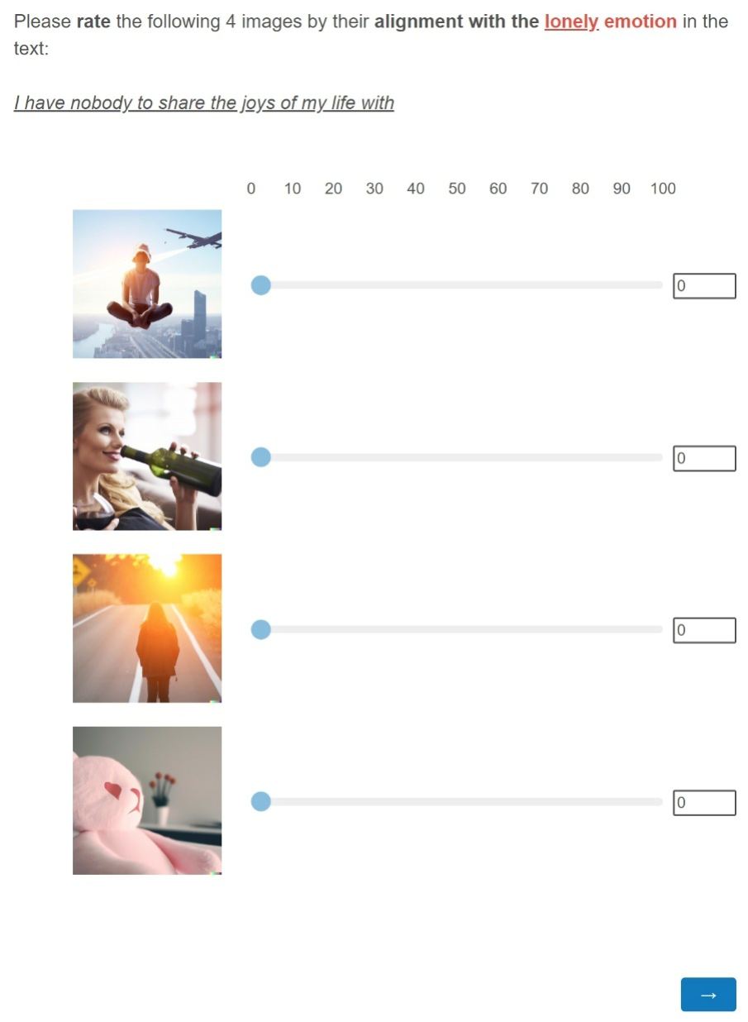
Interview Study
Procedure

Slide 18
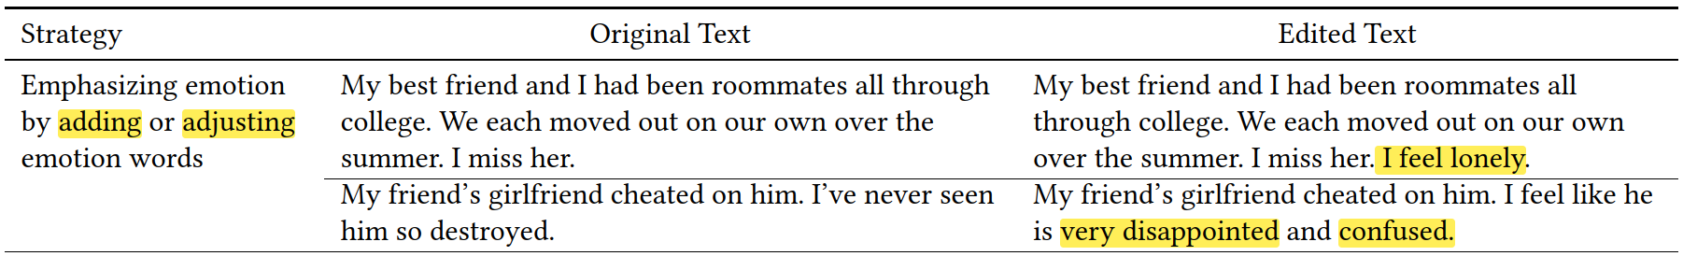
Interview Study
Procedure
  Ask the participant to explain their strategies for editing the text during or after the editing.

Slide 19
Interview Study
Results
  The study identified 4 themes from participants’ understandings of DALL·E 2 from the interviews.
  The AI could understand simple and concrete texts, instead of complex and abstract texts.
  The AI did not understand some specific concepts.
  An objective description of the expected image seems better for AI to understand.
  The AI was not quite accurate, and it was sometimes difficult to understand it when it failed to generate the expected images.

Slide 20
Interview Study
Results
  Participants’ editing strategies can generally classify into two principles.
    Make the emotion and key concepts in the context concise and straightforward.
    Make the elements and description concrete.
  Participants are lacking precision and global understanding of the AI model.
  Need a data-driven method to automatically refine text prompts.

Slide 21
05
Technical Method of RePrompt

Slide 22
Technical Method of RePrompt
Feature Curation
  Interview study results
  Prior works of understanding large language models
  text-based emotion analysis with machine learning
  Choose and design intuitive and easy-to-adjust features.
    Part-of-speech (POS) of each word in the text prompt (noun, adj, verb)
    Count occurrences of each POS type and compute the mean concreteness score
  For example, We can delete or add nouns to easily adjust the feature value.

Slide 23
Technical Method of RePrompt
CLIP Score for Image Quality Assessment
  This study adopted the CLIP Score for the IEA and ITA as measures of image quality.
  CLIP is a pre-trained vision-language model that can represent both text and images in one unified semantic embedding space.
  CLIP score is defined as the cosine similarity of the resultant CLIP embeddings.
    ITA: image and text
    IEA: image and emotion label

Slide 24
Technical Method of RePrompt
Proxy model
  The study used CLIP Score as the computational measure of image quality, then developed machine learning models to predict the image quality with the curated features.
  We need to understand how features affect image generation.
  However, computing model explanations for feature analysis requires calling the model many times.
  Training a proxy model to estimate the image quality.
    LightGBM
    Focus on the IEA prediction to investigate model explanations.

Slide 25
Technical Method of RePrompt
Feature Analysis by Model Explanations
  Selecting Salient Features
    Apply SHAP(SHapley Additive exPlanations) to the proxy model to obtain the global feature importance for IEA prediction.
    Select six features for the proxy model: number and mean concreteness of noun, adjectives, and verbs.
  Identifying Feature Value Ranges
    Apply partial dependence plots (PDP) to illustrate the marginal model output over the distribution of the target feature.

Slide 26
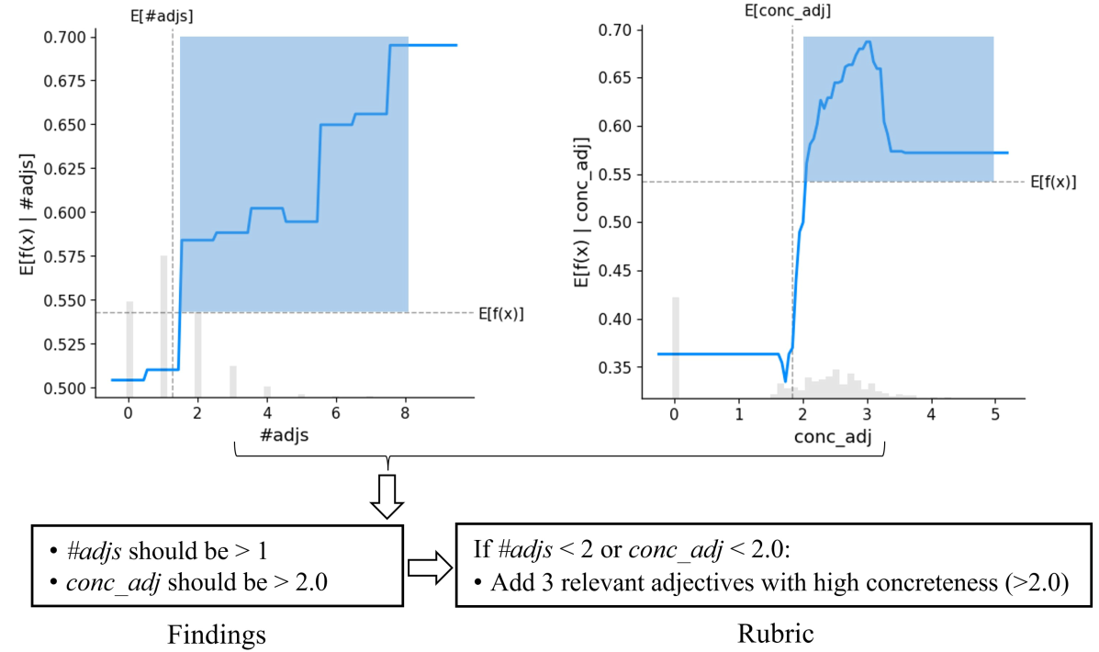
Technical Method of RePrompt
Feature Analysis by Model Explanations

Slide 27
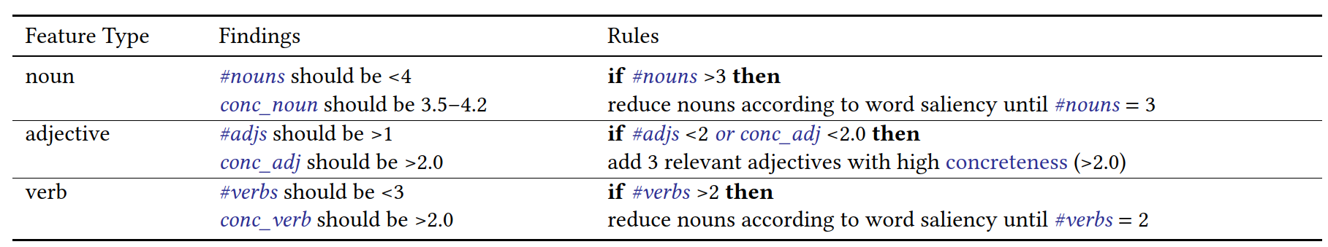
Technical Method of RePrompt
Rubric for Automatic Prompt-Editing
  Rules

Slide 28
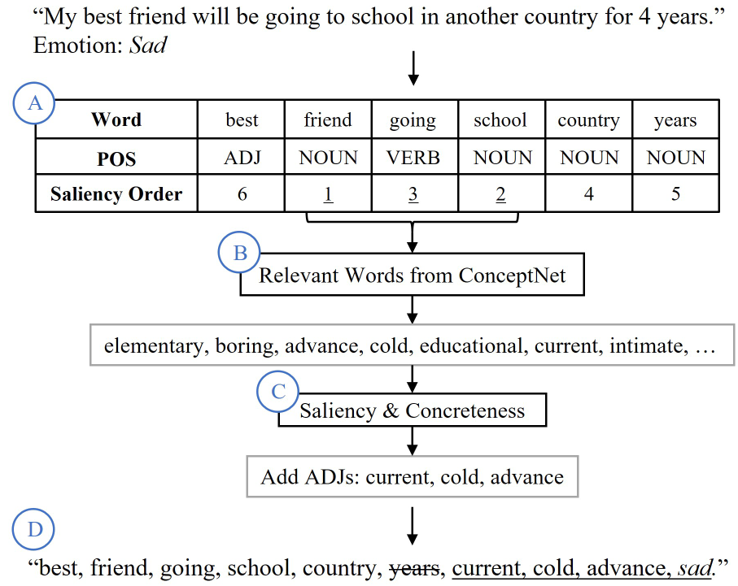
Technical Method of RePrompt
Rubric for Automatic Prompt-Editing

Slide 29
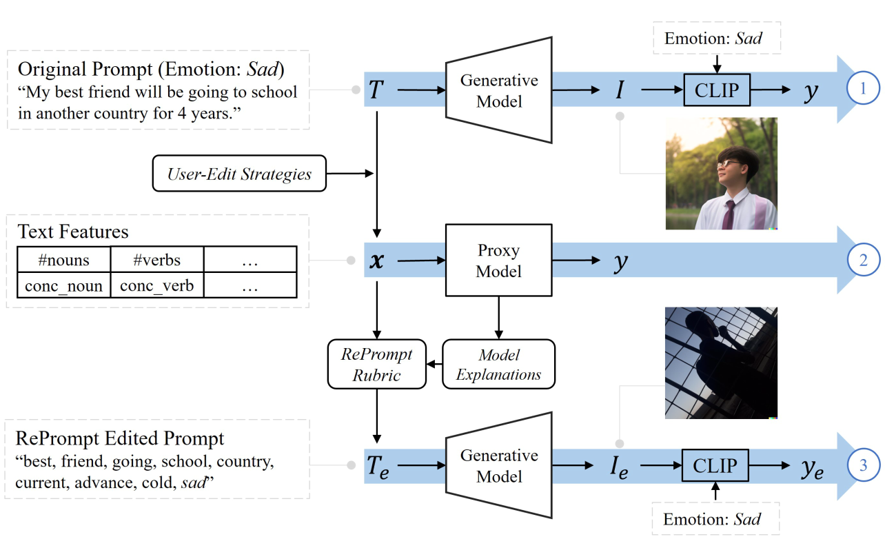
Technical Method of RePrompt
RePrompt pipeline

Slide 30
06
EVALUATION

Slide 31
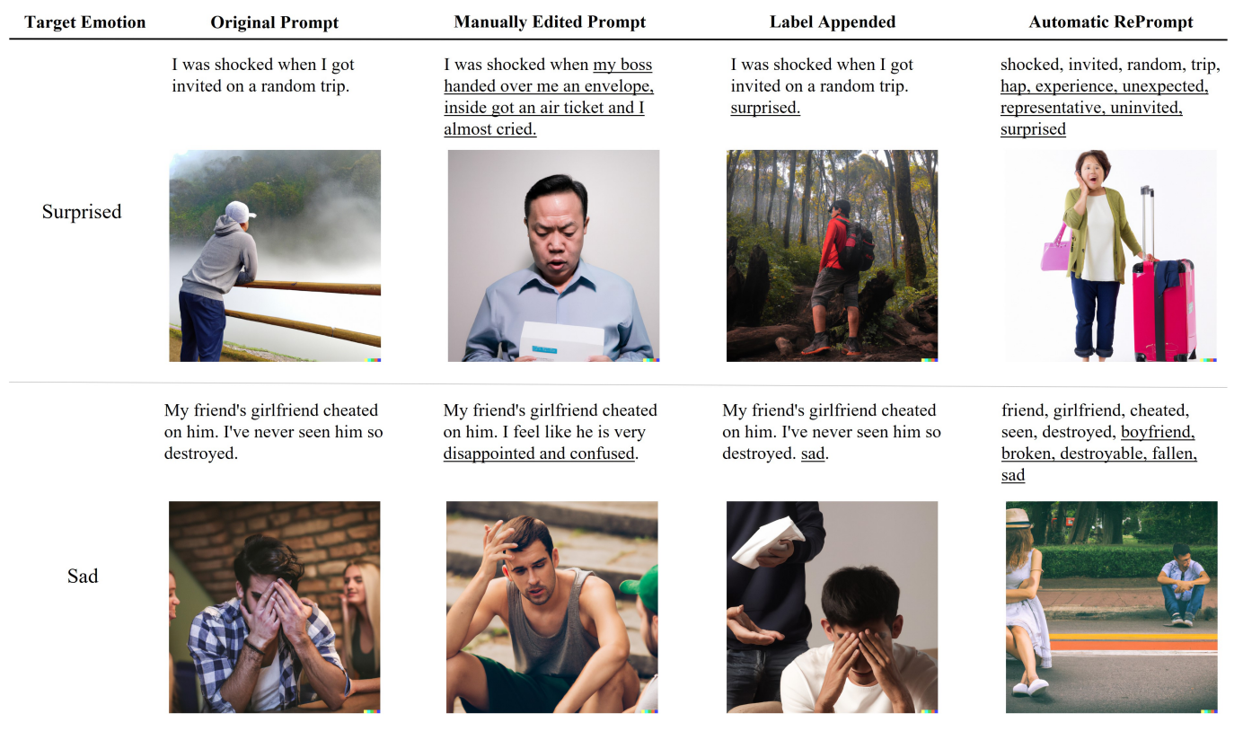
Metrics and Conditions
Example prompts and AI-generated images across four conditions
Notes:
為了評估 RePrompt 的效果，作者進行了模擬研究和用戶評估研究。在模擬研究中，他們使用 CLIP Score 來客觀測量圖像-情感對齊 (IEA) 和圖像-文本對齊 (ITA)。
他們將 RePrompt 與其他三種提示編輯方法進行了評估。除了原始提示、手動編輯提示和自動 RePrompt 之外，他們還添加了一種單純的自動文本編輯方法，稱為標籤附加提示。這種方法只是將情感標籤附加到原始文本上。使用與訪談研究中相同的文本實例，他們使用 DALL·E 2 生成了圖像。圖 6 顯示了四個條件下的文本和圖像示例。

Slide 32
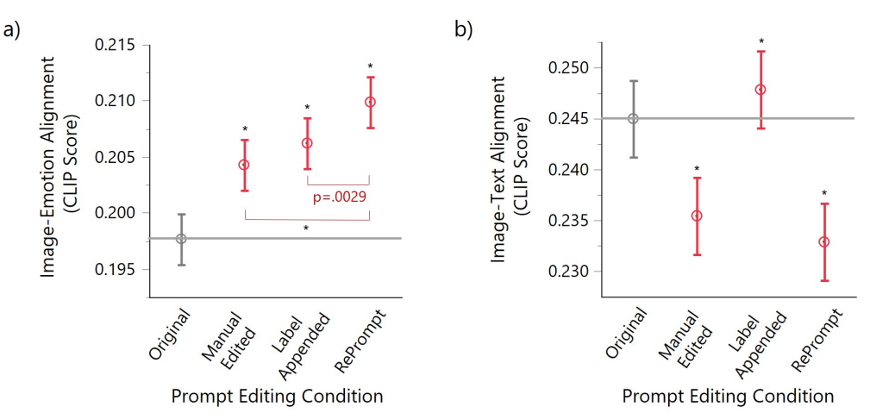
Simulation Study
Notes:
圖像-情感對齊（IEA）CLIP Score。所有三種提示編輯方法生成的圖像與原始提示相比，圖像-情感對齊（IEA）分數顯著更高（圖7a）。更重要的是，RePrompt 生成的圖像得分顯著高於其他提示的圖像。相比之下，手動編輯的分數比標籤附加的分數要低。
圖像-文本對齊（ITA）CLIP Score。手動編輯和RePrompt的圖像-文本對齊（ITA）分數顯著低於原始提示，這表明這些提示顯著改變了原始文本。然而，與原始提示相比，標籤附加的ITA分數顯著較高（圖7b），這表明情感標籤與原始文本非常相關。

Slide 33
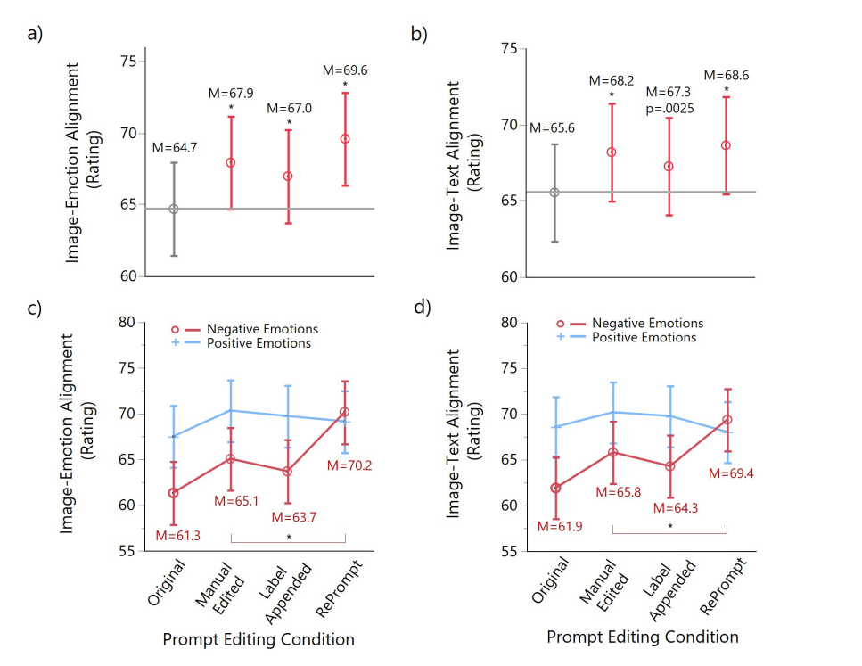
Image Evaluation User Study
Notes:
6.4 重點摘要 在第6.4節中，研究人員進行了圖像評估用戶研究，以評估不同提示編輯方法對圖像生成中情感表達的影響。
6.4.1 過程 在這個過程中，參與者被要求評估情感文本和相應的AI生成圖像。他們的任務是確定文本和圖像之間的情感一致性以及文本與圖像之間的對齊程度。每個參與者通過篩選測試和情感智力測試後，被要求評估一系列文本及相應的圖像。
6.4.2 參與者和數據收集 共有197名參與者，他們具有良好的英語能力和情感理解能力。這些參與者評估了146組圖像，確保了評估結果的充分性和可靠性。平均每組圖像被評價了20.24次，這表明了參與者的積極參與和對實驗的重視。
6.4.3 評分結果的解釋 圖像-情感對齊評分（IEA）：這一結果表明RePrompt方法生成的圖像在情感一致性方面顯著優於其他提示編輯方法。RePrompt方法能夠更準確地表達出原始文本所包含的情感，使生成的圖像更貼近原始情感的表達。相反，Manual Edited方法生成的圖像在情感一致性方面的表現較差，可能是因為手動編輯過程中失去了一些原始情感信息，導致生成的圖像與原始文本之間的情感一致性降低。 圖像-文本對齊評分（ITA）：與情感對齊評分相反，Manual Edited和RePrompt方法生成的圖像在文本與圖像之間的對齊方面表現較差。這意味著這兩種方法在文本編輯過程中引入了較多的變化，使生成的圖像與原始文本之間的對齊程度降低。然而，Label Appended方法生成的圖像在文本與圖像對齊方面表現較好，這表明僅將情感標籤添加到原始文本會使生成的圖像更貼近原始文本的場景和元素，從而提高了文本與圖像之間的對齊程度。 綜合來看，RePrompt方法在情感一致性方面表現優異，但在文本與圖像之間的對齊方面可能存在一定的挑戰。這表明在進行提示編輯時需要平衡情感表達和文本與圖像之間的對齊程度，以確保生成的圖像既能準確地表達出情感，又能與原始文本保持一致。

Slide 34
07
SUMMARY OF RESULTS

Slide 35
SUMMARY OF RESULTS
RQ1. How would laypersons perceive the AI-generated images regarding emotional expressiveness and strategically refine the text prompts to improve image generation?
  emphasizing emotions by adding or adjusting emotion words or contexts
  simplifying text by deleting sentences or paraphrasing;
  increasing text concreteness; and
  changing self-expression from first-person to third-person image descriptions.
Notes:
7 SUMMARY OF RESULTS
RQ1. 普通人如何感知AI生成的圖像的情感表達能力，並如何策略性地改進文本提示以改善圖像生成？ 在我們的訪談中，參與者發現AI主要能理解簡單具體的文本而非複雜抽象的文本；對某些概念不太理解；更能理解客觀描述；當AI失敗時，其表現不太準確且有時難以理解。參與者的編輯策略主要包括：1）通過添加或調整情感詞語或情境來強調情感；2）通過刪除句子或改寫來簡化文本；3）增加文本的具體性；4）將自我表達從第一人稱改為第三人稱的圖像描述。

Slide 36
SUMMARY OF RESULTS
RQ2. How can text prompts be automatically refined to generate better images regarding emotional expressiveness?
  Curated intuitive text features based on layperson editing strategies
  Trained machine learning models to predict image quality scores using these text features
  Applied model explanations to generate a rubric for automatically editing text prompts
Notes:
RQ2. 如何自動改進文本提示以生成情感表達更好的圖像？ 在RePrompt中，我們基於普通人的編輯策略精心挑選了直觀的文本特徵，訓練了機器學習模型來使用這些文本特徵預測圖像質量分數，然後應用模型解釋來生成一個自動編輯文本提示的標準。
RQ3. RePrompt在改進圖像生成的情感表達方面的效果如何？ 模擬研究和用戶研究結果表明，RePrompt改善了與情感相關的圖像生成，特別是在IEA方面，對於負面情感的改進尤為明顯。然而，在ITA方面的結果則有所不同。在我們的評估用戶研究中，評估者無法感知到不同條件下對於正面情感表達的差異，這可能是因為人類對於正面刺激的敏感性較低，以及CLIP模型在建模正面情感方面的能力較弱所導致的。

Slide 37
SUMMARY OF RESULTS
RQ3. How effective is RePrompt at improving emotional expression in image generation?
  RePrompt improves image generation with the AI model, particularly in terms of Image-Emotion Alignment (IEA), especially for negative emotions.
  The user evaluation study did not detect discernible differences in the expression of positive emotions across conditions.
  This lack of differentiation may stem from humans' lower sensitivity to positive stimuli and CLIP's weaker ability to model positive emotions.
  Results for Image-Text Alignment (ITA) were mixed, indicating variability in the alignment between images and text prompts.
Notes:
RQ3. RePrompt在改進圖像生成的情感表達方面的效果如何？ 模擬研究和用戶研究結果表明，RePrompt改善了與情感相關的圖像生成，特別是在IEA方面，對於負面情感的改進尤為明顯。然而，在ITA方面的結果則有所不同。在我們的評估用戶研究中，評估者無法感知到不同條件下對於正面情感表達的差異，這可能是因為人類對於正面刺激的敏感性較低，以及CLIP模型在建模正面情感方面的能力較弱所導致的。

Slide 38
08
DISCUSSION

Slide 39
Design Implications and Limitations
CLIP Perception and Biases:
  There are discrepancies between CLIP's evaluation of image-text alignment and human perception, especially with positive emotions. Addressing biases in text-to-image models is crucial for broader application
Biases and Emotional Expression:
  Biases in text-to-image models present challenges for emotional expression tasks. Future research should focus on mitigating biases to improve model performance
Notes:
8.1 重點摘要： 情感感知與CLIP偏見： 研究發現，CLIP分數中的圖像-文本對齊（ITA）無法與人類感知一致，特別是對於正面情緒。然而，圖像-情感對齊（IEA）的CLIP分數在負面情緒方面表現較好。這可能是由於人類對於負面刺激的固有敏感性以及CLIP模型對於正面情緒的限制所導致的。 情感偏見和應用： 最近的研究表明，文本到圖像生成模型存在情感偏見，這可能是由於訓練中情感數據集的不足或對於捕捉正面情緒細微差異的有效策略的缺乏。這種偏見可能影響情感生成模型的應用，特別是對於情感表達的應用。

Slide 40
Generalization of RePrompt
RePrompt Generalization
  The editing standards developed with VQGAN-CLIP are applicable to other datasets like DALL·E 2, showcasing the method's adaptability
RePrompt Pipeline Adaptability
  The RePrompt process can be tailored to different models and applications by adjusting the proxy model, features, and explanations, ensuring flexibility
Benefits and Applications
  RePrompt's clear revisions aid user understanding and streamline editing. It shows promise in emotional communication, regulation, and enhancing authors' expression and idea generation
Notes:
8.2 重點摘要： RePrompt通用性： 研究結果表明，我們使用VQGAN-CLIP生成的提示編輯標準在DALL·E 2中仍然有效。我們進一步對另一個來自Twitter的情感文本數據集進行了測試，結果顯示該標準對於其他數據集也具有泛化能力。 RePrompt流程的通用性： RePrompt的三個關鍵組件包括特徵的策劃、代理模型的建模和模型解釋。這個流程可以應用於其他類型的文本到圖像生成模型，也可以用於其他類型的生成模型。通過調整代理模型、特徵集和模型解釋，可以將該流程應用於不同的場景和應用中。
8.3 重點摘要： RePrompt的益處和應用： RePrompt提供了可讀性高的提示修改，可以幫助用戶理解模型並減少試錯嘗試。在實際應用中，可以通過顯示明確的編輯（添加或刪除的單詞）來幫助用戶進行迭代提示修改。此外，RePrompt的應用也可能擴展到情感表達方面的應用，例如通過生成個性化的情感圖像來支持情感交流和情感調節，或者在撰寫過程中提供上下文圖像來增加作者的情感表達和想法產生。

Slide 41
09
CONCLUSION

Slide 42
CONCLUSION
Proposed RePrompt to refine text prompts for better image generation in text-to-image models
Conducted interviews to understand how people edit text prompts for AI-generated images
Developed an automatic editing method based on interview findings
Results showed RePrompt improved image generation, especially for conveying negative emotions
Notes:
提出了 RePrompt 方法，旨在改進文本到圖像生成模型的文本提示 通過初步的訪談研究了解普通人對人工智能生成的圖像的看法和他們的文本提示編輯策略 根據受訪者的策略開發了 RePrompt 管道，並建立了可解釋和自動化的提示編輯標準 通過模擬研究和用戶研究的結果顯示，RePrompt 改進的文本提示能夠引導生成式人工智能模型生成更好的圖像，特別是在與所需情感的對齊方面，尤其是負面情緒。

Slide 43

THANKS!

Slide 44
USE THIS CALENDAR
JANUARY | FEBRUARY | MARCH | APRIL
Main activity | Main activity | Main activity | Main activity
MAY | JUNE | JULY | AUGUST
Main activity | Main activity | Main activity | Main activity
SEPTEMBER | OCTOBER | NOVEMBER | DECEMBER
Main activity | Main activity | Main activity | Main activity

Slide 45
THREE IMPORTANT IDEAS
JUPITER
VENUS
SATURN
Jupiter is a gas giant and the biggest planet in the Solar System. It's the fourth-brightest object in the night sky and it was named after the Roman god of the skies
Venus has a beautiful name and is the second planet from the Sun. It’s terribly hot and its atmosphere is poisonous. It’s the second-brightest natural object in the night sky
Saturn is a gas giant and has several rings and it's composed mostly of hydrogen and helium. Saturn was also named after the Roman god of wealth and agriculture

Slide 46
YOU CAN USE THIS INFOGRAPHIC
PHASES
1 | OK | Mercury is the smallest planet of them all
2 | - | Venus is extremely hot, even hotter than Mercury
3 | - | Despite being red, Mars is actually a cold place
4 | X | Jupiter is the biggest planet in the Solar System
DATE
MON | TUE | WEN | THU | FRI | SAT | SUN
1 | 2 | 3 | 4 | 5 | 6 | 7
8 | 9 | 10 | 11 | 12 | 13 | 14
15 | 16 | 17 | 18 | 19 | 20 | 21
22 | 23 | 24 | 25 | 26 | 27 | 28
29 | 30 | 31 | - | - | - | -

Slide 47
THESE ARE FOUR IDEAS
MARS
VENUS
Despite being red, Mars is actually a cold place. It's full of iron oxide dust, which gives the planet its reddish cast
Venus has a beautiful name and is the second planet from the Sun. It’s terribly hot, even hotter than Mercury
JUPITER
SATURN
Jupiter is a gas giant and the biggest planet in the Solar System. It's the fourth-brightest object in the night sky
Saturn is a gas giant and has several rings. It's composed mostly of hydrogen and helium. It has beautiful rings

Slide 48
HERE’S ANOTHER INFOGRAPHIC
MOON
The Moon is Earth’s only natural satellite
EARTH
Earth is the third planet from the Sun
NEPTUNE
Neptune is the farthest planet from the Sun
PROJECT
SATURN
It’s composed of hydrogen and helium
JUPITER
It’s the biggest planet in the Solar System
MARS
Despite being red, Mars is a cold place

Slide 49
REVIEWING CONCEPTS
MARS
VENUS
NEPTUNE
Despite being red, Mars is actually a cold place. It's full of iron oxide dust, which gives the planet its reddish cast
Venus has a beautiful name and is the second planet from the Sun. It’s terribly hot, even hotter than Mercury
Neptune is the farthest planet from the Sun. It's also the fourth-largest planet by diameter in the Solar System
EARTH
SATURN
JUPITER
Earth is the third planet from the Sun and the only one that harbors life in the Solar System. This is where we all live
Saturn is a gas giant and has several rings. It's composed mostly of hydrogen and helium. It has beautiful rings
Jupiter is a gas giant and the biggest planet in the Solar System. It's the fourth-brightest object in the night sky

Slide 50
AWESOME WORDS

Slide 51
—SOMEONE FAMOUS
“This is a quote, words full of wisdom that someone important said and can make the reader get inspired”

Slide 52

A PICTURE IS WORTH A THOUSAND WORDS

Slide 53

A PICTURE ALWAYS REINFORCES
THE CONCEPT
Images reveal large amounts of data, so remember: use an image instead of a long text. Your audience will appreciate it

Slide 54
98,300,000
Big numbers catch your audience’s attention

Slide 55
9h 55m 23s
333,000
386,000 km
Jupiter's rotation period
The Sun’s mass compared to Earth’s
Distance between Earth and the Moon

Slide 56
ALSO USE THIS INFOGRAPHIC
DEFINE
PLAN
CLOSE
Despite being red, Mars is a cold place
Mercury is the closest planet to the Sun
The Moon is Earth’s only natural satellite
Saturn was named after a Roman god
Venus is the second planet from the Sun
Pluto is now considered a dwarf planet
Jupiter is the biggest planet of them all
Earth is the third planet from the Sun
Neptune is very far away from us

Slide 57
LET’S USE SOME PERCENTAGES
25%
50%
75%
MERCURY
VENUS
MARS
Mercury is the closest planet to the Sun and the smallest of them all
Venus has a beautiful name and is the second planet from the Sun
Despite being red, Mars is actually a cold place. It’s full of iron oxide dust

Slide 58
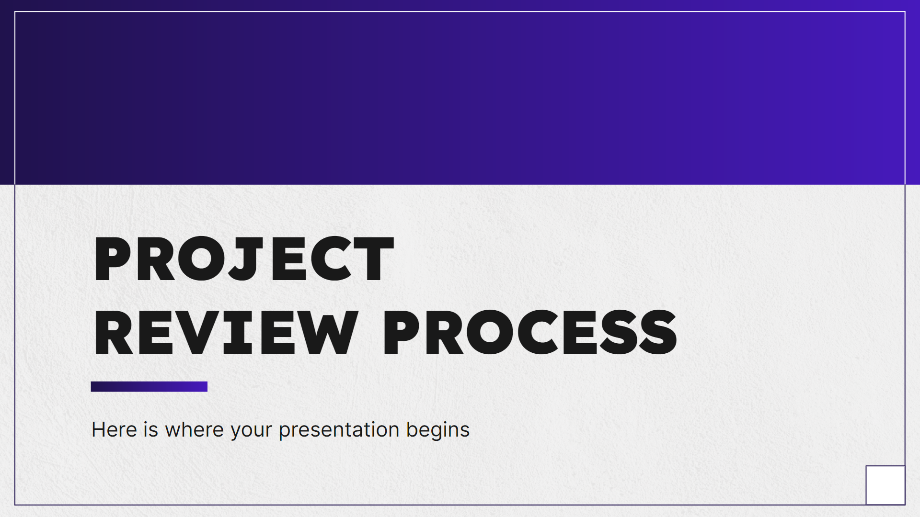
COMPUTER MOCKUP
You can replace the image on the screen with your own work. Just right-click on it and select “Replace image”

Slide 59

TABLET MOCKUP
You can replace the image on the screen with your own work. Just right-click on it and select “Replace image”

Slide 60

PHONE MOCKUP
You can replace the image on the screen with your own work. Just right-click on it and select “Replace image”

Slide 61
A TIMELINE ALWAYS WORKS WELL
STEP 1
STEP 2
STEP 3
STEP 4
Earth is the third planet from the Sun
The Moon is Earth’s only natural satellite
Mercury is the closest object to the Sun
Saturn was named after a Roman god
01
02
03
04
08
07
06
05
STEP 8
STEP 7
STEP 6
STEP 5
Neptune is very far away from us
Despite being red,
Mars is a cold place
Jupiter was named after a Roman god
Ceres is located in the main asteroid belt

Slide 62
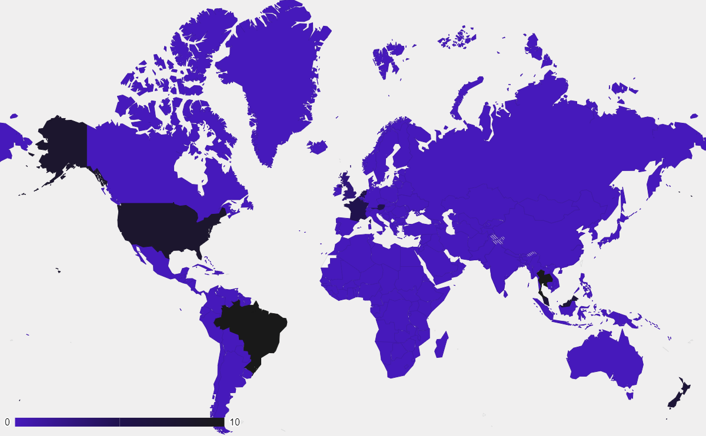
THIS IS A MAP
MARS
Mars is very cold
MERCURY
Mercury is small
VENUS
Venus is very hot
Follow the link in the graph to modify its data and then paste the new one here. For more info, click here

Slide 63
A TIMELINE ALWAYS WORKS WELL
STEP 01
STEP 03
Jupiter is the farthest planet from the Sun
Despite being red, Mars is a cold place
STEP 02
STEP 04
Saturn was named after a Roman god
Mercury is the closest object to the Sun

Slide 64
INFOGRAPHICS ARE USEFUL
MARS
A
B
VENUS
Despite being red, Mars is actually a cold place. It’s full of iron oxide dust
Venus has a beautiful name and is the second planet from the Sun
SOLAR SYSTEM
MERCURY
G
H
JUPITER
Mercury is the closest planet to the Sun and the smallest of them all
Jupiter is a gas giant and the biggest planet in the Solar System

Slide 65
USE TABLES TO REPRESENT DATA
 |  | TEAM A | TEAM B | TEAM C | TEAM D
TASK 1 | MERCURY | Jupiter is big | Mercury is small | Venus is very hot | Earth has life
 | MARS | XX | XX | XX | XX
TASK 2 | SATURN | Saturn has rings | Mars is a red planet | The Sun is a star | Mars is very cold
 | VENUS | XX | XX | XX | XX
RESULTS |  | 100K | 250K | 860K | 450K

Slide 66
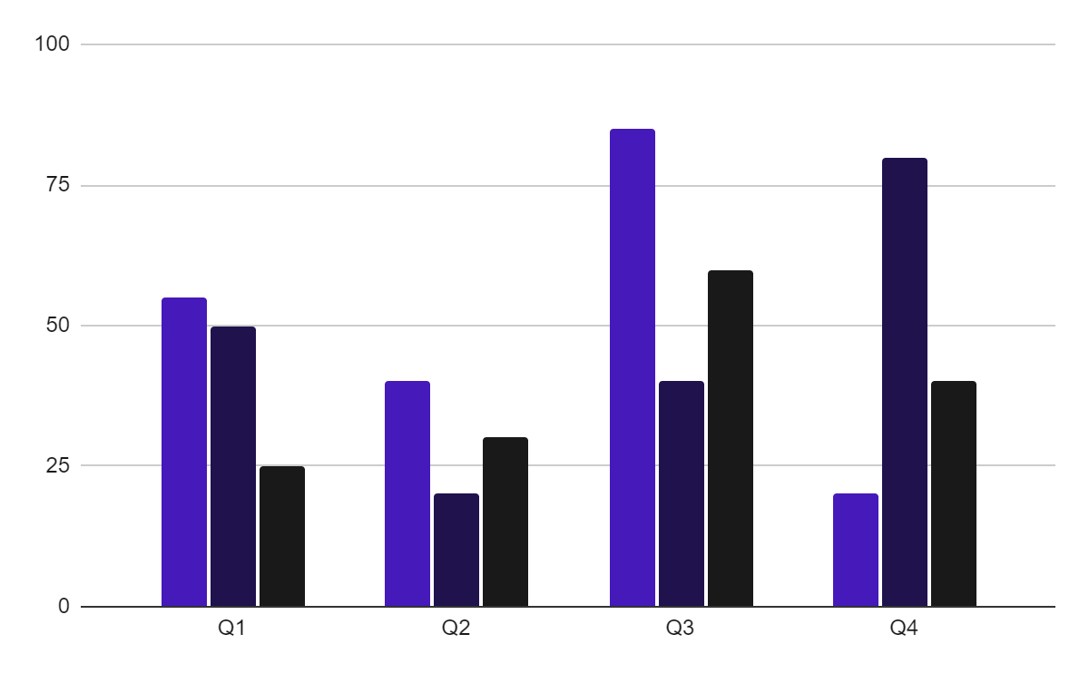
YOU CAN USE THIS GRAPH
TEAM 1
TEAM 2
TEAM 3
Follow the link in the graph to modify its data and then paste the new one here. For more info, click here

Slide 67
ROADMAP INFOGRAPHIC
 |  | MONTH
 |  | 1 | 2 | 3 | 4 | 5 | 6 | 7 | 8 | 9 | 10 | 11 | 12
PHASE 01 | Task 1
 | Task 2
PHASE 02 | Task 4
 | Task 5
PHASE 03 | Task 6
In progress
Done

Slide 68


OUR TEAM
SOFIA HILL
TOM HARRIS
You can speak a bit about this person here
You can speak a bit about this person here

Slide 69
THANKS!
Do you have any questions?
youremail@freepik.com
+34 654 321 432
yourwebsite.com
Please keep this slide for attribution

Slide 70
ALTERNATIVE RESOURCES
Here’s an assortment of alternative resources whose style fits the one of this template:

Slide 71
RESOURCES
Did you like the resources on this template? Get them for free at our other websites:
Photos
Beautiful women working together in a startup company
Corporate employee posing at the office
Businessman looking on a tablet
Two male colleagues talking to each other during a meeting
Office workers using finance graphs
Man showing something to his colleagues on laptop during a meeting

Slide 72
Instructions for use
If you have a free account, in order to use this template, you must credit Slidesgo by keeping the Thanks slide. Please refer to the next slide to read the instructions for premium users.
As a Free user, you are allowed to:
Modify this template.
Use it for both personal and commercial projects.
You are not allowed to:
Sublicense, sell or rent any of Slidesgo Content (or a modified version of Slidesgo Content).
Distribute Slidesgo Content unless it has been expressly authorized by Slidesgo.
Include Slidesgo Content in an online or offline database or file.
Offer Slidesgo templates (or modified versions of Slidesgo templates) for download.
Acquire the copyright of Slidesgo Content.
For more information about editing slides, please read our FAQs or visit our blog:
https://slidesgo.com/faqs and https://slidesgo.com/slidesgo-school

Slide 73
Instructions for use (premium users)
As a Premium user, you can use this template without attributing Slidesgo or keeping the Thanks slide.
You are allowed to:
Modify this template.
Use it for both personal and commercial purposes.
Hide or delete the “Thanks” slide and the mention to Slidesgo in the credits.
Share this template in an editable format with people who are not part of your team.
You are not allowed to:
Sublicense, sell or rent this Slidesgo Template (or a modified version of this Slidesgo Template).
Distribute this Slidesgo Template (or a modified version of this Slidesgo Template) or include it in a database or in any other product or service that offers downloadable images, icons or presentations that may be subject to distribution or resale.
Use any of the elements that are part of this Slidesgo Template in an isolated and separated way from this Template.
Register any of the elements that are part of this template as a trademark or logo, or register it as a work in an intellectual property registry or similar.
For more information about editing slides, please read our FAQs or visit our blog:
https://slidesgo.com/faqs and https://slidesgo.com/slidesgo-school

Slide 74
Fonts & colors used
This presentation has been made using the following fonts:
Lexend
(https://fonts.google.com/specimen/Lexend)
Inter
(https://fonts.google.com/specimen/Inter)
#191919
#f0efef
#ffffff
#4619bb
#20124d

Slide 75




Storyset
Create your Story with our illustrated concepts. Choose the style you like the most, edit its colors, pick the background and layers you want to show and bring them to life with the animator panel! It will boost your presentation. Check out how it works.
Pana
Amico
Bro
Rafiki
Cuate

Slide 76
Use our editable graphic resources...
You can easily resize these resources without losing quality. To change the color, just ungroup the resource and click on the object you want to change. Then, click on the paint bucket and select the color you want. Group the resource again when you’re done. You can also look for more infographics on Slidesgo.

Slide 79
JANUARY
FEBRUARY
MARCH
APRIL
MAY
JUNE
PHASE 1
Task 1
Task 2
PHASE 2
Task 1
Task 2
JANUARY
FEBRUARY
MARCH
APRIL
PHASE 1
Task 1
Task 2

Slide 82
...and our sets of editable icons
You can resize these icons without losing quality.
You can change the stroke and fill color; just select the icon and click on the paint bucket/pen.
In Google Slides, you can also use Flaticon’s extension, allowing you to customize and add even more icons.

Slide 83
Educational Icons
Medical Icons

Slide 84
Business Icons
Teamwork Icons

Slide 85
Help & Support Icons
Avatar Icons

Slide 86
Creative Process Icons
Performing Arts Icons

Slide 87
Nature Icons

Slide 88
SEO & Marketing Icons

Slide 89


