Slide 1
Emotion AI at Work: Implications for Workplace Surveillance,
Emotional Labor, and Emotional Privacy
Kat Roemmich, Florian Schaub, Nazanin Andalibi

Slide 2
Abstract
The study explores workers' perceptions and experiences of emotion AI in the workplace, finding that it is viewed as a violation of emotional privacy and may be used to enforce compliance with emotional labor expectations.
Emotion AI in the workplace can lead to a range of harms for workers, highlighting the need to recognize and define emotional privacy as an individual right and raise research and policy questions on how to protect it.

Slide 3
01
Introduction

Slide 4
Introduction
The need to understand the perceptions and experiences of workers subject to emotion AI in the workplace, as little is known about this topic.
It emphasizes the potential privacy risks and vulnerability to manipulation that people may face when interacting with emotion AI in the workplace, particularly in the context of employer surveillance practices in the US.
The paper aims to address the gap in empirical understanding of the implications of emotion AI-enabled workplace surveillance from the perspective of workers, and the lack of legal protections or regulatory safeguards for emotional privacy.
The power asymmetry between organizations and workers is acknowledged, and the importance of including workers' perspectives in understanding the ethical and social implications of emotion AI in the workplace is emphasized.
The paper also outlines the research questions addressed in the study, including workers' perceptions of emotion AI, behavioral adaptations, and the consequences associated with its use in the workplace.
Notes:
AI agents are increasingly deployed in customer service to reduce the burden of human labor and sometimes replace human employees
emotional AI technologies are critical for developing and deploying AI service agents because human employees’ positive emotions are a key driver of customer service evaluations in firm–customer en-counters

Slide 5
02
Background and related work

Slide 6
Workplace Surveillance of Workers’ Interiority
Employers have been surveilling employees' interior states since the 1920s, using surveys, interviews, and psychological tests.
Surveillance practices have evolved over time, with the use of lie detector tests in the 1970s and electronic performance monitoring in the 1980s.
Emotion recognition technologies have further fueled the desire to monitor workers' emotions, but they fail to consider the nuances and context of emotional expression at work.
Workplace monitoring now includes the detection and monitoring of workers' emotions, mood, and core affect.
This study aims to investigate workers' general perceptions of emotion AI.
Notes:
AI agents are increasingly deployed in customer service to reduce the burden of human labor and sometimes replace human employees
emotional AI technologies are critical for developing and deploying AI service agents because human employees’ positive emotions are a key driver of customer service evaluations in firm–customer en-counters

Slide 7
Emotion AI in the Workplace
Workplace monitoring aims to shape employees' behavior and activities through emotion AI-enabled technologies.
Workers' emotions and affects influence organizational outcomes, such as sales and productivity.
Emotion AI in the workplace is adopted for various purposes, including safety and compliance, employee wellness, and behavior analysis.
HCI scholars have developed emotion AI applications for the workplace, such as promoting happiness and productivity.
Emotion AI generates data about workers' emotions, which can be used to inform organizational strategy and manage employees.
Little is known about how the collection and sharing of workers' emotional information may impact their behavior.
Notes:
AI agents are increasingly deployed in customer service to reduce the burden of human labor and sometimes replace human employees
emotional AI technologies are critical for developing and deploying AI service agents because human employees’ positive emotions are a key driver of customer service evaluations in firm–customer en-counters

Slide 8
Adverse Consequences of Emotion AI
The potential benefits of emotion AI to organizations are well-established, but its effects on workers and associated social and privacy implications are relatively unknown.
Negative attitudes towards emotion AI have been observed, including discomfort in the workplace and concerns about privacy.
Emotion AI technologies should be used fairly and ethically, with meaningful consent, transparency, and contestability of information, and without widening power asymmetries.
The use of emotion AI in workplaces is largely unconstrained and unregulated, posing threats to worker autonomy and privacy.
Workers may be unable to meaningfully consent to or protest the inference and collection of their emotion data in the workplace.
Notes:
AI agents are increasingly deployed in customer service to reduce the burden of human labor and sometimes replace human employees
emotional AI technologies are critical for developing and deploying AI service agents because human employees’ positive emotions are a key driver of customer service evaluations in firm–customer en-counters

Slide 9
Adverse Consequences of Emotion AI
Privacy theories such as privacy regulation theory, communication privacy management theory, and theory of contextual integrity help understand the privacy implications of emotion AI.
Emotion AI may rupture boundaries, rules, and norms around emotional information sharing in the workplace, exposing workers to various privacy harms.
This study aims to investigate the perceived risks of adverse consequences of emotion AI in the workplace from the perspective of workers.
Notes:
AI agents are increasingly deployed in customer service to reduce the burden of human labor and sometimes replace human employees
emotional AI technologies are critical for developing and deploying AI service agents because human employees’ positive emotions are a key driver of customer service evaluations in firm–customer en-counters

Slide 10
03
Method

Slide 11
AI-Expressed Positive Emotion
AI agent is less expected to express positive emotion than a human employee.
A violation of this expectation should weaken the positive impact of expressed positive emotion.
Hypothesis 1
The positive effect of positive emotion expressed by an agent on service evaluations depends on the agent’s identity such that the effect is greater for a human agent than for an AI agent.
‹#›

Slide 12
Affective pathway
One’s expressed emotion can lead an observer to feel the same emotion through emotional contagion.
A customer’s positive emotion triggered by emotional contagion leads to a positive evaluation of a service encounter.
Hypothesis 2a
An AI agent’s expressed positive emotion increases a customer’s positive emotion, which, in turn, enhances service evaluations.
‹#›

Slide 13
Cognitive pathway
Expectation-disconfirmation influences consumer behaviors, including evaluations of products, services, and information systems.
Emotional expression by an AI agent is considered a negative violation of expectation.
The negative violation of expectation is argued to result in lower service evaluations.
Hypothesis 2b
An AI agent’s expressed positive emotion increases the extent of expectation–disconfirmation, which, in turn, reduces service evaluations.
‹#›

Slide 14
Effect of Relationship Norm Orientation
The expectation–disconfirmation pathway may vary based on an individual's specific expectation.
Relationship norm orientation is introduced as an individual difference variable capturing natural variations in customers' expectations.
There are two distinct relationship norms: exchange-oriented relationships and communal-oriented relationships
Positive emotion expressed by an AI agent aligns with communal-oriented expectations, leading to weaker expectation–disconfirmation.
Hypothesis 3
For communal-oriented customers, an AI agent’s expressed positive emotion has a positive effect on service evaluations, but for exchange-oriented customers, such an effect is nonexistent or even reversed.
‹#›
Notes:
Communal-Oriented Customers:
Communal-oriented customers expect genuine concern and care, similar to a friend or family member.
Positive emotion expressed by an AI agent aligns with communal-oriented expectations, leading to weaker expectation–disconfirmation.
Exchange-Oriented Customers:
Exchange-oriented customers expect a transaction-focused, professional service.
Positive emotion expressed by an AI agent does not align with exchange-oriented expectations, leading to stronger expectation–disconfirmation.

Slide 15
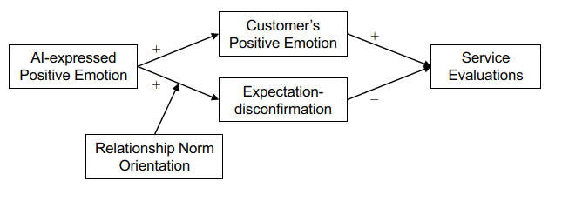
Overall
‹#›

Slide 16
03
Studies
& Results

Slide 17
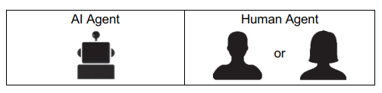
Study 1: Procedure
Manipulate agent’s identity
It shows the icon next to the messages.
‹#›

Slide 18
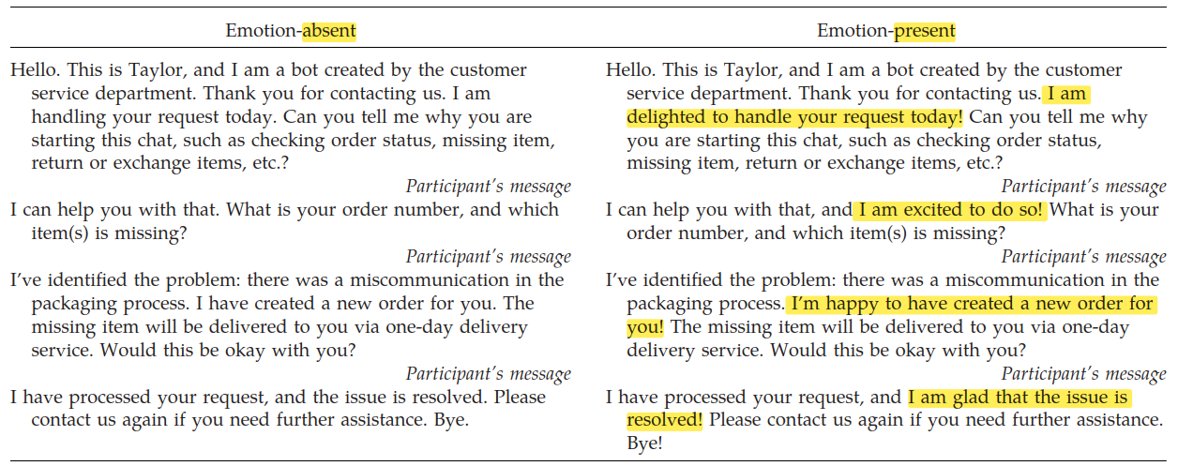
Study 1: Procedure
Manipulate positive emotion
Low and high emotional intensity scripts
‹#›

Slide 19
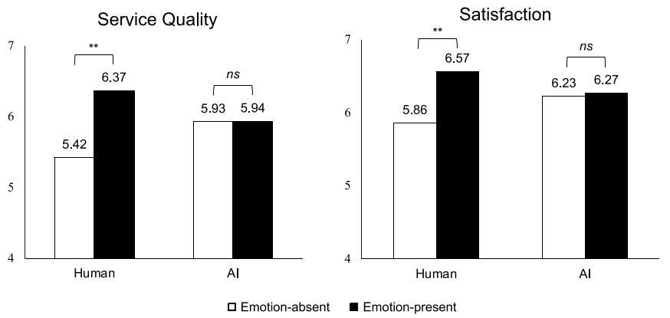
Study 1: Results
Humans expressed positive emotion significantly get more scores than AI expressed.
Support Hypothesis 1.
‹#›

Slide 20
Study 2: Procedure
Similar to Study 1, but changing Relationship Norm Orientation
Extending the conversation’s length by adding one additional message.
The message would ask the participant the reason why he needs help.
Use a seven-point, semantic differential scale with three items, describing the kind of relationship a participant would want with an online customer service agent. (strictly for business/bonded like family and friends)
Only considering AI agent’s service
‹#›

Slide 21
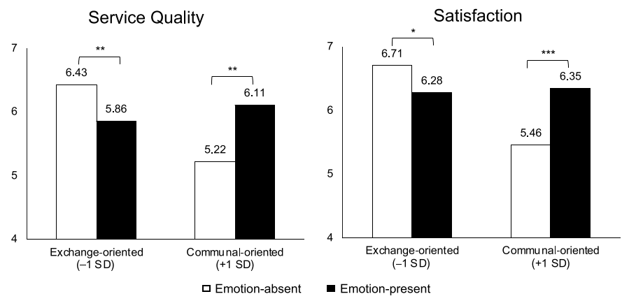
Study 2: Results
Support Hypothesis 3.
‹#›

Slide 22
Study 3: Procedure
Combine Study 1&2 and ask more information
Affective pathway:
Ask participants’ felt positive emotions to quantify emotional contagion, such as sad/joyful, cheerful/depressed, etc.
Cognitive pathway(expectation–disconfirmation):
Measure the extent to which participants confirmed their expectations toward the service agent, such as “The level of the chatbot’s emotional display was exactly what I expected”.
‹#›

Slide 23
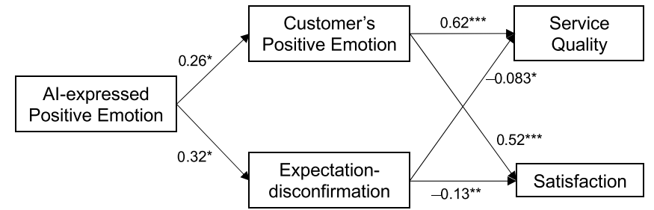
Study 3: Results
‹#›
Notes:
中介變項分析

Slide 24
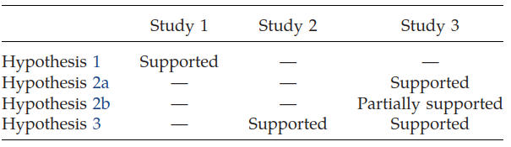
Summary
‹#›

Slide 25
04
Conclusion

Slide 26
Contribution
Extension to AI in Customer Service
Contribution to Human-AI Interaction Study
Exploration of Emotional Factors
Understanding Emotional Contagion in AI
Unraveling Underlying Mechanisms
‹#›

Slide 27
Future works
Extension of Relationship Norm Orientation
Addressing Interdependencies of Affective and Cognitive Processes
Comprehensive Understanding of Emotion
Not just in text, we can also use other ways to reveal emotions
‹#›
Notes:
Brand
3. Other types of emotions

Slide 28
THANKS!
Please keep this slide for attribution

Slide 29
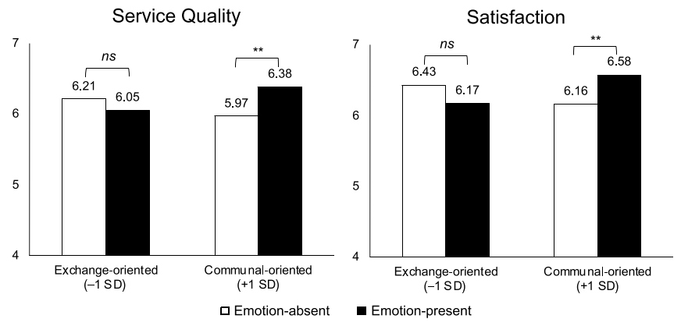
Study 3: Results
‹#›

Slide 30
CONTENTS OF THIS TEMPLATE
You can delete this slide when you’re done editing the presentation
FONTS | To view this template correctly in PowerPoint, download and install the fonts we used
USED AND ALTERNATIVE RESOURCES | An assortment of graphic resources that are suitable for use in this presentation
THANKS SLIDE | You must keep it so that proper credits for our design are given
COLORS | All the colors used in this presentation
ICONS AND INFOGRAPHIC RESOURCES | These can be used in the template, and their size and color can be edited
EDITABLE PRESENTATION THEME | You can edit the master slides easily. For more info, click here
For more info:
SLIDESGO | BLOG | FAQs
You can visit our sister projects:
FREEPIK | FLATICON | STORYSET | WEPIK | VIDEVO

Slide 31
TABLE OF CONTENTS
01
02
03
04
05
06
SECTION
SECTION
SECTION
SECTION
SECTION
SECTION

Slide 32
WHOA!
This can be the part of the presentation where you introduce yourself, write your email…

Slide 33
01
NAME OF THE SECTION

Slide 34
DO YOU NEED LONGER TEXT?
Mercury is the closest planet to the Sun and the smallest one in the entire Solar System. This planet's name has nothing to do with the liquid metal, since Mercury was named after the Roman messenger god. Despite being closer to the Sun than Venus, its temperatures aren't as terribly hot as that planet's. Its surface is quite similar to that of Earth's Moon, which means there are a lot of craters and plains
Speaking of craters, many of them were named after artists or authors who made significant contributions to their respective fields. Mercury takes a little more than 58 days to complete its rotation, so try to imagine how long days must be there! Since the temperatures are so extreme, albeit not as extreme as in Venus, and the solar radiation is so high, Mercury has been deemed to be non-habitable for humans

Slide 35
THE SLIDE TITLE GOES HERE!
Do you know what helps you make your point crystal clear? Lists like this one:
They’re simple
You can organize your ideas clearly
You’ll never forget to buy milk!
And the most important thing: the audience won’t miss the point of your presentation

Slide 36
YOU CAN DIVIDE THE CONTENT
MERCURY
VENUS
Mercury is the closest planet to the Sun and the smallest one in the Solar System—it’s only a bit larger than the Moon. The planet’s name has nothing to do with the liquid metal, since Mercury was named after the Roman messenger god
Venus has a beautiful name and is the second planet from the Sun. It’s terribly hot—even hotter than Mercury—and its atmosphere is extremely poisonous. It’s the second-brightest natural object in the night sky after the Moon

Slide 37
USE THIS CALENDAR
JANUARY | FEBRUARY | MARCH | APRIL
Main activity | Main activity | Main activity | Main activity
MAY | JUNE | JULY | AUGUST
Main activity | Main activity | Main activity | Main activity
SEPTEMBER | OCTOBER | NOVEMBER | DECEMBER
Main activity | Main activity | Main activity | Main activity

Slide 38
THREE IMPORTANT IDEAS
JUPITER
VENUS
SATURN
Jupiter is a gas giant and the biggest planet in the Solar System. It's the fourth-brightest object in the night sky and it was named after the Roman god of the skies
Venus has a beautiful name and is the second planet from the Sun. It’s terribly hot and its atmosphere is poisonous. It’s the second-brightest natural object in the night sky
Saturn is a gas giant and has several rings and it's composed mostly of hydrogen and helium. Saturn was also named after the Roman god of wealth and agriculture

Slide 39
YOU CAN USE THIS INFOGRAPHIC
PHASES
1 | OK | Mercury is the smallest planet of them all
2 | - | Venus is extremely hot, even hotter than Mercury
3 | - | Despite being red, Mars is actually a cold place
4 | X | Jupiter is the biggest planet in the Solar System
DATE
MON | TUE | WEN | THU | FRI | SAT | SUN
1 | 2 | 3 | 4 | 5 | 6 | 7
8 | 9 | 10 | 11 | 12 | 13 | 14
15 | 16 | 17 | 18 | 19 | 20 | 21
22 | 23 | 24 | 25 | 26 | 27 | 28
29 | 30 | 31 | - | - | - | -

Slide 40
THESE ARE FOUR IDEAS
MARS
VENUS
Despite being red, Mars is actually a cold place. It's full of iron oxide dust, which gives the planet its reddish cast
Venus has a beautiful name and is the second planet from the Sun. It’s terribly hot, even hotter than Mercury
JUPITER
SATURN
Jupiter is a gas giant and the biggest planet in the Solar System. It's the fourth-brightest object in the night sky
Saturn is a gas giant and has several rings. It's composed mostly of hydrogen and helium. It has beautiful rings

Slide 41
HERE’S ANOTHER INFOGRAPHIC
MOON
The Moon is Earth’s only natural satellite
EARTH
Earth is the third planet from the Sun
NEPTUNE
Neptune is the farthest planet from the Sun
PROJECT
SATURN
It’s composed of hydrogen and helium
JUPITER
It’s the biggest planet in the Solar System
MARS
Despite being red, Mars is a cold place

Slide 42
REVIEWING CONCEPTS
MARS
VENUS
NEPTUNE
Despite being red, Mars is actually a cold place. It's full of iron oxide dust, which gives the planet its reddish cast
Venus has a beautiful name and is the second planet from the Sun. It’s terribly hot, even hotter than Mercury
Neptune is the farthest planet from the Sun. It's also the fourth-largest planet by diameter in the Solar System
EARTH
SATURN
JUPITER
Earth is the third planet from the Sun and the only one that harbors life in the Solar System. This is where we all live
Saturn is a gas giant and has several rings. It's composed mostly of hydrogen and helium. It has beautiful rings
Jupiter is a gas giant and the biggest planet in the Solar System. It's the fourth-brightest object in the night sky

Slide 43
AWESOME WORDS

Slide 44
—SOMEONE FAMOUS
“This is a quote, words full of wisdom that someone important said and can make the reader get inspired”

Slide 45

A PICTURE IS WORTH A THOUSAND WORDS

Slide 46

A PICTURE ALWAYS REINFORCES
THE CONCEPT
Images reveal large amounts of data, so remember: use an image instead of a long text. Your audience will appreciate it

Slide 47
98,300,000
Big numbers catch your audience’s attention

Slide 48
9h 55m 23s
333,000
386,000 km
Jupiter's rotation period
The Sun’s mass compared to Earth’s
Distance between Earth and the Moon

Slide 49
02
NAME OF THE SECTION

Slide 50
ALSO USE THIS INFOGRAPHIC
DEFINE
PLAN
CLOSE
Despite being red, Mars is a cold place
Mercury is the closest planet to the Sun
The Moon is Earth’s only natural satellite
Saturn was named after a Roman god
Venus is the second planet from the Sun
Pluto is now considered a dwarf planet
Jupiter is the biggest planet of them all
Earth is the third planet from the Sun
Neptune is very far away from us

Slide 51
LET’S USE SOME PERCENTAGES
25%
50%
75%
MERCURY
VENUS
MARS
Mercury is the closest planet to the Sun and the smallest of them all
Venus has a beautiful name and is the second planet from the Sun
Despite being red, Mars is actually a cold place. It’s full of iron oxide dust

Slide 52
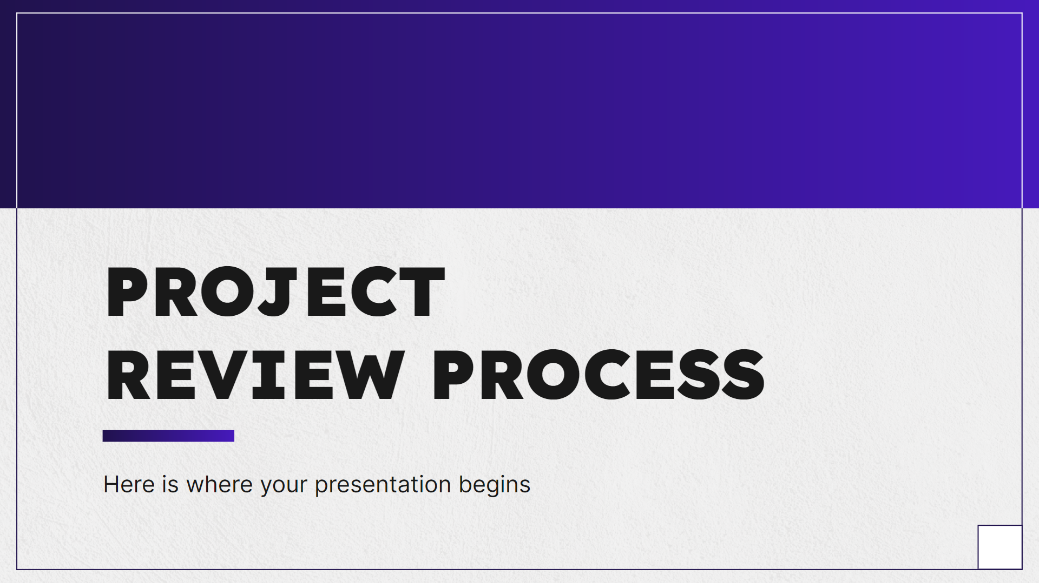
COMPUTER MOCKUP
You can replace the image on the screen with your own work. Just right-click on it and select “Replace image”

Slide 53

TABLET MOCKUP
You can replace the image on the screen with your own work. Just right-click on it and select “Replace image”

Slide 54

PHONE MOCKUP
You can replace the image on the screen with your own work. Just right-click on it and select “Replace image”

Slide 55
A TIMELINE ALWAYS WORKS WELL
STEP 1
STEP 2
STEP 3
STEP 4
Earth is the third planet from the Sun
The Moon is Earth’s only natural satellite
Mercury is the closest object to the Sun
Saturn was named after a Roman god
01
02
03
04
08
07
06
05
STEP 8
STEP 7
STEP 6
STEP 5
Neptune is very far away from us
Despite being red,
Mars is a cold place
Jupiter was named after a Roman god
Ceres is located in the main asteroid belt

Slide 56
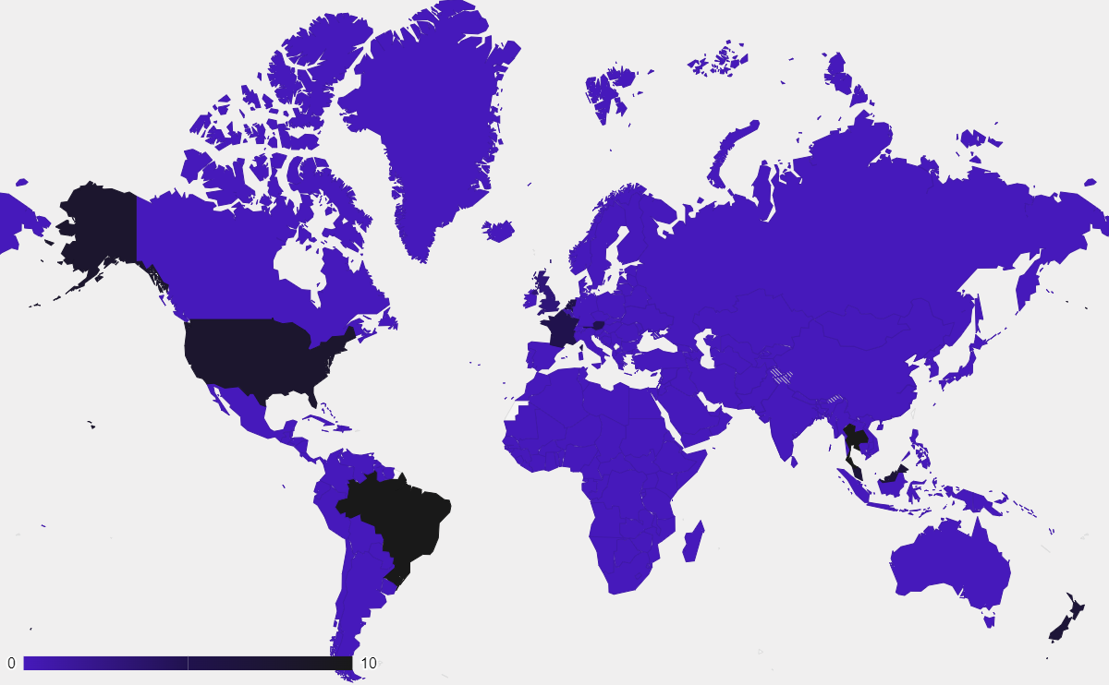
THIS IS A MAP
MARS
Mars is very cold
MERCURY
Mercury is small
VENUS
Venus is very hot
Follow the link in the graph to modify its data and then paste the new one here. For more info, click here

Slide 57
A TIMELINE ALWAYS WORKS WELL
STEP 01
STEP 03
Jupiter is the farthest planet from the Sun
Despite being red, Mars is a cold place
STEP 02
STEP 04
Saturn was named after a Roman god
Mercury is the closest object to the Sun

Slide 58
INFOGRAPHICS ARE USEFUL
MARS
A
B
VENUS
Despite being red, Mars is actually a cold place. It’s full of iron oxide dust
Venus has a beautiful name and is the second planet from the Sun
SOLAR SYSTEM
MERCURY
G
H
JUPITER
Mercury is the closest planet to the Sun and the smallest of them all
Jupiter is a gas giant and the biggest planet in the Solar System

Slide 59
USE TABLES TO REPRESENT DATA
 |  | TEAM A | TEAM B | TEAM C | TEAM D
TASK 1 | MERCURY | Jupiter is big | Mercury is small | Venus is very hot | Earth has life
 | MARS | XX | XX | XX | XX
TASK 2 | SATURN | Saturn has rings | Mars is a red planet | The Sun is a star | Mars is very cold
 | VENUS | XX | XX | XX | XX
RESULTS |  | 100K | 250K | 860K | 450K

Slide 60
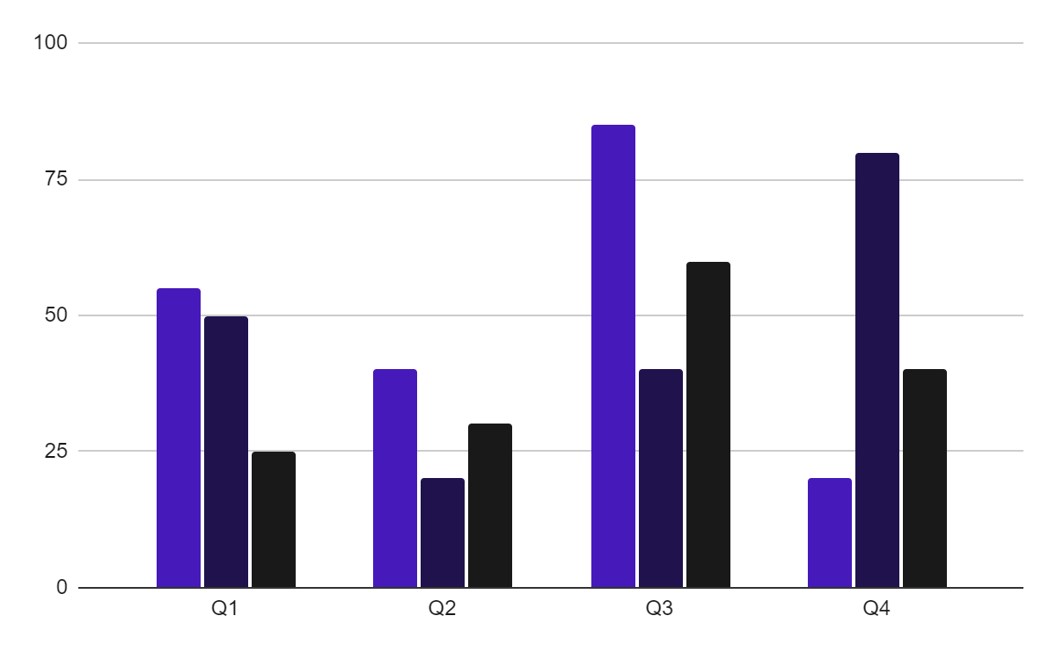
YOU CAN USE THIS GRAPH
TEAM 1
TEAM 2
TEAM 3
Follow the link in the graph to modify its data and then paste the new one here. For more info, click here

Slide 61
ROADMAP INFOGRAPHIC
 |  | MONTH
 |  | 1 | 2 | 3 | 4 | 5 | 6 | 7 | 8 | 9 | 10 | 11 | 12
PHASE 01 | Task 1
 | Task 2
PHASE 02 | Task 4
 | Task 5
PHASE 03 | Task 6
In progress
Done

Slide 62


OUR TEAM
SOFIA HILL
TOM HARRIS
You can speak a bit about this person here
You can speak a bit about this person here

Slide 63
THANKS!
Do you have any questions?
youremail@freepik.com
+34 654 321 432
yourwebsite.com
Please keep this slide for attribution

Slide 64
ALTERNATIVE RESOURCES
Here’s an assortment of alternative resources whose style fits the one of this template:

Slide 65
RESOURCES
Did you like the resources on this template? Get them for free at our other websites:
Photos
Beautiful women working together in a startup company
Corporate employee posing at the office
Businessman looking on a tablet
Two male colleagues talking to each other during a meeting
Office workers using finance graphs
Man showing something to his colleagues on laptop during a meeting

Slide 66
Instructions for use
If you have a free account, in order to use this template, you must credit Slidesgo by keeping the Thanks slide. Please refer to the next slide to read the instructions for premium users.
As a Free user, you are allowed to:
Modify this template.
Use it for both personal and commercial projects.
You are not allowed to:
Sublicense, sell or rent any of Slidesgo Content (or a modified version of Slidesgo Content).
Distribute Slidesgo Content unless it has been expressly authorized by Slidesgo.
Include Slidesgo Content in an online or offline database or file.
Offer Slidesgo templates (or modified versions of Slidesgo templates) for download.
Acquire the copyright of Slidesgo Content.
For more information about editing slides, please read our FAQs or visit our blog:
https://slidesgo.com/faqs and https://slidesgo.com/slidesgo-school

Slide 67
Instructions for use (premium users)
As a Premium user, you can use this template without attributing Slidesgo or keeping the Thanks slide.
You are allowed to:
Modify this template.
Use it for both personal and commercial purposes.
Hide or delete the “Thanks” slide and the mention to Slidesgo in the credits.
Share this template in an editable format with people who are not part of your team.
You are not allowed to:
Sublicense, sell or rent this Slidesgo Template (or a modified version of this Slidesgo Template).
Distribute this Slidesgo Template (or a modified version of this Slidesgo Template) or include it in a database or in any other product or service that offers downloadable images, icons or presentations that may be subject to distribution or resale.
Use any of the elements that are part of this Slidesgo Template in an isolated and separated way from this Template.
Register any of the elements that are part of this template as a trademark or logo, or register it as a work in an intellectual property registry or similar.
For more information about editing slides, please read our FAQs or visit our blog:
https://slidesgo.com/faqs and https://slidesgo.com/slidesgo-school

Slide 68
Fonts & colors used
This presentation has been made using the following fonts:
Lexend
(https://fonts.google.com/specimen/Lexend)
Inter
(https://fonts.google.com/specimen/Inter)
#191919
#f0efef
#ffffff
#4619bb
#20124d

Slide 69





Storyset
Create your Story with our illustrated concepts. Choose the style you like the most, edit its colors, pick the background and layers you want to show and bring them to life with the animator panel! It will boost your presentation. Check out how it works.
Pana
Amico
Bro
Rafiki
Cuate

Slide 70
Use our editable graphic resources...
You can easily resize these resources without losing quality. To change the color, just ungroup the resource and click on the object you want to change. Then, click on the paint bucket and select the color you want. Group the resource again when you’re done. You can also look for more infographics on Slidesgo.

Slide 73
JANUARY
FEBRUARY
MARCH
APRIL
MAY
JUNE
PHASE 1
Task 1
Task 2
PHASE 2
Task 1
Task 2
JANUARY
FEBRUARY
MARCH
APRIL
PHASE 1
Task 1
Task 2

Slide 76
...and our sets of editable icons
You can resize these icons without losing quality.
You can change the stroke and fill color; just select the icon and click on the paint bucket/pen.
In Google Slides, you can also use Flaticon’s extension, allowing you to customize and add even more icons.

Slide 77
Educational Icons
Medical Icons

Slide 78
Business Icons
Teamwork Icons

Slide 79
Help & Support Icons
Avatar Icons

Slide 80
Creative Process Icons
Performing Arts Icons

Slide 81
Nature Icons

Slide 82
SEO & Marketing Icons

Slide 83


