Slide 1
Brainstorm, then Select: a Generative Language Model Improves Its Creativity Score
Douglas Summers-Stay, Clare R. Voss, Stephanie M. Lukin
U.S. Army Research Lab

Slide 2
Abstract
Creative problem solving is a crucial ability for intelligent agents
Individuals or groups use to invent creative solutions:
Brainstorming
Selection
Using the Alternate Uses Task, a test for divergent thinking abilities show that when a large language model is given a sequence of prompts that include both brainstorming and selection phases, its performance improves over brainstorming alone.
Furthermore, a large language model can even achieve higher than average human performance on the same task.

Slide 3
Introduction
Creatively solving problems as they arise is necessary for intelligent agents to take action in any real-world situation that is constantly in flux.
However, in order for a solution to be considered creative, it must be both new and nonobvious, as well as be useful and effective at solving an actual problem. These criteria present something of a conundrum for neural networks, however, because anything truly novel that is generated must be something the network has not seen in training.

Slide 4
Introduction
Deep neural generative models are much more successful at generalization than previous approaches. Large neural language models have been applied to an enormous variety of creative writing tasks, including writing in the style of a named author on a given theme, writing jokes, interactive storytelling and role-playing, creating fictional interviews with celebrities, and many others.
Despite the rise in designing models for these creative applications, quantitative measures of the generated creativity proper have been less common. It has become increasingly important to characterize both the capabilities and the limitations of such models on creative problem-solving tasks.

Slide 5
Introduction
One such challenging creative generation task is the Alternate Uses Task (AUT), a test commonly used for divergent thinking ability, a key aspect of creativity. It was created as a means to measure and compare human creativity.
Test taker:
  a common object: pencil , asked to name as many and varied uses as possible within a time limit
  answers were scored on fluency, originality, flexibility, and elaboration
  Such measures proved hard to apply consistently, and more recently the test has been scored with anumerical assessment of novelty and usefulness which are thought to be the necessary and sufficient conditions for a response to be creative.

Slide 6
Introduction
A recent study explored using GPT as a problem-solver for the AUT. Their study used various settings of the largest GPT-3 model, Davinci, to solve the AUT for three objects (a book, a tin can, and a fork), and additionally collected human-authored responses for the same set of objects. And created a pool mixing the GPT-3 and human solutions to the AUT
Scored by trained raters for utility, originality, and surprise:
  results show that
    GPT scored somewhat higher than the human average on utility
    slightly lower on originality and surprise, among other findings.
Our objective in this paper is to assess GPT’s creative problem-solving abilities for the AUT, using a human inspired approach to creative problem-solving.

Slide 7
Methods
This study builds on previous work by Stevenson et al. (2022)
  focus on leveraging GPT-3's capabilities for creative problem-solving.
Goal of this study:
  Find chain of prompts to enhance GPT-3's performance
  Selects potential uses that are most promising in terms of utility and originality.
  First brainstorming and then selecting the best answers
    Utility
    Originality

Slide 8
Methods
Enhance the creative problem-solving abilities:
  Brainstorming Phase
    Generate a wide range of possible solutions to a given problem
    Leverage the generative capabilities of GPT-3
  Selection Phase
    Evaluate the generated ideas based on specific criteria
    Refine the pool of generated ideas by filtering out less useful or less original ones

Slide 9
Improving Utility
Large Language Model
  Do not contain explicit physics models to simulate what might happen
  Generalize answer from previous cases (in literature)
    eg. books can be used to swat flies, or to press leaves, or to impress a girlfriend
    generalized answers may be: using a book to kill a snake, or to press flowers, or to impress one’s boss.

Slide 10
Improving Utility
Evaluation Process (using GPT-3)
  Advantages Prompt
    advantages of using a specific object for a proposed purpose
  Drawbacks Prompt
    drawbacks to using the object for the same purpose
  Evaluation Prompt
    combines the insights from the advantages and drawbacks to make a comprehensive evaluation.
brainstorming
selection

Slide 11
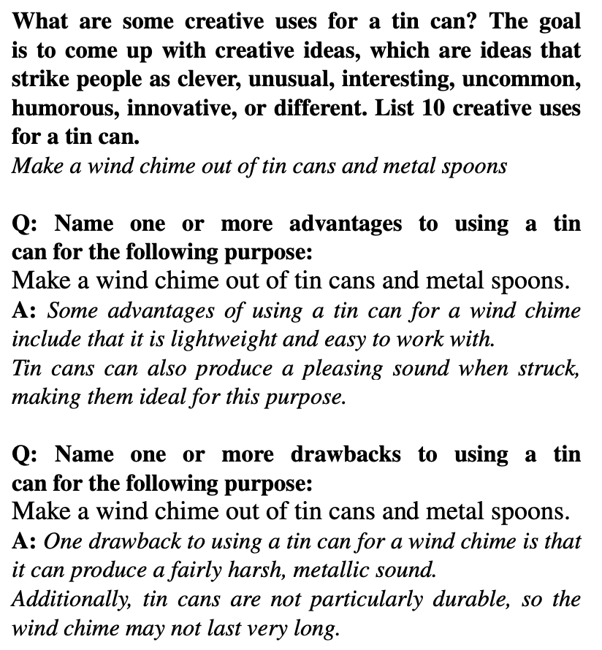
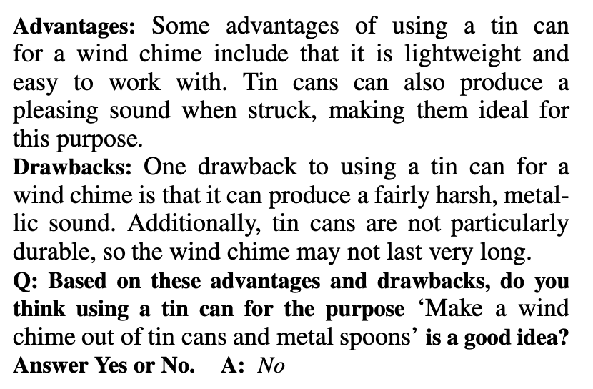
Improving Utility

Slide 12
Improving Originality
Paradox of predicting the next token
  “clever, unusual, interesting, uncommon, humorous, innovative, or different
GPT-3's deductive reasoning vs. analogical reasoning
  bottle : stained glass :: tin can : ???
  “embossed tin art”
  word embeddings such as word2vec

Slide 13
Improving Originality
Evaluation Process (using GPT-3)
  Advantages Prompt
    advantages of using a specific object for a proposed purpose
  Drawbacks Prompt
    drawbacks to using the object for the same purpose
  Evaluation Prompt
    combines the insights from the advantages and drawbacks to make a comprehensive evaluation.
brainstorming
selection

Slide 14
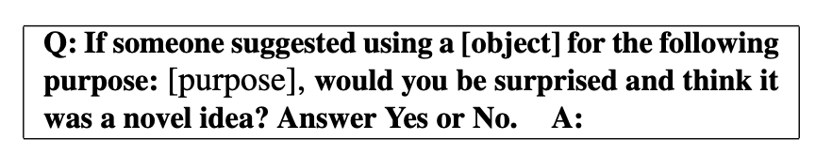
Improving Originality

Slide 15
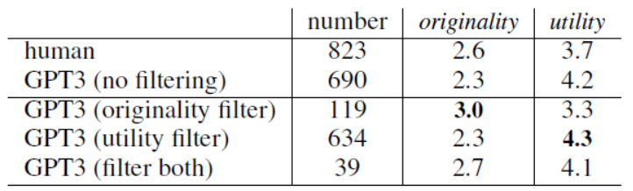
Result
Notes:
這張表顯示了應用新提示作為filter來回應的結果。透過重複使用GPT-3選擇那些被評為原創、有用或兩者揭皆是的答案，可以提高分數。先前也有學者指出，原創性和實用性是一種取捨，作者也發現這些filter也是如此。如果僅選擇GPT-3確信是原創的回應，那麼評定的原創性就從2.3提高到3.0，但評定的實用性則從4.2降低到3.3。如果我們僅選擇GPT確信是有用的回應，我們可以將實用性得分從4.2提高到4.3，而不會減少太多原創性。如果我們僅選擇那些GPT確信是既原創又有用的回應，那麼原創性會提高，但實用性會稍微下降，儘管原創性和實用性仍然高於人類回應的平均評分。

Slide 16
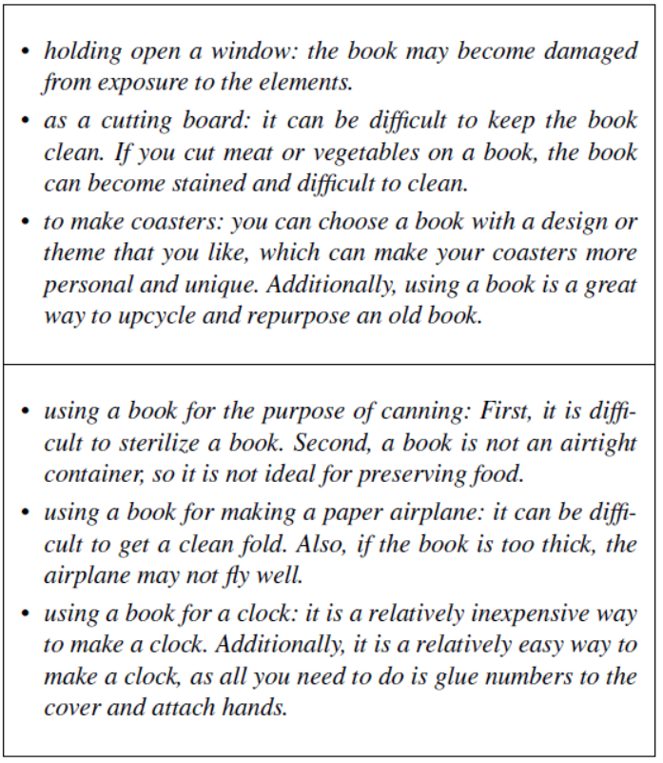
Sample Outputs of Suggested Advantages and Drawbacks
Notes:
他們假設生成優點和缺點的prompt將有助於使模型在回答解決方案是否比較偏向有用或新穎。
然而，當建議的用途完全荒謬時，模型仍然提出了優點，從未僅僅拒絕一個想法為不可能或沒有可取之處。第二組三個結果顯示，它生成的優點和缺點可能非常愚蠢。
將窗戶打開以保持通風：書籍可能因受到自然元素的曝曬而損壞。
作為砧板使用：保持書籍清潔可能會有困難。如果在書上切肉或蔬菜，書籍可能會被染污且難以清潔。
製作杯墊：您可以選擇一本您喜歡的設計或主題的書籍，這可以使您的杯墊更加個人化和獨特。此外，使用書籍是將舊書重新利用和再利用的絕佳方式。
使用書籍進行罐裝食品的用途：首先，對書籍進行滅菌很困難。其次，書籍不是密封容器，因此不適合保存食物。
將書籍用於製作紙飛機：很難折出一個整潔的摺痕。此外，如果書籍太厚，飛機可能飛行效果不佳。
將書籍用於製作時鐘：這是一種相對廉價的製作時鐘的方式。此外，這是一種相對簡單的製作時鐘的方式，因為您只需要將數字黏貼到封面上並安裝指針即可。

Slide 17
Discussion and Future Work
This paper has presented a paradigm to encourage creativity in GPT-3 by first brainstorming and then selecting the best answers according to their novelty and usefulness.
They seek to better understand in what other contexts the generation of possible solutions and evaluation can be successfully applied. While GPT-3 was successful at the AUT, this may not be the case for other problems requiring multiple novel steps to be carried out in succession.
Notes:
本文根據其新穎性和實用性選擇最佳答案，以鼓勵GPT-3中的創造力。
他們希望更好地了解在哪些其他情境中，可能解決方案的生成和評估可以成功應用。雖然GPT-3在AUT方面取得了成功，但對於需要連續執行多個新穎步驟的其他問題，就可能不同。
一個沒有人知道的問題是：這個模型是否僅僅複製了它已經見過的“創意用途”示例？該模型提出的其中一個更糟糕的建議是使用叉子“搭建堡壘”。儘管這個想法對叉子來說幾乎毫無意義，但搭建堡壘的想法通常與創意遊戲有關。也許生成的建議與GPT從訓練數據中總體學到的“創造力”概念更相關，而不是真正的發明。
其中的一種探索方法是在原始提示中不提及新穎性或創造力的情況下重新運行實驗。如果不引入它從其他創意的上下文中看到的示例，GPT-3是否仍然能夠提出既新穎又實用的答案？
他們還希望將他們的方法與一個模型結合起來，該模型將解決方案的自然語言描述轉換為可以由機器（如機器人）執行的工作程序。目前已經在探索如何通過提示結構將預訓練大型語言模型（LLM）中存儲的知識轉移到機器人任務中。

