Slide 1


Slide 2
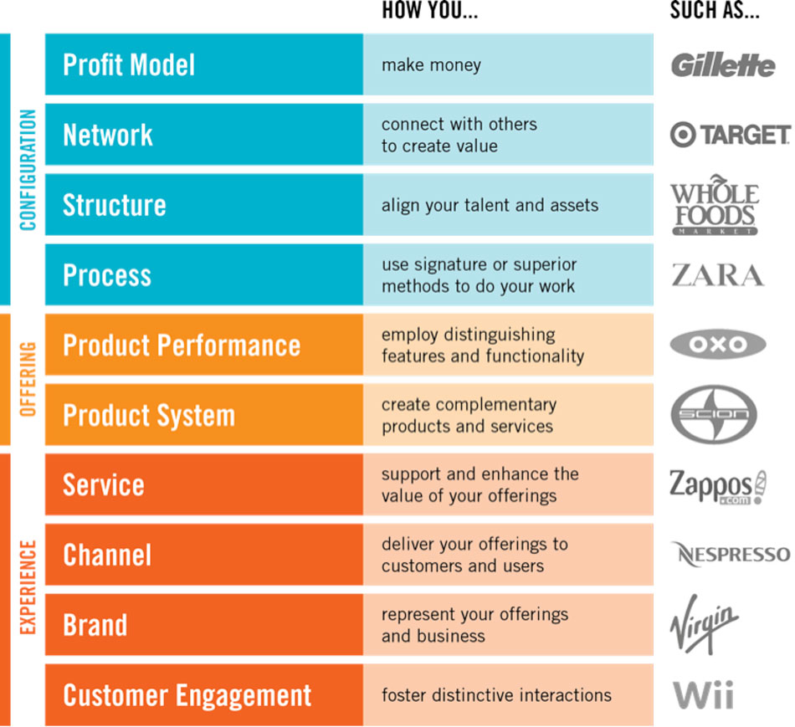
Ⅰ. The Ten Types (創新10個原點)
A useful tool to diagnose and enrich an innovation
Right side (Onstage)
The types become increasingly apparent and obvious to end users.
Left side (Backstage)
The most internally focused and distant from customers.

Slide 3
Framework
Configuration (配置)
  Focused on the innermost working
Offering (商品)
  Focused on an enterprise’s core product or service
Experience(體驗)
  Focused on more customer-facing elements

Slide 4
VPRC model
Income Generation
Customer Engagement | Customer
Brand
Service
Channel
Innovation
Value
Revenue
Price
Cost
Business
Profit Model
Network
Structure
Process
Product Provision
Product performance Product system

Slide 5
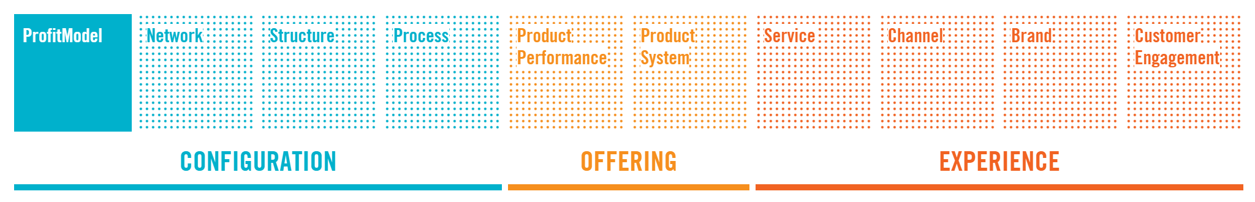
Profit model
How you make money
Innovative profit models find a fresh way to convert a firm’s offerings and other sources of value into cash.
Must align with company’s overarching strategy and innovation intent
  Premium price, Auction prices
    what customers and users actually cherish
    where new revenue or opportunities might lie

Slide 6
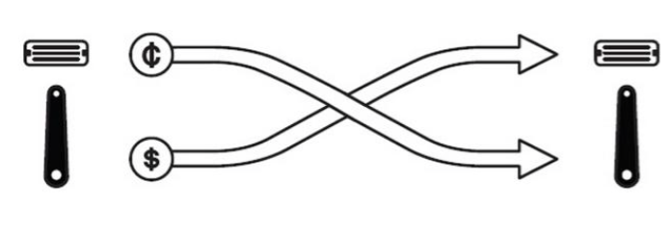
Profit model innovation story
Gillette
The “razor and blades” profit model:
Create an installed base by selling the enduring part of the system at low cost (or even a loss)
Enjoy recurring revenue by selling the disposable parts at a premium.
Evolving the profit model from driving adoption to extending the product lifecycle
Notes:
Gillette
The "razor and blades" profit model has been celebrated for years and adapted to countless other industries, from printers and cartridges to capsule coffee. The gist is simple—create an installed base by selling the enduring part of the system at low cost (or even a loss), and then enjoy recurring revenue by selling the disposable parts at a premium.
As Randal C. Picker noted, Gillette initially used the opposite profit model— charging a premium for the razor handle and selling the blades cheaply." This had

Slide 7
獲利模式創新 | 廣告支援 Ad-Supported 一方免費提供內容服務，同時把聽眾、觀眾或”眼球”出售給另一方。 | 彈性定價Flexible Pricing 根據需求調整定價。
 | 拍賣Auction 允許市場和市場的使用者為產品或服務定價組合定價。 | 預付款Float 在產品生產前預收款項，在交貨前先賺取該筆款項的利息。
 | 成本領導cost leadership 把變動成本壓低，薄利多銷。 | 限量供應Forced Scarcity 限制商品供應量、供應時間或取得方式，以刺激需求或抬高售價。
 | 分拆定價 Disaggregated Pricing 讓顧客只買他們想要的商品。 | 免費增值Freemium 免費提供基礎服務，但是進階服務或特殊服務需要額外收費。
 | 融資Financing 不是從直接銷售商品獲得營收，而是從結構性支付計畫和售後利益中獲得收入。 | 建立基礎客戶Installed Base 以薄利（甚至虧本）銷售“核心”產品，以刺激需求與忠誠度，再靠銷售額外的產品和服務賺取獲利。

Slide 8
獲利模式創新 | 授權Licensing 以特定的價格，授權團體或個人採去指定的方式使用你的商品。 | 風險分擔Risk Sharing 如果沒有達到某個標準就免除標準費用或成本，但是達到標準就要收取超額收益。
 | 會員制Membership 收取一定期間的費用，讓會員有資格進入特定的場所，購買非會員無法享受的商品或服務。 | 規模交易 Scaled Transactions 單位成本固定時，以大量大規模的交易來提升利潤。
 | 以量計價Metered Use 讓顧客依使用量付費。 | 訂閱Subscription 顧客需要預先支付一次性或多次性的費用，才能在未來取得商品或服務，這可以創造可預測的現金流。
 | 小額交易Microtransaction 很多東西只賣1美元，或甚至是1美分，以刺激衝動型消費。 | 集散中心Switchboard 撮合許多買家和賣家。如果有愈多買家和賣家加入，這個集散中心就會愈有價值。
 | 議價Premium 把價格訂得比競爭對手高，已獲得較高的利潤，通常用於比較高檔的商品、體驗、服務或品牌上。 | 使用者決定User-Defined 按照顧客的付款意願設定價格

Slide 9
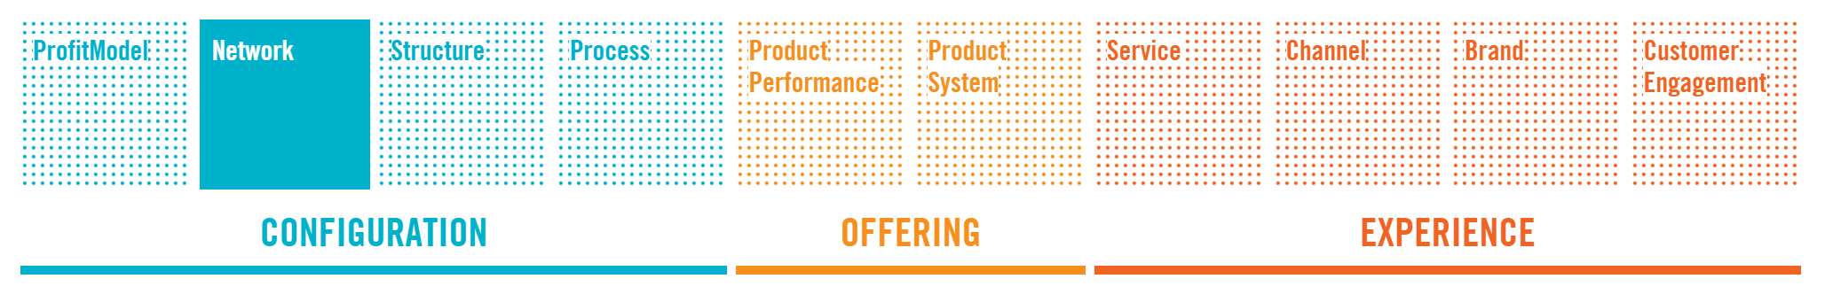
Network
How You to Connect with Others to Create Value
Network innovations provide a way for firms to take advantage of other companies’ processes, technologies, offerings, channels, and brands.
  Open innovation: prizes or crowdsourcing
  Franchises

Slide 10
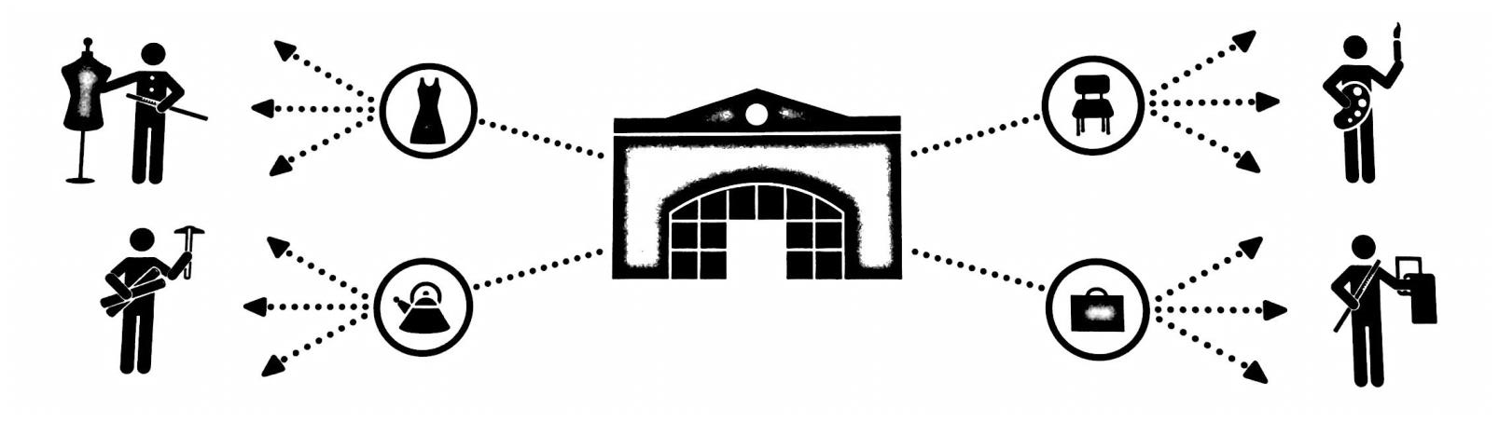
Network innovation story
Target Corporation
It is the second-largest discount retailer in the United States
It has intended to differentiate its stores from its competitors by offering what it believes is more upscale, trend-forward merchandise at lower costs
Rather than the traditional concept of focusing on low-priced goods
Cooperate with numerous designers (product) and famous retailers (promotion)

Slide 11
網路創新 | 聯盟Alliances 分享收益並分擔風險，共同改善各自的競爭優勢。 | 連鎖加盟Franchising 授權付費的夥伴使用經營原則、流程及品牌。
 | 合作Collaboration 為了互利與他人合夥。 | 併購Merger/Acquisition 將兩個或多個實體合併起來，已取得資產和技術。
 | 互補合作 Complementary Partnering 和瞄準相似市場，帶供應不同產品和服務的公司共用資產，提升價值。 | 開放式創新open Innovation 取得其他公司的流程或專利，已運用、延伸及精進專業，或是對內部的智慧財產權和流程做相同的事。
 | 整合Consolidation 收購多家在相同或互補市場的公司。 | 次級市場Secondary Markets 為浪費資源、副產品或其他的另類產品找到需要的顧客。
 | 競合Coopetition 與競爭對手合作，達成共同目標。 | 供應鏈整合Supply Chain Intergration 協調並整合跨公司貨價值鏈上不同單位的資訊或流程。

Slide 12
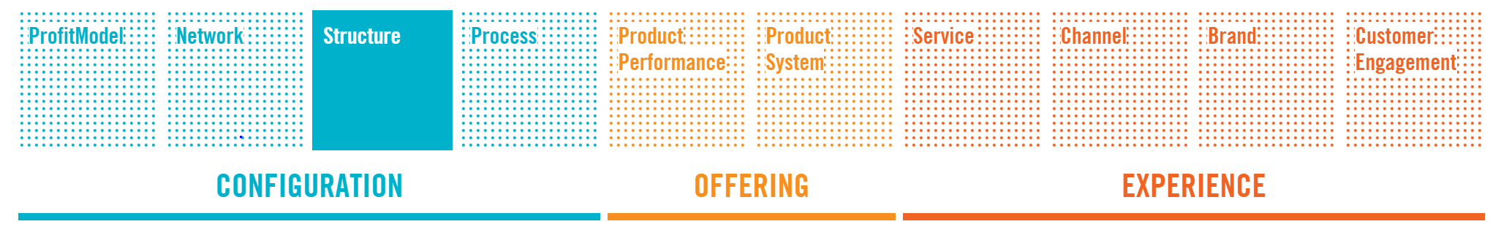
Structure
How You Organize and Align Your Talent and Assets
Focused on organizing company assets- hard, human, or intangible- in unique ways that create value.
  Building incentive
  Asset standardizing
  Corporate university

Slide 13
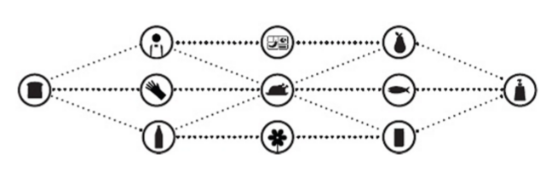
Structure innovation story
Whole Foods Market (全食超市)
Teams are everything at Whole Foods：for its radical decentralization of management.
Each store is composed of self-directed teams that manage departments with unusual
team within the store has very clear performance targets.
“organizing into small interlocking teams helps ensure that trust will flow in all directions within the organization”
Notes:
Whole Foods Market
Teams are everything at Whole Foods; the company is well known for its radical decentralization of management. Each store is composed of self-directed teams that manage departments with unusual autonomy—making decisions about what products to stock and how to display them. Importantly, each team also makes decisions about who to hire; joining a team requires two thirds of its current members' approval. Each store is measured as an independent line on the Profit & Loss statement, and each team within the store has very clear performance targets.
Describing Whole Foods's structure as a "high trust organization," CEO John Mackey wrote in 2010 that "organizing into small interlocking teams helps ensure that trust will flow in all directions within the organization—upwards, downwards,

Slide 14
結構創新 | 資產標準化 Asset Standardization 透過資產標準化來降低營運成本，提升連結性和模組化。 | 資訊科技整合IT Integration 整合技術資源和應用程式。
 | 研發中心Competency Center 把資源、實物及專業集中在一起，用來支援組織各部門，以提高效率與效力。 | 知識管理Knowledge Management 在內部分享相關資訊，以減少重複的工作，提升工作績效。
 | 企業大學Corporate University 提供管理層工作或公司相關的訓。 | 組織設計Organizational Design 依照組織功能決定作法，使基礎架構配合核心特質和商業流程。
 | 分權管理 Decentralized Management 把決策權交給比較接近顧客或業務運作的員工。 | 外包Outsourcing 指派外部廠商開發或維護系統。
 | 獎勵機制Incentive Systems 提供財務或非財務方面的獎勵，鼓勵員工。

Slide 15
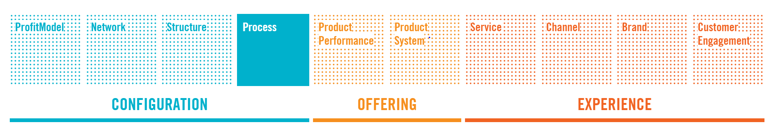
Process
How You Use Signature or Superior Methods to Do Your Work
Involve the activities and operations that produce an enterprises’s primary offerings.
Often from the core competency of an enterprise, and may include patented or proprietary.
  Lean production ➢ Process standardization
  Complexity

Slide 16
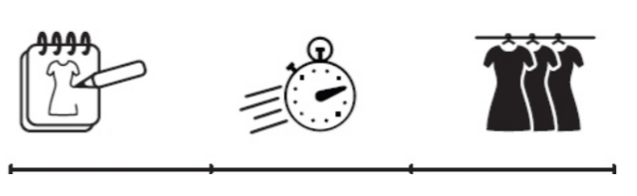
Process innovation story
Zara
Its stores are sited in high-end locations in major shopping areas
Using an integrated and efficient production system drives short turnaround times and keeps stock at a minimum
Its designers can quickly review production issues and respond to changing fashion trends
Zara using its supply chain to its advantage, as it maximizes inventory turns and allows the company to respond to emerging trends briskly.

Slide 17
流程創新 | 群眾外包Crowdsourcing 把重複性、挑戰性高工作外包給一群半組織化的個體。 | 物流系統Logistics Systems 生產端到最終使用端的物品、資訊與其他資源的管理。
 | 彈性製造Flexible Manufacturing 採用可以迅速因應改變並保持高效率的生產系統。 | 按需求生產On-Demand Production 接單後再生產，避免庫存成本。
 | 智慧財產權Intellectual Property 使用專屬的流程把點子商業化，使其他人無法抄襲。 | 預測分析Predictive Analytics 用過往的業績資料建立模型，用來預測未來的設計和訂價。
 | 精實生產Lean Production 減少生產流程及其他營運中的浪費按成本。 | 流程自動化Process Automation 運用工具和基礎架構來管理例行活動，讓員工有時間做其他的任務。
 | 在地化Localization 為了鎖定特定的文化或地區而調整商品、流程或體驗。 | 流程效率Process Efficiency 用更少的原料、能源或時間，創造或製造更多的產出。
 | 流程標準化Process Standardization 使用常見的產品、流程及政策，以減少複雜到、成本和錯誤。 | 策略設計Strategic Design 刻意顯示出公司在商品、品牌、體驗上保持一致。

Slide 18
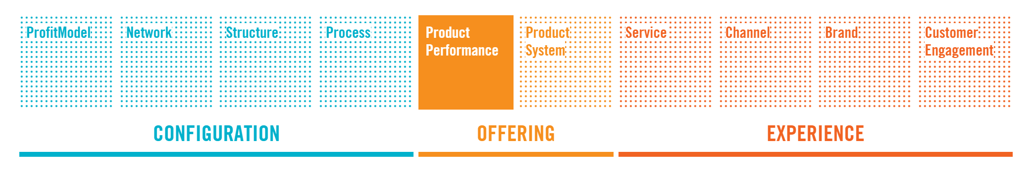
Product performance
How You Develop Distinguishing Features and Functionality
Address the value, feature, and quality of a company’s offering
Involves both entirely new products as well as updates and line extensions that add
  Simplification
  Sustainability
  Customization

Slide 19

Product innovation story
OXO Good Grips (OXO 好握公司)
The inspiration came after Sam Farber watched his arthritic wife struggle to peel some apples
The utensils were priced at a premium.
But the products not only appeal the intended audience of the infirm or movement-impaired but also attracted larger audience of people who cared about home cooking

Slide 20
產品表現創新 | 增加功能Added Functionality 為現有商品增添新功能。 | 功能彙整Feature Aggregation 把不同商品的功能集中在單一商品。
 | 環境保護Conservation 設計環保產品，減少使用者消耗的能源或材料。 | 聚焦Focus 為特定的客群設計產品或服務。
 | 客製化Customization 按個人要求或規格更改產品。 | 功能簡化Performance Simplification 刪除多餘的細節、功能和介面，以減少複雜度。
 | 好用Ease of Use 讓產品更簡單、直覺，使用更舒適。 | 安全Safety 提供顧客的信心和安全感。
 | 吸引人的功能Engaging Functionality 提供出人意料或引人關注的功能，以增加顧客互動。 | 時尚Styling 挹注引人注目的風格、流行或形像，以創造出顧客渴望的產品。
 | 環境友善Environmental Sensitivity 生產對環境無害或危害少的商品。 | 卓越產品Superior Product 開發優異設計、品質或體驗的商品。

Slide 21
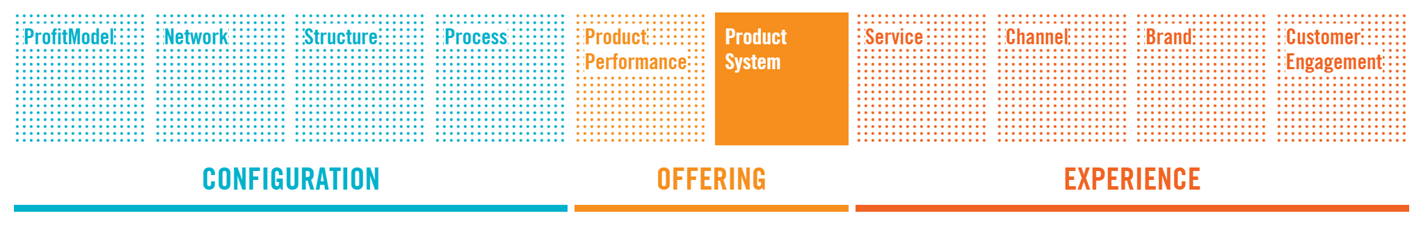
Product System
How You Create Complementary Products and Services
Help to build ecosystems that captivate and delight customers and defend against competitors.
  Product bundling → platform
  Product extension
  Product and service combination
  Complementary

Slide 22
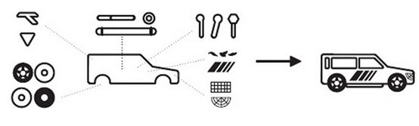
Product innovation story
Scion (賽揚汽車)
Built by passion, not by committee
Customers can design the cars which they want to drive.
Integrate the market of car customization and components.

Slide 23
產品系統創新 | 互補商品 Complements 銷售相關和周邊的產品或服務。
 | 延伸/外掛 Extensions/Plug-ins 允許內部或協力廠商開發增添功能的附件。
 | 商品整合 Integrated Offering 把獨立的零組件組成完整的體驗。
 | 模組化系統 Modular Systems 提供一套零件組，可以獨立使用，但合併使用會增加效用。
 | 套裝產品 Product Bundling 把幾個產品合成一套組合販售。
 | 產品/服務平台 Product/Service Platforms 開發連結其他合作夥伴的產品或服務的系統，形成完整的商品組合。

Slide 24
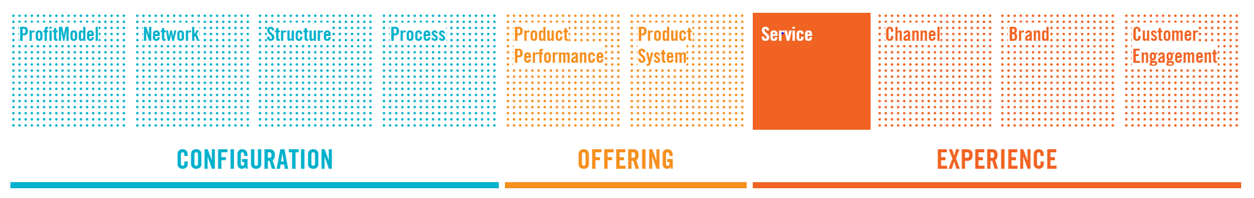
Service
How You Support and Amplify the Value of Your Offerings
Enhance the utility, performance, and apparent value of an offering.
Make a product easier to try, use, and enjoy
product use enhancements ➢ maintenance plans
customer support ➢ information and education
warranties and guarantees

Slide 25
Product innovation story
Scion(捷步)
Built by passion, not by committee
Customers can design the cars which they want to drive.
Integrate the market of car customization and components.

Slide 26
服務創新 | 附加價值 Added Value 基本價格裡包含額外服務或功能。 | 忠誠計畫 Loyalty Programs 為經常光顧、帶來高價值的常客提供獎勵和折扣優惠。
 | 禮賓服務 Concierge 替顧客承擔無暇應付的任務，藉此提供高級服務。 | 客製化服務 Personalized Service 根據顧客資料提供量身訂做的服務。
 | 售後保證 Guarantee 幫顧客消除因產品失靈或購買錯誤造成的金錢或時間損失風險。 | 自助服務 Self-Service 讓顧客自行活動，不需中介者幫忙完成的服務。
 | 租貸或借出 Lease or Loan 允許顧客分期付款，以降低期初成本。 | 卓越服務 Superior Service 提供比競爭對手更好的品質和功效，或更好的體驗。

Slide 27
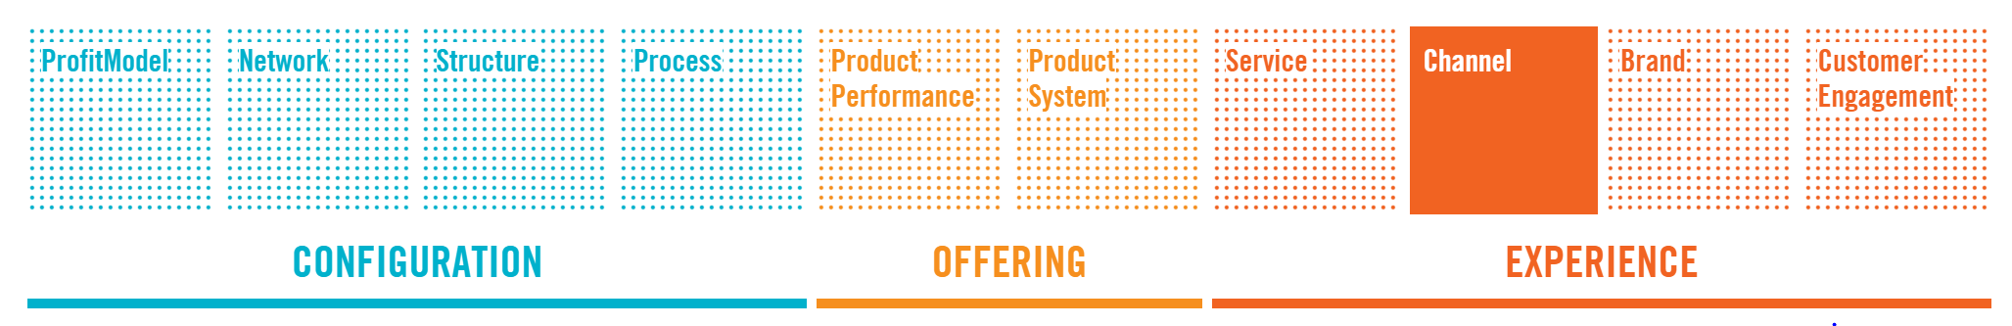
Channel
How You Deliver Your Offerings to Customers and Users
Encompass all the ways that you connect your company’s offerings with your customers and users.
Goal : users can buy what they want, when and how they want it, with minimal friction and cost and maximum delight
  Flagship store ➢ Pop-up store (期間限定店 )
  Indirect distribution or multi-level marketing

Slide 28
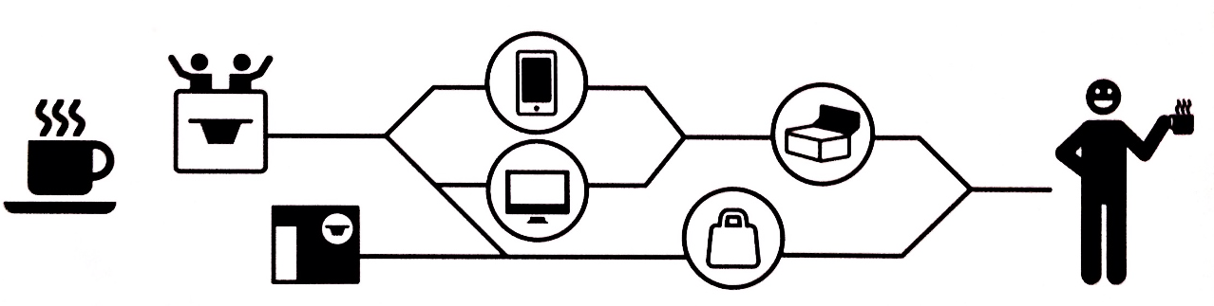
Channel innovation story
Nespresso
Build many channels to make sure all the customers can access their product.
Set “Nespresso Club” online to help customers to order , and remind them by the mail.
Cooperated with other business, such as Ritz-Carlton, Hyatt Hotells to produce the chance to touch the customers

Slide 29
通路創新 | 特定情境 Context Specific 即時提供商品給在特定地點、場合、情境中的顧客。 | 間接經銷 Indirect Distribution 找其他人當經銷商，把商品賣給最終使用者。
 | 交叉銷售 Cross-Selling 在顧客想購買時，提供可提升體驗的其他誘人產品、服務或資訊。 | 多層次傳銷 Multi-Level Marketing 批發商品給入會但獨立的業務員，讓他們幫你銷售。
 | 多角化 Diversification 增加或擴充新通路或不同通路。 | 非傳統通路 Non-Traditional Channels 運用新奇和相關的管道來接觸與服務顧客。
 | 體驗中心 Experience Center 設立讓顧客和產品互動的場所，但可從不同的通路(通常價格較低)購買。 | 按需求提供 On-Demand 在顧客需要即時提供商品。
 | 旗艦店 Flagship Store 建立零售商店，展示經典品牌和產品特質。 | 期間限定店 Pop-Up Presence 打造引人關注的臨時商店，以展示或銷售商品。
 | 直銷 Go Direct 跳過傳統零售通路，直接接觸顧客。

Slide 30
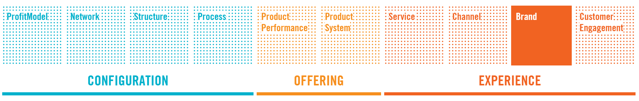
Brand
How You Represent Your Offerings and Business
Brand innovations can transform commodities into prized products, and confer meaning, intent, and value to your offerings and your enterprise.
  Brand extension
  Branding your component

Slide 31

Brand innovation story
Virgin(維珍集團)
Start form music industry(Virgin Record Shop).
Cross-field investment in many industry, such as Virgin Altanic Airways, Virgin Active.
Each subsidiary company runs independently, makes the fail investment be unable to influence the parent company .

Slide 32
品牌創新 | 品牌延伸 Brand Extension 在現有品牌下提供新的產品或服務。 | 關鍵零組件品牌 Component Branding 為商品內的某個零組件建立品牌，讓整個商品更有價值。
 | 品牌槓桿 Brand Leverage 允許其他人使用你的品牌，讓他們借用你的信譽，拓展公司的影響力。 | 自有品牌 Private Label 在別人製作的商品上使用自家公司的品牌銷售。
 | 認證 Certification 開發一個品牌或標誌，以代表或確保協力廠商的商品符合某些必要的特性。 | 資訊透明 Transparency 讓顧客看到你的經營方式，參與你的品牌塑造和商品設計。
 | 聯合品牌 Co-Branding 結合不同品牌，強化彼此的重要特質，或增加商品的可信度。 | 一致的價值 Values Alignment 讓你的品牌代表某個理念或價值觀，在公司的各方面都一致傳達那個訊息。

Slide 33
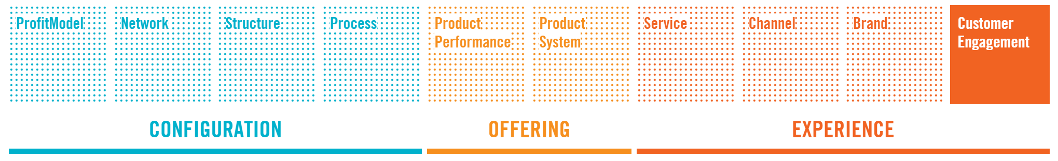
Customer Engagement
How You Foster Compelling Interactions
Understanding the deep-seated aspirations of customers and users
provide broad avenues for exploration
help people find ways to make parts of their lives more memorable, fulfilling, delightful — even magical.

Slide 34

Customer Engagement innovation story
Blizzard Entertainment (暴雪娛樂)
Built Massively Multiplayer Online Role-Playing Games to make players cooperate with each other.
Focus on making the best user experience in the games.
Establish the Online Forum to encourage players discuss with each other, get them involve in the game groups.

Slide 35
顧客參與創新 | 自治和權利 Autonomy and Authority 讓顧客自己塑造體驗。 | 體驗簡化 Experience Simplification 減少複雜度，專注把特定體驗發展到極致。
 | 社群和歸屬 Community and Belonging 促進情感聯繫，讓顧客覺得自己是群體或某項活動的一份子。 | 精通技能 Mastery 幫助顧客獲得卓越的技巧，或是某個活動或主題的深入知識。
 | 策展 Curation 創造獨特的觀點，塑造鮮明的形象，確切提供追隨者想要的東西。 | 個人化 Personalization 改變標準化商品，以彰顯顧客身分。
 | 體驗自動化 Experience Automation 幫助使用者省去重複的勞務，讓生活更輕鬆，覺得新體驗相當美妙。 | 地位和肯定 Status and Recognition 提供有意義的線索，讓使用者與和他互動的人瞭解他的身分特色。
 | 拓展體驗 Experience Enabling 提供以往不可能產生的體驗。 | 與眾不同與人性化Whimsy and Personality 提供人性化商品，傳達充滿活力的品牌訊息。

Slide 36
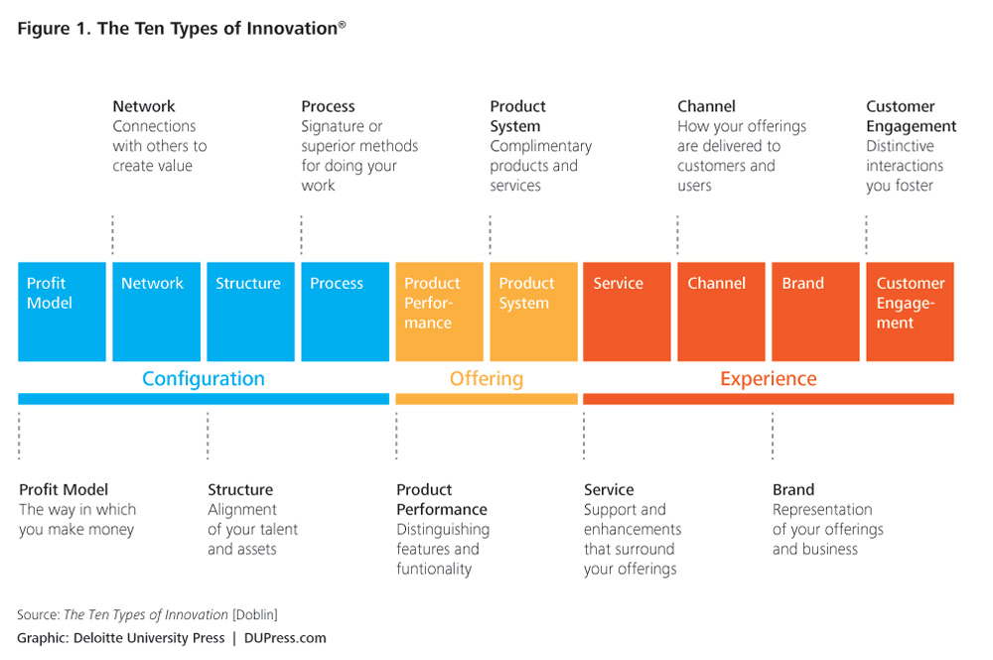

Slide 38

Ⅱ. Spot the Innovation
創新案例解析
Ginger
DELL
FedEx
Lego
method

Slide 39

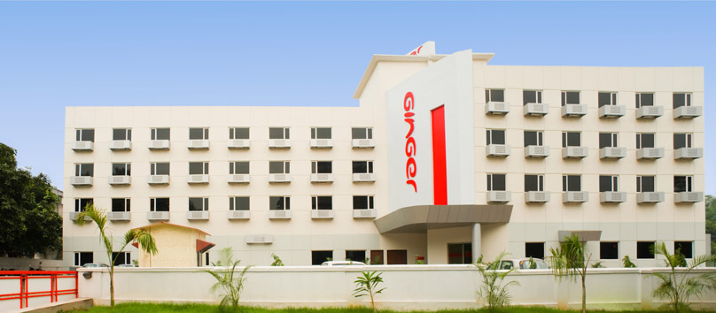
Ginger Hotels (薑之棧):
Please Help Yourselves
Indian Hotels Company Limited’s company
Target: cheaper price, don’t need luxury experience
How:
  Self-service facilities (vending machine, self check-in counter etc.)
  Cooperation with Cafe’ Coffee Day
  Central Reservation System

Slide 40

Network: Cafe’ Coffee Day in the hotel. Menu for order in.
Structure: Rely on outsourcing (laundry, maintenance)
Product performance: Provision of infrastructure(make it affordable)
Service: Self-service facilities (vending machine, self check-in counter)
Brand: Simple & Affordable

Slide 41


Dell (戴爾)
The best PC seller
Target: reduce inventory, make after order
How
  Using Intranet website for partners
  Lead-Time Meeting: provide inventory information
Benefits
  Reduce cash conversion cycle
  Gain net income from 28 hundred million to 123 hundred million

Slide 42
Profit model: cash conversion cycle
Network: decrease the number of partners
Process: produce according to customer’s standard
Service: provide all day phone orders and technical support
Channel: sale on the internet instead of stores

Slide 43

FedEx (聯邦快遞)
Problem: most air parcel had inefficient delivery
Target: for time limit
How:
  Customer Operations Service Master Online System, COSMOS
  ->deliver in time
  Employee scan for details for each
  SenseAware: track temperature, location and exposure to sunlight

Slide 44

Profit model: limited time delivery
Process: just in time
Product performance: using data to improve usability
Service: the best tracking service
Channel: acquisition Kinkos. Inc for more spots

Slide 45
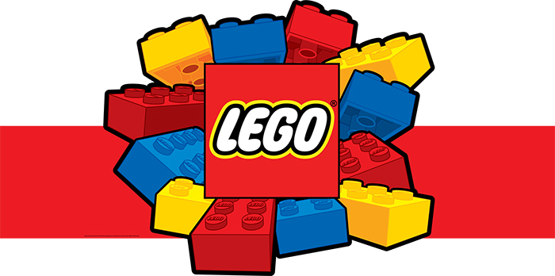
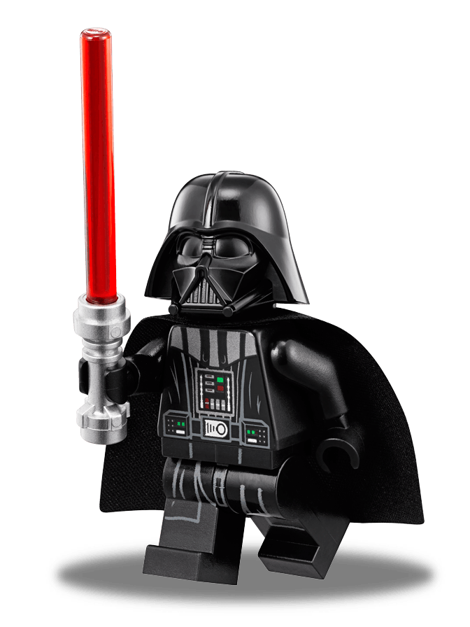
LEGO (樂高)
Target: adults lego
How:
  Building: Fallingwater (落水山莊), Guggenheim museum (古根漢博物館)
  Cooperation with MIT media Lab: LEGO MINDSTORMS
  DVD and Electric toys
Benefits:
  Net income increase 17% (2011)

Slide 46
Network: Contract with Star Wars, Lord of the Rings
Product System: lego now are compatible with lego in 1958
Channel:
  Online: high price merchandise
  Large retailer: general merchandise
  Exclusive shops: limited edition
Customer engagement : LEGOLAND Billund (比隆樂高)

Slide 47


Method (美則)
Promise: to people + to the environment (環保清潔)
How:
  Cradle to cradle (搖籃到搖籃), environmental protection
  Not only for cleanness, but also for design

Slide 48
Structure: outsourcing, flexible reaction
Process: green sourcing method
Product performance: precautionary principle
Brand: Karim Rashid designed, Easily recognizable,
Bright and colorful packaging
Customer engagement: invite people interest in Environmental Protection

Slide 49
Ⅲ. 建構創新計劃的攻略
商業模式導向 | 平台導向 | 顧客體驗導向
開放式邀請 Open Invitation | 特許經營 Franchise | 賦予身分地位 Status-Based
協同消費 Collaborative Consumption | 交易平台 Exchange | 沉浸式體驗 Immersion
免費提供基本商品 Free –Based | 協同創造 Collaborative Creation | 社群聯繫 Connected Community
徹底最佳化 Radical Optimization | 研發導向平台 Competency-Driven Platform | 樹立價值觀 Value-Based
前瞻性業務 Predictive Business | 生態系統體驗 Experience Ecosystem | 產品簡化 Simplification

Slide 50





商業模式導向
開放式邀請 Open Invitation | 使用策略
鼓勵其他人與你合作，無論專家或陌生人 | [開放式創新或群眾外包]＋研發中心
協同消費 Collaborative Consumption | 使用策略
運用人際關係顛覆傳統的所有權形式 | [以量計費或集散中心]+ 流程自動化+[安全或使用者社群 / 支援系統或一致的價值]
免費提供基本商品 Free –Based | 使用策略
免費來吸引許多使用者，再用多種方法從他們身上賺錢 | 免費增值+吸引人的功能+[小額交易或會員制或廣告支援或集散中心]
徹底最佳化 Radical Optimization | 使用策略
超越一般的營運效率，讓競爭對手望塵莫及 | 資訊科技整合+流程自動化+流程標準化+售後保證
前瞻性業務 Predictive Business | 使用策略
從資料中找出行為模式，進行分析，讓你可以因此對客戶做出承諾，預測結果，不斷提升效率 | [風險分擔或以量計費]+預測分析+套裝產品+售後保證

Slide 51
Open Invitation
Encourage other people to work with you
Network-Open Innovation
Structure-Competency Center
Process-Crowdsourcing
Acquire other company’s process or patent to promote profession.
Concentrate resources, practice, profession together to improve efficiency.
Outsourcing high repeatability or high challenge work to other organization.

Slide 52
Open Invitation:葛蘭素史克
葛蘭素史克消費者醫療保健部門，培養許多外部合作夥伴，與內部的科學家一起開發新點子 共同分擔開發的風險
Network-Open Innovation
Structure-Competency Center
Process-Crowdsourcing
葛蘭素史克的家護活性泡沫潔牙膏裡的發泡技術就是和四個獨立夥伴合作的成果。
消費者醫療保健部門是在開放式的空間裡上班，如果包裝設計師剛好坐在臨床醫師對面，那麼他們只要傾身即可開始交流，不必安排會議，也更容易激發創意。
葛蘭素史克的開放是創新入口網站允許外部人是尋找葛蘭素史克的技術和產品需求，並提出合作的想法。

Slide 53
Collaborative Consumption
Leverage connectivity to upend traditional forms of ownership and change the way customers relate to your goods or services.
Profit Model-Metered Use
Process-Process Automation
Let customers paid by usage
Using instrument and infrastructure to manage routine activities.
Product Performance-Safety
Brand-Values Alignment
Improve customer’s confidence and security
Let your brand represent an idea and convey consistency in every part of company.

Slide 54
Collaborative Consumption: Zipcar
Zipcar打破傳統租車業的常規，它的汽車可以按時數租賃，它鎖定的是不需要整天用車或不想養車的人。
Profit Model-Metered Use
Process-Process Automation
Zipcar允許會員在租車時才需要付錢，彈性的計價模式讓顧客可以只租一小時的車。
Zipcar核心是快速車對系統，運用GPS和無線資料系統，讓顧客自行取車，又可以追蹤車輛的使用狀況。
Product Performance-Safety
Brand-Values Alignment
如果車上有吃剩的速食包裝或是車子快沒汽油了，顧客可以馬上打熱線電話通報公司處理。
Zipcar的公司商標刻意設計成綠色，像蒸汽車共用的環保價值觀。

Slide 55
Free-Based
Give away basic offerings for free to attract many users and then make money off of them in multiple ways.
Profit Model-Freemium
Profit Model-Switchboard
Profit Model-Membership
Provide basic services for free but charge for the advanced services.
Match many buyers and sellers. The value of switchboard basis on the number of members.
Charge a fee for a period and let members to have special service.
Profit Model-Ad Supported
Product Performance-Engaging Functionality
Provide free content or services and profit from the advertising.
Provide surprising features to engage interaction with customers.

Slide 56
Free-Based: Linkedln
Linkedln專門幫助專業人士建立人脈網絡，它的主要收入來源是人才招募服務、提供人力名單、廣告。營收多角化是讓這類攻略獲利的關鍵。
Profit Model-Freemium
Profit Model-Switchboard
Profit Model-Membership
Linkedln的基本帳號可以免費使用包含個人檔案、人脈網路、電子郵件等系統。
在Linkedln中，工作成為買賣的物件，他們的收入有50%來自招募方案服務。
會員支付月費，獲得專屬功能，例如近街搜尋、主動向企業推薦等功能。
Profit Model-Ad Supported
Product Performance-Engaging Functionality
Linkedln的行銷方案相當於一般網站的展示型廣告，企業可以針對特定領域建構內容更深入的企業專頁。
Linkedln讓使用者輕易建檔並發展人脈圈，同時也會提供人脈圈裡的最新個人動態與推薦人脈。

Slide 57
Radical Optimization
Move beyond standard operational efficiencies to make it painful for other firms to compete with you.
Structure-IT Integration
Process-Process Automation
Integrate technical resources and application.
Using instrument and infrastructure to manage routine activities.
Process-Process Standardization
Service-Guarantee
Using common product, process, and policy to reduce the complexity, cost, and error.
Help customers eliminate the risk of money or time loss due to the product error.

Slide 58
Radical Optimization:西麥克斯
墨西哥許多城市都有交通阻塞的問題，西麥克斯著手於研究孟菲斯營運中心，以及休士頓的救護車和緊急醫療服務系統，致力於提升水泥車的運輸系統。
Structure-IT Integration
Process-Process Automation
西麥克斯為大部分的水泥車加裝全球衛星定位系統電腦，讓管理者可以規劃最好的時程表，提升車隊的效率。
西麥克斯以系統持續改善路線的配置，根據不斷改變的交通狀況與水泥車的位置來調度車輛。
Process-Process Standardization
Service-Guarantee
水泥車的運送是由樞紐中心安排，該中心負責監督整個城市裡的一切運作狀況，並隨時有多輛水泥車可以因應狀況。
西麥克斯推出「保證20X20計畫」，保證在排定時間的20分鐘內把水泥送達，否則顧客每立方公尺的水泥可以少付20披索。

Slide 59
Predictive Business mine data to model behaviors and breakdowns, allowing you to make promises, predict outcomes, and drive efficiencies for customers.
Profit Model-Risk Sharing
Process-Predictive Analytics
Have an insurance to escape the fee while the cost is under the standard.
Using past data to establish model for predicting future design and pricing.
Product System-Product Bundling
Service-Guarantee
Compose multiple products to sell.
Help customers eliminate the risk of money or time loss due to the product error.

Slide 60
Predictive Business:奇異公司
奇異公司以OnPoint方案徹底改變飛機引擎產業，這項方案整合保養、材料、資產管理等服務，以及奇異融資的融資能力，變成保證引擎正常運作的單一商品，而且全部依照飛行時數計價。
Profit Model-Risk Sharing
Process-Predictive Analytics
萬一引擎突然故障，奇異航空會負擔一切成本，如果成本低於預期，奇異公司就會獲利。
奇異航空密切衡量與追蹤引擎的成效，並歸納出模式，預測引擎何時需要維修、以及建構恰當的服務系統。
Product System-Product Bundling
Service-Guarantee
OnPoint方案有全年24小時無休的全球服務團隊迅速支援，保證引擎正常運作。
OnPoint方案把之前分開供應的商品，結合成一套服務，包括引擎換購計畫、外廠維護、技術升級等。

Slide 61





平台導向
特許經營 Franchise | 使用策略
開發獨家商品和體驗，讓你和其他人使用這開發延伸的生態系統 | 卓越產品或互補產品＋品牌延伸
交易平台 Exchange | 使用策略
為既有資源、興趣、市場或產業建立活動中心和商務中心 | 集散中心+ 使用者原創+使用者社群 / 支援系統
協同創造Collaborative Creation | 使用策略
以空間及工具和社群建立關係，鼓勵社群替你創造商品 | 群眾外包+流程自動化+使用者社群 / 支援系統+[ 一致的價值或地位和肯定]
研發導向平台 Competency-Driven Platform | 使用策略
開放關鍵資產和技術讓其他人使用，推動他們的事業 | 互補合作+智慧財產權+卓越產品+多角化
生態系統體驗Experience Ecosystem | 使用策略
打造一個順暢的系統，結合產品、服務及延伸產品，讓他們以吸引人的方式相互作用與連結 | 授權+聯盟+策略設計+功能簡化+產品/服務平台+直銷

Slide 62
Franchise
Develop signature offerings and experiences that you use to develop ecosystems of extensions.
Product Performance-Superior Product
Product System-Complements
Brand-Brand Extension
Develop excellent design, quality, or experience products.
Sell related products or services.
Provide new product or services under the existing brand.

Slide 63
Franchise:哈利波特
哈利波特就像如今的多數流行一樣，迅速演化成跨媒體的特許經營，延伸發展出電影、電玩、糖果、玩具，以及多種把霍格華茲魔法學校帶給粉絲的產品。
Product Performance-Superior Product
Product System-Complements
Brand-Brand Extension
哈利波特小說扣人心弦，故事裡的人物和世界不僅小孩身受吸引，連大人也覺得豐富。
雖然整個故事架構在2007年出版後已經結束，新的補充內容仍持續出現，讓該魔法故事得以延續。
羅琳和她的團隊細心挑選的延伸產品，讓特許經營壯大，電影是最明顯的例子，此外還有400種以上的授權商品。

Slide 64
Exchange
Establish hubs of activity and commerce for any given resource, interest, market, or industry.
Profit Model-Switchboard
Process-User Generated
Service-User Communities/Support Systems
Match many buyers and sellers. The value of switchboard basis on the number of members.
Let users create and display the successful part of the products.
Provide public resources for the using of products and services

Slide 65
Exchange: Kickerstarter
2009年Kickerstarter創立，迅速成為獨力產品開發者、藝術家‘作家與各領域創作者尋求認同與資助專案的地方。
Profit Model-Switchboard
Process-User Generated
Service-User Communities/Support Systems
交易是從撮合個體與團體中抽成獲利，Kickstarter會從每項募資專案抽取5%的金額，3年來募資總額已突破4億美元。
交易平台的優點在於，一旦達到臨界規模，大抵上就能自給自足。Kickstarter只提供工具協助專案創作者製作內容而已。
Kickstarter撮合興奮的創業家與有興趣的消費者和投資者，針對專案的可取之處提供意見回饋與見解。

Slide 66
Collaboration Creation
Connect communities with canvases and toolkits that encourage them to create offerings for you.
Process-Crowdsourcing
Process-Process Automation
User Communities/
Support Systems
Outsourcing high repeatability or high challenge work to other organization.
Using instrument and infrastructure to manage routine activities.
Provide a communal resource for product/service support, use and extension.
Brand- Values Alignment
Customer engagement- Status and Recognition
Let your brand represent an idea and convey consistency in every part of company.
Provide meaningful clues, let users and interaction with him to understand the characteristic of his identity
Notes:
平臺導向

Slide 67
Collaboration Creation: Threadless
Threadless是一家沒有時尚設計師的時尚公司，它是從線上社群取得設計，社群由買家和設計貢獻者所組成。
Process-Crowdsourcing
Process-Process Automation
User Communities/
Support Systems
Threadless從社群的設計師取得T恤和其他產品的設計。設計獲得生產時，藝術家可收到現金和購物券。
藝術家透過論壇和Threadless社群互動，請使用者評論其設計，並提供建議和意見。
Threadless由使用者爲設計評分，當某個設計達到生產標準時，系統就會自動尋問投票者是否有意願購買。
Brand-Values Alignment
Customer engagement- Status and Recognition
Threadless始終主張，獨立藝術家才是事業的核心。
藝術家因爲獲得的物質獎勵以及個人創造得以實現，會持續創作，評論者會發表評論則是出於對社群的歸屬感。
Notes:
平臺導向

Slide 68
Competency-Driven Platform
Open up key assets and capabilities and let others use them to power their own businesses.
Network - Complementary Partnering
Process - Intellectual Property
Leverage assets by sharing them with companies that serve similar markets but offer different products and services.
Protect an idea that has commercial value—such as a recipe or industrial process—with legal tools like patents.
Product performance - Superior Product
Channel -Diversification
Develop an offering of exceptional design, quality, and/or experience.
Add and expand into new or different channels.

Slide 69
Competency-Driven Platform
亞馬遜在2006年推出亞馬遜網路服務通過虛擬的基礎設施與套裝應用程式，提供幾乎無限的運算能力，讓每家公司都可以便宜地租用。
Network - Complementary Partnering
Process -Intellectual Property
亞馬遜網路服務和Adobe、ESRI、Salesforce.com之類的公司策略合作。
亞馬遜在管理複雜的資訊科技基礎架構上，有系統地保護創新。
Product performance - Superior Product
Channel-Diversification
亞馬遜網路服務挑戰傳統資訊科技部門過於依賴實體基礎架構的程式，提供靈活、敏捷、開放、安全的產品。
將亞馬遜原有的內部技術發展成新事業，可以爲母公司另闢收入來源，也擴展客群。

Slide 70
Experience Ecosystem
Connect communities and capabilities and let others use them to power their own businesses
Profit model- Licensing
Network- Alliances
Process -Strategic Design
Grant permission to some other group or individual to use your offering in a defined way for a specified payment.
Share risks and revenues to jointly improve individual competitive advantage.
Employ a purposeful approach that manifests itself, brands, and experiences.
Product performance-Performance Simplification
Product system- Product /Service Platforms
Channel -Go Direct
Omit superfluous details, features, and interactions to reduce complexity.
Develop systems that connect with other, partner products and service to create a holistic offering.
Skip traditional retail channel and connect directly with customers.

Slide 71
Experience Ecosystem:蘋果iTunes
蘋果iTunes系統是革命性的成果，而且過去絕無僅有。這個單一平臺改變音樂、媒體、軟體、手機及個人電腦業。
Profit model- Licensing
Network - Alliances
Process -Strategic Design
蘋果的iTunes商店和APP商店爲其硬體裝置提供內容，這兩個平臺都從歌曲、影片、媒體訂閱或者應用程序的每筆交易中抽成。
賈伯斯和他的律師團說服各大唱片公司加入蘋果的平臺，改用一次販售一首歌的模式。
蘋果在產品開發流程中以重視設計著稱。
Performance Simplification
Product system- Product /Service Platforms
Channel- Go Direct
蘋果的iPod、iPad、iPhone改變大家對於個人電子用品的外觀與人機互動所抱持的原始觀念。
蘋果生態系統裏的所有裝置和軟體都能順暢互動，並自動與iTunes及iCloud同步。
建立並管理銷售點不僅幫助蘋果確保顧客互動的品質，也協助蘋果支配那些想對其廣大使用者銷售商品和服務的公司。

Slide 72




顧客體驗導向
賦予身分地位 Status-Based | 使用策略
運用線索展現顧客的地位，創造熱愛你的商品和服務的菁英族群 | 忠誠計畫＋個人化+地位和肯定
沉浸式體驗 Immersion | 使用策略
創造吸引人的環境，讓顧客有更深的參與和投入 | 策略設計+ 旗艦店+拓展體驗
社群聯繫 Connected Community | 使用策略
運用社群力量深化顧客的體驗，並鼓勵他們分享 | 聚焦+使用者社群 / 支援系統+一致的價值+社群和歸屬
樹立價值觀 Value-Based | 使用策略
讓你的產品代表某種信念，推動某種趨勢，鎖定特定的群體、力念或意義 | 聚焦+資訊透明+一致的價值越產品+與眾不同與人性化
產品簡化 Simplification | 使用策略
徹底為顧客削減複雜，繁複或艱澀的操作與功能，讓他們輕鬆完成以前無法完成的事 | 好用+吸引人的功能+體驗簡化+與眾不同與人性化

Slide 73
Status-Based
Use subtle or explicit cues to confer status to your customers — creating elite groups that engage rabidly with your products and services.
Service- Loyalty Programs
Customer engagement- Personalization
Customer engagement- Status and Recognition
Provide benefits and/or discount to frequent and high-value customers.
Alter a standard offering to allow the projection of the customer’s identity.
Offer cues that infer meaning, allowing users—and those who interact with them—to develop and nature aspects of their identity.
Notes:
顧客體驗導向

Slide 74
Status-Based: Foursquare
Foursquare是一種免費的手機app，讓使用者分享他們正在哪裏做什麼。
Service - Loyalty Programs
Customer engagement- Personalization
Customer engagement- Status and Recognition
業者利用該平臺通知使用者到他的位置打卡，以享有特價、折扣或者免費禮物，目的是鼓勵客人一再到訪，促進商家和訪客的關係。
Foursquare讓使用者查看某個地方是否已經有朋友打卡，讓使用者更相信該地方的評價。
Foursquare是成就的象徵，只有經常在某處打卡的使用者才能獲得——例如「Gym Rat」是給30天到健身房10次的人。
Notes:
顧客體驗導向

Slide 75
Immersion
Create environments that captivate and mesmerize customers, fostering new levels of engagement and commitment.
Process -Strategic Design
Channel- Flagship Store
Customer engagement -Experience Enabling
Employ a purposeful approach that manifests itself consistently across offerings, brands, and experiences.
Create a store to showcase quintessential brand and product attributes.
Extend the realm of what’s possible to offer a previously improbable experience.

Slide 76
Immersion: Cabela’s
坎貝拉（Cabela’s）創立於1961年，銷售打獵、釣魚及戶外活動的商品，旗下的40家銷售據點就以體驗式策略爲經營核心。
Process - Strategic Design
Channel -Flagship Store
Customer engagement- Experience Enabling
坎貝拉的傳統賣場佔地多達25萬平方英尺，即使是較小的賣場，也都維持一致的風格。
這些賣場投資也拓展顧客在賣場以外的忠誠度，2011年，坎貝拉的營收有超過三分之一來自型錄與網路銷售。
坎貝拉持續以其他方式拓展顧客的體驗，例如開發幫助打獵者追蹤並記錄旅程的iPhone app、專屬電玩遊戲。

Slide 77
Connected Community
Leverage the power of social ties to deepen experiences and encourage consumers to share common interests, activities, and offerings that support them.
Product performance - Focus
User Communities/
Support Systems
Design an offering specifically for a particular audience at the expense of others.
Provide a communal resource for product/service support, use and extension.
Brand - Values Alignment
Customer engagement - Community and Belonging
Make your brand stand for a big idea or a set of values and express them consistently in all aspects of your company.
Facilitate visceral connections to make people feel they are part of a group or movement.

Slide 78
Connected Community:哈雷機車
1903年，哈雷等人打造出他們的第一台機車，當年他們總共製造了3台；2011年，哈雷機車總營收是46.4億美元，哈雷依舊深受顧客的喜歡，公司也非常努力維繫與顧客的關係。
Product performance - Focus
User Communities/
Support Systems
哈雷機車有獨特的設計與聲音，引擎的隆隆聲就是魅力之一。
成立哈雷女性車友社團，以培養女性騎機車的嗜好，並安排教練幫助女性騎士建立信心於提供建議。
Brand - Values Alignment
Customer engagement -Community and Belonging
使用「Ride to live—Live to Ride」之類的熱門標語，把哈雷機車融入美國生活中。
全球有1400個以上的哈雷車主俱樂部，讓近100萬名哈雷車迷有機會碰面，一起騎車。

Slide 79
Values-Based
Make your products stand for something and foster a movement— focusing on a particular constituency, cause, or reason for existing.
Product performance - Focus
Brand-Transparency
Design an offering specifically for a particular audience at the expense of others.
Let customers see into your operations and participate with your brand and offerings.
Brand-Values Alignment
Customer engagement- Whimsy and Personality
Make your brand stand for a big idea or a set of values and express them consistently in all aspects of your company.
Humanize your offering with small flourishes of on-brand, on-message ways of seeming alive.

Slide 80
Values-Based:修納德裝備店
1957年，依凡•修納德開始自制硬鐵岩釘，避免使用當時攀岩時常棄置於岩石上的軟鐵岩釘，開始營運修納德裝備店，後來演變成專門販售以可回收資源所生產的服飾公司。
Product performance-Focus
Brand - Transparency
與供應商密切合作，設計有效又可靠的的織品材質。
向外透露供應鏈細節的原因：一是盡可能維持環境敏感度；二是激勵其他公司跟進，以減少對環境的衝擊。
Brand- Values Alignment
Customer engagement-Whimsy and Personality
公司致力於生產實用的東西，而消費者只買需要的東西。
員工和品牌大使在公司部落格上訴說他們的故事，由真實照片與真誠意見的分享，以平易近人的方式傳達公司的熱情。

Slide 81
Simplification
Radically ease the complicated, nagging, or arcane for customers—allowing them to accomplish things they simply couldn’t have done before.
Product performance- Ease of use
Product performance-Engaging Functionality
Make your product simple, intuitive and comfortable to use.
Provide an unexpected or newsworthy experiential; component that elevates the customer interaction.
Experience Simplification
Customer engagement-Whimsy and Personality
Reduce complexity and focus on delivering specific experiences exceptionally well.
Humanize your offering with small flourishes of on-brand, on-message ways of seeming alive.

Slide 82
Simplification: Wii
2006年，Wii剛上市時看起來對索尼PlayStation或微軟Xbox毫無威脅，但Wii靠簡單的圖像與動作感應控制器，一推出就風靡一時，開賣第一週就創下1.9億美元的銷售佳績。
Product performance- Ease of use
Product performance- Engaging Functionality
遊戲機的介面非常簡潔，不分老少都能輕易操作。
設計逼真易用的玩家與遊戲的互動方式。
Customer engagement- Experience Simplification
Customer engagement- Whimsy and Personality
Wii以簡單的遊戲爲家庭和社羣帶來樂趣，打入原本對複雜遊戲平臺美譽興趣的新市場，甚至變成一些養老院的特色，連老人也愛上這些遊戲。
玩家開始玩Wii時，可以先爲自己設計一個虛擬身份，這些角色讓整個遊戲平臺更加生動。

Slide 83
商業模式導向 | 平台導向 | 顧客體驗導向
開放式邀請 Open Invitation | 特許經營 Franchise | 賦予身分地位 Status-Based
鼓勵其他人與你合作，無論專家或陌生人 | 開發獨家商品和體驗，讓你和其他人使用這開發延伸的生態系統 | 運用線索展現顧客的地位，創造熱愛你的商品和服務的菁英族群
協同消費 Collaborative Consumption | 交易平台 Exchange | 沉浸式體驗 Immersion
運用人際關係顛覆傳統的所有權形式 | 為既有資源、興趣、市場或產業建立活動中心和商務中心 | 創造吸引人的環境，讓顧客有更深的參與和投入
免費提供基本商品 Free –Based | 協同創造Collaborative Creation | 社群聯繫 Connected Community
免費來吸引許多使用者，再用多種方法從他們身上賺錢 | 以空間及工具和社群建立關係，鼓勵社群替你創造商品 | 運用社群力量深化顧客的體驗，並鼓勵他們分享
徹底最佳化 Radical Optimization | 研發導向平台 Competency-Driven Platform | 樹立價值觀 Value-Based
超越一般的營運效率，讓競爭對手望塵莫及 | 開放關鍵資產和技術讓其他人使用，推動他們的事業 | 讓你的產品代表某種信念，推動某種趨勢，鎖定特定的群體、力念或意義
前瞻性業務 Predictive Business | 生態系統體驗Experience Ecosystem | 產品簡化 Simplification
從資料中找出行為模式，進行分析，讓你可以因此對客戶做出承諾，預測結果，不斷提升效率 | 打造一個順暢的系統，結合產品、服務及延伸產品，讓他們以吸引人的方式相互作用與連結 | 徹底為顧客削減複雜，繁複或艱澀的操作與功能，讓他們輕鬆完成以前無法完成的事

